Slide 1
Midterm 1 Review
We covered Three Modules
What to expect:
26 questions in total
True or False (10 * 2pts)
Multiple Choice/Select/Fill in the Blank (10 * 5pts)
Short answer (6 * 5pts)
Grades are not Finalized right after the exam.

Slide 2
Often times, software requirements are derived from higher level user and system requirements.
All system requirements end up getting "flowed down" to the software subsystem.
Functional requirements are statements of service that the system should provide. They describe what the system should do.
Non-functional requirements are reserved to describe the things the system should not do.
Non-functional requirements could affect the overall architecture of a system.
It is very unusual for software requirements to be refined over time.
It can be hard to differentiate a software requirement from a design feature/decision at times(Maintainabiliy, Efficiency,….).

Slide 3
Often times, it is not helpful to observe what stakeholders need the system to do when trying to develop software requirements.
A software requirements specification is informally controlled during the development of the specification, until the requirements have been reviewed and are "baselined".
Fixing a software requirement error after product delivery could cost significantly more than fixing an implementation error.
Rework can consume 30%-50% of a software product's total development costs.
Of all of the software process models that we learned about, Agile is by far one of the oldest.
Waterfall and "V" software development models are very similar to one another in many regards because they both traditionally result in a document / artifact of some type that is signed off and approved before proceeding to the next phase of development.

Slide 4
There are multiple forms of Agile that can be adopted by different software development teams, depending on the nature of the product under development, team size, and discipline formality.
There is a constant demand for developing software cheaper, better and faster.
"Fast to failure" is one of the features of the Waterfall software development model.
System modeling is accomplished through many different "views" of the system.
Software quality attributes are qualitative, but not quantitative, measures of the "goodness" of software.
The "Usability" quality attribute evaluates how easy or how hard it is to configure / reconfigure the software system if changes are made to it.

Slide 5
Many software quality attributes can result in direct conflicts with one another.
Quality attributes do not affect software requirements.
Architectural patterns are a means of representing, sharing, and reusing knowledge.
Using object oriented design features are useful predominately for small, simple, and compact software products that are limited in functionality.
In the Unified Modeling Language (UML), structural design models describe the "static" structure of the system, while dynamic models show the static interactions between objects.
There are multiple levels of potential reuse in a software product, including at the abstraction level and the component level.

Slide 6
In software architecture modeling, we often consider the following perspectives:
Context or environment the software operates in
Interactions between software and its components or environment
Structure of the data processed by the software
For SW Quality Attributes:
Reliability: A product performs specific functions under specific conditions for a given amount of time.
Interoperability: Considers how a system interacts with other systems.
Performance: Evaluates how well the system executes specified / required functions over time.
Availability: Measures the amount of time a system is able to perform its intended functions.
Modifiability: Considers how the system can accommodate anticipated and unanticipated changes.

Slide 7
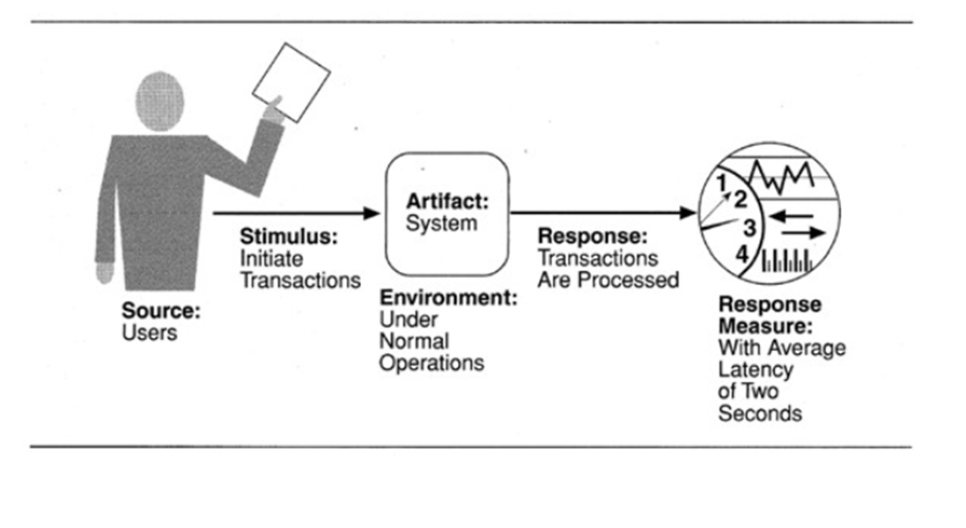
The following diagram describes the software quality attribute: Performance
For the architecture patterns:
Layered: Organizes the system into layers with related functionality at each layer.
Model-View-Controller: Separates presentation and interactions from the system data. Structured into logical components that interact together.
Client-Server: Organizes the system into services, each service delivered from a separate server. Clients are users of these services and access servers as requested.

Slide 8
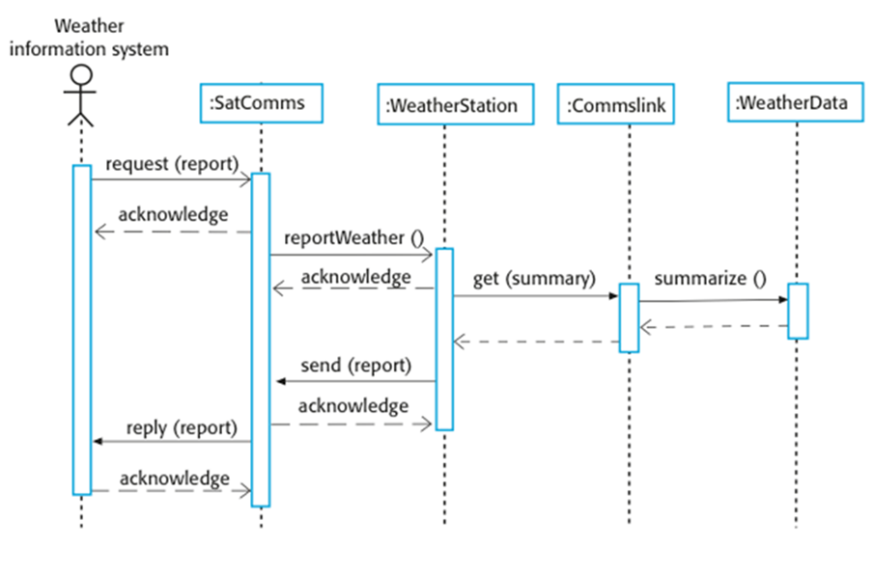
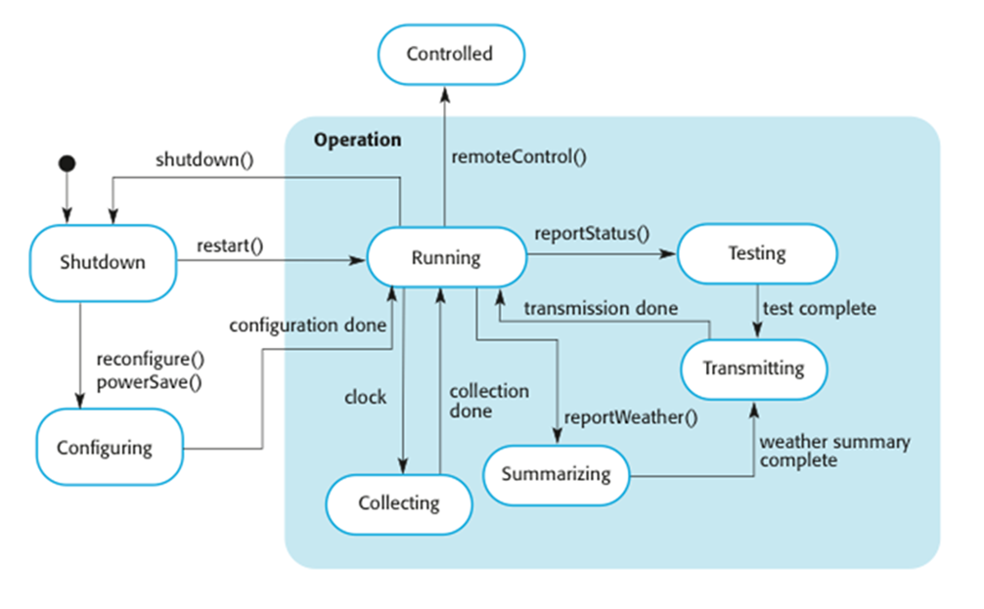
Following is an example of sequence diagram
Following is an example of status transition diagram

Slide 9
“Non-functional requirements“ includes:
Security requirements
Efficiency requirements
Primary activities performed in requirements engineering include:
Discovering requirements by working with various product stakeholders at multiple levels.
Maintaining the integrity of the requirements baseline by controlling and tracking changes to the requirements over time.
Ensuring the requirements describe / define what the customers and users need the software to do.
Software requirements should adhere to the following quality standards as they are being developed:
It can stand on its own.
It can be verified.
Is traceable to higher level system requirements.

Slide 10
For requirement validation techniques:
Requirement reviews: Verifies that the requirements are captured accurately.
Prototyping: Can be used to find gaps in communication / specification early and demonstrates requirement understanding.
Test case development: Used to determine if a requirement is testable and reduces ambiguity.
Changes in software requirements can ultimately affect:
Design
Type of data collected
Cost and schedule
Configuration baseline
Scope creep: Allowing customers to change requirements without revisiting development plans and costs.
During subsystem integration, we need to ensure integrated component logic is correct.

Slide 11
For SDLC:
Software Requirements Analysis: Decompose system level requirements into specific software requirements.
Architecture / Design: Develop models to represent the structure of the software.
Implementation: Develop a code base.
Test: Perform integration and validation of the software against requirements.
Production Support: Maintain rigorous configuration control of all software artifacts applicable to a given software release
For software process models:
Waterfall: Cascades from one phase to another, traditionally resulting in an artifact that is signed off and approved before proceeding to the next phase.
V: Each phase closely aligns to a complementary testing phase.
Iterative: Requirements are broken into multiple standalone software builds/releases wherein each build will repeatedly undergo different phases of the SDLC before moving on to the next capability release/build.
Agile: Breaks the software development activity up into short 2 to 3 weeks sprints in which 1 or more phases of the SDLC may be employed to achieve the goals of the sprint.

Slide 12
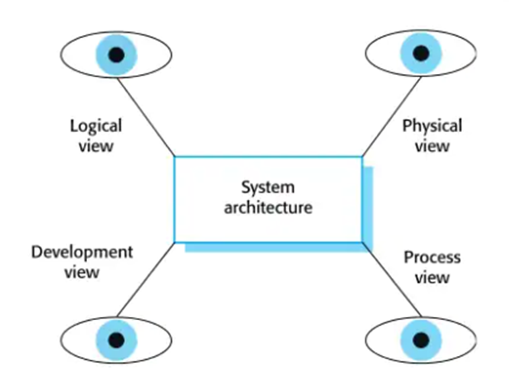
In a few sentences, explain how spending time to develop a robust and sound architecture can limit the amount of time required to refactor a system's design in the future.
Improves stakeholder communication
Supports more thorough system analysis
Supports large scale system reuse
Explain "how" each of the "views" in the diagram below captures the software system architecture / design of a software system.
LOGICAL: Shows key abstractions in the system
DEVELOPMENT: Shows how the software is decomposed for development
PROCESS VIEW: Shows how at “run time”, the system is composed of interacting processes
PHYSICAL VIEW: Shows the system hardware and software components are distributed across processing elements
Explain the primary design stages used in developing a software design?
Define the context and the modes the system will be used in
Design the system architecture
Identify the principal software objects
Develop design models
Specify object interfaces

Slide 13
In Object-Oriented (OO) design, what is a 'class'? What is an 'object'? How do the two differ from one another? How do the two complement each other?
Class: Code template for creating objects, Defines the variables and methods, Determines how an object behaves
Objects: Self contained component which consists of properties to make a particular type of data useful, Model real world objects you find in everyday life
Explain why software reuse is important:
Designs were very unstructured and difficult to maintain in early days
Costs and schedule pressure
Common practice now

Slide 14
Explain what "open-source' software is, how it can help software engineers develop software more quickly. Give at least 4 examples of commonly used open-source software.
Open-source software (OSS) is software that is released with a license that allows anyone to use, study, change, and distribute the software and its source code. The copyright holder grants these rights to users.
Explain what the term "spaghetti code" means. Describe at least 3 strategies used to avoid developing spaghetti code.
The phrase spaghetti code dates to the 1970s as a metaphor for sloppy, unmaintainable code.
Spaghetti code derives its meaning from the tangled, disconnected mess of intertwined and /or contiguous code segments symbolized by a bowl of spaghetti.
planning and preparation, modularity, Naming conventions and comments, Less is more

Slide 15
Explain what "requirements traceability" means. Why is it important?
Requirements traceability is the ability to connect requirements to other artifacts, such as software tests or bugs.
It's used to track requirements and prove that they have been fulfilled.
Explain the difference between a "functional requirement" and a "non-functional requirement". Give an example of both types of software requirements.
Functional requirements define how the system must work and non functional requirements detail how it should perform.
Describe at least 3 checks that can be used to evaluate the "goodness" of a software requirement.
Validity checks
Consistency checks
Completeness checks
Realism checks
Verifiability checks

Slide 16
Define / describe 3 different principles from the ACM's Software Code of Ethics. Give an example of each of the 3 principles that you chose to describe.
Public
Client and Employer
Product
Judgement
Management
Profession
Colleagues
Self
Discuss the pros / cons of both Agile software development and Waterfall software development processes.
Waterfall is a better method when a project must meet strict regulations as it requires deliverables for each phase before proceeding to the next one.
Agile is better suited for teams that plan on moving fast, experimenting with direction and don't know how the final project will look before they start.

