Slide 1
Module 6 – Python Classes, Functions and Modules
Sharon ONeal
sharononeal@email.arizona.edu
520-822-4040

Slide 2
Chapter 10 – In Class Activities
10.1 MOdules
What is a Python script?
A Python script is a file that contains commands in logical order.
To keep our code!
What is a module?
A module is a file that contains Python code. Modules can be used to organize code, reuse code, and make code easier to read and understand.
Who can use a module? Anyone.
What does importing a module mean?
Importing a module means that you are telling the Python interpreter to look for a file with the same name as the module in a specific directory (sys.path tells).
SFWE 101 | classes

Slide 3
Chapter 10 – In Class Activities
10.1 MOdules
Where should the import statement be placed in a file?
The import statement should be placed at the top of the file, before any other code.
What should a module filename end with?
A module filename in Python should end with the .py extension.
What does it mean when a program has a dependency on another program?
A module being required by another program is often called a dependency.
SFWE 101 | classes

Slide 4
Chapter 10 – In Class Activities
10.2 Finding Modules
How does a computer know where to find a module that has been imported?
It searches a list of directories contained in sys.path which contains the following directories:
The directory of the executing script.
A list of directories specified by the environment variable PYTHONPATH.
/usr/local/lib/python3.X/site-packages (default PYTHONPATH)
The directory where Python is installed.
What is a built-in module?
Examples are sys, math, time
Be careful not to use the name of a module that is already a built-in module
What is an environment variable?
Stored in the computers OS and can be accessed by any program running on the computer
SFWE 101 | modules

Slide 5
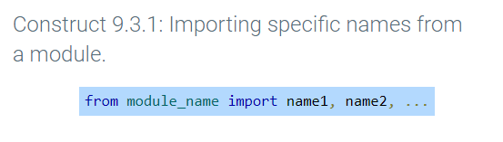
Chapter 10 – In Class Activities
10.3 Importing specific names from a module
How do you import specific names from a module?
Why might a programmer only want to import specific names from a module?
To avoid name collisions
To import only the functionality that is needed
import HTTPServer print(HTTPServer.address)
from HTTPServer import address print(address)
from HTTPServer import * print(address)
SFWE 101 | modules

Slide 6
Chapter 10 – In Class Activities
10.3 Importing specific names from a module
What does the following statement do?
From <name of module> import *
Is it good programming practice to use this type of import syntax?
No, because it makes identification of dependencies and origins of variables difficult for readers of the code to understand
SFWE 101 | modules

Slide 7
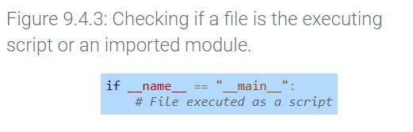
Chapter 10 – In Class Activities
10.4 Executing modules as scripts
An import statement executes the code contained within the imported module. Thus, any statements in the global scope of a module, like printing or getting user input, will be executed when that module is imported. Execution of those statements may be an unintended side effect of the import.
How do you prevent an imported module from having unintended side effects of the import?
Using the __name__ syntax as shown to the right
if __name__ == "__main__" is true, then the file is being executed as a script and the branch is taken. Otherwise, the file was imported and thus __name__ is equal to the module name, e.g., "web_search".
SFWE 101 | modules

Slide 8
Chapter 10 – In Class Activities
10.5 reloading modules
What does the reload() function do?
Reload and re-execute the changed module
What does the __file__ special name do?
Contains the path to a module in the computer file system
print(__file__) file.py
print(os.path.dirname(__file__)) /path/to/current/directory
print(os.path.abspath(__file__)) C://Documents/file.py
SFWE 101 | modules

Slide 9
Chapter 10 – In Class Activities
10.6 Packages
What is a package in Python?
A package is a directory that when imported, gives access to all of the modules stored in the directory
Why might you want to use a package?
Better organization
Code reuse
Avoiding duplicate
How do you import a package? (see figure 10.6.1 for an example)
What must the directory contain? (To indicate that a directory is a package)
A file called __init__.py
SFWE 101 | modules

Slide 10
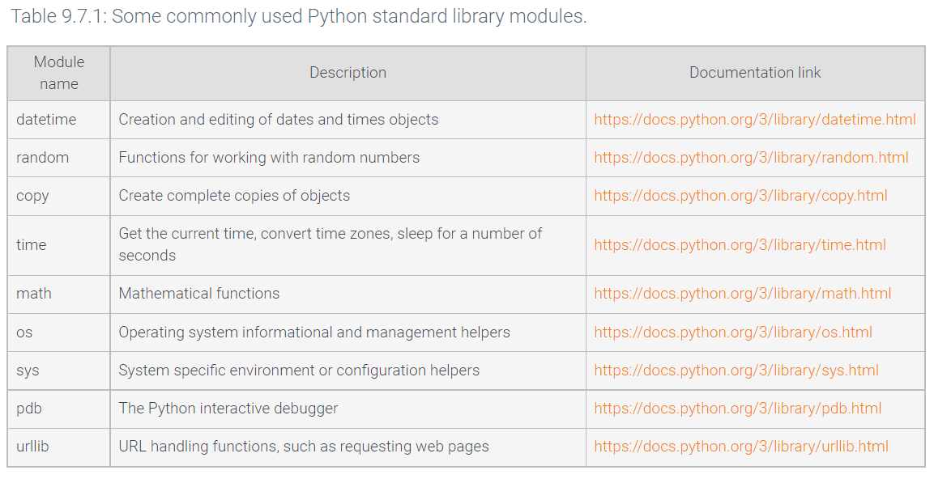
Chapter 10 – In Class Activities
10.7 Standard library
What is the Python standard library?
SFWE 101 | modules

Slide 11
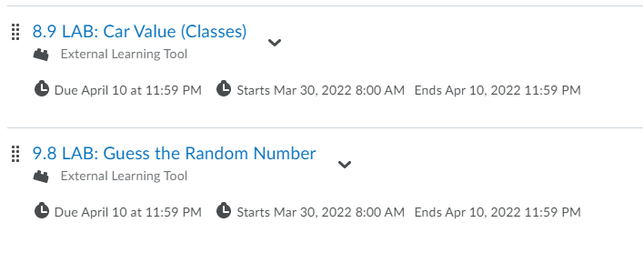
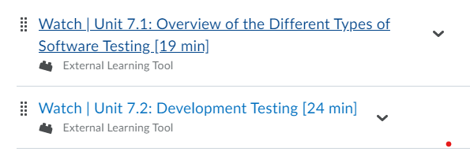
Reminders….
Just in case you have nothing else going on this weekend….
Extra credit labs for Exam #2 are due by midnight on Sunday, 4/10 (no exceptions will be given!!!))
The following labs are due by midnight on Sunday 4/10 for everyone:
We will be starting Module 7 on Monday 4/11!!!
Watch the following pre-recorded lectures before coming to class:
SFWE 101 | modules

