Slide 1
SFWE101
Module 6
Chapter 12
Working with Files

Slide 2
Chapter 7 Terms
Filename. The name of a file and its extension.
Path. The location of the file on the computer.

Slide 3


Files and File Paths
A file has two key properties:
Filename is the name of the file
Includes the extension (.txt, .docx, .pdf, .py, etc…)
path is the location of the file on the computer
C:\Users\sweldon\
C: is the root folder
C:\
Users
Folders also called directories
sweldon
python_stuff.py

Slide 4
Slashes
On Windows boxes paths use backslashes (\)
OS X and Linux use forward slashes (/)
We can write Python scripts to handle both
os.path.join() returns a string file path using correct separators
__________________________________________________
>>> import os >>> os.path.join(‘usr’, ‘bin’, ‘spam’) ‘usr\\bin\\spam’ __________________________________________________
Windows example has \\ to escape the \
OS X, Linux returns ‘usr/bin/spam’
Windows example

Slide 5
Current Working Directory
Every program has a current working directory (cwd)
os.getcwd() returns the current working directory as a string value
__________________________________________________
>>> import os >>> os.getcwd() 'C:\\Users\\sweldon\\AppData\\Local\\Programs\\Python\\Python37-32' __________________________________________________
Note: Have you ever had to work through directories to find a path?

Slide 6
Current Working Directory
We can also change the current working directory
Use os.chdir()
__________________________________________________
>>> import os >>> os.getcwd() ‘C:\\Python34’ >>> os.chdir(‘C:\\Windows\\System32’) os.getcwd() ‘C:\\Windows\\System32’ __________________________________________________

Slide 7
Absolute vs Relative Paths
Two ways to specify a file path
Absolute path, always beginning with the root folder
Relative path, relative to the program’s cwd
The dot (.) and dot-dot (..) folders
Not real folders
Special names to use in a path
dot (.) folder means ‘this directory’
dot-Dot (..) folder means ‘the parent folder’

Slide 8
Absolute vs Relative Paths
An example
Relative Paths Absolute Paths
..\ C:\
.\ C:\Users
.\sweldon C:\Users\sweldon
.\sweldon\ C:\Users\sweldon\
python_stuff.py python_stuff.py
C:\
Users
cwd
sweldon
python_stuff.py

Slide 9
Absolute and Relative Paths
os.path module provides functions that
Return absolute path of a relative path
Check whether a given path is an absolute path
Let’s look at
os.path.abspath()
os.path.isabs()
os.path.relpath()

Slide 10



os.makedirs()
Our Python programs can also create new directories
Use os.makedirs()
__________________________________________________
>>> import os >>> os.makedirs(‘C:\\tender\\chicken\\strips’) __________________________________________________
Python Chicken
C:\
tender
chicken
strips

Slide 11
File Sizes and Folder Contents
You can also gather information about specific files and folders
os and os.path modules provides functions to
find size of a file in bytes
Find the files and folders inside a given folder

Slide 12
File Sizes and Folder Contents
os.path.getsize(path) returns the size in bytes of the file in the path argument
__________________________________________________ >>> os.path.getsize(‘C:\\Windows\\System32\\calc.exe’) 31232 __________________________________________________
calc.exe is 31232 bytes

Slide 13
File Sizes and Folder Contents
os.listdir(path) returns a list of filename strings for each file in the path argument
__________________________________________________ >>> os.path.listdir(‘C:\\Users\\sweldon\\Documents’) ['1H2018 Global Internet Phenomena Report.pptx', 'ACM Flyer.pdf', 'Custom Office Templates', 'desktop.ini', 'IISExpress', 'LogicEvals.pdf', 'My Digital Editions', 'My Music', 'My Pictures', 'My Videos', 'My Web Sites', 'Traveler Information Form - 2018 CAE SECC_Weldon.xlsx', 'Visual Studio 2015', 'Visual Studio 2017', 'Weldon'] __________________________________________________

Slide 14
Checking Path Validity
Many Python functions will crash if the path doesn’t exist
os.path module provides functions to
Check whether a given path exists
Check if a file exists
Check if a folder exists

Slide 15
Checking Path Validity
os.path.exists(path) returns True if the file or folder in the argument exists
__________________________________________________ >>> os.path.exists(‘C:\\Windows\\’) True >>> os.path.exists(‘C:\\not_really_there’) False __________________________________________________

Slide 16
Checking Path Validity
os.path.isfile(path) returns True if the path argument exists and is a file
__________________________________________________ >>> os.path.exists(‘C:\\Windows\\System32’) False >>> os.path.exists(‘C:\\Windows\\System32\\calc.exe’) True __________________________________________________

Slide 17
Checking Path Validity
os.path.isdir(path) returns True if the path argument exists and is a file
__________________________________________________ >>> os.path.isdir(‘C:\\Windows\\System32’) True >>> os.path.isdir(‘C:\\Windows\\System32\\calc.exe’) False __________________________________________________

Slide 18
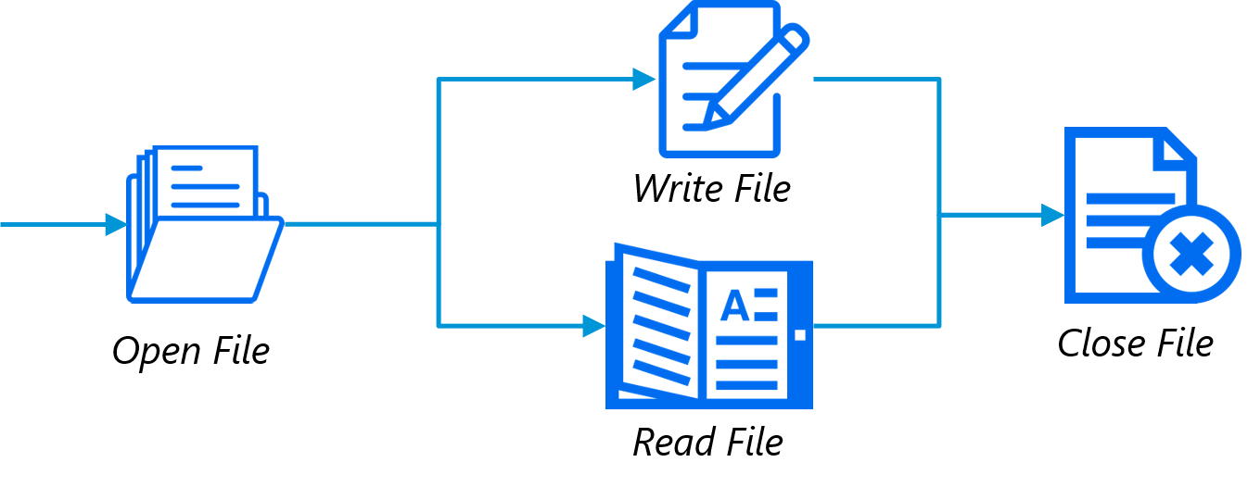
File Reading and Writing
Reading or writing files in Python
Call the open() function to return a File object
Call the read() or write() method on the File object
Close the file by calling close() on the File object

Slide 19
File Reading and Writing
We’ll consider two types of files, but work mostly with one
Plaintext files contain basic text characters
Don’t include font, size, color information
Examples: .txt and .py files
Can be opened with Window’s Notepad or OS X’s TextEdit
Binary files are all other file types
Examples: .pdf, .docx, xlsx, .exe

Slide 20
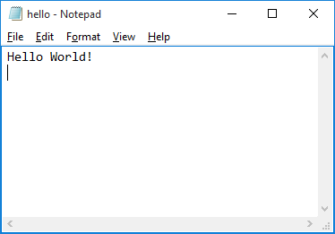
Opening Files
Use the open() function
Pass it a string path indicating the file to open
Absolute path, or…
Relative path
open() returns a File object
__________________________________________________ >>> helloFile = open(‘C:\\Users\\sweldon\\Desktop\\hello.txt’) __________________________________________________
Will open the file in read mode; default behavior for open()
Can explicitly open the file in read mode using open(path, ‘r’)
Absolute path

Slide 21
Reading File Contents
You can now start reading from the File object
read() method allows reading the entire file as a string
__________________________________________________ >>> helloContent = helloFile.read() >>> helloContent ‘Hello World!\n’ __________________________________________________
Entire contents of the file will be represented as a single string value

Slide 22
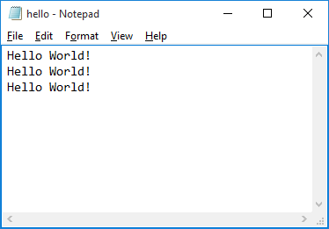
Reading File Contents
Modify hello.txt to be three lines of Hello World!
read() allows reading the entire file as a string
readlines() returns a list of string values
One string value for each line of text
__________________________________________________
__________________________________________________ >>> helloFile = open(‘C:\\Users\\sweldon\\Desktop\\hello.txt’) >>> helloContent = helloFile.readlines() >>> helloContent [‘Hello World!\n’, ‘Hello World!\n’, ‘Hello World!\n’)] __________________________________________________

Slide 23
Reading File Contents
Can we do the same thing using the relative path?
Yes, but…
__________________________________________________ >>> helloFile = open(‘hello.txt’) Traceback (most recent call last): File "<pyshell#5>", line 1, in <module> helloFile = open('hello.txt') FileNotFoundError: [Errno 2] No such file or directory: 'hello.txt'
__________________________________________________
Clearly, we have a problem…
What to do? Ideas?
Relative path

Slide 24
Reading File Contents
Lets start by determining the current working directory
__________________________________________________ >>> import os >>> os.getcwd() ‘C:\\Users\\sweldon\\AppData\\Local\\Programs\\Python\\Python37-32’
__________________________________________________
Where’s our hello.txt?
Parked at ‘C:\\Users\\sweldon\\Desktop’
This might be a problem. Ideas?

Slide 25
Reading File Contents
We could move hello.txt to the cwd
We could punt on third down and use absolute path…
Instead, let’s change the cwd
__________________________________________________ >>> os.chdir(‘C:\\Users\\sweldon\\Desktop’) >>> os.getcwd() ‘C:\\Windows\\sweldon\\Desktop’
__________________________________________________
Now the cwd is the same directory where hello.txt is parked
Are we good now?

Slide 26
Reading File Contents
Here’s what happens
__________________________________________________ >>> helloFile = open(‘hello.txt’) >>>
__________________________________________________
By default, Python will first look in the cwd for a file we’re trying to open
We tell Python otherwise using absolute path or specifying relative path
Having only the filename means Python assumes the file is in the cwd
>>> is a good sign!

Slide 27
Reading File Contents
Now we just keep going as we did before…
__________________________________________________
>>> helloContent = helloFile.readlines() >>> helloContent [‘Hello World!\n’, ‘Hello World!\n’, ‘Hello World!\n’)] >>> helloFile.close() >>> __________________________________________________
We had a bit of work to do using Interactive Shell
When using File Editor, we often just park all files in the same directory; .py, .txt, .bmp,…
Make relative path much easier to use than absolute path

Slide 28
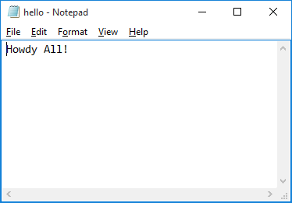
Writing to Files
Python allows us to write content to a file
We’ll open files in write mode (w) or append mode (a)
Write mode overwrites the existing file
Append mode adds text to the end of the existing file
__________________________________________________
>>> helloFile = open(‘hello.txt’, ‘w’) >>> helloFile.write(‘Howdy All!\n’) 11 >>> helloFile.close() >>> helloFile = open(‘hello.txt’) >>> helloContent = helloFile.readlines() >>> helloContent [‘Howdy All!\n’] __________________________________________________

Slide 29


Intro
Now we’re going to look at CSV and JSON files
Plaintext files
Can be viewed in a text editor; IDLE file editor

Slide 30
Intro
CSV stands for “comma-separated values”
Simplified spreadsheets stored as plaintext files
Python’s csv module parses CSV files
JSON stands for “JavaScript Object Notation”
Pronounced “JAY-sawn” or “Jason”
Store JavaScript source code in plaintext files
Don’t need to know JavaScript to work with JSON files
Used in many web applications

Slide 31
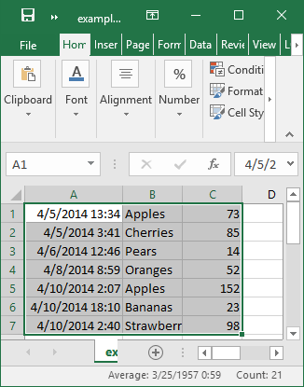
The csv Module
Each line is a CSV file represents a row in a spreadsheet
Commas separate the cells in the row
__________________________________________________ 4/5/2015 13:34,Apples,73 4/5/2015 3:41,Cherries,85 4/6/2015 12:46,Pears,14 …
___________________________________________________
Above is a portion of example.xlsx as a .csv file

Slide 32
The csv Module
CSV files are simple, lack many Excel spreadsheet features
Everything is a string; no types for values
No font size or color settings
Can’t specify cell widths and heights
Can’t merge cells
Can’t have embedded images or charts
Can’t have multiple worksheets
CSV advantages?
Simplicity
Widely supported ; many types of programs including IDLE File Editor

Slide 33
The csv Module
Although CSVs are just text files, we don’t read them in as a string and process the string as we’ve done before
Why?
Not every comma in a CSV file is a cell boundary
CSV files have their own set of escape characters
Allows commas and other characters to be included as part of the values
split() method doesn’t handle these CSV escape characters
Bottom Line: Use the csv module when working with CSV files…

Slide 34
The csv Module
*** In Class Exercise ***
Create a Reader object to read data from a CSV file
Allows you to iterate over lines in the CSV file
__________________________________________________ >>> import csv >>> exampleFile = open(‘example.csv’) >>> exampleReader = csv.reader(exampleFile) >>> exampleData = list(exampleReader) >>> exampleData [['4/5/2014 13:34', 'Apples', '73'], ['4/5/2014 3:41', 'Cherries', '85'], ['4/6/2014 12:46', 'Pears', '14'], ['4/8/2014 8:59', 'Oranges', '52'], ['4/10/2014 2:07', 'Apples', '152'], ['4/10/2014 18:10', 'Bananas', '23'], ['4/10/2014 2:40', 'Strawberries', '98']]
___________________________________________________
A list of lists

Slide 35
The csv Module
*** In Class Exercise ***
Now we can access the values at particular rows and columns
__________________________________________________ >>> exampleData[0][0] '4/5/2014 13:34‘ >>> exampleData[0][1] 'Apples‘ >>> exampleData[0][2] '73‘ >>> exampleData[1][1] 'Cherries‘ >>> exampleData[6][1] 'Strawberries'
___________________________________________________

Slide 36
Reading Data in a for Loop
*** In Class Exercise ***
For large CSV files, you may want to use the Reader object in a for loop
__________________________________________________ >>> import csv >>> exampleFile = open(‘example.csv’) >>> exampleReader = csv.reader(exampleFile) >>> for row in exampleReader: print(‘Row #’ + str(exampleReader.line_num) + ‘ ’ + str(row)) Row #1 ['4/5/2014 13:34', 'Apples', '73'] Row #2 ['4/5/2014 3:41', 'Cherries', '85'] Row #3 ['4/6/2014 12:46', 'Pears', '14'] Row #4 ['4/8/2014 8:59', 'Oranges', '52'] Row #5 ['4/10/2014 2:07', 'Apples', '152'] Row #6 ['4/10/2014 18:10', 'Bananas', '23'] Row #7 ['4/10/2014 2:40', 'Strawberries', '98'] ___________________________________________________
Easier to read…

Slide 37
Writer Objects
*** In Class Exercise ***
A Writer object lets you write data to a CSV file
Use csv.writer() to create the file
__________________________________________________ >>> import csv >>> outputFile = open('output.csv', 'w', newline='') >>> outputWriter = csv.writer(outputFile) >>> outputWriter.writerow(['spam', 'eggs', 'bacon', 'ham']) 21 >>> outputWriter.writerow(['Hello, World!', 'eggs', 'bacon', 'ham']) 32 >>> outputWriter.writerow(['1', '2', '3.141592', '4']) 16 >>> outputFile.close() ___________________________________________________
writerow() takes a list argument

Slide 38
delimiter and line terminator
*** In Class Exercise ***
The delimiter is the character that appears between cells on a row
Default is a comma
The line terminator is the character that comes at the end of a row
Default is a newline (\n)
Python allows you to change the defaults by sending keyword arguments to csv.writer()
__________________________________________________ >>> import csv >>> csvFile = open('example.tsv', 'w', newline='') >>> csvWriter = csv.writer(csvFile, delimiter='\t', lineterminator='\n\n')
>>> csvWriter.writerow(['apples', 'oranges', 'grapes']) 23 >>> csvWriter.writerow(['eggs', 'bacon', 'ham']) 16 >>> csvWriter.writerow(['spam', 'spam', 'spam']) 16 >>> csvFile.close() ___________________________________________________
Note the .tsv file extension
Changing default values

Slide 39
JSON and APIs
JavaScript Object Notation is a very popular way to format data as a single human-readable string
JSON is used in JavaScript programs to write data structures
Resembles pprint()
Many websites have JSON content for programs to interact with the website
Application Program Interface (API)
Accessing a website via API is similar to accessing via URL
Data returned from an API is formatted; where JSON comes in

Slide 40
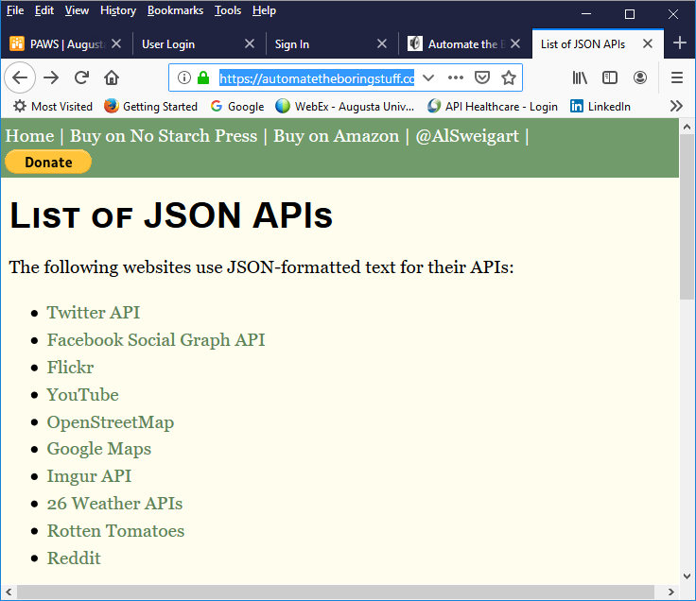
JSON and APIs
You can use APIs to
Scrape data from website
Often more convenient than downloading and parsing HTML data
Download social media posts and repost to another account
See https://automatetheboringstuff.com/list-of-json-apis.html for examples of websites with json-formatted text for APIs

Slide 41
The json Module
Python’s json module handles translations between JSON data (string) and Python values
Use the json.loads() and json.dumps()
JSON can store strings, integers, floats, Booleans, lists, dictionaries, and NoneType
JSON can’t represent Python-specific objects; File objects, CSV Reader or Writer objects, Regex objects, or Selenium WebElement objects

Slide 42
Reading JSON
json.loads() translates JSON data (string) into a Python value
loads() means load string
__________________________________________________
>>> import json >>> stringOfJsonData = '{"name": "Zophie", "isCat": true, "miceCaught": 0, "felineIQ": null}' >>> jsonDataAsPythonValue = json.loads(stringOfJsonData) >>> jsonDataAsPythonValue {'name': 'Zophie', 'isCat': True, 'miceCaught': 0, 'felineIQ': None}
__________________________________________________
JSON uses double quotes for strings

Slide 43
Writing JSON
json.dumps() translates a Python value to JSON data (string)
dumps() means dump string
__________________________________________________
>>> import json >>> pythonValue = {'isCat': True, 'miceCaught': 0, 'name': 'Zophie', 'felineIQ': None}
>>> stringOfJsonData = json.dumps(pythonValue)
>>> stringOfJsonData
'{"isCat": true, "miceCaught": 0, "name": "Zophie", "felineIQ": null}'
__________________________________________________
Single quotes ok here?

