Slide 1
Instruction Sets:
Characteristics and Functions
Addressing Modes

Slide 2
Instruction
This manipulates the stored data.
Instruction = Opcode + Address field
ADD R1,R0
(opcode) (address fields: R1- source register, R0- destination register)

Slide 3
What is an Instruction Set?
The complete collection of instructions that are understood by a CPU
Machine language: binary representation of operations and (addresses of) arguments
  Assembly language: mnemonic representation for humans, e.g.,
  OP A,B,C (meaning A <- OP(B,C))
Notes:
2

Slide 4
Elements of an Instruction
Operation code (opcode)
  Do this: ADD, SUB, MPY, DIV, LOAD, STOR
  (how data is to be manipulate)
Source operand reference
  To this: (address of) argument of op, e.g. register, memory location
Result operand reference
  Put the result here (as above)
Next instruction reference (often implicit)
  When you have done that, do this: BR
Notes:
3

Slide 5
Simple Instruction Format
15 14 12 11 0
I | Opcode | Address
3 bit operation code
12 bit address
Access mode denoted by I:
direct:0
Indirect: 1

Slide 6
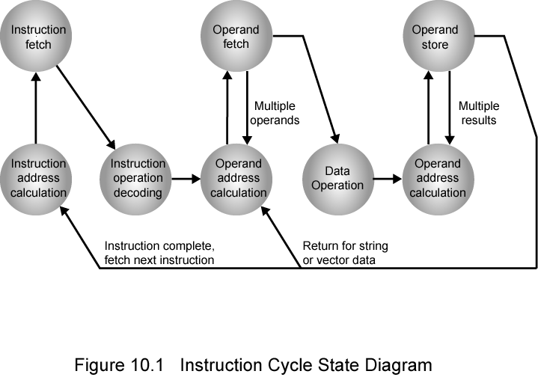
Instruction Cycle State Diagram

Slide 7
Design Decisions
Operation repertoire
  How many ops?
  What can they do?
  How complex are they?
Data types (length of words, integer representation)
Instruction formats
  Length of op code field
  Length and number of addresses (e.g., implicit addressing)
Notes:
12

Slide 8
Registers
  Number of CPU registers available
  Which operations can be performed on which registers? General purpose and specific registers
Addressing modes (see later)
Notes:
13

Slide 9
Instruction Types
Data transfer: registers, main memory, stack or I/O
Data processing: arithmetic, logical
Control: systems control, transfer of control
Notes:
6

Slide 10
Data Transfer
Move data from one place to another in system without changing the data content.
Store, load, exchange, move, clear, set, push, pop
Specifies: source and destination (memory, register, stack), amount of data
May be different instructions for different (size, location) movements, e.g.,
Notes:
19

Slide 11
Input/Output
May be specific instructions, e.g. INPUT, OUTPUT
May be done using data movement instructions (memory mapped I/O)
May be done by a separate controller (DMA): Start I/O, Test I/O
Notes:
23

Slide 12
Arithmetic
Add, Subtract, Multiply, Divide for signed integer (+ floating point and packed decimal) – may involve data movement
May include
  Absolute (|a|)
  Increment (a++)
  Decrement (a--)
  Negate (-a)
Notes:
20

Slide 13
Logical
Bitwise operations:
AND, OR, NOT, XOR, TEST, CMP, SET
Notes:
21

Slide 14
Systems Control
Privileged instructions: accessing control registers or process table
CPU needs to be in specific state
  Ring 0 on 80386+
  Kernel mode
For operating systems use
Notes:
24

Slide 15
Transfer of Control
Skip, e.g., increment and skip if zero:
ISZ Reg1, cf. jumping out from loop
Branch instructions: BRZ X (branch to X if result is zero), BRP X (positive), BRN X (negative), BRE X,R1,R2 (equal)
Procedure (economy and modularity): call and return
Notes:
25

Slide 16
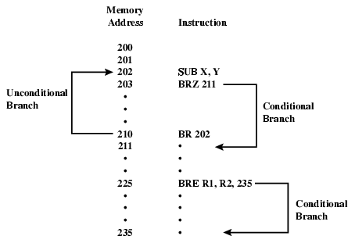
Branch Instruction

Slide 17
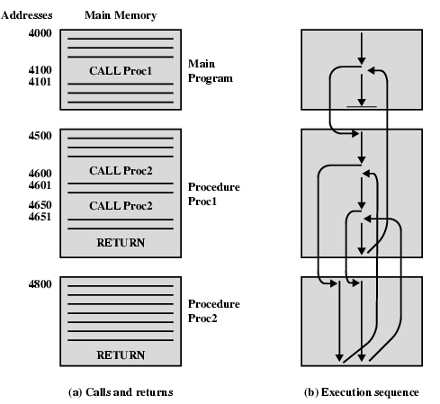
Nested Procedure Calls

Slide 18
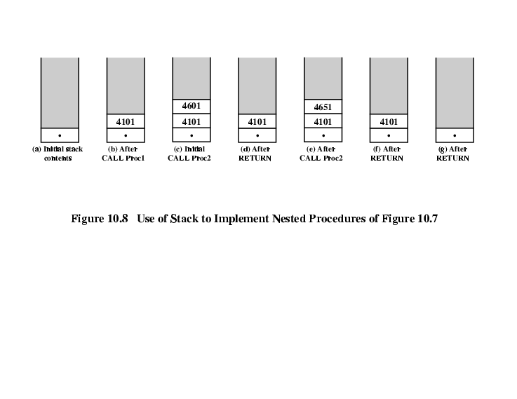
Use of Stack:
Saving the return address for reentrant procedures

Slide 19
Types of Operand
Addresses: immediate, direct, indirect, stack
Numbers: integer or fixed point (binary, twos complement), floating point (sign, significand, exponent), (packed) decimal (246 = 0000 0010 0100 0110)
Characters: ASCII (128 printable and control characters + bit for error detection)
Logical Data: bits or flags, e.g., Boolean 0 and 1
Notes:
14

Slide 20
Pentium Data Types
Addressing is by 8 bit unit
General data types: 8 bit Byte, 16 bit word, 32 bit double word, 64 bit quad word
Integer: signed binary using twos complement representation
(Un)packed decimal
Near pointer: offset in segment
Bit field
Strings
Floating point
Notes:
15

Slide 21
Instruction Formats
Layout of bits in an instruction
Includes opcode
Includes (implicit or explicit) operand(s)
Usually more than one instruction format in an instruction set

Slide 22
Instruction Length
Affected by and affects:
  Memory size
  Memory organization - addressing
  Bus structure, e.g., width
  CPU complexity
  CPU speed
Trade off between powerful instruction repertoire and saving space

Slide 23
Allocation of Bits
Number of addressing modes: implicit or additional bits specifying it
Number of operands
Register (faster, limited size and number, 32) versus memory
Number of register sets, e.g., data and address (shorter addresses)
Address range
Address granularity (e.g., by byte)

Slide 24
Number of Addresses
More addresses
  More complex (powerful?) instructions
  More registers - inter-register operations are quicker
  Less instructions per program
Fewer addresses
  Less complex (powerful?) instructions
  More instructions per program, e.g. data movement
  Faster fetch/execution of instructions
Example: Y=(A-B):[(C+(DxE)]
Notes:
11

Slide 25
3 addresses
Operation Result, Operand 1, Operand 2
  Not common
  Needs very long words to hold everything
  SUB Y,A,B Y <- A-B
  MPY T,D,E T <- DxE
  ADD T,T,C T <- T+C
  DIV Y,Y,T Y <- Y:T
Notes:
7

Slide 26
2 addresses
One address doubles as operand and result
  Reduces length of instruction
  Requires some extra work: temporary storage
  MOVE Y,A Y <- A
  SUB Y,B Y <- Y-B
  MOVE T,D T <- D
  MPY T,E T <- TxE
  ADD T,C T <- T+C
  DIV Y,T Y <- Y:T
Notes:
8

Slide 27
1 address
Implicit second address, usually a register (accumulator, AC)
LOAD D AC <- D
MPY E AC <- ACxE
ADD C AC <- AC+C
STOR Y Y <- AC
LOAD A AC <- A
SUB B AC <- AC-B
DIV Y AC <- AC:Y
STOR Y Y <- AC
Notes:
9

Slide 28
0 (zero) addresses
All addresses implicit, e.g. ADD
  Uses a stack, e.g. pop a, pop b, add
  c = a + b
Notes:
10

Slide 29
Addressing Modes
Immediate
Direct
Indirect
Register
Register Indirect
Displacement (Indexed)
Stack
Notes:
2

Slide 30
Immediate Addressing
Operand is part of instruction
Operand = address field
e.g., ADD #5
  Add 5 to contents of accumulator
  5 is operand
No memory reference to fetch data
Fast
Limited range
Notes:
3

Slide 31
Direct Addressing
Address field contains address of operand
Effective address (EA) = address field (A)
e.g., ADD A
  Add contents of cell A to accumulator
  Look in memory at address A for operand
Single memory reference to access data
15 14 12 11 0
I | Opcode | Address
Instruction Code Format
Notes:
5

Slide 32
Direct Addressing Diagram
Instruction
Opcode
Address A
Memory
Operand
Notes:
6

Slide 33
15 14 12 11 0
I | Opcode | Address
22: address in memory
I=0:direct access
Operand: ADD
Add Port: binary eq. to 457
Control finds the operand in memory at address 457 & add it to content of AC.
Read instruction
Read Operand
22
0 | ADD | 457
Operand
457
+
AC

Slide 34
Indirect Addressing (1)
Memory cell pointed to by address field contains the address of the operand
EA = (A)
  Look in A, find effective address and look there for operand
E.g. ADD (A)
  Add content of cell pointed to by content of A to accumulator
  Effective address: address of operand in computation type instruction or the target address.
  E.g. 457, 1350
Notes:
7

Slide 35
15 14 12 11 0
I | Opcode | Address
Control goes to address 300 to find the address of operand where 1350 found in add 1350; is the address of operand and then operand found in 1350 is added to the content of AC.
Read add of operand
Operand itself
22
1 | ADD | 300
1350
Operand
300
+
AC

Slide 36
Indirect Addressing (2)
Large address space
2^{n} where n = word length
Multiple memory accesses to find operand
Hence slower
Notes:
8

Slide 37
Indirect Addressing Diagram
Instruction
Opcode
Address A
Memory
Pointer to operand
Operand
Notes:
9

Slide 38
Register Addressing (1)
Operand is held in register named in address field
EA = R
Limited number of registers
Very small address field needed
  Shorter instructions
  Faster fetch
No memory access
Very fast execution
Very limited address space
Multiple registers helps performance
  Requires good assembly programming or compiler writing – see register renaming
cf. direct addressing
Notes:
10

Slide 39
Register Addressing Diagram
Instruction
Opcode
Register Address R
Registers
Operand
Notes:
12

Slide 40
Register Indirect Addressing
Cf. indirect addressing
EA = (R)
Operand is in memory cell pointed to by contents of register R
Large address space (2^{n})
One fewer memory access than indirect addressing
Notes:
13

Slide 41
Register Indirect Addressing Diagram
Instruction
Opcode
Register Address R
Memory
Registers
Pointer to Operand
Operand
Notes:
14

Slide 42
Displacement Addressing
EA = A + (R)
Address field holds two values
  A = base value
  R = register that holds displacement
  or vice versa
See segmentation
Notes:
15

Slide 43
Displacement Addressing Diagram
Instruction
Opcode
Register R
Address A
Memory
Registers
Displacement
+
Operand
Notes:
16

Slide 44
Relative Addressing
A version of displacement addressing
R = Program counter, PC
EA = A + (PC)
i.e., get operand from A cells away from current location pointed to by PC
cf. locality of reference & cache usage
Notes:
17

Slide 45
Paged Addressing
In this, memory is divided into no of blocks c/d pages.
Special register c/d page register used to hold page no and instruction( to provide offset: address with ref to starting address of page.)
Notes:
17

Slide 46
Indexed Addressing
A = base
R = displacement
EA = A + R
Good for iteration, e.g., accessing arrays
  EA = A + R
  R++
Sometimes automated: autoindexing (signalled by one bit in instruction)
Notes:
19

Slide 47
Stack Addressing
Operand is (implicitly) on top of stack
e.g.
  ADD Pop top two items from stack and add and push result on top
Notes:
21

Slide 48
PowerPC Addressing Modes
Load/store architecture (see next slide):
  Displacement and indirect indexed
  EA = base + displacement/index
  with updating base by computed address
Branch address
  Absolute
  Relative (see loops): (PC) + I
  Indirect: from register
Arithmetic
  Operands in registers or part of instruction
  For floating point: register only

Slide 49
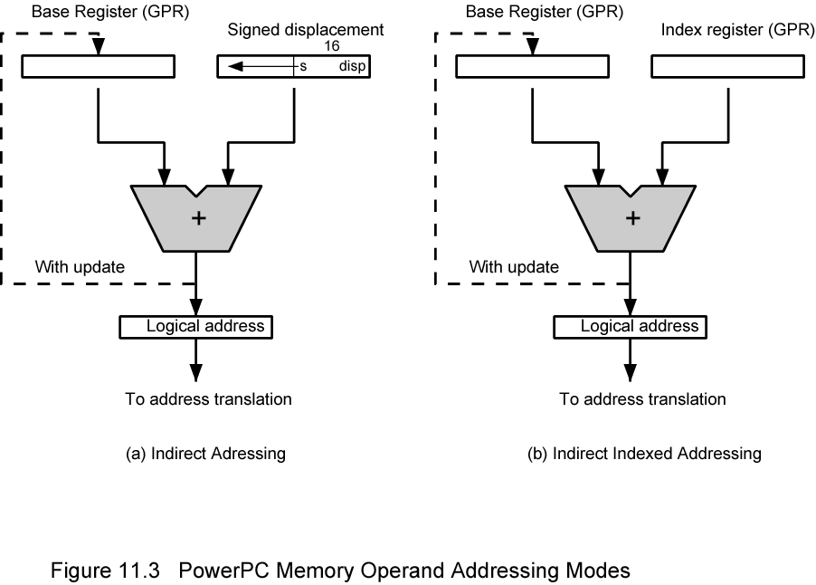
PowerPC Memory Operand Addressing Modes

Slide 50
Instruction format types
Memory reference
i/p-o/p instruction
Register Reference
15 14 12 11 0
I | Opcode | Address
Memory ref: Opcode =000; through 110
Register ref: Opcode =0111; I=0
15 14 12 11 0
0111 | Register operation
Left most specifies operation of AU
I/p-o/p:1111,I=1
15 14 12 11 0
0111 | i/o operation

