Slide 1
Working principles of keyboard, mouse, scanner, digitizing camera, track ball, tablets and joysticks

Slide 2
Working principles of keyboard

Slide 4
Computer Keyboard Functions: How does a Keyboard Work
A computer keyboard is a hardware device that functions in accordance to the instructions made by the user. It comprises circuits, switches and processors that help in transferring keystroke messages to the computer.
In today's technology driven world, everyone is aware about computing and the usage of computer keyboard. We all know that keyboard is an input device that functions in accordance to the instructions of the user. Computer keyboards are used for performing various tasks such as typing on a word processor or text editor, accessing menus and playing games. Though pressing a key corresponds to typing a letter, sign or symbol, it may also represent computer commands. For example, pressing the F5 key is a command for refreshing.

Slide 5
Continue…
For some characters, it is necessary to press and hold more than one key at the same time. Speaking about the history of compute keyboards, it was modeled in the 1940's based on the technology of typewriter keyboard. Similar to typewriter keyboard, a computer keyboard consists of a set of keys engraved with symbols and letters. However, the productivity of working on a computer keyboard is much more than that of a typewriter keyboard.

Slide 6
Continue…
Functioning of a Computer Keyboard In general, there are 80-110 keys in a computer keyboard. The keys may vary depending upon the brand and the type of operating system. Nevertheless, the shape, size and spacing of keys are almost same for all keyboards. Also the layout or arrangement of keys that represent letters, signs and symbols is same, which is referred to as QWERTY. The working of a computer keyboard can be compared to a miniature computer. Inside the keyboard, there are metallic plate, circuit board (key matrix) and processor, which are responsible for transferring information from the keyboard to the computer. Depending upon the working principle, there are two main types of keys, namely, capacitive and hard-contact. Let's discuss in brief about the functioning of capacitive and hard contact key.

Slide 7
Continue…
Capacitive Key On the underside of a capacitive key, a metal plunger is fixed, which helps in activating the circuit flow. When a capacitive key is pressed, the metal plunger applies a gentle pressure to the circuit board. The pressure is identified by the computer and the circuit flow is initiated, resulting in the transfer of information from the circuit to the currently installed software.
Hard Contact Key A hard contact key is attached with a metallic plate that helps in connecting the circuit board. When the hard contact key is pressed, it pushes a metallic plate, which in turn touches the metallic portion of the circuit plate. This overall process of completing a circuit results in a circuit flow, allowing the transfer of the message to the central processing unit (CPU), which is further transmitted to the software.

Slide 8
Continue…
In both the key types, the circuit signals the processor to read and/or identify the character that has been pressed. For example, in a hard contact key, the processor reads that pressing 'shift' and 'a' keys at the same time corresponds to 'A'. Hence accordingly, the letter, sign or symbol is displayed on the screen. Releasing the pressed key breaks the circuit flow, after which the key retains its original position. The communication between a computer keyboard and main computer is bi-directional, meaning that message or information can be sent within each other.

Slide 9
Key Matrix

Slide 10
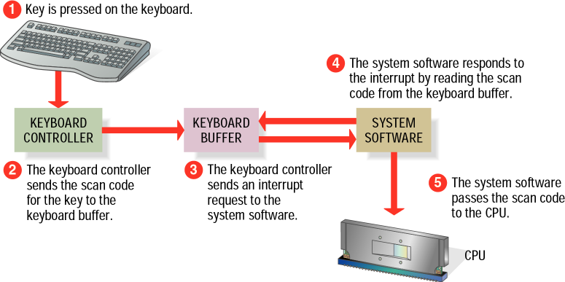
How key board works

Slide 11
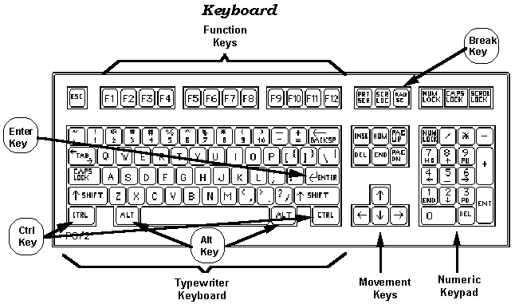

Slide 12
Working principles of mouse

Slide 13
What is a mouse?
The mouse is a pointing device which helps us to operate the computer. Unlike the complicated hardwares such as Mother board, RAM, Hard disk, Processor of the computer, the mouse is designed with a simple circuit to process. Now a days, we get varieties of mouse with different technologies in the market.
The developing applications in the computer field has not completely excluded the mouse yet. Although, we have switched to Touchpads in Laptops, "the function of mouse is easy and user-friendly when compared with touch pads for a new user", says the users. Mostly all the applications are operated with mouse for easy working. In recent days, the optical mouse had overcome the old ball mouse, because of its 'easy to use' function.

Slide 14
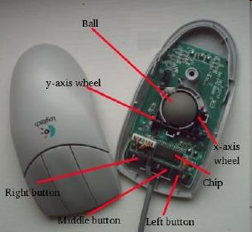
Disadvantages of Ball mouse
With the previous ball-rolled mouses, the movement of the pointer in the computer is decided by the ball inside the mouse. So, if the ball gets damaged, or if dust gets clustered, the operation of the mouse becomes problem. When dust gathers, it takes some time to clear it too. With these disadvantages, the ball mouse was slowly moved away form the computer technology leaving the optical mouse to fill its space.

Slide 15
Working of Optical mouse
Now, almost everyone tries to switch from ball/roller mouse to Optical mouse. As the cost of the mouse is also being decreasing, the replacement is quiet quicker. To connect this optical mouse, the necessity is PS/2 or USB plug, and windows, Macintosh or LINUX operating system installed in the computer.
The main components of the optical mouse are:
Inbuilt optical sensor
High speed camera which can take 1000 pictures at a time
LED

Slide 16
Continue…
These optical mouses do have an inbuilt optical sensor. The optical sensor reads the movements of the optical mouse (moved by the user) with the help of the light rays which comes out from the bottom. ( The area in which a light glows). When the user moves the optical mouse, the LED (Light Emitting Diode) present inside the mouse emits the light according the minute movements. These movements are send to the camera as light rays. The camera captures the difference in light rays as images. When the camera captures the images, each and every pictures and compared to one another with the digital technology. With the comparison, the speed of the mouse and the direction of the movement of the mouse are rapidly calculated. According to the calculation, the pointer moves on the screen.

Slide 17
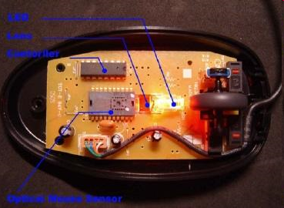
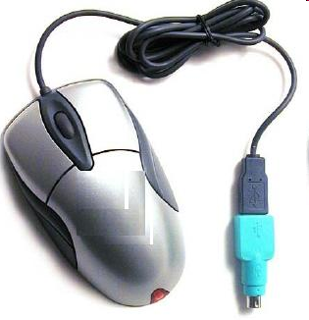
Continue…
Optical mouse

Slide 18
Comparison between a roller/ball mouse and optical mouse
The optical mouse does not have any movable parts as of the ball mouse. So, the life of the optical mouse is long compared to the ordinary mouse.
Since the mouse works with the sensor recognition, the movements are clearly captured and so the moves gives out a same function in all moves.
Since the ball is absent in the optical mouse, the weight of the optical mouse is less than that of the ball mouse.
The dust clustering problem is abolished in the optical mouse as its parts are all static.

Slide 19
Continue…
The optical mouse can also function good without a mouse pad, which is impossible with ordinary mouses. Any way, optical mouses cannot be used above reflecting glasses or any glass materials.

Slide 20
Working principles of scanner

Slide 21
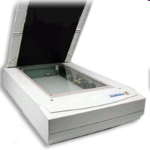
Introduction & overview of scanner
Scanners have become an important part of the home office over the last few years. Scanner technology is everywhere and used in many ways:
Flatbed scanners, also called
desktop scanners, are the most
versatile and commonly used scanners.
In fact, this article will focus on the
technology as it relates to flatbed
scanners.
Sheet-fed scanners are similar to
flatbed scanners except the document
is moved and the scan head is immobile.
A sheet-fed scanner looks a lot like a small
portable printer.
The basic principle of a scanner is to analyze an image and process it.

Slide 22
Continue…
Handheld scanners use the same basic technology as a flatbed scanner, but rely on the user to move them instead of a motorized belt. This type of scanner typically does not provide good image quality. However, it can be useful for quickly capturing text.
Drum scanners are used by the publishing industry to capture incredibly detailed images. They use a technology called a photomultiplier tube (PMT). In PMT, the document to be scanned is mounted on a glass cylinder. At the center of the cylinder is a sensor that splits light bounced from the document into three beams. Each beam is sent through a color filter into a photomultiplier tube where the light is changed into an electrical signal.

Slide 23
Basic principle of scanner
The basic principle of a scanner is to analyze an image and process it in some way.
Image and text capture (optical character recognition or OCR) allow you to save information to a file on your computer.
You can then alter or enhance the image, print it out or use it on your Web page.

Slide 24
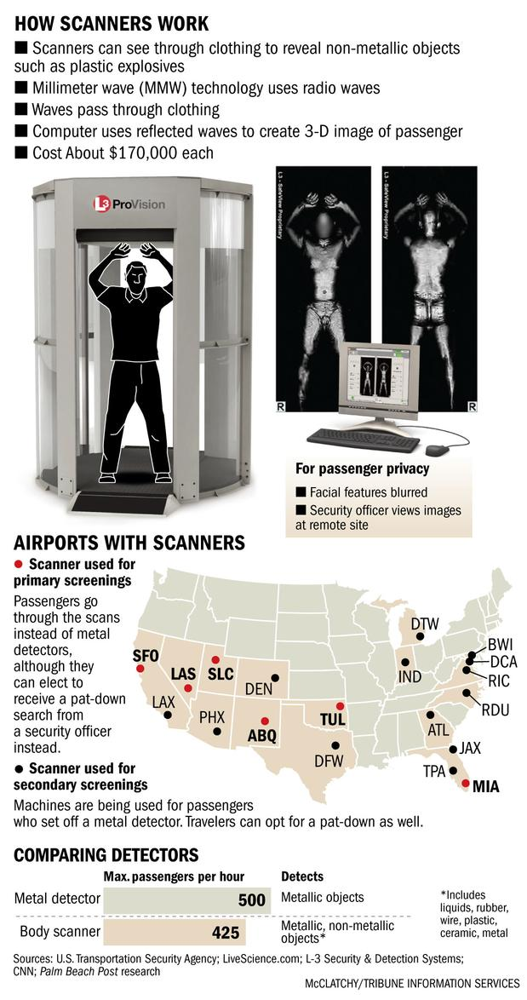

Slide 25
Working principles of digitizing camera

Slide 26
Introduction & overview of digitizing camera
It's easy to understand the booming business that digital camera manufacturers are doing these days. The host of easy-to-use personal and business publishing applications, the dramatic expansion of the Web and its insatiable appetite for visual images, and the proliferation of inexpensive printers capable of photo-realistic output make a digital camera an enticing add-on. Those factors, combined with improving image quality and falling prices, put the digital camera on the cusp of becoming a standard peripheral for a home or business PC.

Slide 27
Working principle of digitizing camera
In principal, a digital camera is similar to a traditional film-based camera. There's a viewfinder to aim it, a lens to focus the image onto a light-sensitive device, some means by which several images can be stored and removed for later use, and the whole lot is fitted into a box. In a conventional camera, light-sensitive film captures images and is used to store them after chemical development. Digital photography uses a combination of advanced image sensor technology and memory storage, which allows images to be captured in a digital format that is available instantly - with no need for a "development" process.

Slide 28
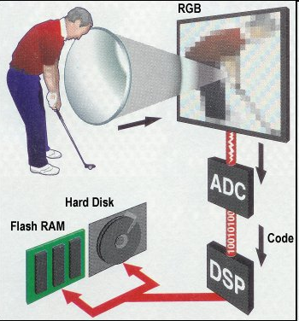
Continue…

Slide 29
Continue…
Although the principle may be the same as a film camera, the inner workings of a digital camera are quite different, the imaging being performed either by a charge coupled device (CCD) or CMOS (complementary metal-oxide semiconductor) sensors. Each sensor element converts light into a voltage proportional to the brightness which is passed into an analogue-to-digital converter (ADC) which translates the fluctuations of the CCD into discrete binary code. The digital output of the ADC is sent to a digital signal processor (DSP) which adjusts contrast and detail, and compresses the image before sending it to the storage medium. The brighter the light, the higher the voltage and the brighter the resulting computer pixel. The more elements, the higher the resolution, and the greater the detail that can be captured.

Slide 30
Continue…
This entire process is very environment-friendly. The CCD or CMOS sensors are fixed in place and it can go on taking photos for the lifetime of the camera. There's no need to wind film between two spools either, which helps minimize the number of moving parts.

Slide 31
Working principles of track ball

Slide 32
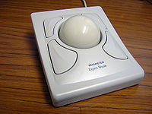
Definition of Trackball
A trackball is a computer device that serves as an alternative to a computer mouse or touch pad for moving the pointer around on a computer screen.
Kensington Expert Mouse trackball, it can use a standard American pool ball

Slide 33
Function
A trackball consists of a stationary hand rest, which is usually larger than a mouse, that contains a round track ball set in a socket, which allows it to rotate freely. You rotate the ball with your thumb, and sensors detect movement along two perpendicular axes, which, in turn, move the pointer on the screen.

Slide 34
Similarity to a Mouse
The basic principle of a trackball is the same as a ball mouse: with a ball mouse, moving the mouse causes the ball on the bottom to move, and sensors pick up the movement. With a track ball, the thumb moves the ball directly instead rolling the ball across a flat surface.

Slide 35
Movement
Trackballs are useful because the hand can remain stationary while using them, so they are easy to use without a flat surface or mouse pad.

Slide 36
Accuracy
Trackballs tend not to skip and flow more smoothly than mouse or touch pads, but mouse are often easier to manipulate quickly and accurately.

Slide 37
Maintenance
Trackballs tend not to get as dirty as mice because only the thumb comes in contact with the ball. The trackball is easily removed and can be rubbed clean with a piece of cloth.

Slide 38
Working principles of tablets

Slide 39
What is a graphics tablet?
Also referred to as a digitizing tablet, graphics pad, or drawing tablet, a tablet is an alternate type of input device that can be used in place of, or in conjunction with, a mouse, trackball, or other pointing device.
The tablet consists of two parts, a flat surface for drawing, and a pen, stylus, or puck that is programmed to work with the tablet.
Usually, you also get a pen holder, and some tablets even come with a cordless mouse that works on the tablet surface.
Even non-artists may choose to use a tablet because it offers a more ergonomic method of input that can reduce the likelihood of developing repetitive strain injury.

Slide 40
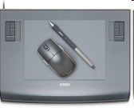
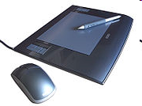
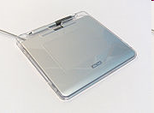
Continue…
Wacom Intuos3 6x8, shown with pen and mouse.
A 6×8 Wacom Intuos3 graphics tablet with DuoSwitch erasing Grip Pen stylus and 5-button scrollwheel puck.
A Wacom Graphire4 graphics tablet with two-button erasing stylus.

Slide 41
Working principle
The tablet cores to be film coated make continual orbital motions within the closed rotating drum under the action of a streamlined guide plate. During the motion, coating medium automatically sprays according to the technological process and rational technological parameters, at the same time hot air is supplied under a negative pressure. The hot air penetrates through the tablet core layers and is discharged from the bottom of the layers, so that the coating medium sprayed on the surface will dry rapidly and evenly, thus forming a solid and smooth surface film.

Slide 42
some of the common features of graphics tablets...
Size:
Size is one of the first factors you'll need to consider in choosing a tablet. Bigger is not necessarily better.
For home users and hobbyists, the most common sizes are 4" by 5" and 6" by 8".
CAD users, artists, and technical illustrators may desire a larger surface area, but the price escalates as the size increases. Remember, the larger your tablet surface is, the more you will need to move your arms.
Many people prefer a smaller tablet to minimize arm motion. However, this may feel unnatural to an artist who is used to drawing or painting with large sweeping motions.

Slide 43
Continue…
Another important thing to know about tablet size is that the dimensions given almost always refer to the input surface area of the tablet.
The actual footprint of the tablet can be as much as 4 to 5 inches larger than the input area.
Keep this in mind as you shop, or you may be surprised that your tablet takes up much more desktop space than you may have considered. My 6" by 8" Wacom Intuos tablet, for instance, has a footprint of 10" by 13.5".

Slide 44
Continue…
Until recently, the popular sizes of graphics tablets have been 4x5, 6x8, and 9x12 which matches up neatly to the 4:3 aspect ratio of traditional computer monitors. But starting in the mid-2000s there has been a proliferation of widescreen aspect ratio monitors. Because of this, Wacom has begun producing wide-format graphics tablets to better correspond with the aspect ratio of widescreen monitors and for users working with multiple monitors.
Although it's nice, it's not necessary that your graphics tablet match the aspect ratio of your monitor, because the tablet software takes care of the mapping.
Currently, Wacom and Aiptek are the only manufacturers I know of producing wide-format graphics tablets.

Slide 45
Continue…
Interface:
The interface is how your tablet connects to your computer. Most tablets these days have a USB interface which is ideal since most computers in use today support USB.
USB devices are hot swapable so you'll be ale to move the tablet more easily for use on multiple computers or just to get it off the desk when you need to.
If you have a very old computer that does not support USB, you'll need to choose a tablet with a serial interface. If you need a serial interface, be sure your computer has an available serial port that does not conflict with another device.
If you have both a serial mouse and a serial modem (rare these days), proceed with caution, because you could face a conflict if you add a serial tablet.

Slide 46
Continue…
A tablet with a USB interface gets its power from your computer, but a serial tablet requires a separate power connection, so you'll want to make sure you have an available outlet that can accommodate a medium-sized transformer.
Bluetooth is another option for connecting a graphics tablet to your computer without the use of wires. Bluetooth is a wireless protocol frequently used for connecting electronics devices.
Currently, Wacom is the only manufacturer I know of producing a Bluetooth-capable tablet, the Graphire Bluetooth, which can connect to your computer without wires.

Slide 47
Continue…
Pen/Stylus and Accessories
Tablet should come with a pen that feels comfortable and natural in your hand.
Find out if the stylus requires a battery. A battery will not only require occasional replacement, but it will make the pen heavier, too.
Your pen may be tethered or free. If the pen is untethered you'll have to be more careful about losing or misplacing it.
If the pen is tethered, make sure you can choose which side of the tablet to attach the pen.

Slide 48
Continue…
Many pens will also have a switch or buttons built onto the pen, and some pens have an erasing end. This is an excellent feature because the buttons can be programmed for specific functions such as a right-click or double-click, and the erasing tip can perform a delete function in one swipe, or automatically activate the eraser tool in your graphics software.
Some tablet manufacturers offer additional pens and other pointing tools that you can program independently. When using these optional accessories, your tablet should recognize it as a new tool and use the customized preferences you have specified for that specific tool.

Slide 49
Continue…
Pressure-sensitivity
Pressure level refers to the sensitivity to pressure on the surface of the tablet.
Most tablets have either 256, 512, or 1024 pressure levels.
The pressure-sensitivity can control line thickness, transparency, and/or color.
The higher the pressure-sensitivity, the more responsive and natural your tablet will feel and the more control you will have.

Slide 50
Working principles of joysticks

Slide 51
Introduction of joystick
A joystick is an input device consisting of a stick that pivots on a base and reports its angle or direction to the device it is controlling.
Joysticks are often used to control video games, and usually have one or more push-buttons whose state can also be read by the computer. A popular variation of the joystick used on modern video game consoles is the analog stick.
The joystick has been the principal flight control in the cockpit of many aircraft, particularly military fast jets, where center stick or side-stick location may be employed.

Slide 52
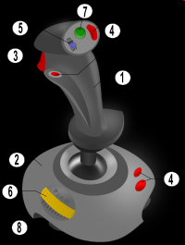
Continue…
Joysticks are also used for controlling machines such as cranes, trucks, underwater unmanned vehicles, wheelchairs, surveillance cameras and zero turning radius lawn mowers. Miniature finger-operated joysticks have been adopted as input devices for smaller electronic equipment such as mobile phones.
joystick elements:
1. Stick
2. Base
3. Trigger
4. Extra buttons
5. Autofire switch
6. Throttle
7. Hat Switch (POV Hat)
8. Suction Cup

Slide 53
How Joysticks Work
Joysticks pull off a really neat trick. They take something entirely physical -- the movement of your hand -- and translate it into something entirely mathematical -- a string of ones and zeros (the language of computers).
With a good joystick, the translation is so flawless that you completely forget about it. When we are really engaged in a game, you feel like you're interacting with the virtual world directly.
We'll find out how several common joystick designs handle this translation. As we'll see, the technology has evolved a great deal from the first game console designs to the sophisticated "force feedback" models available today.

Slide 54
Technical details
Most joysticks are two-dimensional, having two axes of movement (similar to a mouse), but one and three-dimensional joysticks do exist.
A joystick is generally configured so that moving the stick left or right signals movement along the X axis, and moving it forward (up) or back (down) signals movement along the Y axis.
In joysticks that are configured for three-dimensional movement, twisting the stick left (counter-clockwise) or right (clockwise) signals movement along the Z axis. These three axes - X Y and Z - are, in relation to an aircraft, roll, pitch, and yaw.
An analog joystick is a joystick which has continuous states, i.e. returns an angle measure of the movement in any direction in the plane or the space (usually using

Slide 55
Continue…
potentiometers) and a digital joystick gives only on/off signals for four different directions, and mechanically possible combinations (such as up-right, down-left, etc.).
(Digital joysticks were very common as game controllers for the video game consoles, arcade machines, and home computers of the 1980s.)
Additionally joysticks often have one or more fire buttons, used to trigger some kind of action. These are simple on/off switches.
Some joysticks have haptic feedback capability. These are thus active devices, not just input devices. The computer can return a signal to the joystick that causes it to resist the movement with a returning force or make the joystick vibrate.

Slide 56
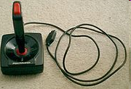
Continue…
Most I/O interface cards for PCs have a joystick (game control) port. Modern joysticks mostly use a USB interface for connection to the PC.
1980s one-button game joystick

Slide 57
Industrial applications
In recent times, the employment of joysticks has become commonplace in many industrial and manufacturing applications, such as; cranes, assembly lines, forestry equipment, mining trucks, and excavators.
In fact, the use of such joysticks is in such high demand, that it has virtually replaced the traditional mechanical control lever in nearly all modern hydraulic control systems.
Due to the highly hands-on, rough nature of such applications, the industrial joystick tends to be more robust than the typical video-game controller, and able to function over a high cycle life. This led to the development and employment of Hall Effect sensing to such applications in the 1980s as a means of contactless sensing.
Several companies produce joysticks for industrial applications using hall effect technology.

