Slide 1
Chapter -1
Prepared by:
Ms. Bharti Bhattad

Slide 2
Basic Components
We need two things to get a task done on a computer:
  A computer program to do the task
  The computer itself to do the task
A computer program is the set of instructions that carries out the work
The instruction is the smallest piece of work the computer can do – it cannot carry out only a part of an instruction!

Slide 3
Basic Components
John von Neumann proposed the model we use for computers in 1946
There are five parts:
  Memory
  Processing Unit
  Input
  Output
  Control Unit
Together, these are called the von Neumann model

Slide 4
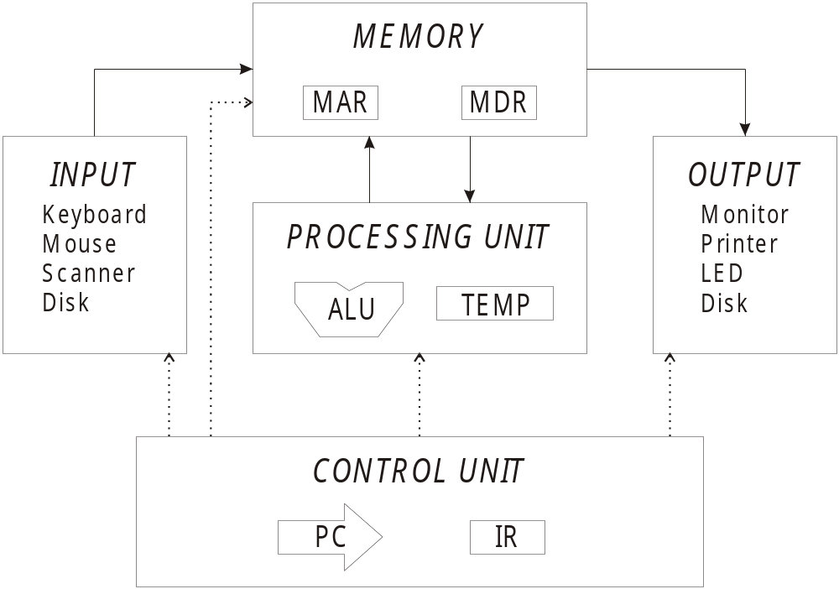
Basic Components

Slide 5
Input and Output
We need to get the information into the computer somehow
  Input provides this capability
Then we must do something with the data
  Output allows us to do that
Together, they are generically called peripherals because they are like accessories for the computer.

Slide 6
Input / Output
Device
The PC has two such devices
  Keyboard for input
  Monitor for output
Other systems have many more
  Mouse
  LED display
  Scanner
  Printer
  Floppy disk
  Punch cards

Slide 7
Memory
How to we read or write to memory?
We need to first specify the location we want to access
we place the memory location in the memory address register(MAR)
Then, we can read or write that part of memory
The memory data register(MDR) contains the value that is read or the value to write

Slide 8
Memory
How to write:
  Place the address we want to write to in the MAR
  Place the value we wish to write in the MDR
  We issue the memory command with the Write Enable signal
  The value in MDR is written to address MAR

Slide 9
Memory
How to read:
  Place the address to read in the MAR
  Issue the memory command without Write Enable
  Read the value from MDR

Slide 10
Memory
Let us re-emphasize memory has two properties:
  The address of the memory location
  The value stored in that memory location
This is like post office boxes:
  There are numbers on the boxes
  Each box has mail in it

Slide 11
Processing Unit
The processing of information is carried out by the processing unit
The simplest form is the Arithmetic and Logic Unit, denoted ALU
It performs:
  Basic arithmetic – add, subtract
  Basic logic – bitwise AND, OR, and NOT
The LC-3 has an ALU which can perform ADD, AND, and NOT

Slide 12
Processing Unit
On most processing units, there is some form of temporary storage
This storage is typically “within” the ALU for speed
Example: Compute (a+b)·c
  First compute a+b and store
  Then, take that value and multiply by c

Slide 13
Control Unit
The control unit handles all the other units
The control unit keeps track of the running program in memory
There are two main registers for the control unit:
  Instruction register – contains the instruction that is currently processing
  Program Counter(PC) – has the address of the next instruction to execute

Slide 14
System Bus
Von Neumann: how does the computer components communicate? Answer: via the System Bus.
An external (to the CPU) mean of communication between the CPU and other computer components.
NOTE: there is also an internal bus within the CPU that connects its registers, ALU and CU – do NOT mix it with the System Bus, please!
Bus: Set of wires to transfer data/address among internal components of system.

Slide 15
System buses
Set of wires, that interconnects all the components (subsystems) of a computer
  A source component sources out data onto the bus
  A destination component inputs data from the bus
May have a hierarchy of buses
  Address, data and control buses to access memory and an I/O controller.
  Second set of buses from I/O controller to attached devices/peripherals
  PCI bus(Peripheral Component Interconnect) is an example of a very common local bus

Slide 16
System Bus for multiprocessor
Common Local Bus
shared {(System Bus ctrler),CPU,IOP, Local Memory}
memory
SYSTEM BUS
Local Bus Local Bus ………………………. Local Bus
Transfer of data:
Synchronous: data sends periodically with the help of common clock on
both sides i.e. source and destination.
2. Asynchronous: data sends with handshaking control signals.

Slide 17
System Bus Types
System Bus can often be seen as three “sub-busses”:
  Data Bus. Primarily for data-only communication among different types of units, such as CPU, Memory, and I/O devices.
  Address Bus. Used to communicate address information, i.e. where to look for/to send to the data (an address in the Memory; I/O device number).
  Control Bus. Control data lines to report status, to request writing or reading between communicating parties.
2/8/2016

Slide 18
System Bus types structure
CPU
Memory
I/O Device
Data Bus
Address Bus
Control Bus
System Bus
There are approx. 100 signal lines. Like: Control, Timing, Command, Transfer…..

Slide 19
Define:
Accumulator(AC): register that holds one of operand and receive result of most of airthmatic and logical operations.
Program Counter(PC): keeps track of addresses of instruction which to be executed.
Memory Address Register(MAR): holds address of instruction or data to be fetched from memory.
Memory Data/Buffer Register(MBR): holds instruction /data received from or sent to memory.
Instruction Register(IR): contains 8 bit opcode instruction being executed.

Slide 20
Instruction Buffer Register: specify address in memory of word to be written from or read into MBR.
AC & Multiplier Quotient: holds temp operand and result of ALU.
Clock Cycle: Timing refers to the manner in which events are coordinated in the bus. A single 1-0 transmission is c/d clock/Bus cycle.(time slot)
Execute Cycle: essential steps tht r carried out to execute instruction c/d EC.
Memory
fetch CPU
Decoder ckt
Opcode
IR
(read/write)

Slide 21
Fetch Cycle: at starting of instruction cycle, fetch cycle occurs. It includes: MAR,MBR, PC,IR
Instruction Cycle: IC= fetch + Execute
Three State Buffer: System Bus made with 3 state gates;
  2 states: signals equals to 1/0.
  Third is hign impedance state( like open ckt means that o/p is nt connected and has not any logical significance)
  Eg. : AND, NAND

