Slide 1
Register Transfer Languages (RTL)

Slide 2
Basic Definitions
  Digital system is a collection of digital hardware modules
  Modules are registers, counters, arithmetic elements, etc connected via:
    - data paths routes on which information is moved
    - control paths routes on which control signals are moved
  Micro operations (micro-ops) are operations on data stored in registers
  Digital modules (often just called “registers”) are defined by their information contents and the set of micro-ops they perform
  Register transfer language is a concise and precise means of describing those operations

Slide 3
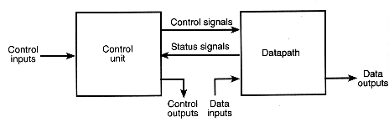
Data-paths and Control units
Data-path module comprises processing logic and collection of registers that perform data processing
Control unit module is made up of logic that determines the sequence of data processing operations carried out in the data-path

Slide 4
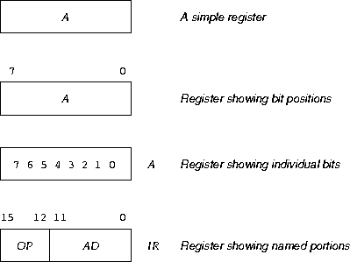
Register Transfer Operations
Registers: denoted by upper case letters, and optionally followed by digits or letters
Register transfer operations: the movement of data stored in registers and the processing performed on the data

Slide 5
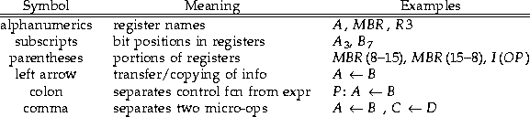
What is Register Transfer Language?
Register Transfer Language (RTL): used to describe CPU organization in high-level terms
RTL expressions are made up of elements which describe the registers being manipulated, and the micro-ops being performed on them
Here are the basic components of RTL expressions:

Slide 6

Instruction Representation
Word size is 16 bits
  12 bits to represent a memory address
  3-bit opcode
  1 bit to distinguish between direct and indirect memory addressing

Slide 7
Instruction Representation
(cont.)
When the I (indirect) bit is 0, the value in AD is the actual address of the operand (direct addressing)
When I is 1, contains the address of an indirect word, which in turn will contain the actual operand address (indirect addressing)

Slide 8
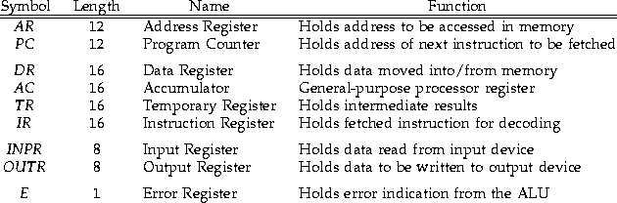
Register Structure

Slide 9
Common Micro-Ops
There are 4 types of Micro-Ops:
Transfer: transfers data from one register to another
R0 <- R1
Arithmetic: performs arithmetic on data in registers
R0 <- R1 + R2
Logic/bit manipulation: performs bit (Boolean) operations on data
R0 <- R1 & R2 ; or R0 <- R1 | R2
Shift: shift data in registers by one or more bit positions
R0 <- R1 << 3; or R0 <- R2 >> 2

Slide 10


Micro-Ops Transfer
Parallel
  Parallel transfer is typically used for transfers between registers
  Ex: Transfer all contents of A into B on one clock pulse
    A <- B
  Control function: we can do this by structuring the RTL expression to indicate the controlling condition
  Ex: P: A<- B

Slide 11
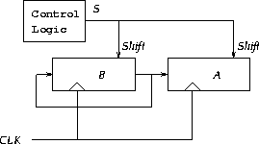
Micro-Ops Transfer
Serial
  Serial transfer is used to specify that a collection of bits are to be moved, but that the transfer is to occur one bit at a time
Ex:
S: A <- B, B <-B

Slide 12
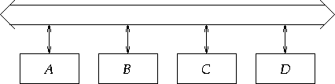
Micro-Ops Transfer
Bus
  A bus consists of a set of parallel data lines
  To transfer data using a bus: connect the output of the source register to the bus; connect the input of the target register to the bus; when the clock pulse arrives, the transfer occurs

Slide 13
Micro-Ops Transfer
Memory
  Memory transfers are similar to register transfers, but…
  Memory to register transfers are called read operations, while register to memory transfers are called write operations
    RTL expressions for a read operation, assuming the use of an address registers:
    AR <- address
    DR <- M[AR]
    RTL expressions for a write operation, assuming use of a data register:
    AR <- address
    DR <- value
    M[AR] <- DR

Slide 14
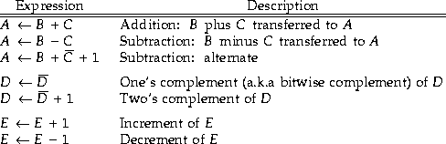
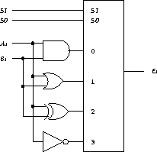

Micro-Ops Arithmetic & Logic
CPU typically provides addition, subtraction, increment, and decrement operations in its ALU (arithmetic-logic unit).
Logic micro-ops are like arithmetic, but treat each bit of the register(s) separately

Slide 15
Applications of Logic Micro-ops
How are logic operations useful?
- can be used to change bit values
- delete a group of bits
- insert new bits into a register

Slide 16
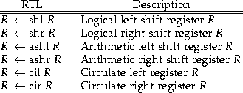
Micro-Ops Shift
Move the information in a register by one bit position
Shifts come in three varieties:
- Logical
- Arithmetic
- Circular

Slide 17
Using RTL to specify Digital System
Specification of Digital Components
  D flip-flop
Specification and Implementation of simple system: complete design of the system to implement the RTL code using,
  Direct connection
  Bus and Tri-state buffers
  Bus and Multiplexer

Slide 18
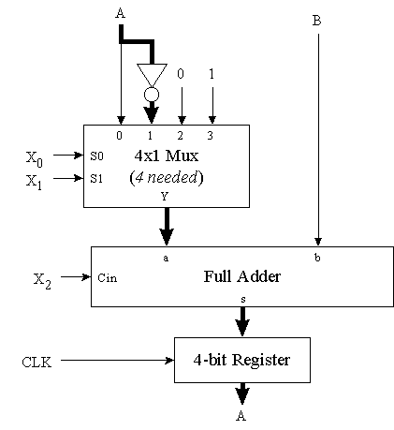
Data-path Design
Example Design and Operation
Micro-operation
RTL Expression
X₂X₁X₀
Load
A B
010
Add
A B + A
000
Subtract
A B - A
101
Increment
A B + 1
110
Decrement
A B - 1
011
Table: Micro-operation Control Signal Definitions

Slide 19
More Complex Digital System & RTL
There are two complex Digital System and RTL:
  Module 6 Counter
  Toll Booth Controller

