Slide 1
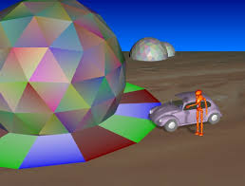
Computer Graphics and Multimedia

Slide 2
Course Goal
The goal of this course is to provide an introduction to the theory and practice of computer graphics and multimedia.
Prerequisites for the Course
The course will assume a good background in programming in C or C++
A background in mathematics including familiarity with the theory and use of coordinate geometry and of linear algebra such as matrix multiplication.

Slide 3
Course Objectives
Introduction to theory and practices of CGMM.
Computer graphics deals with all aspects of creating images with Computer -
Software
Hardware
Applications
Procedures and methods for drawing images.
Algorithms for point, line, circle, etc.

Slide 4
Career Options
Graphic designer, production artist, computer game designer/developer, computer animator
Average salary
$49,000* -$67,540* $72,000* (per annum)
3280795 /- Per annum to 4820760/- per annum

Slide 5
References
Recommended Text
Donald Hearn and M.P. Becker “Computer Graphics” Pearson Pub.
Rogers, "Procedural Elements of Computer Graphics", Tata McGraw Hill
Folay vandam, Feiner, Hughes “computer graphics principle & Practice”. Pearson Pub
Prabat K Andleigh and Kiran Thakrar, “Multimedia Systems and Design”, PHI Learning, 3rd Indian reprint edition , 2008.
Tay Vaughan, “Multimedia making it work”, Tata McGraw Hill edition.
Amarendra N Sinha & Arun D Udai , “Computer Graphics”, McGraw Hill publication . Fundamental of Computer Graphics and Multimedia, Mukherjee, PHI Learning

Slide 6
Course overview
Unit-I (Basics)
Introduction to Raster scan displays, Storage tube displays, refreshing, flickering, interlacing, color monitors, display processors, resolution,
Working principle of dot matrix, inkjet laser printers, working principles of keyboard, mouse scanner, digitizing camera, track ball , tablets and joysticks,
Graphical input techniques, positioning techniques, rubber band techniques, dragging etc.

Slide 7
Course Overview
Unit-II :
Scan conversion techniques, image representation,
line drawing Algorithms: Simple DDA for line, Bresenham’s Algorithm for line,
Circle drawing, general method, Bresenham’s Algorithm,
Curves, parametric function, Beizier Method, B-Spline Method.

Slide 8
Course Overview
Unit-III :
2D & 3D Co-ordinate system,
Transformations :Translation, Rotation, Scaling, Reflection Inverse transformation, Composite transformation,
world coordinate system, screen coordinate system,
Projections: Parallel and Perspective projection, Representation of 3D object on 2D screen.
Clipping: Point Clipping. Line Clipping Algorithms, Polygon Clipping algorithms,
Hidden Surface Removal : Introduction to Hidden Surface elimination,
Illumination Models: Basic illumination model, diffuse reflection, specular reflection, phong shading, Gourand shading ray tracing, color models like RGB, YIQ, CMY, HSV etc.

Slide 9
Course Overview
Unit-IV Multimedia
An Introduction : Multimedia applications – Multimedia System Architecture – Evolving technologies for Multimedia –
Defining objects for Multimedia systems – Multimedia Data interface standards –
Multimedia Databases.
Multimedia components,
Multimedia Hardware, SCSI, IDE, MCI,
Multimedia Tools, presentation tools, Authoring tools .

Slide 10
Course overview
Unit –V
Compression & Decompression –
Multimedia Data & File Format standards :-TIFF, MIDI, JPEG, DIB, MPEG,RTF, –
Multimedia I/O technologies - Digital voice and audio – Video image and animation–
Full motion video – Storage and retrieval technologies.

Slide 11
Suggested list of experiment
1.Write a program to implement DDA line drawing algorithm
2.Write a program to implement Bresenhames’ line drawing algorithm.
3.Write a program to implement Bresenhames’ circle drawing algorithm.
4.Write a program to draw an ellipse using Bresenhames’ algorithm.
5.Write a program to perform various transformations on line , square & rectangle.
6.Write a program to implement Cohen Sutherland line clipping algorithm.
7.Write a program to implement Liang-Bersky line clipping algorithm.
8.Write a program to implement Cohen-Sutheland polygon clipping algorithm to clip a polygon with a Pattern.
9.Write a program to convert a color given in RGB space to it’s equivalent CMY color space.
10.Study of various Multimedia file formats:-RTF,MIDI,GIF,JPEG,MPEG,TIFF etc.
11.Write a program to implement JPEG compression scheme for still images.
12.Write a program to perform Packbits compression & decompression.
13.Write a short program to create a TIFF file using bitmap segments and text files as the TIFF
File components.
14. Write a program to convert a BMP file into either JPEG or GIF file.
15.Study of various Multimedia Authoring Tools.

Slide 12
Prerequisites
Good programming skills in C (or C++)
Basic Data Structures
Linked lists
Arrays
Coordinate Geometry
Simple Linear Algebra

Slide 13
Credits and Evaluation
MidTerm Exam
Quiz
Assignment
Internal Assesment
External Assesment
Final Written Exam

Slide 14
What is computer Graphics
Computer graphics include almost everything on computers that is not text or sound.
Computer graphics involves display, manipulation and storage of pictures and experimental data for proper visualization using computer systems.
The graphics is one of the most effective and commonly used way to communicate the processed information to user.
It helps in displaying the information in the form of pictures/graphs/charts/ and diagrams instead of text.

Slide 15
Therefore it is important to understand -
How pictures of graphics objects are presented in computer graphics?
How the pictures and graphics objects are prepared in computer graphics for presentation?
How these prepared objects are presented ?
How an effective interaction in between these graphics objects is accomplished ?

Slide 16
Pixel
In computer graphics pictures or graphics objects are presented as a collection of discrete picture elements known as pixels.
The pixel is the smallest addressable screen element.
It is the smallest piece of the display screen which can be controlled.

Slide 17
Graphics System
Any graphics system generally comprises of a computer along with a fast processor, large memory, frame buffer and –
Display devices (monitors)
Input devices ( mouse, KB, Joystick, touch screen, trackballs)
Output devices (LCD Panels, Laser printers, color printers, plotters, etc.)
Interfacing devices( video input output system to machine or TV)

Slide 18
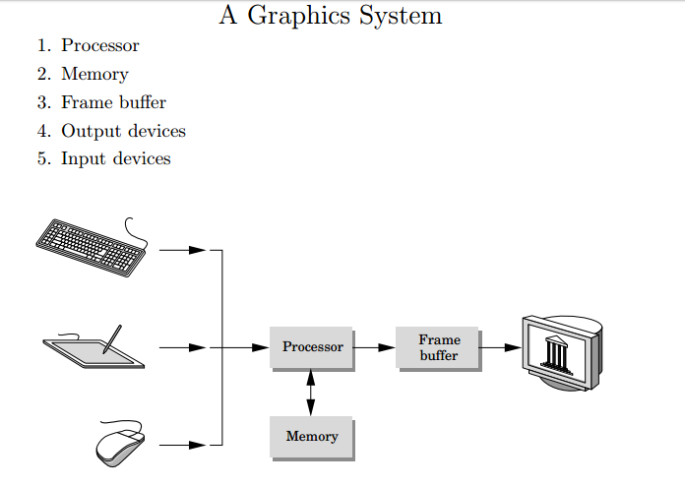

Slide 19
Interactive Graphics System
A Graphic system where the output can be controlled with the help of some i/p or controlling devices by user.
Example- computer games.

Slide 20
A typical interactive graphics system
Designer of computer s/w
Will put his design/ model
Or object planning to display.
Display Unit
Graphics system
Application Model
Application program
Input (KB, Mouse)

Slide 21
Computer Graphics Applications
GUI- Graphical User Interface
It is a piece of programs which provides an interface between an user and graphics application program.
Typical component of GUI are-
Menus
Icons
Cursor
Dialog Boxes
Scroll bars
Buttons
Valuators
Grids
Sketching
3 D Images

Slide 22
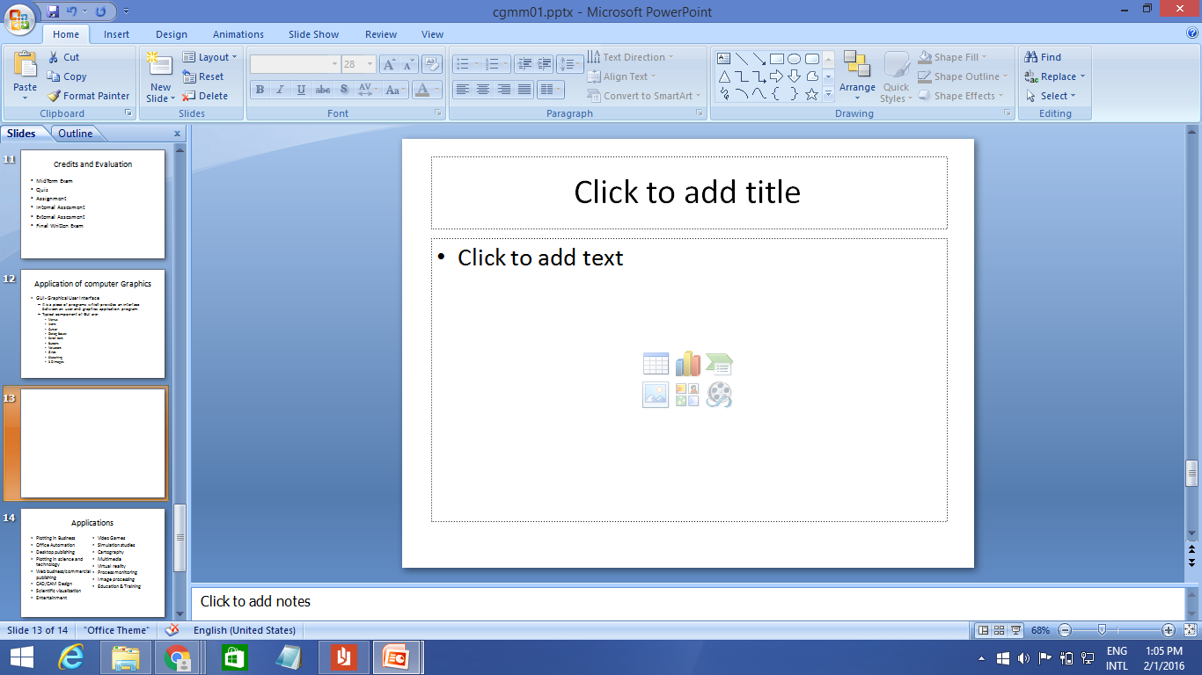
GUI Sample

Slide 23
Applications
Plotting in Business
Office Automation
Desktop publishing
Plotting in science and technology
Web business/commercial publishing
CAD/CAM Design
Scientific visualization
Entertainment
Video Games
Simulation studies
Cartography
Multimedia
Virtual reality
Process monitoring
Image processing
Education & Training

Slide 24
Computer Graphics Application
Plotting in Business
one need to plot various curves in the form of pie charts or simple 2D or 3D graphs.
In business application one needs to show the growth rate of company (profit/loss).
To show various economical data used in business.

Slide 25
Computer Graphics Application
Office Automation
Standard packages of words/PPT/excel.
Desktop publishing
For designing purpose of PowerPoint/images, etc.
Plotting in science & Technology
Curve plots / contour plots for result analysis.
Web business/commercial publishing & advertisement
For designing attractive and effective advertisements and commercial video shootouts.

Slide 26
Computer Graphics Application
CAD/CAM Design
VLSI for digital designs, construction architecture design for civil, circuit designs for electronics.
Scientific visualization
To visualize multidimensional data for example to visualize nuclear explosion.
Need to understand certain patterns in data in genetic engineering / biological sciences.

Slide 27
Computer Graphics Application
Entertainment
Movies, TV Advt., Games etc
Creating animations, real time movies, special effects ( Ex. Movies like Shrek where no camera is used/ star trek/star wars etc. )
Video games like NFS.
Simulation studies
Scientific visualization areas included such as computation fluid dynamics, various mechanical and chemical processes, studies about nuclear disaster management etc.
Flight simulators, docking and naval ship , space shuttle (need to train pilot engineers)

Slide 28
Computer Graphics Application
Cartography
Drawing , manipulation of creation of maps, its an area in geology.
In civil design of maps.
Multimedia
Combining text, audio, video, images etc in synchronized manner.
Computer graphics is an integrated part of any multimedia presentation.

Slide 29
Computer Graphics Application
Process monitoring
To analyze the performance of a system like assembly line working simulation with the help of reading sensor response which can alert the monitoring authority.
Image processing
Manipulation, storage and editing of pictures.
Enhancing the quality of pictures.
Different types of formats like JPEG, BMP, etc.

Slide 30
Computer Graphics Application
Education and Training
Computer Graphics application could be found in training like officers , students, Politicians, sports persons, etc.
Medical Science

