Slide 1
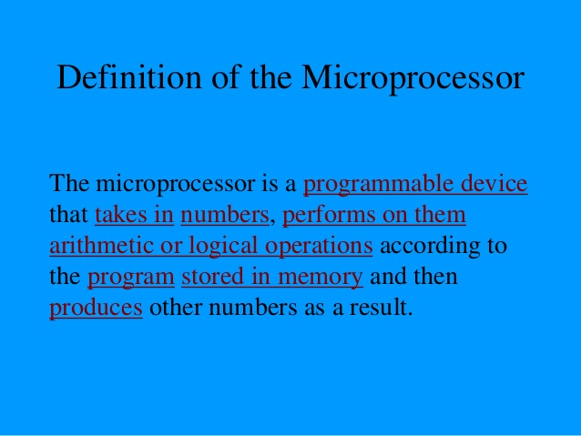

Slide 2
8085 Microprocessor
Instruction Set Of 8085:
1 | Data Transfer
2 | Arithmetic Instruction Set
3 | Logical Instruction
4 | Branch Instruction
5 | Stack, I /o, Control Instruction

Slide 3
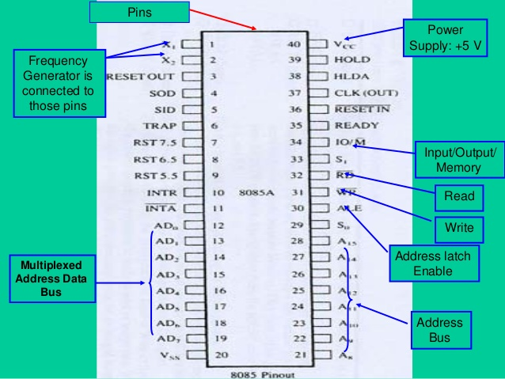
Pin Diagram Of 8085

Slide 4
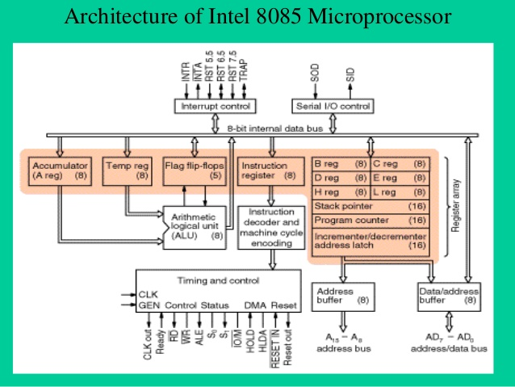

Slide 5
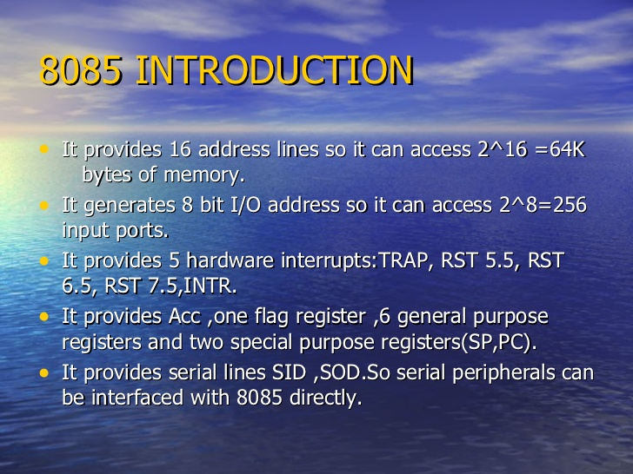
It was introduced in 1977.
 It is 8-bit microprocessor.
 Its actual name is 8085 A.
 Its dimensions are164 mm x 222 mm.
 It is having 40 pins Dual-Inline-Package (DIP).

Slide 6
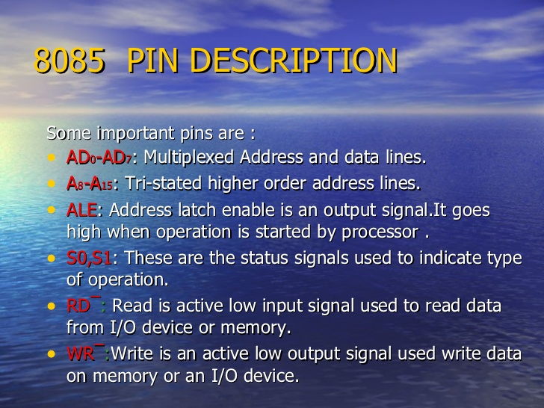

Slide 7
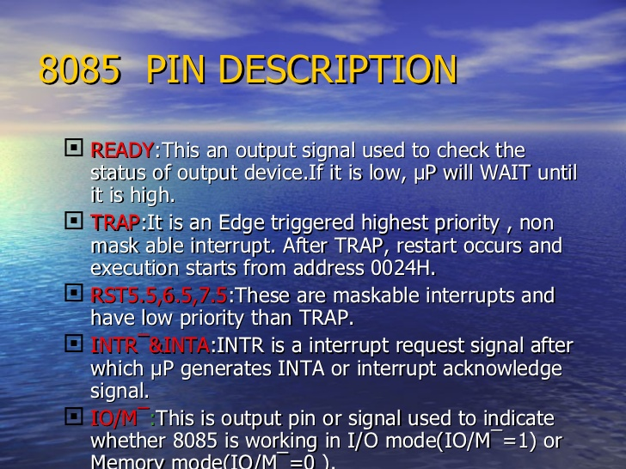

Slide 8
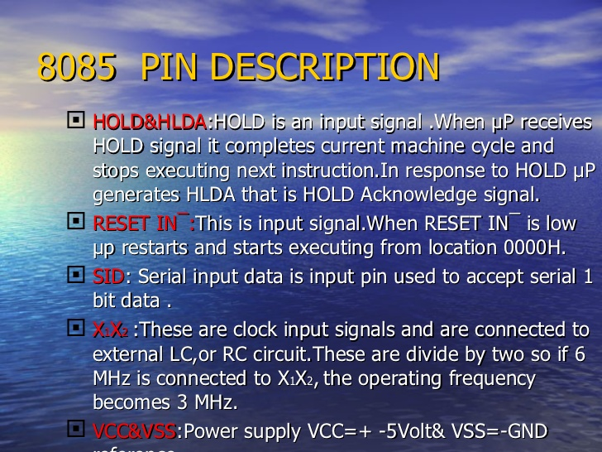

Slide 9
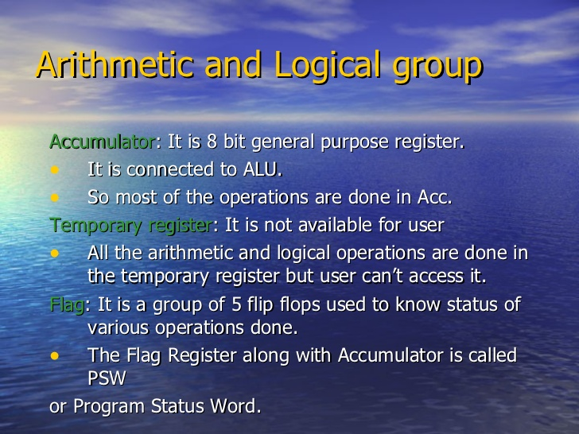

Slide 10
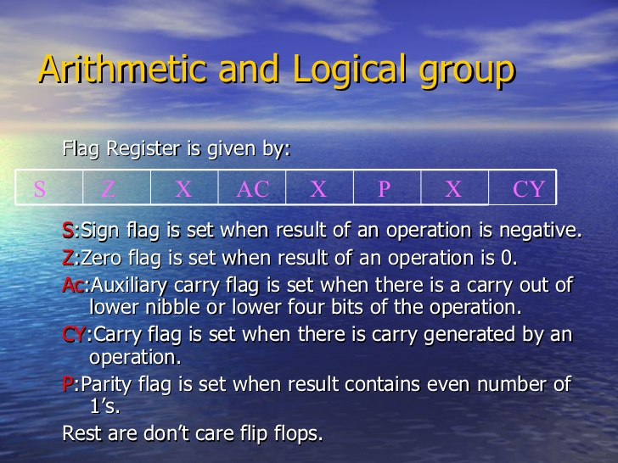

Slide 11
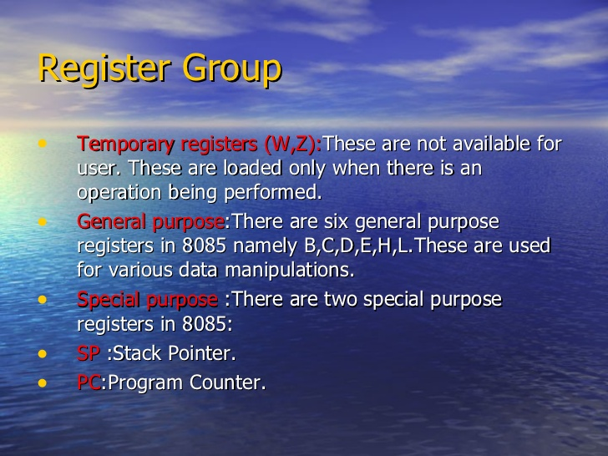

Slide 12
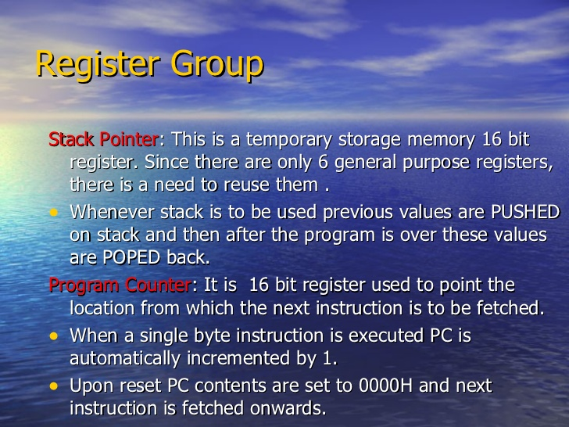

Slide 13
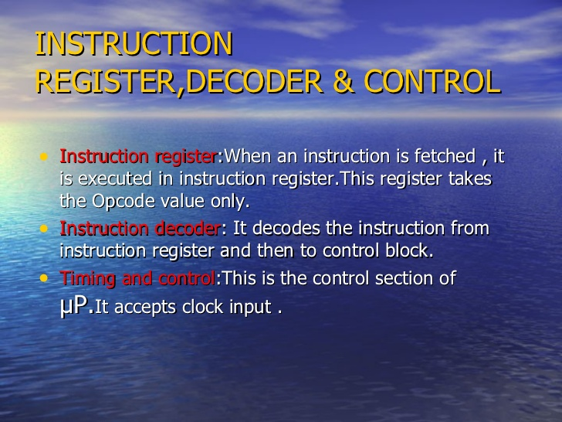

Slide 14
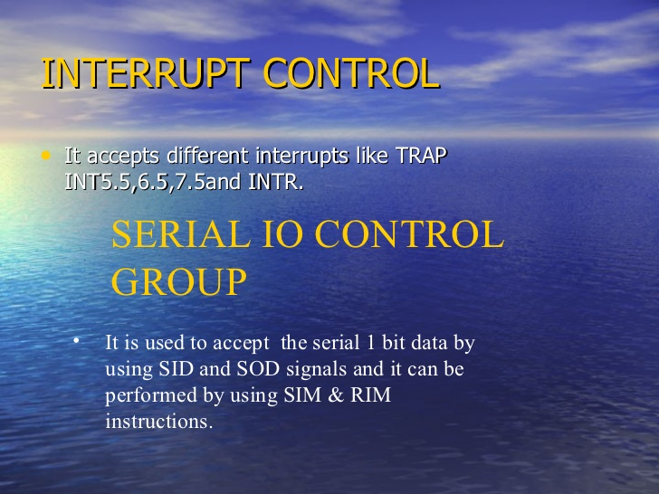

Slide 15
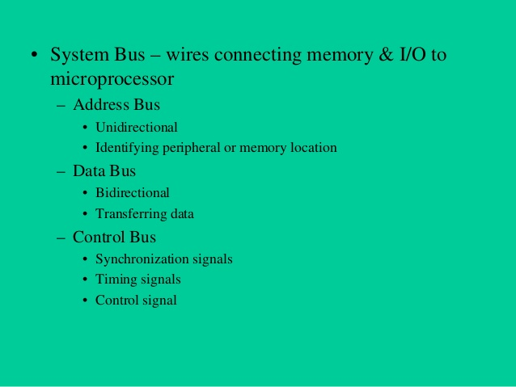
System Bus Of 8085

