Slide 1

Let's Verify Step by Step
Process Supervision for Reliable Mathematical Reasoning
Hunter Lightman et al., OpenAI, 2023
Gang Yan and Xinyao Peng | Apr 30, 2026
Process Reward Modeling in LLMs
Gang Yan and Xinyao Peng
Apr 30, 2026
Notes:
Hi everyone. Today we are presenting OpenAI's 2023 paper, Let's Verify Step by Step. The central topic is process supervision: training a reward model not only to judge whether the final answer is correct, but also to evaluate whether each step in the reasoning process is reliable.
The paper is interesting because it does not primarily try to train a better generator. Instead, it asks: given a generator that can already produce many step-by-step candidate solutions, how should we train a verifier, or reward model, to select the most trustworthy solution? The main question for today is simple: for complex mathematical reasoning, is the final answer enough, or do we need to verify the reasoning path step by step?

Slide 2
Motivation: Reasoning Is Useful, But Fragile
Chain-of-thought prompting enables multi-step reasoning.
But one wrong intermediate step can derail a whole solution.
In math, code, or science, fluent reasoning can still be invalid.
Step 1: valid
Step 2: valid
Step 3: subtle error
Step 4: fluent continuation
Central problem
How can we train a model to verify not only the answer, but the reasoning path?
Final answer
Process Reward Modeling in LLMs
Gang Yan and Xinyao Peng
Apr 30, 2026

Slide 3
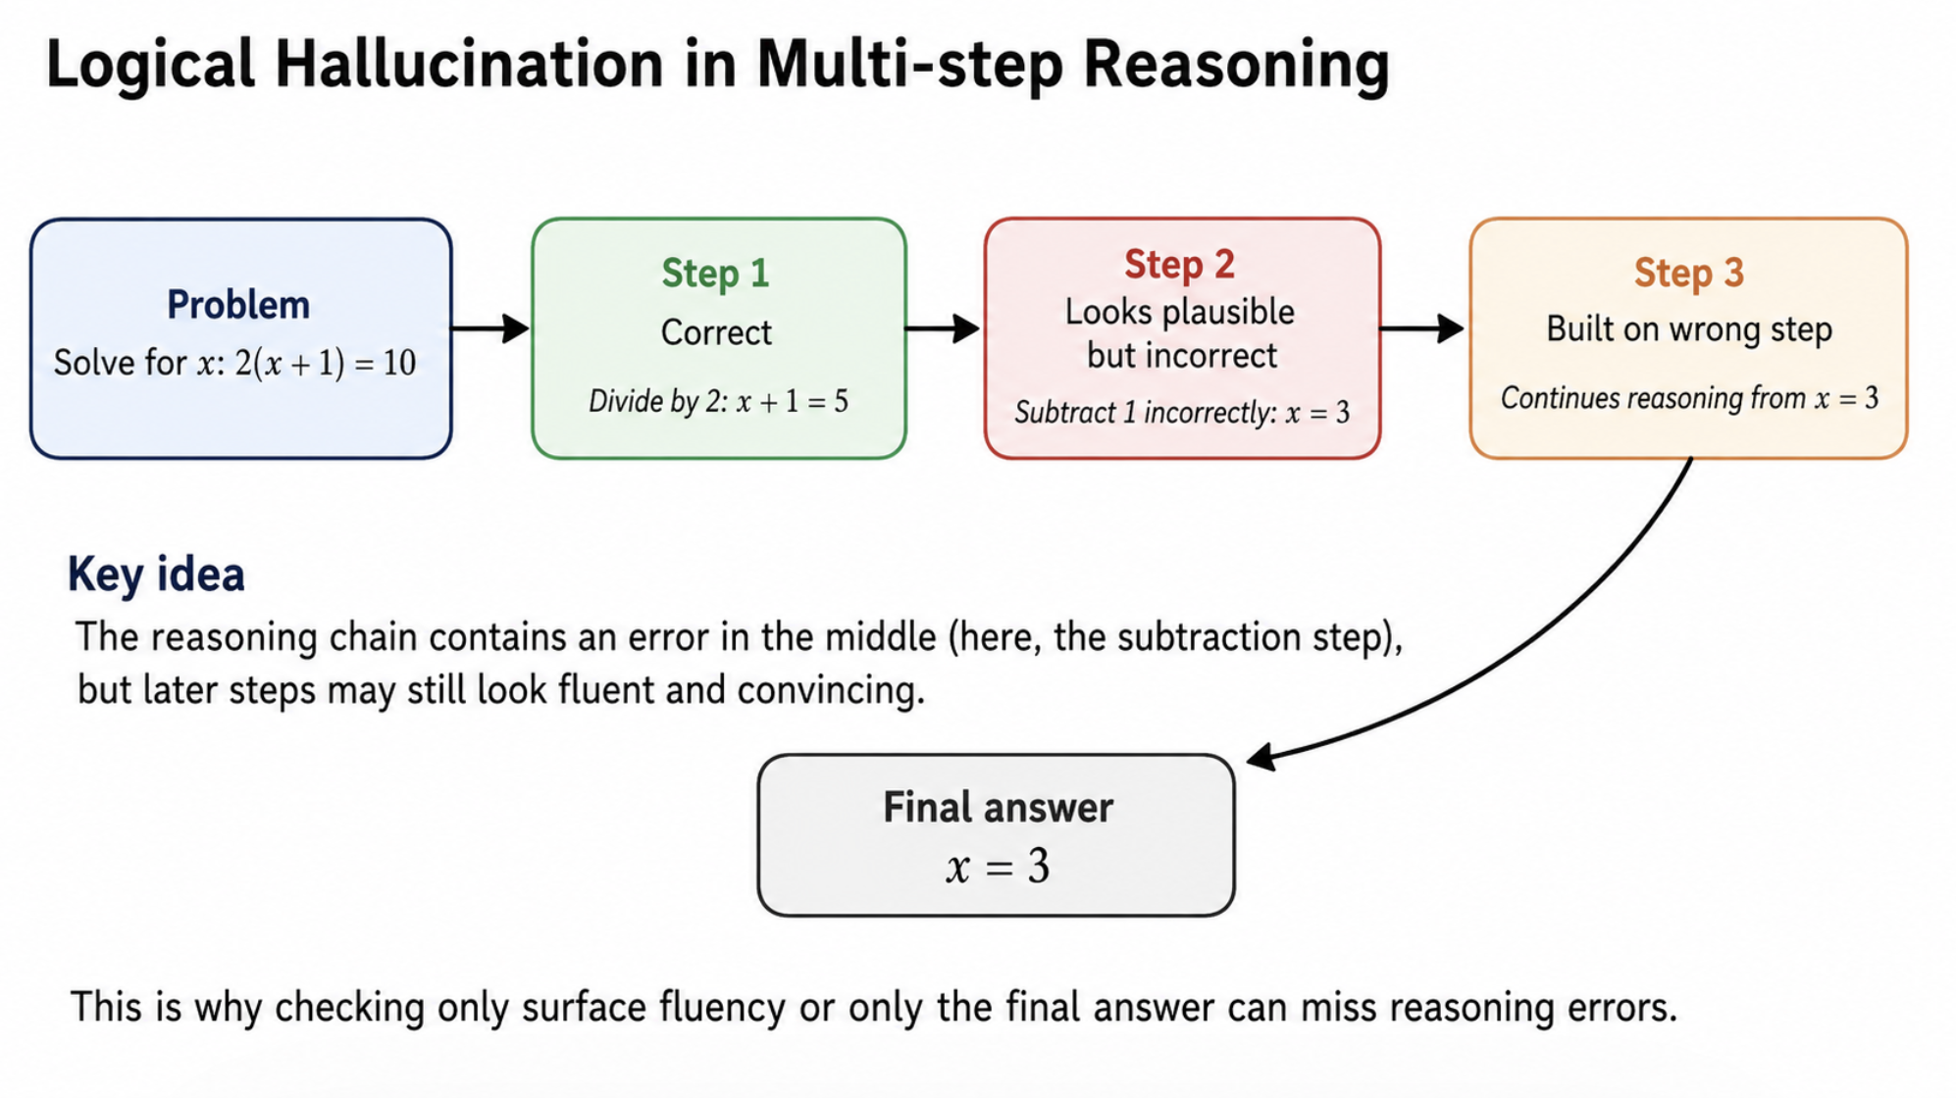
Logical Hallucination
Ordinary hallucination: inventing facts.
Logical hallucination: producing a plausible but invalid reasoning step.
The final answer may be wrong, or even accidentally correct.
Why final answers are not enough
A correct final answer can hide broken reasoning; an incorrect final answer does not reveal where reasoning failed.
Process Reward Modeling in LLMs
Gang Yan and Xinyao Peng
Apr 30, 2026

Slide 4
Verifier / Reward Model Setup
Candidate 1
Candidate 2
...
Candidate N
Reward model
scores all candidates
Problem
Fixed
Generator
sample N
rank
Selected
Solution
best-of-N
Evaluation
The reward model is judged by whether it selects a candidate solution with the correct final answer.
Process Reward Modeling in LLMs
Gang Yan and Xinyao Peng
Apr 30, 2026

Slide 5
Method Overview: Step-by-step Pipeline
Math Problem
Fixed generator produces step-by-step solutions
Reasoning is spilt into explicit
Reward model
scores solution
Best candidate is selected
Important setting: The paper keeps the generator fixed and studies how different reward-model supervision signals affect selection quality.
Process Reward Modeling in LLMs
Gang Yan and Xinyao Peng
Apr 30, 2026

Slide 6
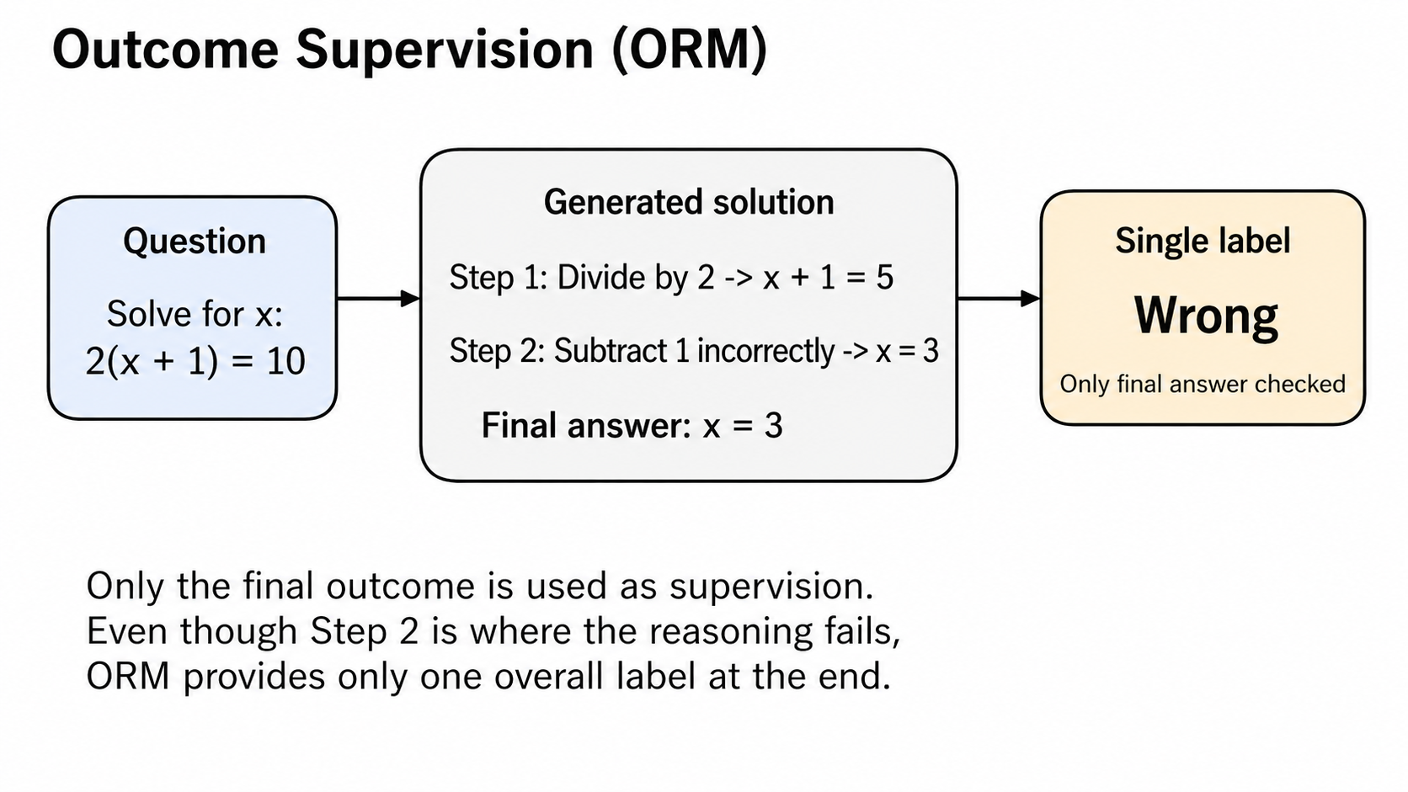
Two Supervision Schemes: ORM
Outcome-supervised RM (ORM)
Trained from the final answer only.
Step 1
Step 2
Step 3
Answer
Single label: Correct/Wrong
Process Reward Modeling in LLMs
Gang Yan and Xinyao Peng
Apr 30, 2026

Slide 7
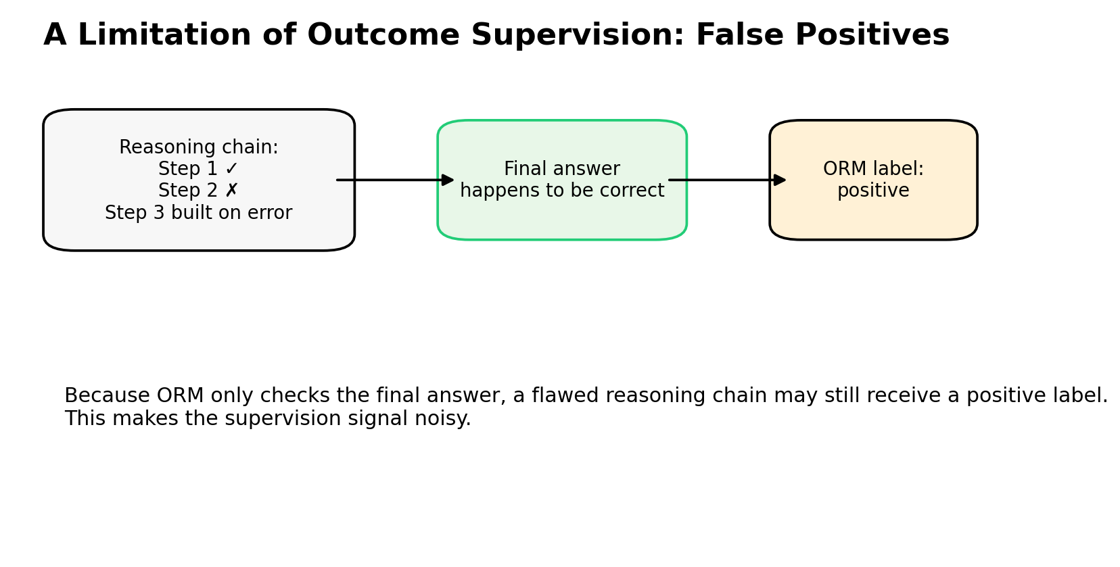
Why Outcome Supervision Is Limited
A negative outcome label says: “something is wrong.”
It does not say which step caused the failure.
On hard problems, most samples are wrong, so a negative label is weak information.
False positives are possible: broken reasoning can reach a correct answer by accident.
Process Reward Modeling in LLMs
Gang Yan and Xinyao Peng
Apr 30, 2026

Slide 8
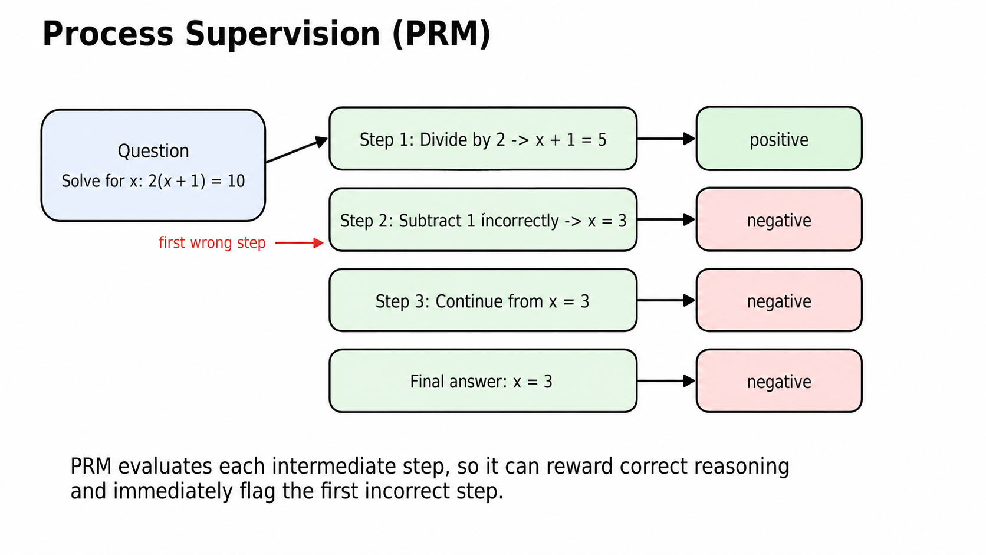
Two Supervision Schemes: PRM
Process-supervised RM (PRM)
Trained from labels on each reasoning step.
Step 1
Step 2
Step 3
Stop
ok
bad
bad
first error
Process Reward Modeling in LLMs
Gang Yan and Xinyao Peng
Apr 30, 2026

Slide 9
Research Questions and Main Contributions
Does process supervision train more reliable reward models than outcome supervision on hard math problems?
Can active learning reduce the cost of collecting step-level human feedback?
Do the results survive controlled small-scale ablations and modest distribution shift?
Headline results
1.PRM solves 78.2% of held-out MATH problems with best-of-1860 selection.
2.PRM800K contains about 800K human step-level labels.
3.Active learning improves data efficiency by about 2.6x.
Process Reward Modeling in LLMs
Gang Yan and Xinyao Peng
Apr 30, 2026

Slide 10
Experimental Scope
Fixed
Compared
The generator at each model scale.
The best-of-N evaluation protocol.
Automatic grading of selected final answers.
How the reward model is supervised.
ORM: final-answer outcome labels.
PRM: step-level process labels.
not used to update
Generator
samples
Reward Model
No RL training
in this paper
Process Reward Modeling in LLMs
Gang Yan and Xinyao Peng
Apr 30, 2026

Slide 11
Data and Models
Large-scale models are fine-tuned from a GPT-4 base model.
Small-scale models use a similar design with roughly 200x less pretraining compute.
Models receive an additional math-focused pretraining stage on MathMix.
The generator is fine-tuned to produce newline-delimited step-by-step solutions.
Benchmark
MATH dataset: challenging competition-style problems.
Final evaluation: 500 held-out MATH test problems.
Some test-split problems were used for PRM800K training, so the authors reserve a clean subset.
Process Reward Modeling in LLMs
Gang Yan and Xinyao Peng
Apr 30, 2026

Slide 12
PRM800K: Collecting Process Supervision
Step 1 positive
1.Human labelers inspect model-generated solutions step by step.
2.Each step receives one label:
a.positive: correct and helpful;
b.negative: incorrect or unreasonable
c.neutral: ambiguous or technically valid
but unhelpful.
3.Labels are collected only up to the first incorrect step.
Step 2 positive
Step 3 neutral
Step 4 negative
stop labeling after
the first mistake
Scale
800K step labels, 75K solutions, 12K problems.
Process Reward Modeling in LLMs
Gang Yan and Xinyao Peng
Apr 30, 2026

Slide 13
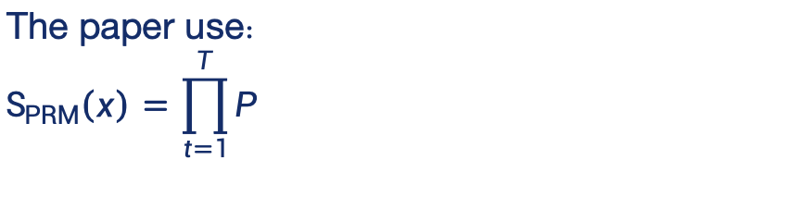
PRM Scoring: From Steps to a Solution Score
The PRM predicts a label distribution after each step.
At test time, one forward pass scores the whole solution.
0.98
0.91
0.87
0.42
The paper use：
$$S_{PRM}\left(x\right)=\prod_{t=1}^{T}{P}$$
solution score = product
Neutral labels are treated as positive by default.
A high score requires
all steps to look reliable.
Process Reward Modeling in LLMs
Gang Yan and Xinyao Peng
Apr 30, 2026

Slide 14
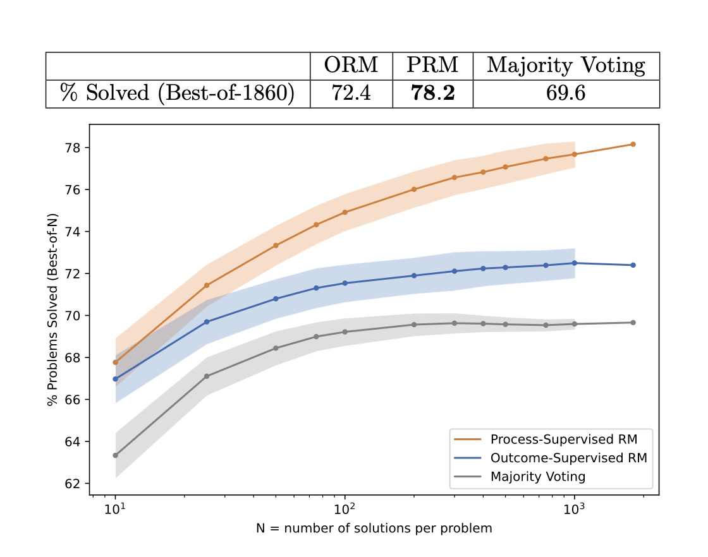
Main Result 1: Large-scale PRM Beats ORM
Evaluation: best-of-N search over generator samples.
PRM outperforms ORM and majority voting for all N.
The gap grows as N increases.
Best-of-1860
PRM: 78.2% ORM: 72.4% Majority vote: 69.6%
Process Reward Modeling in LLMs
Gang Yan and Xinyao Peng
Apr 30, 2026

Slide 15
Why the Large-scale Comparison Is Not Enough
Confounder 1
Confounder 2
The ORM and PRM training sets are not directly comparable.
PRM800K is shaped by active learning; ORM uses a larger uniformly sampled dataset.
Final-answer grading can mislabel broken reasoning.
Correct answer with invalid reasoning becomes a false positive.
Solution
Use a large PRM as a synthetic supervisor to run controlled small-scale ablations.
Process Reward Modeling in LLMs
Gang Yan and Xinyao Peng
Apr 30, 2026

Slide 16
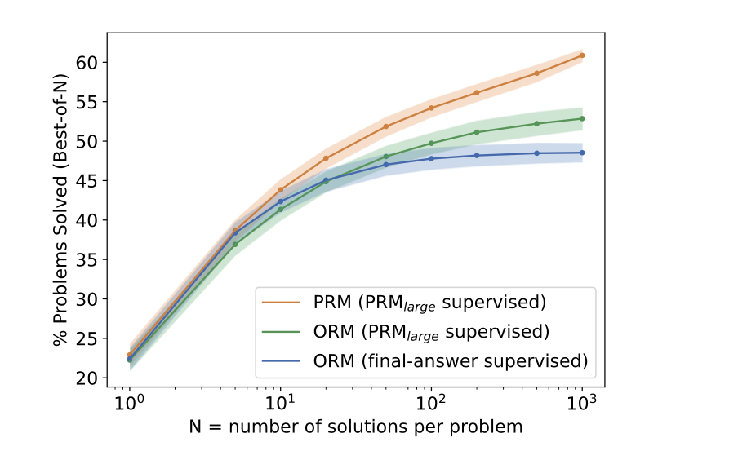
Main Result 2: Controlled Small-scale Ablation
Train three small-scale reward models on the same sampled datasets.
Use the same small-scale architecture and training pipeline.
Only the supervision type changes.
Finding:
Process supervision consistently outperforms both forms of outcome supervision under matched training conditions.
This means the PRM advantage is not only a data-collection artifact; it also comes from the supervision type itself.
Process Reward Modeling in LLMs
Gang Yan and Xinyao Peng
Apr 30, 2026

Slide 17
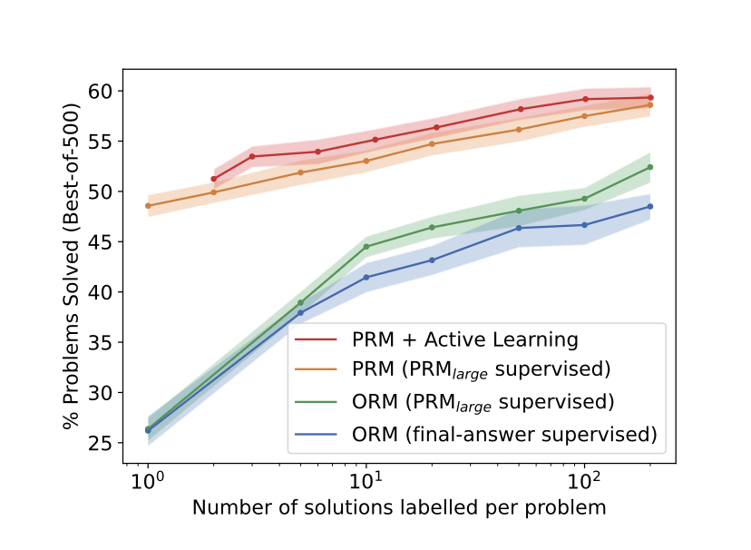
Main Result 3: Active Learning Improves Label Efficiency
Uniform labeling spends effort on many low-information solutions.
The authors instead prioritize “convincing wrong-answer” solutions:
high score under the current PRM;
incorrect final answer.
These are the samples most likely to reveal subtle reasoning mistakes.These examples expose where the PRM is currently fooled.
1000 generated solutions
score with current PRM
select high-scoring wrong answers
send to human labelers
Active learning gives the PRM more informative training data and improves label efficiency by focusing annotation on the most valuable errors.
retrain PRM
Process Reward Modeling in LLMs
Gang Yan and Xinyao Peng
Apr 30, 2026

Slide 18
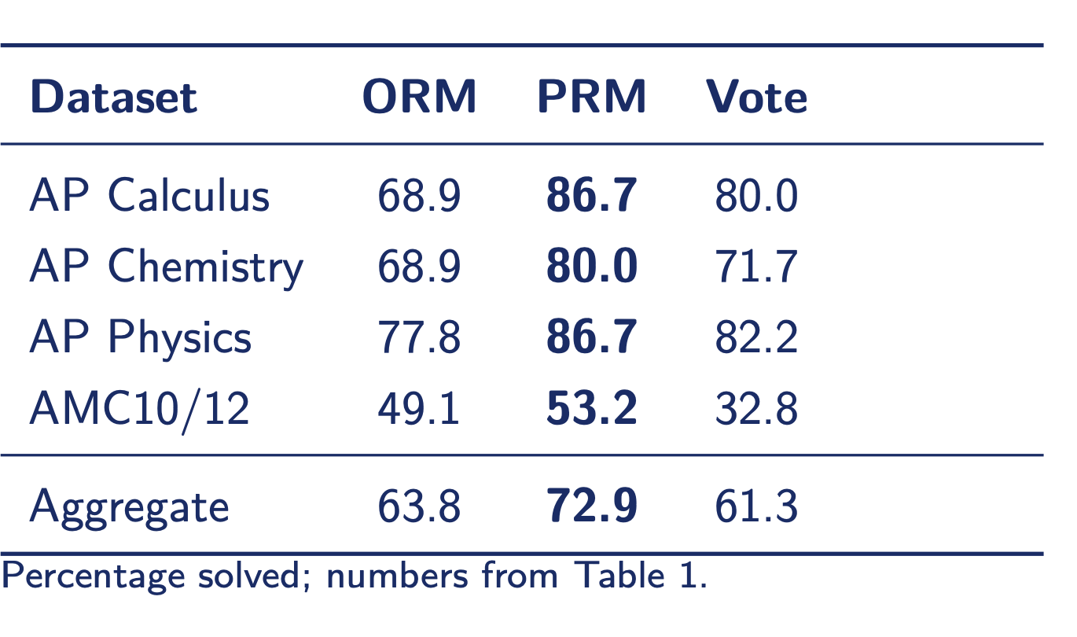
Out-of-distribution Generalization
Test set: recent AP Physics, AP Calculus, AP Chemistry, AMC10/12 problems.
These exams were released after pretraining data was compiled.
Evaluation: best-of-100.
Meaning
PRM's advantage is not limited to the MATH held-out subset.
Process Reward Modeling in LLMs
Gang Yan and Xinyao Peng
Apr 30, 2026

Slide 19
Alignment Perspective
Alignment tax
the performance or efficiency cost of making a model more aligned with human intentions.
Negative alignment tax
a case where a more alignment-friendly method does not hurt performance, and may even improve it.
Alignment is often assumed to come with a cost: safer or more human-aligned systems may become less efficient or less performant.
In this paper, process supervision is more aligned with what we actually want to reward: not just a correct final answer, but a correct visible reasoning process.
Process supervision is stronger since it provides a more local, denser, and more interpretable training signal for evaluating reasoning quality.
Process Reward Modeling in LLMs
Gang Yan and Xinyao Peng
Apr 30, 2026

Slide 20
Limitations and Discussion
Domain: math reasoning has relatively checkable steps.
The main evidence comes from mathematical reasoning, where solutions are relatively structured.
Final answers are often easy to check.
Step-level labels are therefore much easier to define than in open-domain reasoning..
Cost: step-level human feedback is expensive.
Contamination: MATH problems may appear online.
Discussion question
When is the reasoning process itself objectively labelable, and when is it just about style, strategy, or preference?
Process Reward Modeling in LLMs
Gang Yan and Xinyao Peng
Apr 30, 2026

Slide 21
Takeaways
1.For multi-step reasoning, process supervision trains more reliable reward models than final-answer supervision.
2.PRM’s advantage comes from better credit assignment and a more local, denser, and more interpretable supervision signal.
3.Active learning makes expensive step-level labels more data-efficient.
4.The broader lesson: do not only sample more answers;
verify the reasoning path step by step.
Thank you
Process Reward Modeling in LLMs
Gang Yan and Xinyao Peng
Apr 30, 2026

