Slide 1
≋ SENACOR
From Assembler to Rust
Reimagining the Apollo Guidance Computer with AI
Vitaliy Schreibmann · Senacor Technologies · April 2026
Senacor Technologies AG
April 2026 | 1

Slide 2
Agenda
≋ SENACOR
01
The Apollo Guidance Computer
Hardware constraints, real-time architecture, and the original Comanche055 software
02
The Problem Space
Lost abstractions, 1960s assembly code, and why Rust is the right choice
03
AI-Powered Transformation
Multi-agent pipeline: analyst → architect → developer → code-review → tester → debugger
04
Results
5 milestones complete — 207 tests passing — 12,000+ lines of idiomatic Rust
Senacor Technologies AG
April 2026 | 2

Slide 3
01
≋ SENACOR
The Apollo Guidance Computer
01
Block II AGC — Comanche 055 — the original real-time computer
Senacor Technologies AG
April 2026 | 3

Slide 4
The Apollo Guidance Computer
≋ SENACOR
Block II AGC — Comanche 055 — Command Module
PROCESSOR
Comanche 055 — Key Facts
2.048 MHz, 15-bit words, twos complement integers,
~40,000 operations / second
◆ Apollo 11 Command Module flight software
◆ Outputs: thruster + main engine commands
◆ ~100,000 lines of AGC assembly
◆ DSKY console — verb/noun crew interface
MEMORY
4 KB RAM · 72 KB ROM
Magnetically woven core rope
◆ Magnetically woven core rope memory
◆ Hard real-time — 10ms fixed scheduler cycle
SCHEDULER
◆ Navigation: star sightings + IMU data
◆ Fail-safe: always returns to a safe state
No operating system
Software owns 10ms task cycle
Senacor Technologies AG
April 2026 | 4

Slide 5
02
≋ SENACOR
The Problem Space
02
Why re-engineer 1960s assembly — and why Rust?
Senacor Technologies AG
April 2026 | 5

Slide 6
Three Core Challenges
≋ SENACOR
The obstacles between AGC assembler and modern Rust
1
2
3
Lost Abstractions
Hard Real-Time Constraints
Fidelity vs. Readability
AGC assembly has no functions, structs, or types. Variables are raw memory addresses. Everything is in global variables. Comments are the only documentation. The original developer intent must be reconstructed entirely from runtime behavior and cross-references to design documents.
There is no OS. There is no heap allocator. The AGC scheduler ticks every 10ms in silicon. Our Rust implementation must honour the same timing guarantees using no_std and fixed-size, pre-allocated data structures throughout.
Every constant and computation must match Comanche 055 — bit for bit. Yet the overarching goal is readable, idiomatic Rust that any modern engineer can understand and maintain, not a line-for-line transliteration of 1960s opcodes.
Senacor Technologies AG
April 2026 | 6

Slide 7
Why Rust?
≋ SENACOR
The only modern language that matches AGC constraints without a runtime
no_std
Memory Safety
Zero-Cost
Compiles to bare metal with no OS, no heap. Matches the AGC environment exactly — the right foundation for a real-time embedded port.
Ownership and borrow checker eliminate whole classes of bugs without garbage collection overhead or runtime costs.
Enums, traits, and iterators are abstractions that compile away entirely. There is no hidden runtime — what you see is what runs.
Type System
Testability
Readability
Fixed-width integers and custom newtypes (i15, u15) express AGC word semantics explicitly, catching numerical errors at compile time.
#[test] and cargo test give instant feedback. The original AGC had no unit tests. Our port has 207 — all green.
Modules, doc-comments, and meaningful names restore the abstraction layer that was lost when assembly was the only option.
Senacor Technologies AG
April 2026 | 7

Slide 8
03
≋ SENACOR
AI-Powered Transformation
03
A multi-agent pipeline driven by Claude Code
Senacor Technologies AG
April 2026 | 8

Slide 9
The Multi-Agent Pipeline
≋ SENACOR
Specialized AI agents with focused tools, coordinated by Claude Code
analyst-reengineer
sonnet
architect
opus
developer
sonnet
Reads AGC assembly + reference docs. Produces functional specs per component. Knows about orbital mechanics and navigation
Designs Rust module structure, traits, and data types. Validates via Plan Mode.
Implements idiomatic no_std Rust following specs and architecture decisions.
Read · Glob · Grep · Write
Read · Write · EnterPlanMode
Read · Edit · Write · Bash
code-review
sonnet
tester
sonnet
debugger
sonnet
Validates every line against Comanche055. Files ADRs for all deviations.
Writes unit tests per public interface and scenario tests for mission phases.
Diagnoses test failures and regressions. Fixes without breaking passing tests.
Read · Grep · Write
Read · Write · Edit
Read · Edit · Bash
Senacor Technologies AG
April 2026 | 9

Slide 10
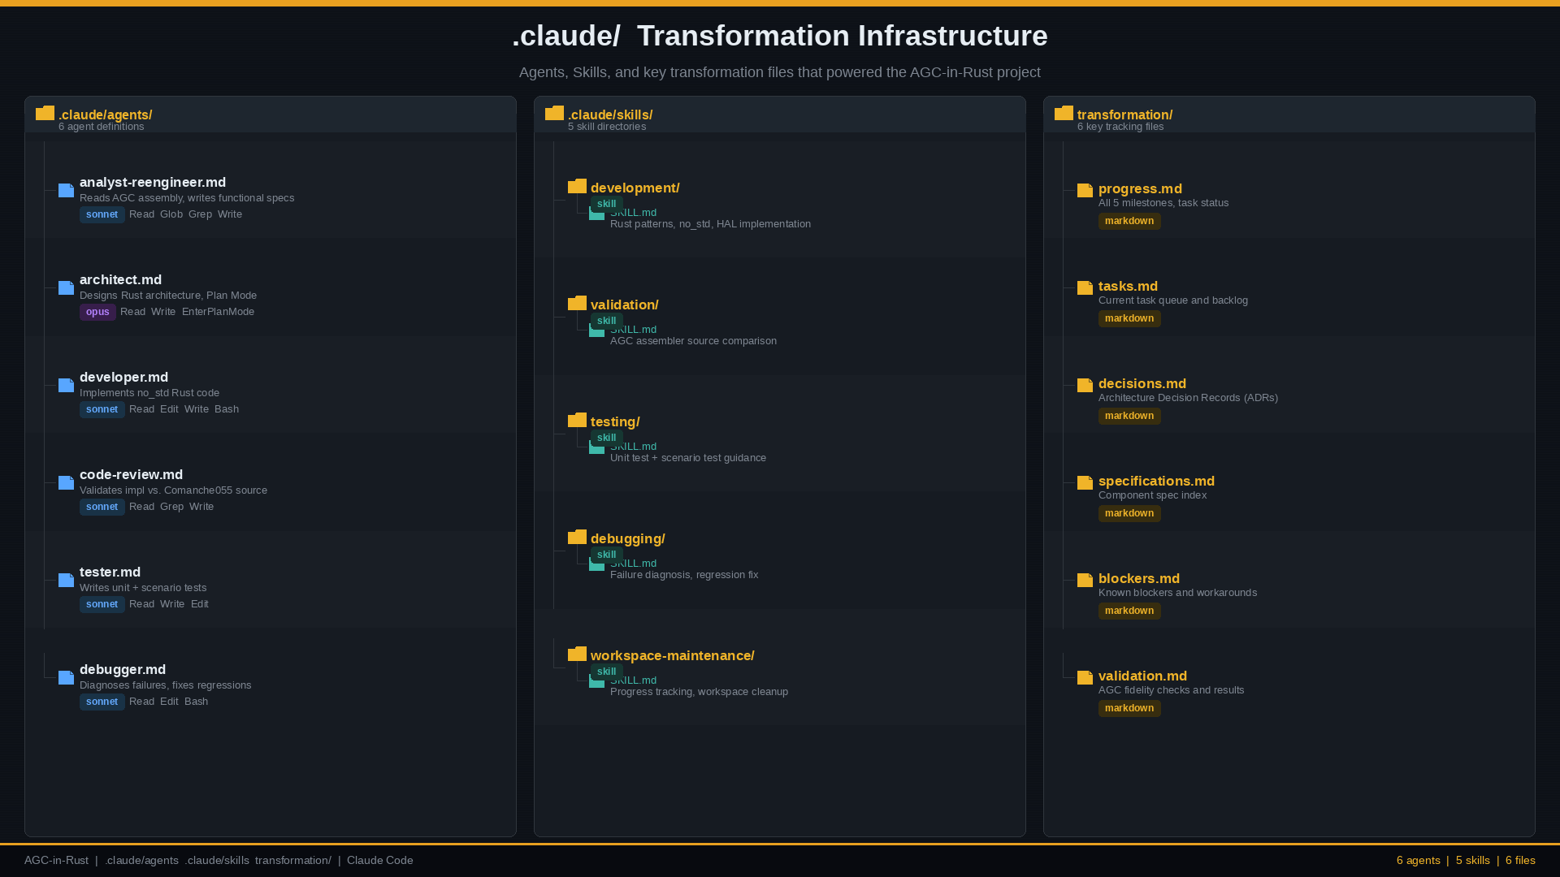
Agent & Skill Architecture
≋ SENACOR
The .claude/ directory — transformation infrastructure as code
Senacor Technologies AG
April 2026 | 10

Slide 11
What We Learned About Claude
≋ SENACOR
Key observations from two days of hands-on experimentation
First Drafts Too Close to Assembler
⚠
Without sufficient context, Claude produces assembly-style Rust — not idiomatic. It needs the Rust Book, Apollo PDFs, and VirtualAGC docs loaded before any code generation.
Prompting Mode Determines Quality — and Token Cost
⚡
Human ad-hoc prompting → Low token usage → Low quality. Spec-Driven prompting → High token usage → High quality.
No way to predict token cost upfront. Commit to quality from the start — token frugality always backfires.
Claude Has Memory — but needs a Strong Foundation Agent
✦
Context accumulates within a session and Claude uses it well. However, the Analyse & Architecture agent must carry massive domain knowledge (AGC hardware, Rust embedded, mission phases) to produce reliable output.
The Workflow That Works: Spec → Code → Test → Validate (PDF / AGS)
✓
Write a full functional spec first → generate Rust → run cargo test → validate against Comanche 055 assembler and AGC specification PDFs. Proven across all 5 milestones.
Senacor Technologies AG
April 2026 | 11

Slide 12
Spec-Driven Development
≋ SENACOR
Design first — original assembler code as support, not basis
" Design First — Requirements are always incomplete. Spec-driven development is Agile. "
Functional
Spec
Rust
Code Gen
Tests
Run
Validate vs
AGS / PDF
Analyse & Architecture
agent
Developer agent
with full context
Tester agent
cargo test
Code-review agent
vs Comanche 055
Design First
Original Code is Support, Not Basis
Always start with a full functional specification — never jump straight to code. Requirements are inherently incomplete; the spec forces clarity and completeness before any generation starts.
The AGC assembler source serves as a validation reference and domain guide. AI generates new idiomatic Rust algorithms — it does not transliterate 1960s assembly line by line.
Spec-Driven = High Token Usage = High Quality
Validation is Essential
Spec-driven prompting consumes significantly more tokens but delivers dramatically higher quality output. Quality is the non-negotiable constraint — token frugality always backfires.
Every milestone validated against Comanche 055 assembler source and the original AGC specification PDFs. No milestone is considered complete until independently verified.
Senacor Technologies AG
April 2026 | 12

Slide 13
The Workday
≋ SENACOR
From blank whiteboard to 5 complete milestones — in one day
Day Plan — April 9, 2026
Actual Execution — April 10, 2026
10:00
1. Architecture
10:15
Start
Architecture locked, pipeline ready
Rough design → fix AGC problems + Rust embedding. Target: ~1,000 lines with structure, types & components.
10:28
M1 Analysis
Core infrastructure spec complete
—
2. Token Strategy
11:00
M1 Dev
Scheduler, fixed-point math, memory map
Pro Plan exhausted after 2 h — no more tokens. Switched approach and planned next steps carefully.
11:30
M1 ✓
All M1 tests green
12:00
3. Proof Reading
11:40
M2 Analysis
IMU, stellar nav spec complete
Architecture doc + Embedded Rust Book — deep knowledge loading for all AI agents before code generation.
12:05
M2 Dev
Navigation foundation implemented
12:25
M2 ✓
Navigation foundation tests green
15:00
4. First Execution
M1 → 5,000 LoC Markdown + 1,000 Rust.
M2 → 5,000 Markdown + 2,500 Rust.
12:30
─ Pause ─
Lunch break
15:00
M3 ✓
Guidance & DAP complete
17:00
5. Milestone Loop
15:55
M4 ✓
Navigation programs (P20/P52/P63–65)
Milestones development with continuous PDF + Comanche 055 assembler validation at every step.
16:40
M5 ✓
DSKY + mission simulation complete
Senacor Technologies AG
LoC Markdown: 13,500 | LoC Rust: 12,200 | Total: 25,700
April 2026 | 13

Slide 14
04
≋ SENACOR
Results
04
All 5 milestones complete — the AGC lives in Rust
Senacor Technologies AG
April 2026 | 14

Slide 15
Five Milestones — All Complete
≋ SENACOR
From bare hardware abstraction layer to full mission simulation
M1
M2
M3
M4
M5
✓
✓
✓
✓
✓
Core
Infrastructure
Navigation
Foundation
Guidance
& DAP
Navigation
Programs
DSKY &
Mission Sim
Scheduler, interrupts, fixed-point math, memory map
IMU integration, stellar orientation, coordinate transforms
Guidance equations, Digital AutoPilot, thruster control
P20, P52, P63, P64, P65 — rendezvous, align, descent
Crew interface, mission phases, earth-moon simulation
Senacor Technologies AG
April 2026 | 15

Slide 16
By the Numbers
≋ SENACOR
Quantitative results from the AGC-in-Rust transformation
207
46
0
13
Unit Tests
Passing
Rust Source
Files
Clippy
Warnings
Constant
Assertions
Code Statistics (tokei)
Language
Files
Code Lines
Comments
Total Lines
Rust
88
12,263
1,847
14,110
Markdown
53
13,569
0
13,569
TOML
4
89
3
92
Total
145
25,921
1,850
27,771
Senacor Technologies AG
April 2026 | 16

Slide 17
Rust Architecture
≋ SENACOR
Layered module design mirroring the original AGC software structure
Mission Layer
mission_phase.rs
earth_moon.rs
P-code dispatcher
DSKY Interface
dsky.rs
verb/noun handler
program status word
Navigation Programs
p20_rendezvous
p52_imu_align
p63–65 descent
Guidance & DAP
guidance.rs
dap.rs
thruster_logic.rs
Navigation Core
imu.rs
stellar.rs
coordinate transforms
Hardware Abstraction
scheduler.rs
memory_map.rs
fixed_point.rs
All modules compile with no_std · cargo test: 207 passing · clippy: 0 warnings
Senacor Technologies AG
April 2026 | 17

Slide 18
≋ SENACOR
207
tests passing
88
Thank You
Rust files
The AGC lives on — in idiomatic Rust.
12,263
github.com/chrislgarry/Apollo-11 · Comanche055 · Claude Code
code lines
5
milestones
Senacor Technologies AG
April 2026 | 18

