Slide 1
OCT 24, 2018
Comptrollership Reporting
System – ITRS Phase 1
Presented to: Cloud Services Group
Presented by: ITD-MB

Slide 2


AGENDA
      Project Overview
      Operational Requirements
      Technical Overview
      Technical Considerations
      Architecture Diagram

Slide 3
Project Overview
Background
BDO Comptrollership Reporting System – International Reporting System (CORS-ITRS)
  JAVA web-based application
  Capture all international transactions made by the bank (i.e., all peso and foreign currency-denominated transactions with non-residents and all foreign currency transactions with residents) from different source systems
  For BSP regulatory requirement to replace BSP GLFX reporting.
  Phase 1
    Loading facility for GLFX raw data
    Loading facility for daily Currency Rates
    Conversion GLFX purpose code to ITRS trancode thru mapping
    Facilitate creation of CSV files for based on BSP guidelines
    Provide Prooflist per Source System loaded in ITRS converter
Notes:
*not sure if should be under OE

Slide 4
Operational Requirements
Recoverability Objective
    RTO – 4 hours
    RPO – 4 hours
support model
Notes:
*not sure if should be under OE

Slide 5
Technical Overview
 | SOFTWARE | BDO PRIVATE CLOUD
 |  | Requested | Actual
Application Server (VM) | Linux Ubuntu 18.04 Java 1.8 | CPU = 4 cores Memory = 16 GB Storage = 100 GB | CPU = 4 cores Memory = 8 GB Storage = 100 GB
Database Server (VM) | Linux Ubuntu 18.04 PostgreSQL 9.6 | CPU = 8 cores Memory = 32 GB Storage = 500 GB | CPU = 4 cores Memory = 4 GB Storage = 500 GB
Workstation | Microsoft Windows 7 and above IE 11 and above; Mozilla Firefox 45.3.0 and above WINSCP (for only users’ workstation that will send files to CSG SFTP designated folder)
Notes:
*not sure if should be under OE

Slide 6
Technical Considerations
Phase 1
Use of Cloud SFTP
Loading of Source files limited to the following due to unavailability of source systems :
    Old GLFX files (in dbf format)
    FRS (in ITRS format)
Generation of ITRS consolidated file required ITRS format by October 1, 2018 (parallel submission set by BSP),
Expected volume of transactions is 120,000 transactions/day
User base - 20 from TRAD-IOS and FRCD-Reports
Data retention - current year plus previous year’s transactions
Performance requirements:
    Loading < 45 mins
    Generation of csv file < 1 hour

Slide 7
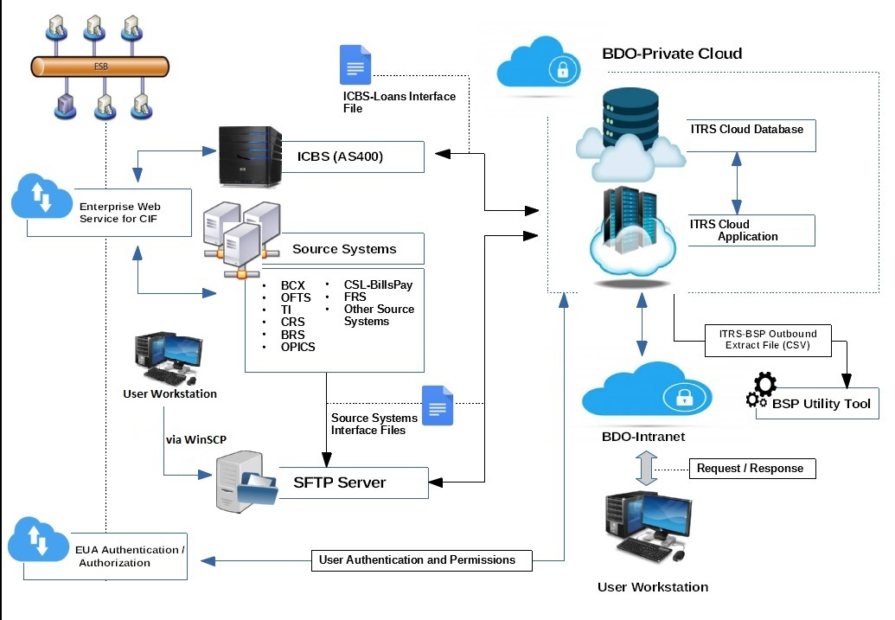
Architecture Diagram
Notes:
*not sure if should be under OE

Slide 8
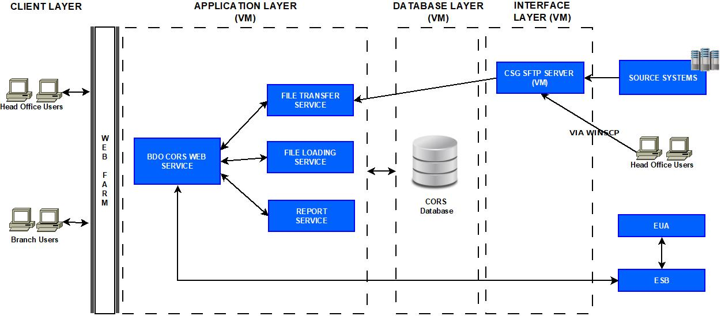
Application Stack Diagram
Notes:
*not sure if should be under OE

Slide 9
Performance Test Results
SDLC Phase | Actual Results | BU’s accepted performance
Loading
FRS_ITRS.csv | Less than 5 minutes with 90,000 records | < 45 mins
Generation of ITRS csv file
ITRS CSV | Less than 15 minutes with 150,000 records | < 1 hour
Report Generation
ITRS schedule report (ITRS format) | Less than 15 minutes with 150,000 records | < 15 minutes
ITRS main report (ITRS format) | Less than 15 minutes with 150,000 records

Slide 10
Schedule
SDLC Phase | Start Date | End Date
Phase 1
Initiation/Requirements Analysis | 05/08/2018 | 07/23/2018
Design/Construction | 07/11/2018 | 08/29/2018
SIT | 08/29/2018 | 09/13/2018
UAT | 09/19/2018 | 10/16/2018
Implementation | 10/16/2018 | 10/30/2018
Phase 2
Initiation/Requirements Analysis | 07/19/2018 | 08/30/2018
Design/Construction | 09/19/2018 | 10/22/2018
SIT | 10/22/2018 | 11/07/2018
UAT | 11/07/2018 | 12/19/2018
Implementation | 12/20/2018 | 12/28/2018

Slide 11
Deployment Summary
Phase 1 Set-Up
Microservices architecture
Production Deployment on separate VM for application and database
Use of CSG SFTP via WINSCP from designated users’ workstations
Use of Web Farm
Next Challenges
Microservices designed to make use of S3 for file storage and retrieval
Production deployment on Kubernetes
Source Systems to make use of CSG SFTP
Use of CSG Web Farm

Slide 12
Links
VA Scan
Installation Guide

Slide 13
Thank you

