Slide 1
Exploring Youth Drug Use: Best Predictors and Differences between Substances
Tyler Franck

Slide 2
Introduction
Explore youth drug use using a filtered version of the 2023 National Survey on Drug Use and Health
The data includes:
For alcohol, marijuana, and cigarettes:
frequency of use over the last year/month
age of first use
have/have not used ever
imputed categories for drug frequency (e.g. 1-2 days, 3-5 days, 6-10 days)
Basic demographics like sex, race, household income
Youth-specific demographics like parental presence in the household and school attendance
We will use tree-based methods (decision tree, bagging, random forests, and boosting) to try to answer the following question: Which demographic, behavioral, and social factors best predict ongoing drug usage, and do these predictors differ for alcohol, marijuana, and cigarettes?
We will use substance usage in the past month to measure “ongoing” drug usage

Slide 3
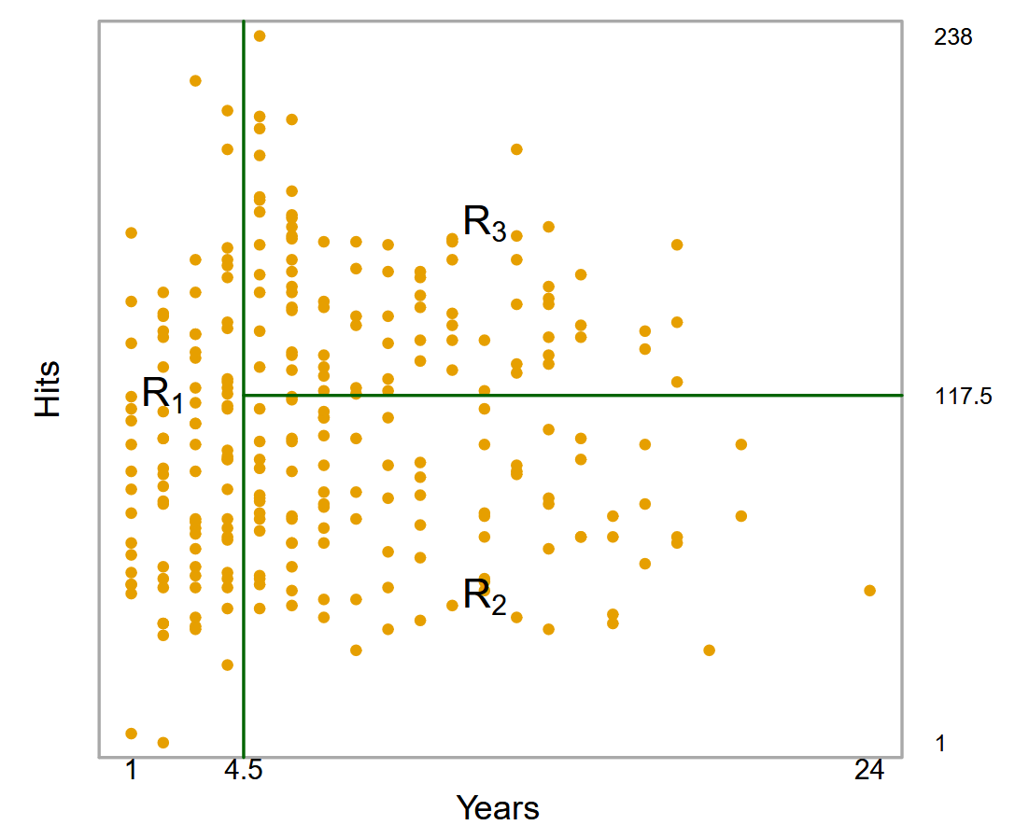
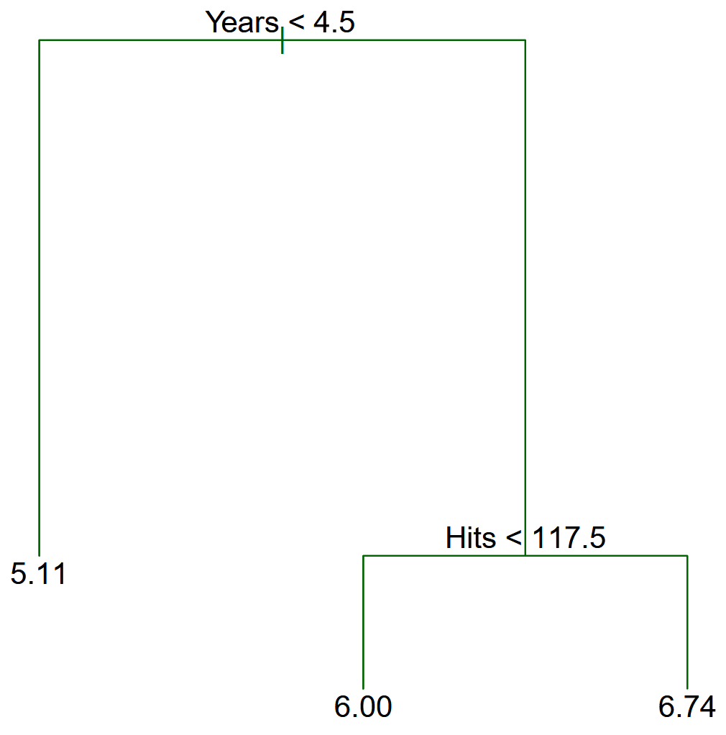
Theoretical Background (Decision Trees)
Decision trees work by partitioning the predictor space into simple, rectangular regions and making predictions using some aggregate of the training observations in the corresponding region
They are called decision tree methods because the splitting rules can be represented with a tree structure

Slide 4
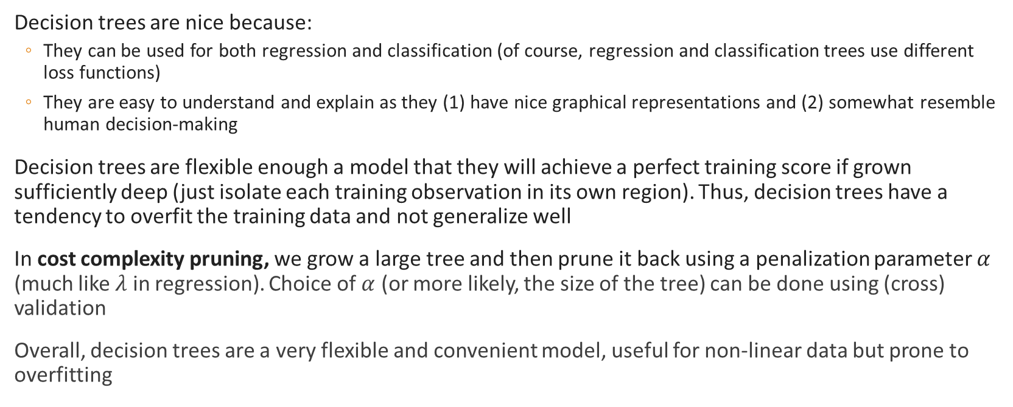
Theoretical Background (Decision Trees)
Decision trees are nice because:
They can be used for both regression and classification (of course, regression and classification trees use different loss functions)
They are easy to understand and explain as they (1) have nice graphical representations and (2) somewhat resemble human decision-making
Decision trees are flexible enough a model that they will achieve a perfect training score if grown sufficiently deep (just isolate each training observation in its own region). Thus, decision trees have a tendency to overfit the training data and not generalize well
In cost complexity pruning, we grow a large tree and then prune it back using a penalization parameter $α$ (much like $λ$ in regression). Choice of $α$ (or more likely, the size of the tree) can be done using (cross) validation
Overall, decision trees are a very flexible and convenient model, useful for non-linear data but prone to overfitting

Slide 5
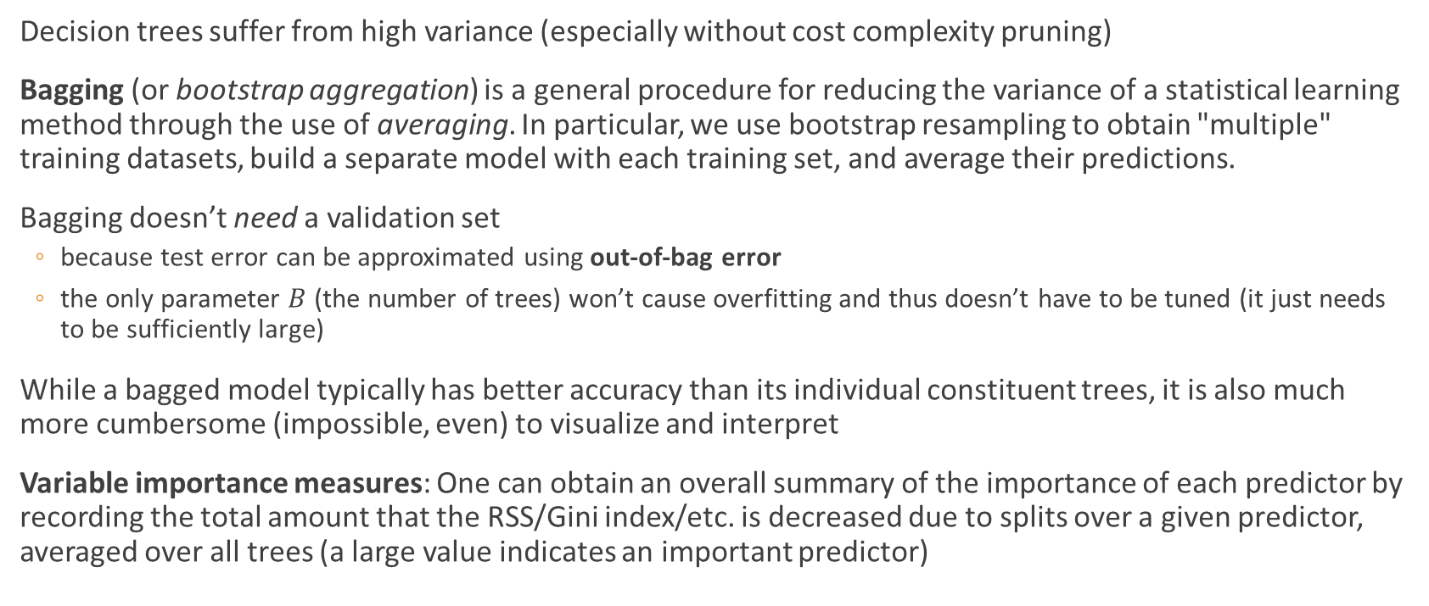
Theoretical Background (Bagging)
Decision trees suffer from high variance (especially without cost complexity pruning)
Bagging (or bootstrap aggregation) is a general procedure for reducing the variance of a statistical learning method through the use of averaging. In particular, we use bootstrap resampling to obtain "multiple" training datasets, build a separate model with each training set, and average their predictions.
Bagging doesn’t need a validation set
because test error can be approximated using out-of-bag error
the only parameter $B$ (the number of trees) won’t cause overfitting and thus doesn’t have to be tuned (it just needs to be sufficiently large)
While a bagged model typically has better accuracy than its individual constituent trees, it is also much more cumbersome (impossible, even) to visualize and interpret
Variable importance measures: One can obtain an overall summary of the importance of each predictor by recording the total amount that the RSS/Gini index/etc. is decreased due to splits over a given predictor, averaged over all trees (a large value indicates an important predictor)

Slide 6
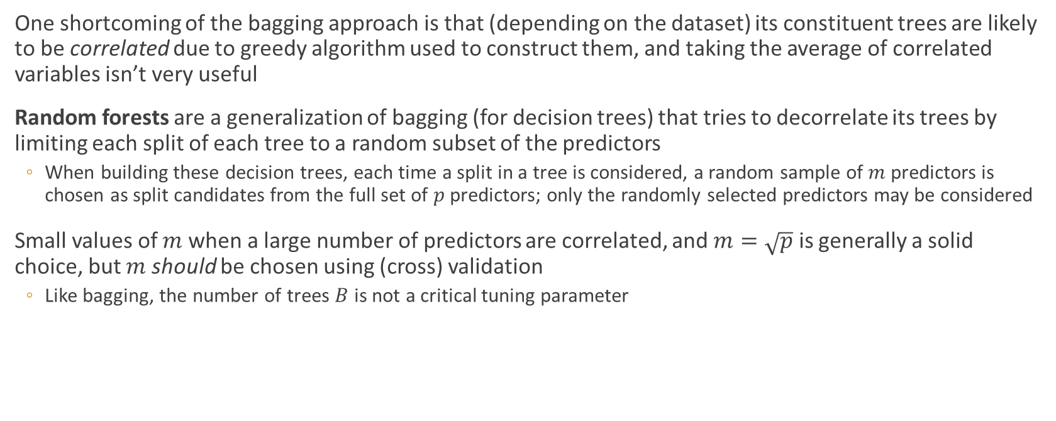
Theoretical Background (Random Forest)
One shortcoming of the bagging approach is that (depending on the dataset) its constituent trees are likely to be correlated due to greedy algorithm used to construct them, and taking the average of correlated variables isn’t very useful
Random forests are a generalization of bagging (for decision trees) that tries to decorrelate its trees by limiting each split of each tree to a random subset of the predictors
When building these decision trees, each time a split in a tree is considered, a random sample of $m$ predictors is chosen as split candidates from the full set of $p$ predictors; only the randomly selected predictors may be considered
Small values of $m$ when a large number of predictors are correlated, and $m=\sqrt{p}$ is generally a solid choice, but $m$ should be chosen using (cross) validation
Like bagging, the number of trees $B$ is not a critical tuning parameter

Slide 7
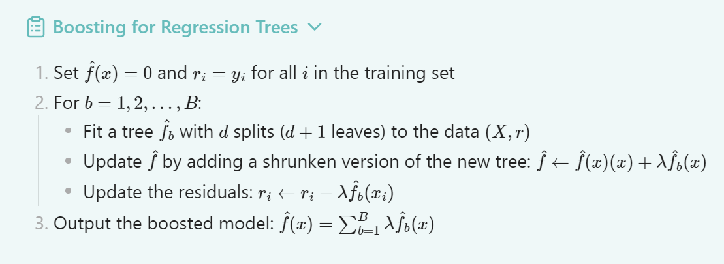
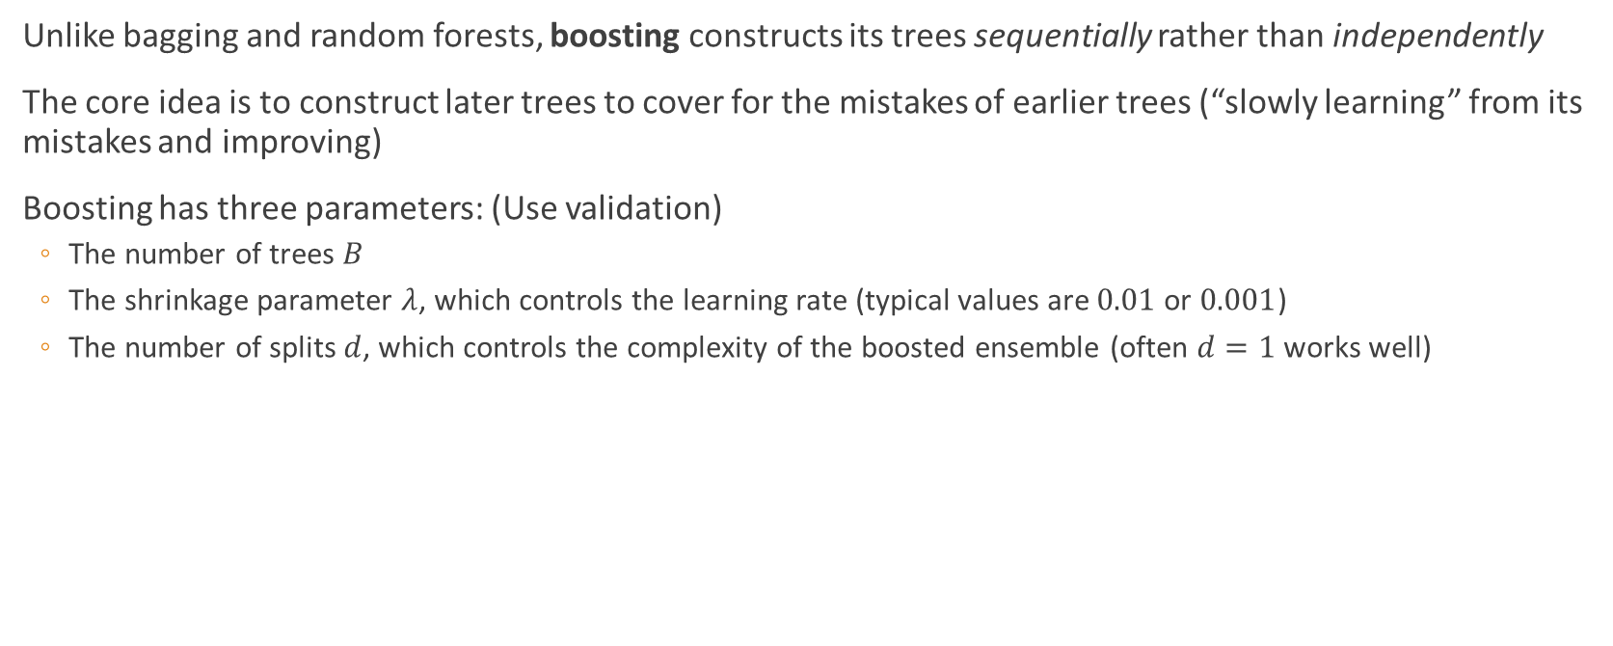
Theoretical Background (Boosting)
Unlike bagging and random forests, boosting constructs its trees sequentially rather than independently
The core idea is to construct later trees to cover for the mistakes of earlier trees (“slowly learning” from its mistakes and improving)
Boosting has three parameters: (Use validation)
The number of trees $B$
The shrinkage parameter $λ$, which controls the learning rate (typical values are $0.01$ or $0.001$)
The number of splits $d$, which controls the complexity of the boosted ensemble (often $d=1$ works well)

Slide 8
Methodology
There are three sections of analysis, one for each substance: alcohol (binary), marijuana (multi-class), and cigarette (regression)
For each substance, we use the demographic and youth question columns to try to predict the monthly substance usage using (1) a decision tree and (2) one of the ensemble methods:
Gather the predictors and response variables and split the dataset into a training and test set (75-25 split)
Fit a decision tree, visualize it, and measure its performance on the test set. See if pruning helps. Gather what we can about predictor importance.
Train ensemble method on training set (using the test set as validation for parameter tuning), evaluate model performance, and use variable important/relative influence to judge predictor importance

Slide 9

Alcohol (Binary)
$\text{IRALCFM}$ indicates frequency of alcohol consumption in past month
Created a binary variable indicating whether they used alcohol in the last month by checking whether $\text{IRALCFM}\text{<91}$
The decision tree just predicted the most common response (no alcohol)
The bagged model did a better job at identifying alcohol users

Slide 10
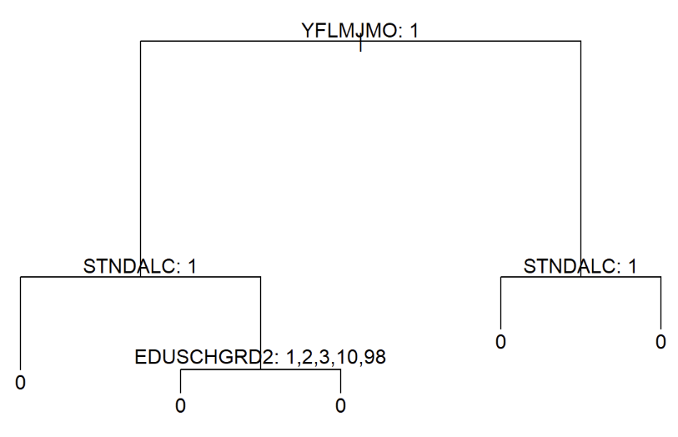
Alcohol (Decision Tree)

Slide 11

Alcohol (Bagging)
Dropped rows with missing values since
Importance plots identified the following predictors as potentially useful:
$\text{YFLMJMO}$: How youth feels about peer marijuana usage
$\text{STNDALC}$: Peer alcohol consumption
$\text{INCOME}$: Family income

Slide 12
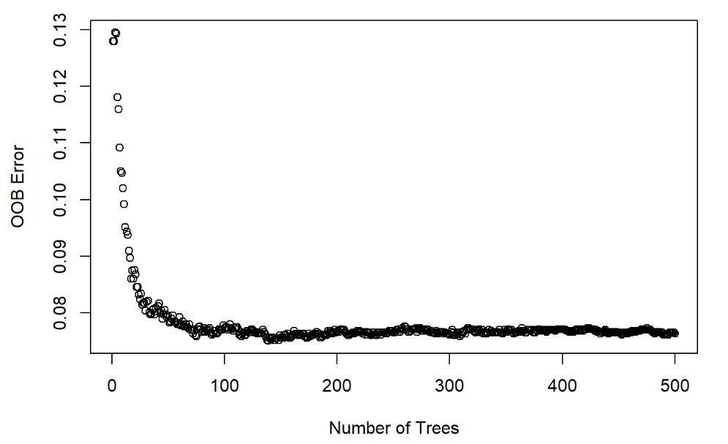
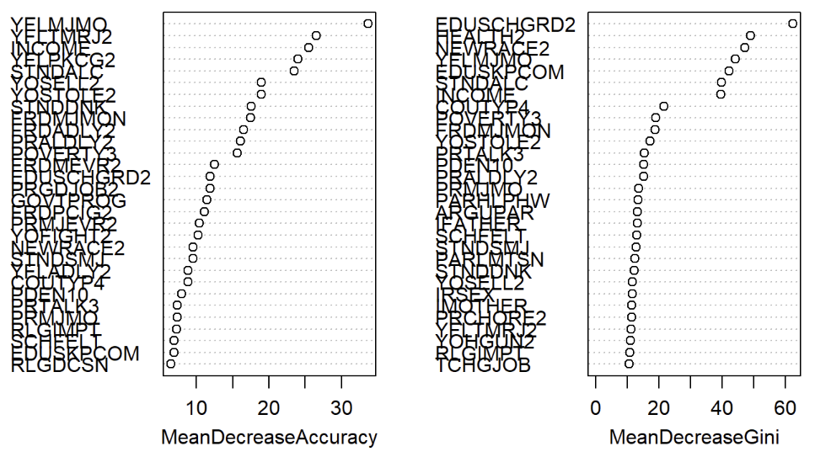
Alcohol (Bagging)

Slide 13

Marijuana (Multi-class)
$\text{MRJMDAYS}$ indicates marijuana frequency in last month (1=1-2, 2=3-5, 3=6-19, 4=20-30, 5=none)
Changed the “none” value so that ordering made sense
Decision tree and Random Forest performed slightly better than null models

Slide 14
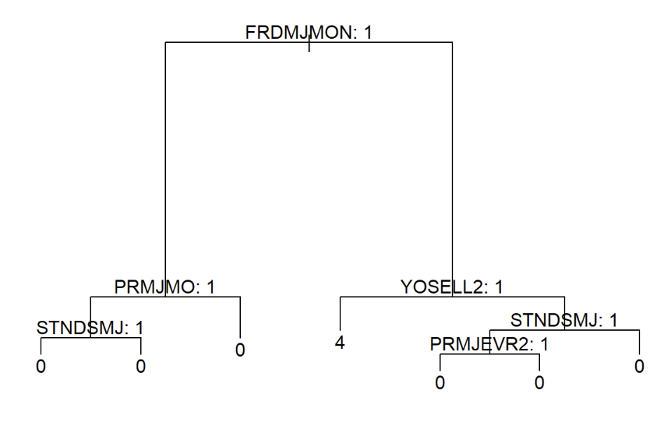
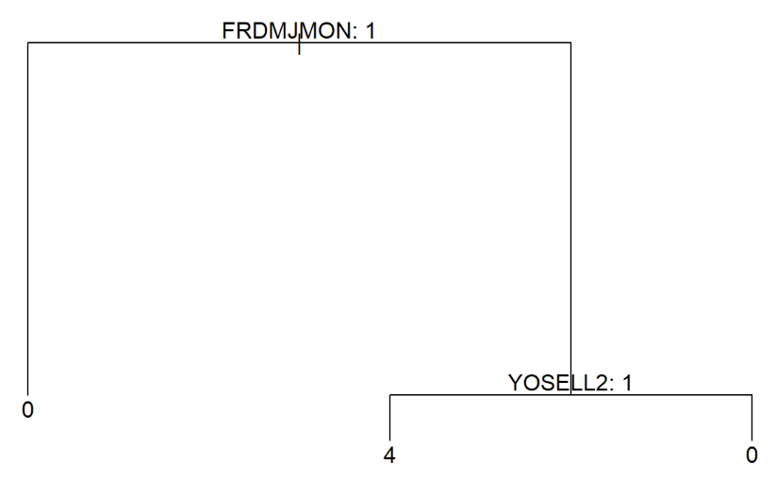
Marijuana (Decision Tree)
Pruned and unpruned same predictions

Slide 15
Marijuana (Decision Tree)
FRDMJMON: how close friends feel about marijuana
YOSELL2: whether youth sells illegal drugs

Slide 16
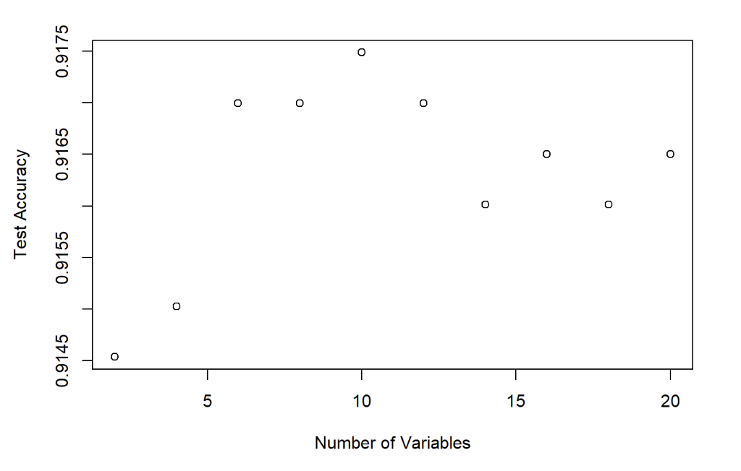

Marijuana (Random Forest)
Again, had to drop rows with missing values
Used validation scores to tune $m$ (tried values up to $p/3$)

Slide 17
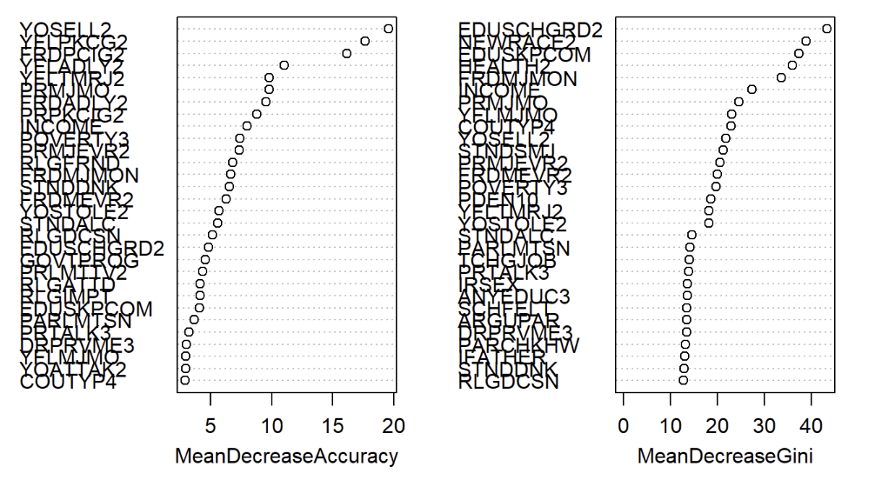
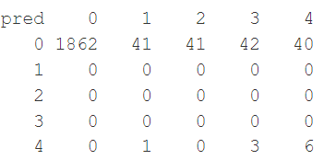

Marijuana (Random Forest)
Random forest with $m=10$ beat base-line test accuracy by about 0.003, the advantage coming from being able to correctly identify high marijuana users

Slide 18
Marijuana (Random Forest)
Some promising predictors are:
YOSELL2: Whether youth has sold illegal drugs
INCOME: Family income
IFATHER: Whether father is in household
PRMJMO/PRMJEVR2: How (youth thinks) parents would feel about them using/trying marijuana

Slide 19
Cigarette (Regression)
IRCIGFM the number of days used in past month
Changed the none values to 0 (times)
Decision tree performed significantly better than null model
Boosted model only performed equal to the null model

Slide 20
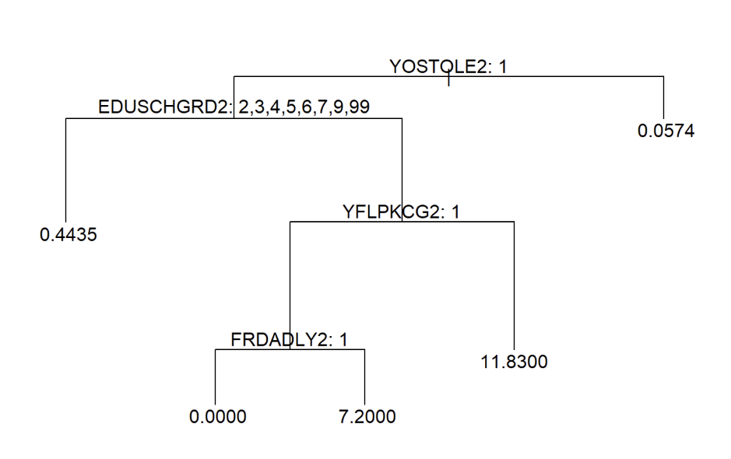
Cigarette (Decision Tree)
Base-line MSE: 0.278
Decision Tree MSE: 0.078

Slide 21
Cigarette (Decision Tree)
YOSTOLE2: Youth stole or tried to steal and item more expensive than $50
EDUSCHGRD2: Current grade
YFLPKCG2: How youth feels about peers smoking
FRDADLY2: How youth feels about friends drinking daily

Slide 22

Cigarette (Boosting)
Performed grid search (using test set to validate) over:
$B∈\left\{100, 500, 1000\right\}$
$d∈\left\{0, 1\right\}$
$λ∈\left\{0.1, 0.01, 0.001\right\}$
Results were disappointing

Slide 23
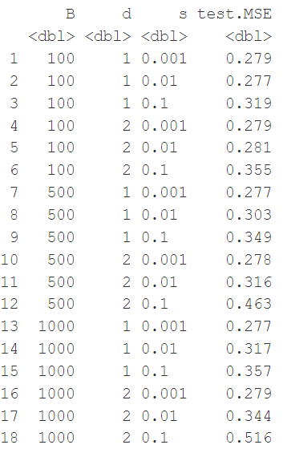

Slide 24
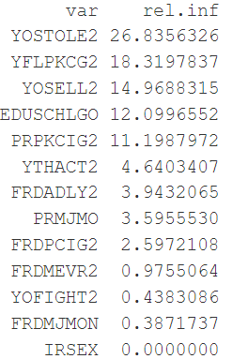
Cigarette (Boosting)
Nevertheless, we can still look at the relative influence
Predictors to consider: (Some overlap with decision tree)
YOSTOLE2: Youth stole or tried to steal and item more expensive than $50
YFLPKCG2: How youth feels about peers smoking
YOSELL2: Has youth sold illegal drugs
EDUSCHLGO: Is the youth going to school
PRPKCIG2: How youth thinks parents would feel about them smoking 1+ pack a day

Slide 25
Conclusions
Alcohol binary classification was mostly a wash, perhaps identifying a correlation with peer alcohol consumption, family income, and thoughts about marijuana
Marijuana multi-class classification was stronger, perhaps identifying a correlation with whether youth has sold illegal drugs, family income, father availability in the household, and how youth thinks their parents would feel them using marijuana
Cigarette regression was the strongest, identifying a correlation with whether youth stole or tried to steal and item more expensive than $50, whether youth sold illegal drugs, their current grade, how youth feels about peers smoking/drinking, and how youth thinks their parents would feel about them smoking 1+ pack a day
Throughline: Other substance usage/interaction, peer usage, parental attitude towards substance usage, and perhaps family income

