Slide 1

HEART DISEASE DATASET ANALYSIS
PRESENTED BY: AISWARYA SEN
GNUMBER: G01388802

Slide 2
OVERVIEW
INTRODUCTION : DATASET INFORMATION, NOIR ANALYSIS & RESEARCH QUESTIONS
DATA CLEANING AND PREPROCESSING
DATA ANALYSIS : VISUALIZATION
DATA MODEL,CLUSTERING,NLP ANALYSIS
CONCLUSION AND FUTURE WORK

Slide 3

INTRODUCTION
DATASET INFORMATION
RESEARCH QUESTIONS
RELEVANT RESEARCH ARTICLES
NOIR ANALYSIS

Slide 4

DATASET SELECTED FOR ANALYSIS:
HEART DISEASE
DATASET INFORMATION
The file describes the contents of the heart-disease directory.
The directory contains 4 databases concerning heart disease diagnosis.
This database contains 76 numeric-valued attributes, but all published experiments refer to using a subset of 14 of them.
Experiments with the Cleveland database have concentrated on simply attempting to distinguish presence (values 1,2,3,4) from absence (value 0) of heart disease.
The "goal" field refers to the presence of heart disease in the patient. It is integer valued from 0 (no presence) to 4.
WHY?
Notes:
The heart is an extremely complex organ with a challenging role to play in keeping us alive.
It is so frequent that every 40 seconds at least one person will have heart attack and every minute at least one person dies out of heart failure conditions. A prompt diagnosis, prompt therapy, and ongoing monitoring are necessary for patients with heart disease.
I am interested in the medical field and health science domain because of which I have opted for this dataset.
Detecting patterns using these datasets would give an upper hand to the health care practices to better provide services to the world.
This aspect excites me as a software engineer where I can contribute to the betterment of health care by applying machine learning paradigms.

Slide 5
SL NO: | ATTRIBUTE | DESCRIPTION
1 | age | Age of the patients in years.
2 | sex | Gender of the patient. [ Female: 0 and Male:1]
3 | cp | Chest pain type experienced by the patients. 1: Typical angina: chest pain related decrease blood supply to the heart 2: Atypical angina: chest pain not related to heart 3: Non-angina pain: typically, esophageal spasms (non-heart related) 4: Asymptomatic: chest pain not showing signs of disease
4 | trestbps | Resting Blood pressure. ((in mm Hg on admission to the hospital)
5 | chol | serum cholesterol in mg/dl
6 | fbs | Fasting blood sugar > 120 mg/dl (1 = true; 0 = false)
THE 14 ATTRIBUTES USED IN THE DATASET WITH DESCRIPTION

Slide 6
SL NO: | ATTRIBUTE | DESCRIPTION
7 | restecg | Resting electrocardiographic result. Value 0: normal Value 1: having ST-T wave Value 2: Left ventricular hypertrophy
8 | thalach | Maximum heart rate achieved
9 | exang | Exercise induced angina (1 = yes; 0 = no)
10 | old peak | ST depression induced by exercise relative to rest
11 | slope | The slope of the peak exercise ST segment Up sloping: better heart rate with exercise (uncommon) Flat sloping: minimal change (typical healthy heart) Down sloping: signs of unhealthy heart
THE 14 ATTRIBUTES USED IN THE DATASET WITH DESCRIPTION

Slide 7
SL NO: | ATTRIBUTE | DESCRIPTION
12 | ca | Number of major vessels (0-3) colored by fluoroscopy
13 | thal | Thallium stress 3: normal 6: fixed defect 7: reversible defect
14 | Num (TARGET) | Diagnosis of heart disease (angiographic disease status) Value 0: < 50% diameter narrowing Value 1: > 50% diameter narrowing
THE 14 ATTRIBUTES USED IN THE DATASET WITH DESCRIPTION
Notes:
A thallium stress test is a nuclear medicine study that shows your physician how well blood flows through your heart muscle while you're exercising or at rest.

Slide 8

MY RESEARCH QUESTIONS
RELEVANT RESEARCH PAPERS ON THIS DATASET
How has gender and age affected the patterns of heart disease occurrence in patient for the past few years?
What are the most effective factors in determining the presence of heart diseases in a patient?
How much physical activity needs to be stimulated in the patients to detect the heart disease in patients?
Prediction of Heart Disease Using a Combination of Machine Learning and Deep Learning
A novel approach for heart disease prediction using strength scores with significant predictors
Improving Heart Disease Prediction Using Feature Selection Approaches
These three research papers help in confirming my research questions on the heart disease dataset.
These papers have discussed on the effective factors that contribute to the presence of heart disease.
By doing a study on heart disease dataset, helps in categorizing symptoms related to heart disease and other illness.

Slide 9
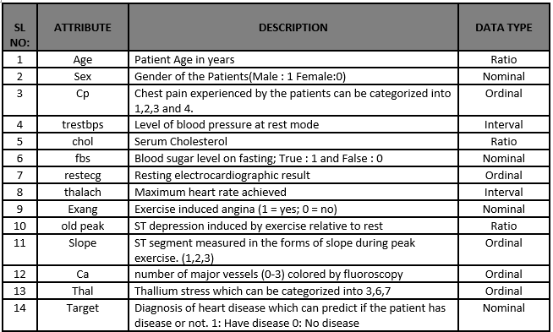
CATEGORICAL DATA TYPE:
Sex
Fbs
Exang
Target
Cp
Restecg
Slope
Ca
thal
CONTINUOUS DATA TYPE:
Age
Trestbps
Chol
Thalach
old peak
NOIR ANALYSIS

Slide 10

DATA CLEANING AND PREPROCESSING
IMPORT DATASET
CHECK FOR DATA MISTAKES
CHECK FOR DATA TYPES
CHECK FOR DUPLICATE ROWS
STATISTICAL SUMMARY

Slide 11
TOOLS AND LANGUAGE USED FOR ANALYSIS:
PYTHON
GOOGLE COLAB
Imported the dataset to start with the analysis.
Created a dataframe
The csv file did not contain a header list. Therefore, I have included the data frame with header list.
I changed the attribute values(string) for easier understanding prior to beginning the categorical attribute plotting.
Before cleaning, the dataset had 302 rows and 14 attributes (columns).
In order to confirm the error data,I have examined the distinct values for each column to look for any data errors in the dataset.
Which made it easier to comprehend that two columns named "ca" and "thal" contain "?" incorrect data. To provide better findings and forecasts, this was eliminated from the data.
I have changed the "?" to a null value in order to eliminate the character.
Data cleaning & preprocessing done on the dataset

Slide 12
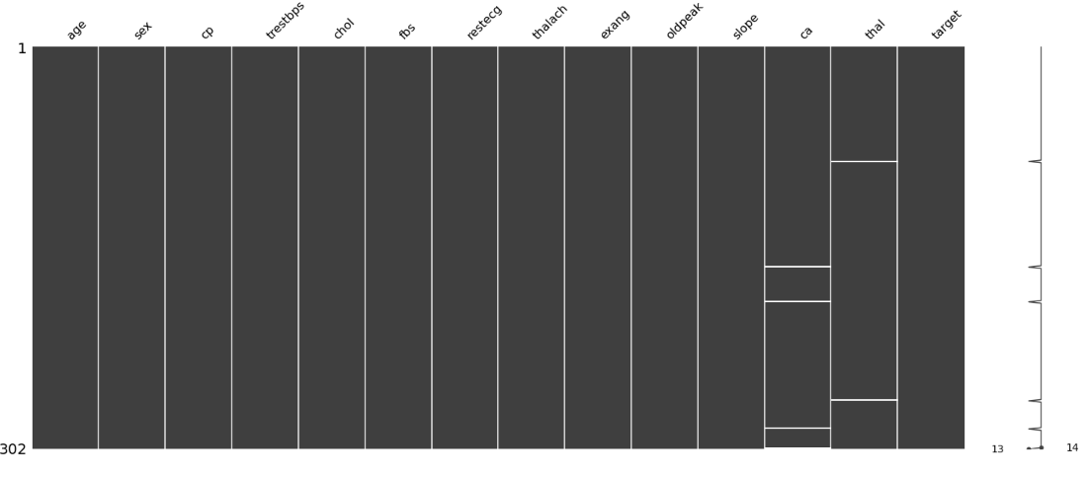
To display the values that are missing, I utilized the Missingno library. The horizontal lines represent the values that are missing. It is evident from this graph that there are six missing values.

Slide 13
All of the missing values from the dataset were successfully deleted. The dataset after cleaning contains 296 rows and 14 attributes (columns).
DATA TYPES:
The data types in the dataset are validated. Most of the columns are given as float data types. Only the "Old Peak" column in the dataset is in float data type, while the rest are in integer data type.
CHECK FOR DUPLICATES:
There were no duplicates available in the dataset.
TARGET ATTRIBUTE:
The target attribute, num, is specified as follows in the dataset:
Num: diagnosis of heart disease (Angiographic disease status) Value 0: < 50% diameter narrowing and Value 1: > 50% diameter narrowing
In the given dataset we have 0,1,2,3,4 values. For the better understanding and data visualization I have replaced the values 2,3,4 as 1. 1: defines people with heart disease 0: defines people without heart disease.
DATA TYPES , DUPLICATES AND TARGET ATTRIBUTE

Slide 14
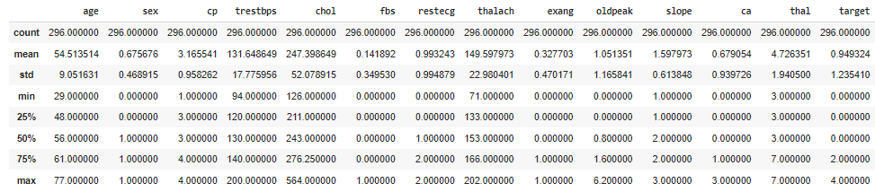
STATISTICAL SUMMARY
This helps in understanding the general statistical study of the dataset. This contains count - The number of not-empty values, mean - The average (mean) value, std - The standard deviation, min - the minimum value, 25% - The 25% percentile*, 50% - The 50% percentile*, 75% - The 75% percentile*, max - the maximum value.

Slide 15

DATA ANALYSIS : VISUALIZATION
MAIN ATTRIBUTES ANALYSIS
CORRELATION MATRIX
RELATIONSHIP PLOT
PAIR PLOT AND SCATTER PLOT
DISTRIBUTION AND HISTOGRAM PLOTS
COMPARING TWO ATTRIBUTES AGAINST ONE ATTRIBUTE

Slide 16
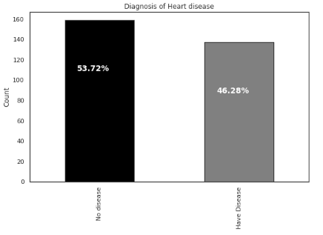
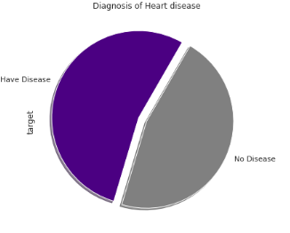
TARGET ANALYSIS
The dataset is balanced with 53.72% individuals without heart disease and 46.28% with heart disease.

Slide 17
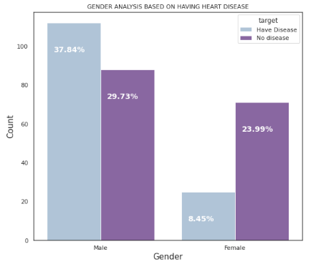
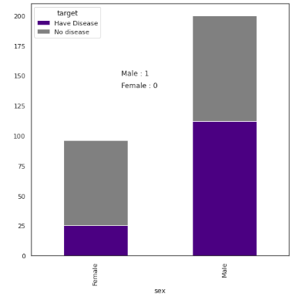
GENDER ANALYSIS
The dataset reveals that male patients with diseases outnumber female patients.

Slide 18
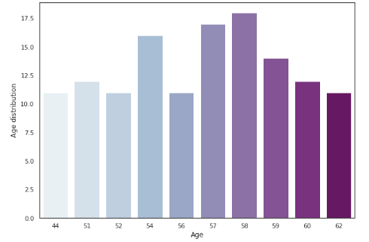
The majority of the patients are in their fifties and sixties.
The mean age is about 54 years;
Min age : 29 years
Max age : 77 years
AGE ANALYSIS

Slide 19
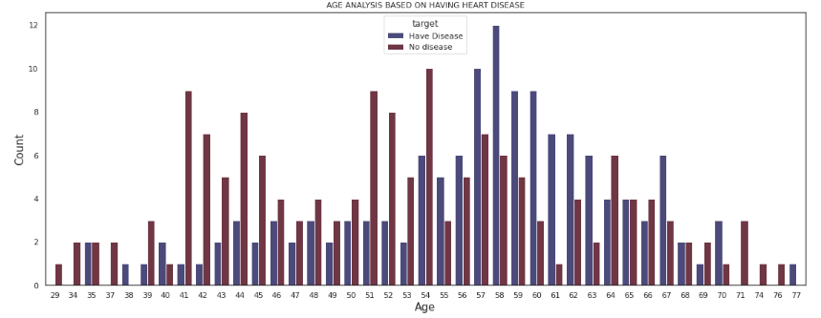
It is obvious from this graph that the individuals in their fifties and sixties are heart disease sufferers. People who are 58 years old or older in this dataset have heart disease.

Slide 20
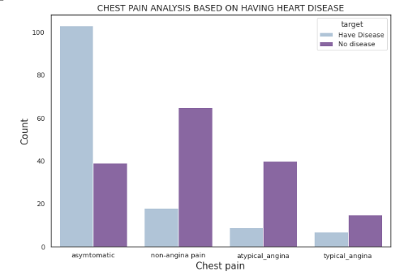
Stress, physical activity, and many other factors can cause chest pain, which differs between genders.
The bar graph above shows that a greater proportion of healthy participants are experiencing non-angina chest pain.
This graph demonstrates that the sample contains a higher percentage of individuals with asymptomatic chest discomfort.
Silent (asymptomatic) myocardial ischemia is a transient alteration in myocardial perfusion without chest pain or the normal symptoms of angina (SMI).
CHEST PAIN TYPE ANALYSIS

Slide 21
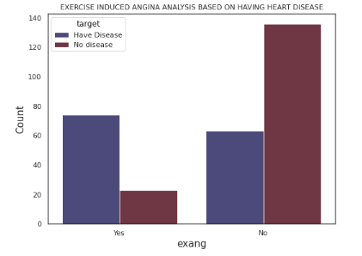
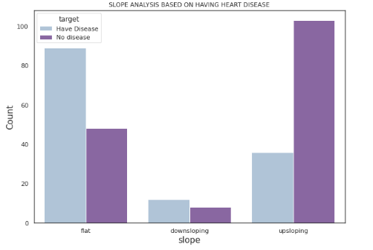
It is obvious from the first graph that those with heart disease are the ones who experience discomfort after engaging in strenuous exercise. We can deduce from the second graph that the healthy individuals will have an upward-sloping graph. (A higher heart rate following activity)

Slide 22
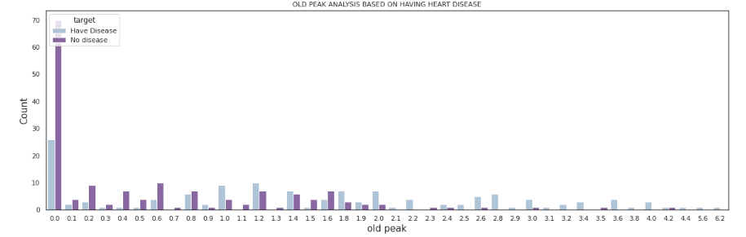
Old peak: ST depression induced by exercise relative to rest looks at stress of heart during exercise. A heart that isn't healthy will stress more. From this graph, we can see the old peak = 1.2 has the more chance of having disease.
The attributes like exang, slope and old peak assist us in identifying individuals who have heart disease by requiring them to engage in physical activity.
OLD PEAK ANALYSIS

Slide 23
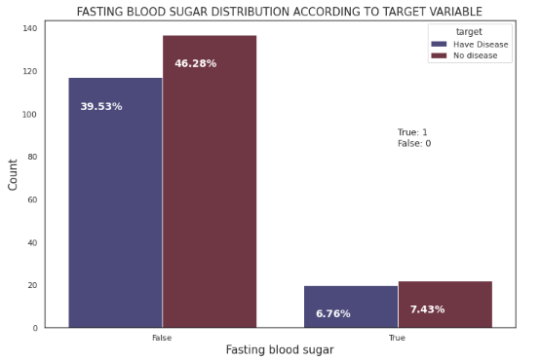
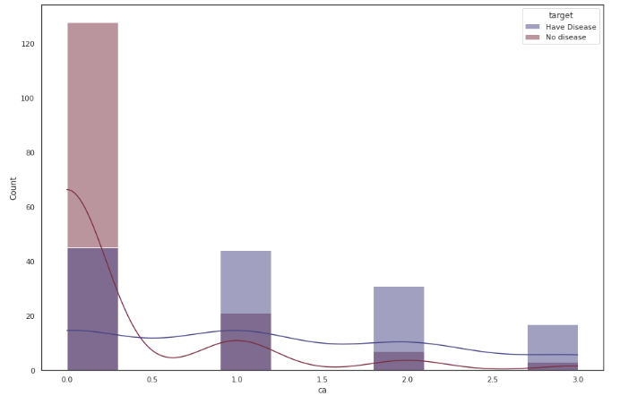
FBS AND CA WITH RESPECT TO TARGET
Notes:
FBS: Here, we observe that the number for class true, is lower compared to class false. However, if we look closely, there are lower number of heart disease patient without diabetes.
This provide an indication that fbs might not be a strong feature differentiating between heart disease and non-disease patient.
ca: number of major vessels (0-3) colored by fluoroscopy —> When the value 0 there is no heart disease patients.

Slide 24
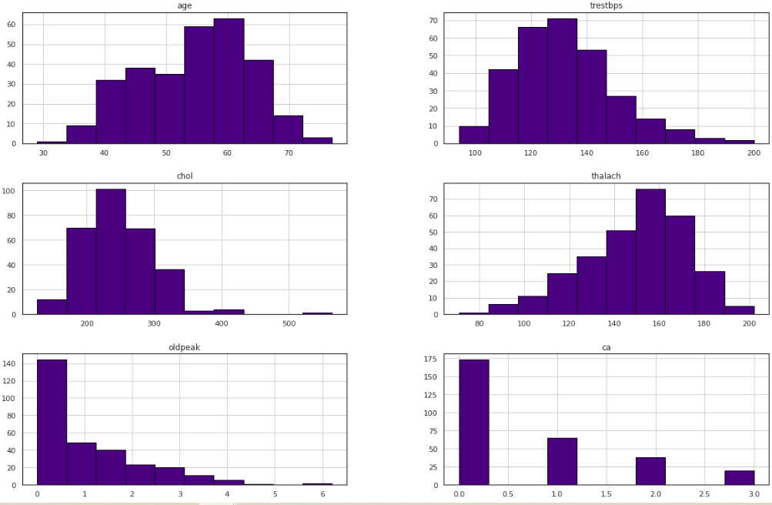
DISTRIBUTION PLOTS
Notes:
By contrasting the empirical distribution of the data with the theoretical values anticipated from a certain distribution, distribution plots provide a visual assessment of the distribution of sample data.
normal distribution: age, trestbps left skewed: old peak, chol right skewed: thalach

Slide 25
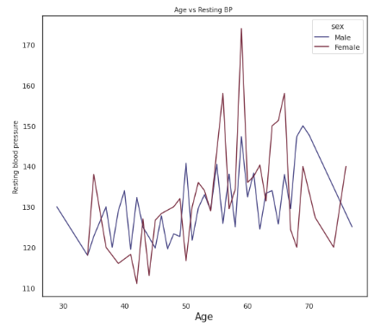
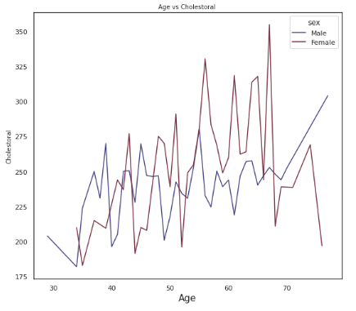
COMPARISON BETWEEN TWO ATTRIBUTES WITH RESPECT TO TARGET
Notes:
AGE VS RESTING BP: Resting blood pressure rises with age, and this dataset shows that resting blood pressure rises dramatically in women.
AGE VS CHOLESTEROL: As people get older, their cholesterol levels rise. Women are more likely to be affected than men.

Slide 26
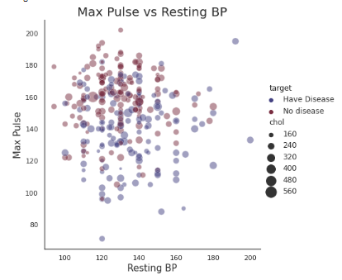
RELATIONSHIP PLOT
Relationship plot demonstrates the variation of max pulse (thalach) with respect to resting bp.
size of circle: cholesterol
This graph shows how the maximum pulse varies with resting blood pressure and what the cholesterol value is for each data point.
Even with lower resting blood pressure, the maximum pulse is very high, and the majority of people in this group have heart disease.
People can have heart disease even when their resting blood pressure is low and their maximum pulse is high.

Slide 27
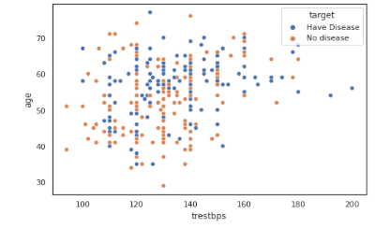
SCATTER PLOT AND PAIR PLOT
PAIR PLOT:
To Plot pairwise relationships in a dataset
Sns pairplot to visualize the distribution.
Oldpeak having a linear separation relation between disease and non-disease.
thalach having a mild separation relation between disease and non-disease.
Other features don’t form any clear separation
This graph shows that people between the ages of 50 and 60 who have high resting blood pressure are more likely to have heart disease.

Slide 28
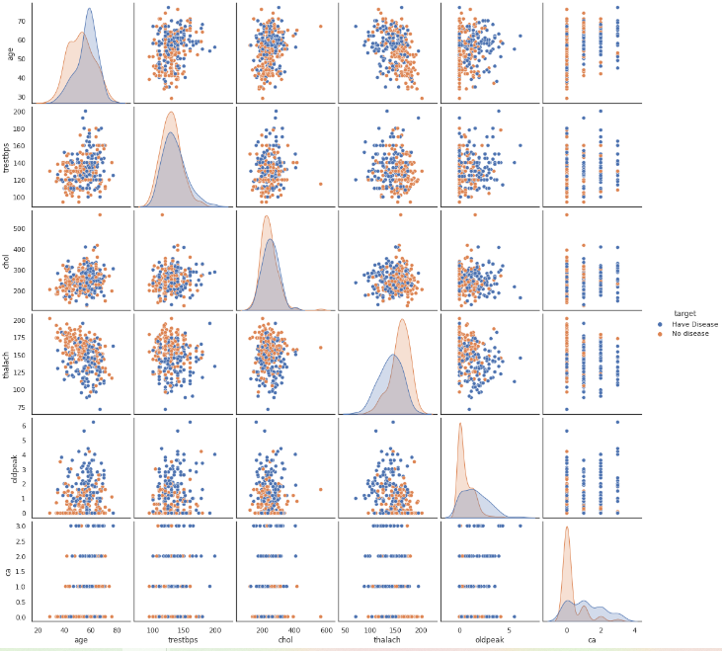
PAIR PLOT

Slide 29
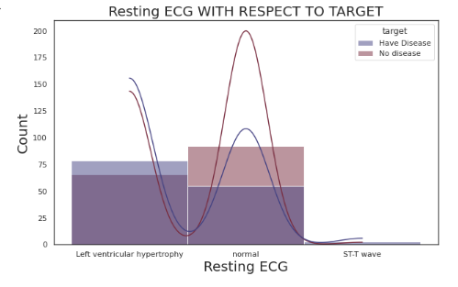
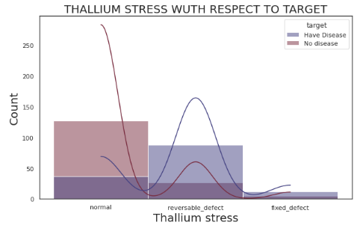
HISTOGRAM PLOTS
Notes:
In the first grah we can see that three values are there 0,1,2 (normal, ST-T wave and left ventricular hypertrophy
People with normal ECG are healthy people compared to that of diseased individuals.
People who have a reversible defect are more likely to have heart disease.
Histogram use: As the dataset suddenly changes, we can see how the graph changes.

Slide 30
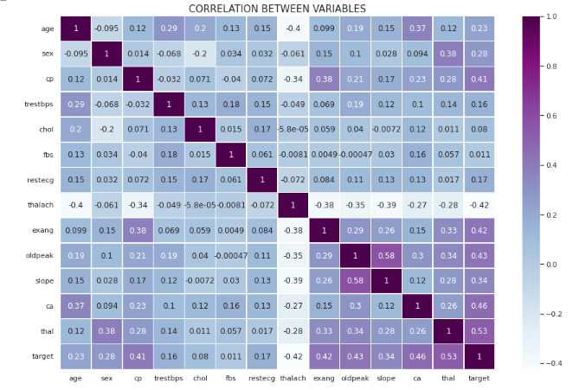
It is high positively correlated at 1.0 (top) and negatively correlated at -0.4 (bottom)
cp, exang, old peak, ca, thal, slope shows good positive correlation with target
thalach shows a good negative correlation with target
age, sex, trestbps, chol, fbs, restecg has low correlation with the target
By doing so, it is possible to identify crucial elements that may contribute to heart disease.
CORRELATION MATRIX
Notes:
corr() is used to find the pairwise correlation of all columns in the Pandas data frame in Python. The function helped me understand the correlation between target and other columns in the dataset.

Slide 31

DATA MODEL
LOGISTIC REGRESSION
KNN
CLUSTERING : K MEANS
NLP ANALYSIS

Slide 32
DATA SCALING
DATA SPLIT AND TRAINING
Scaling helps to transform the so that it fits within a specific scale, like 0-100 or 0-1. This helps the algorithm to learn the values easily.
To train the data, I have split it into test set and training set.
The algorithm will be trained to predict the target attribute.
X will be training set, so we need to drop target attribute and keep all other attributes
Y need to have target
Preferred size is given for the test data.

Slide 33
LOGISTIC REGRESSION
First I have built a logistic regression model.
Since logistic regression identifies an equation that forecasts a result for a binary variable, Y, from one or more response variables, X, it is statistically similar to linear regression.
Contrary to linear regression, the model does not strictly require continuous data, hence the response variables can be categorical or continuous.
I have created an object named logistic regression and assigned it to same name. Fitted the model into X_train and y_train.
To predict on X_test: 1547

Slide 34
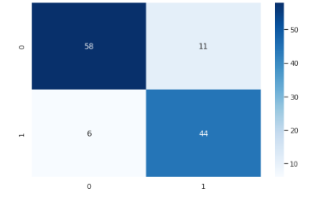
CONFUSION MATRIX
To check the accuracy, I have predicted it on y_test: 119 using a confusion matrix.
True positive: 58 values are predicted correctly by the algorithm
False positive: 11 values are incorrectly identified by the algorithm
False negative: 6 values are incorrectly rejecting for certain class
True negative: 44 certain cases are correctly rejected for certain class
The accuracy calculated here is approx. 85%.

Slide 35
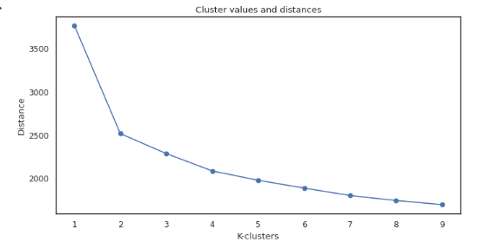
KNN
CLUSTERING
The k-nearest neighbors algorithm, sometimes referred to as KNN or k-NN, is a non-parametric, supervised learning classifier that relies on closeness to produce classifications or predictions about the grouping of a single data point
The accuracy calculated here is approx. 82%.
The best accuracy is obtained for logistic regression compared with KNN.

Slide 36
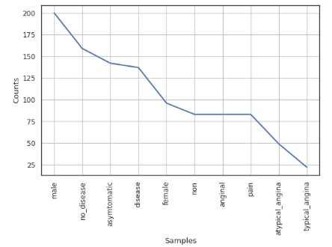
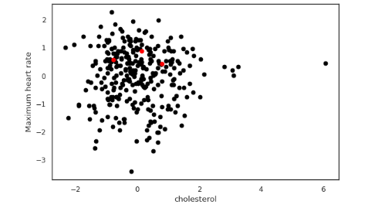
K MEANS CLUSTERING
NLP ANALYSIS
Notes:
K means: Using a scatter plot, the clusters for the data points using “Chol” for your x-axis and “thalach” for your y-axis are plotted along with centroids. The cluster centroids help us to determine the three different clusters obtained.
NLP Analysis: This graph aids in determining the frequency of words. We can also see that the dataset has a higher proportion of males than females. The dataset consists of fewer individuals with heart disease.

Slide 37

CONCLUSION AND FUTURE WORK

Slide 38
Males outnumber females in number.
In this dataset, there are more individuals without heart disease than those who do.
The data types are two: continuous (age, trestbps, chol, thalach, old peak) and categorical (sex, fbs, exang, target, cp, restecg, slope, ca, thal).
The majority of the patients are in their fifties and sixties. The mean age is about 54 years; the youngest is 29 and the oldest is 77.
According to the correlation matrix, the target is positively correlated with cp, exang, old peak, ca, thal, and slope. The target and Thalach have a significant inverse relationship. The target and age, sex, trestbps, chol, fbs, and restecg have little in common.
The dataset makes it clear that people with heart disease are the ones who feel pain following arduous activity.
There are more individuals with asymptomatic chest pain in the dataset.
Age-related increases in resting blood pressure are seen in this sample, and these increases are particularly pronounced in women.
People's cholesterol levels increase as they age. Women are more likely than men to be impacted.
KNN has an around 82% accuracy compared to a roughly 85% accuracy for logistic regression.
CONCLUSION
Notes:
My research questions were successfully completed.
Gender and age analysis : male outnumbers female patients and age 50s and 60s
By correlation matrix we can understand the main feature which helps in understanding the heart disease
By exang, old peak and slope analysis helps us in analyzing the physical activity needs to be stimulated in the patients to detect the heart disease in patients

Slide 39
LIMITATIONS:
Due to the dataset's limited size and higher proportion of healthy individuals than heart disease sufferers, I was unable to perform additional analysis on the persons with heart disease.
FUTURE WORK:
The dataset size can be expanded. The evaluation findings can be improved once more by using machine learning and numerous other optimization approaches. The data can be normalized in a variety of other ways, and the results can be compared. Additionally, there may be additional ways to incorporate heart-disease-trained ML and DL models with specific multimedia for the benefit of patients and physicians.
LIMITATIONS AND FUTURE WORK

Slide 40
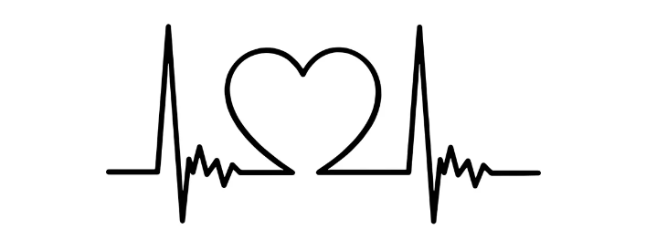
THANK YOU
Thank you for Listening!

