Slide 1
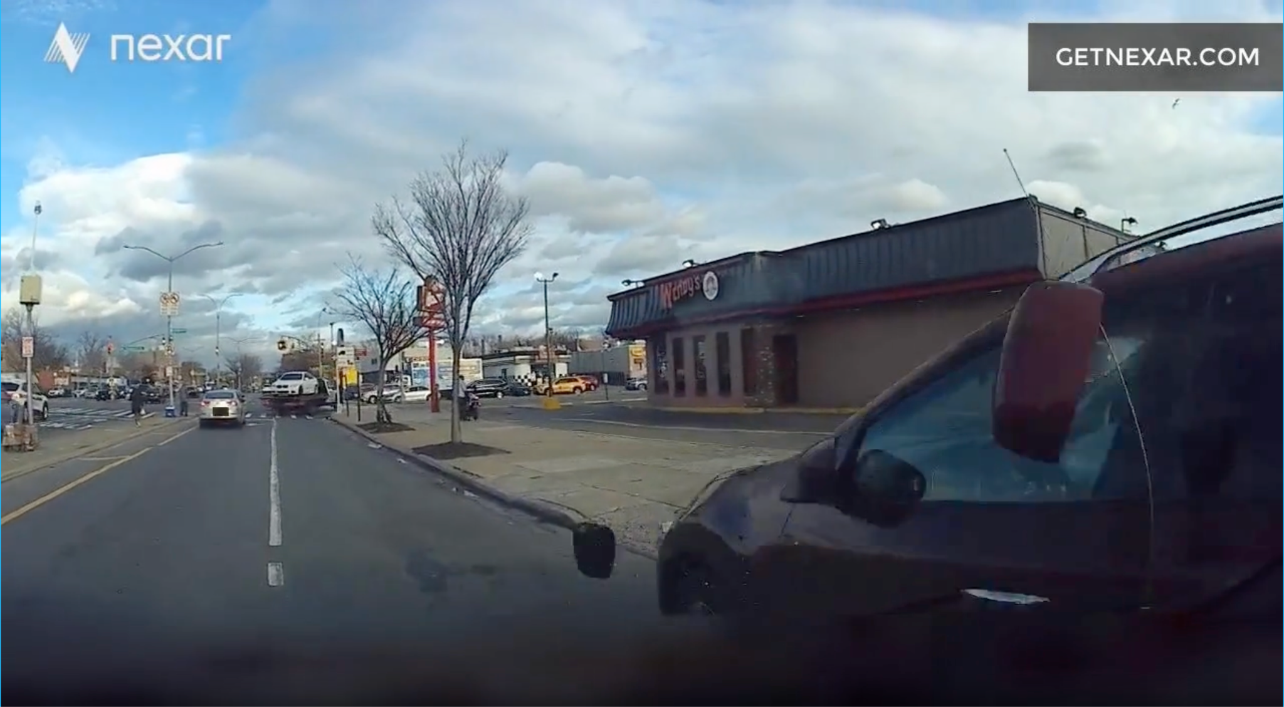
Nexar Dashcam Crash Prediction Challenge
Eleanor Madderra,
Senait Pirani,
Anastasiya Peravalava
Kaggle Competition
2025

Slide 2
Intro
We attempted a Kaggle competition
Our goal was to develop a model that could accurately predict if a dashcam video contained a vehicle collision
This could be helpful with the training of self driving cars or driver assistance systems
Notes:
Eleanor
Can expand on this and talk about why this is important and what it could be used for

Slide 3
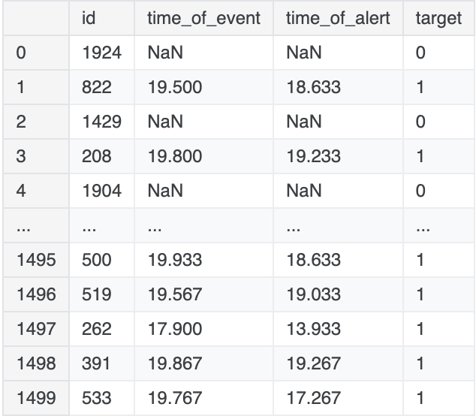
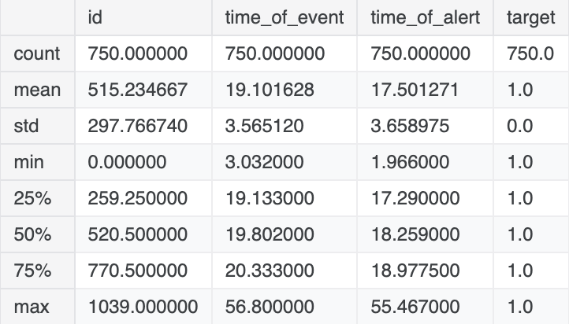
Our Training Data
Our training data contains 1,500 dashcam videos
Each video is approximately 40 seconds long
Each video is 30 frames per second
Each video has a resolution of 1280x720
Notes:
Eleanor

Slide 4
Our Training Data
Each video falls into one of two categories
  Positive: a collision occurs or nearly occurs (target = 1)
  Negative: normal driving with no incidents (target = 0)
  The training data contains 750 positive and 750 negative videos
Notes:
Eleanor

Slide 5
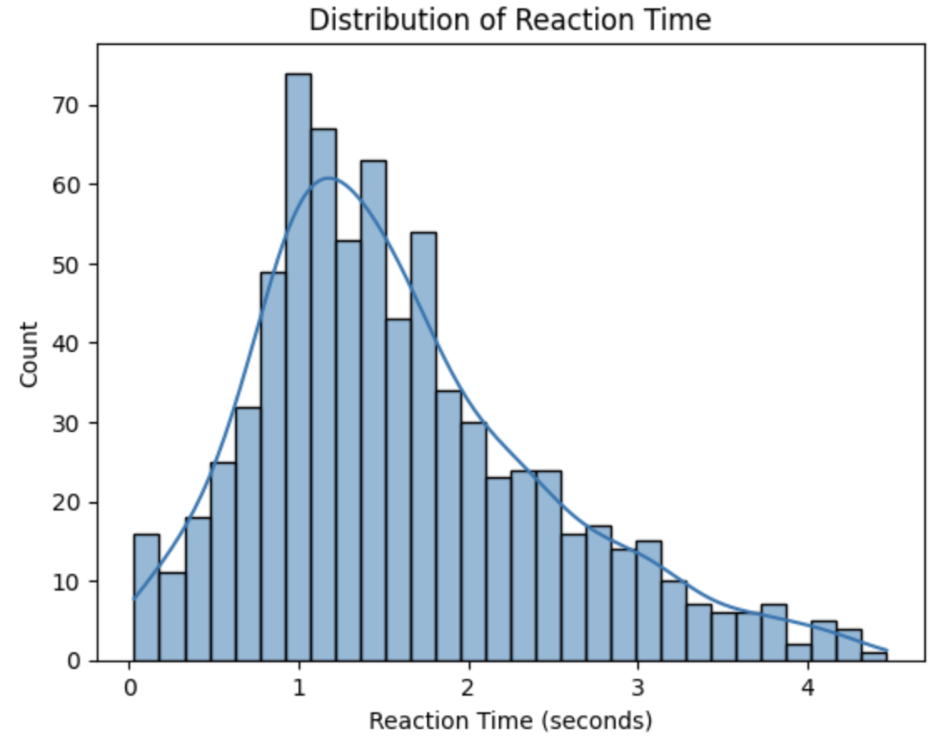
Our Training Data
For positive cases, two timestamps are provided:
  Event time: indicates when the collision or near-miss occurs
  Alert time: marks the earliest moment that action should be taken to prevent the accident
On average, there are less than 2 seconds between the earliest time of possible identification and the time of the event
Notes:
Eleanor

Slide 6
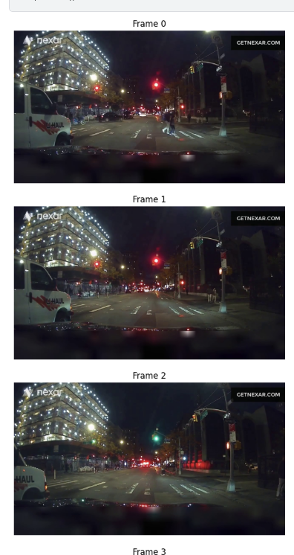
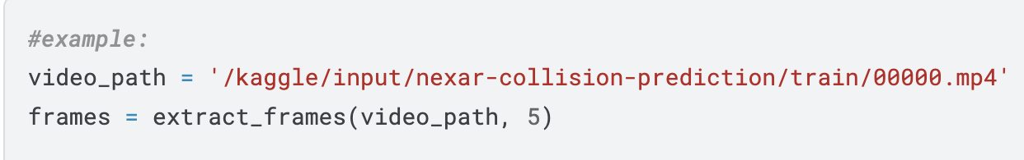
Isolate Frames
To be able to completely analyze our dashcam videos we needed to first be able to isolate each frame
We created a simple function using OpenCV that can read the video and extract frames
The function accepts the video path and the number of frames to print out
Divides the total number of frames by the number of frames to print out
Notes:
Eleanor

Slide 7
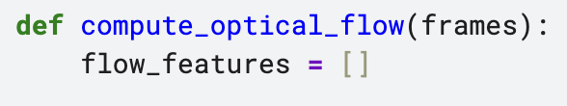
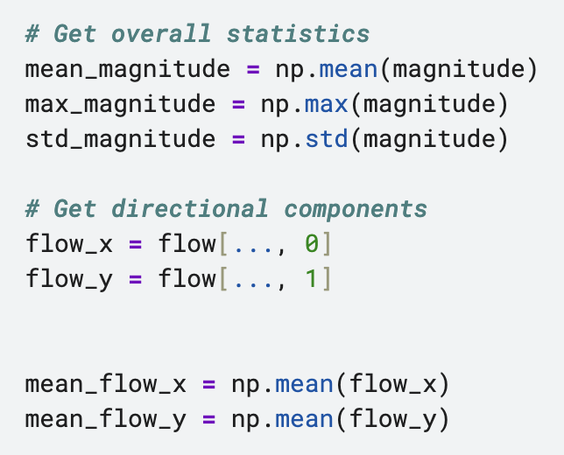
Optical Flow
We analyzed our frames using optical flow
An optical flow output consists of an array of flow magnitudes, representing how much pixels move between frames
Low values indicate smooth motion
  Common in normal driving
High values represent fast movement or sudden changes
  This could be linked to hard braking, swerving, or collisions
  This could help us determine the difference between a positive and negative video (safe vs unsafe dashcam footage)
Notes:
Senait

Slide 8
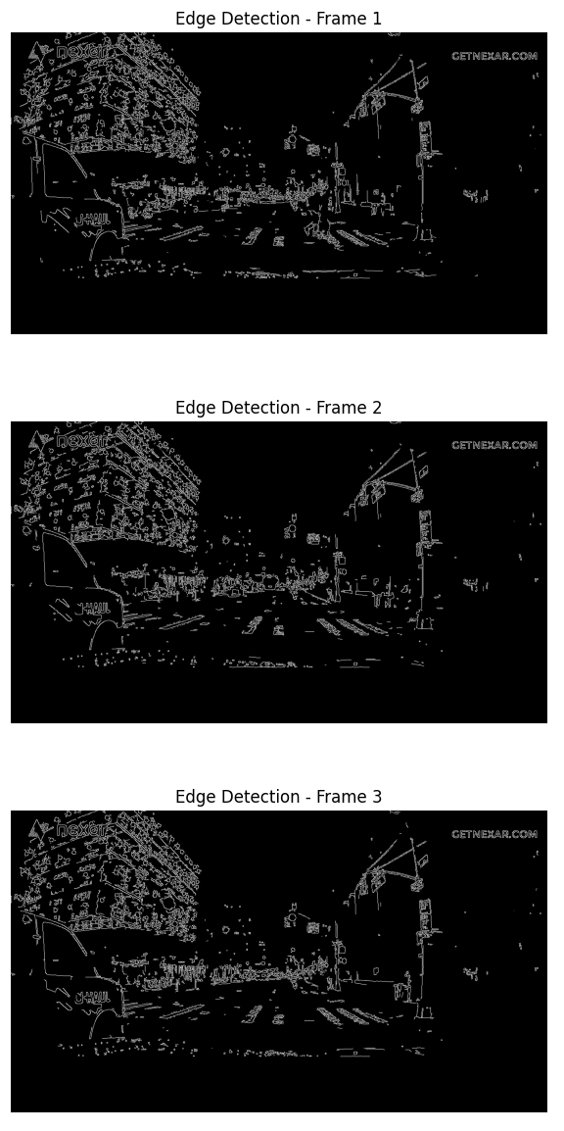
Edge Detection
Canny Edge Detection is applied to the extracted frames
Converts each frame to grayscale and highlights sharp intensity changes (edges)
White lines represent detected edges
Black areas represent regions with no significant edge or intensity change
Helps identify key objects and structural changes in our scene
  Vehicles, road/lane boundaries, crosswalks, pedestrians, etc.
Notes:
Senait

Slide 9
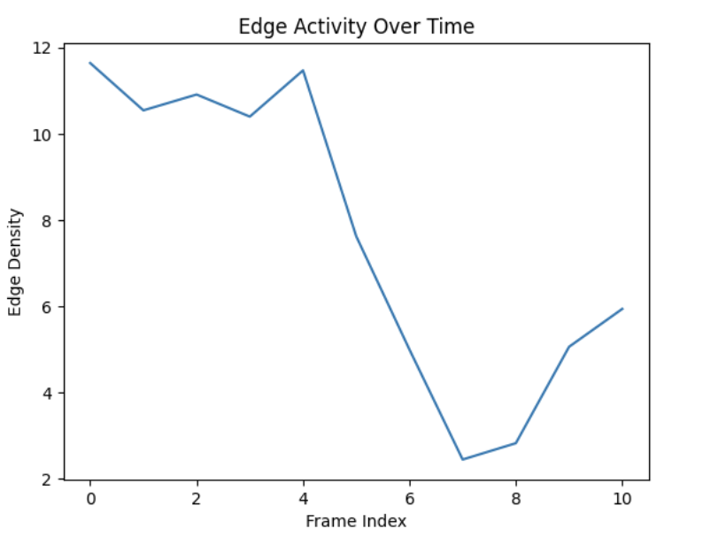
Edge Detection
The X-axis (frame index) represents time
  Showing how edge activity changes over the video sequence
The Y-axis (edge density score) quantifies how many edges are present in each frame
Interpret:
  Low, stable edge density
    Smooth driving on open road
  Sharp peak in edge density
    A sudden change
    Could represent a near miss or collision
  Drop after a peak
    Possible post-collision stabilization
    Car stops moving and surroundings stop changing
Notes:
Senait

Slide 10
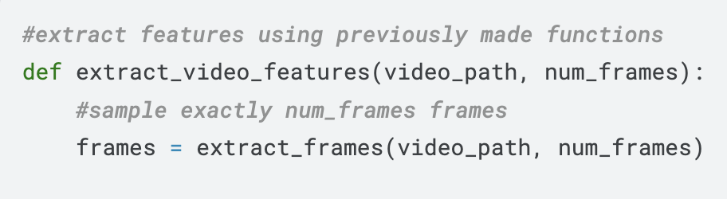
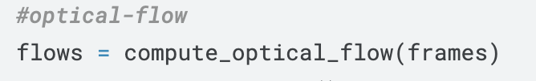
Extract Video Features
We created a function that would extract our video features
Takes the video path and the number of frames
  Some videos are longer than others but will analyze the same number of frames for all videos
  We did this for the sake of time
    All videos will take around the same amount of time to analyze
Notes:
Senait

Slide 11
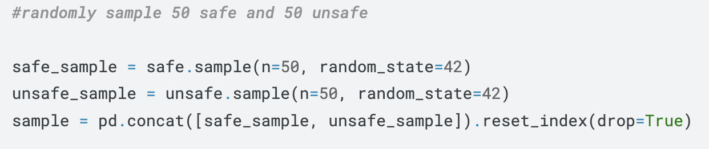
Create Sample Set
During our earlier tests we created our models using small sample sizes
We started with 50 safe examples and 50 unsafe examples
This helped us save on time since each time we ran the program it took a long time to run
This way we could spend more time experimenting and less time waiting
Notes:
Senait

Slide 12
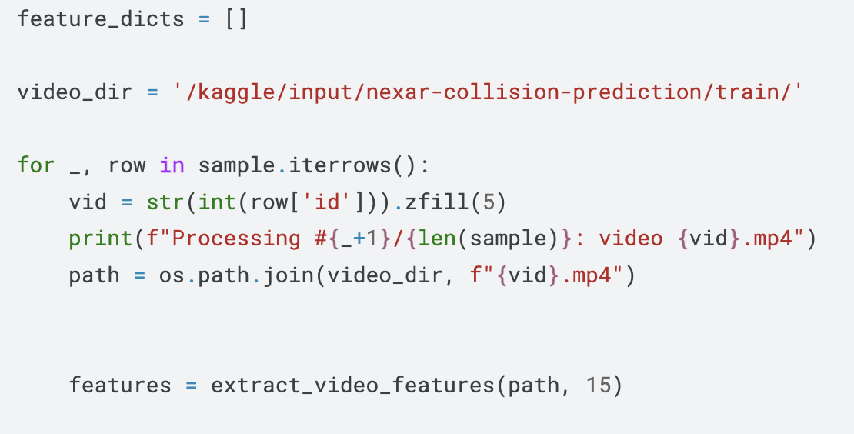
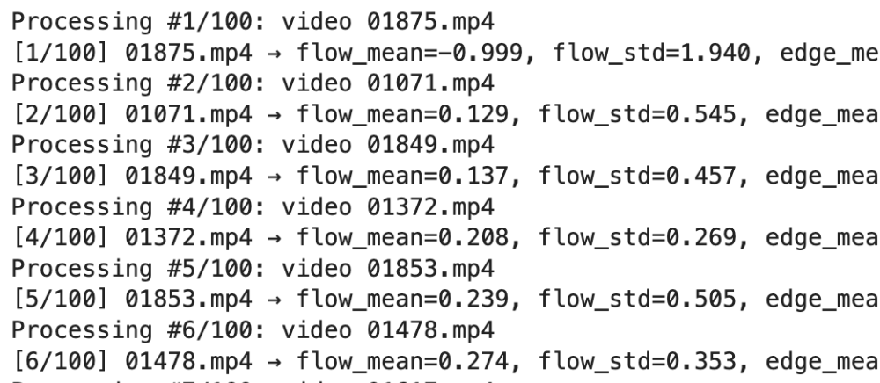
Feature Extraction
Then we used our extract_video_features function
We looped through our sample and got the features for each video
In this example we analyzed 15 frames per video but we played around with this number
  We had to take how long the program takes to run into account
Notes:
Ana

Slide 13
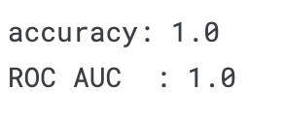
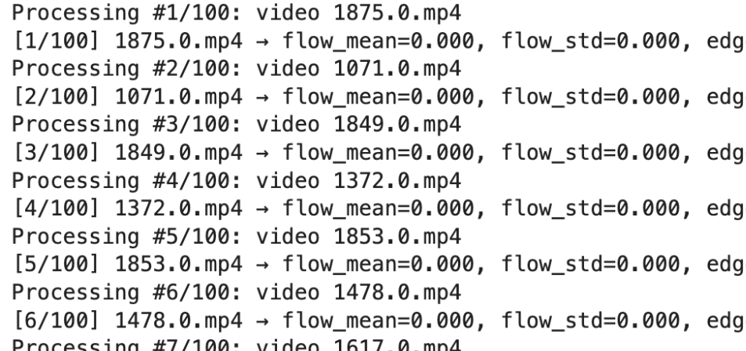
Feature Extraction
We did encounter a problem during this step
Whenever we ran the model our accuracy and AUC scores would be exactly 0.5 or 1.0 which didn’t seem right
After some debugging we discovered that the loop was building the file path using a float
  Ex. 1875.0 instead of 1875
Once we fixed this we started seeing some real data
Notes:
Ana

Slide 14
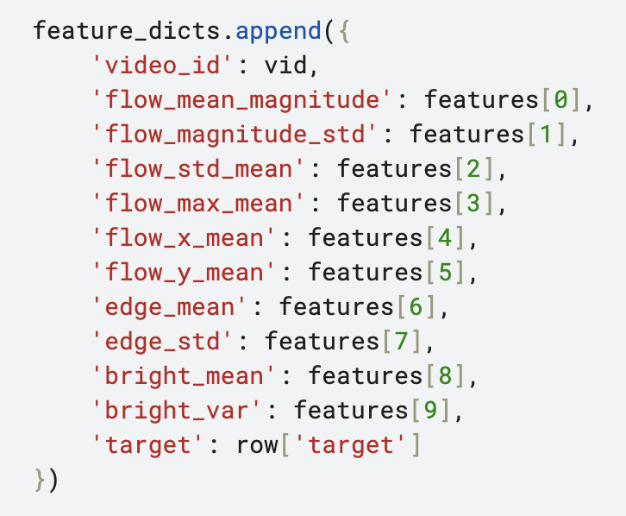
Feature Extraction
Optical flow: mean magnitude
  The average speed of motion in the video
  We compute optical flow between each pair of consecutive frames
  Then find the mean of those magnitudes for the entire video
Optical flow: magnitude standard deviation
  How much the overall motion speed varies frame to frame
  We compute optical flow between each pair of consecutive frames then take the standard deviation of those magnitudes
Notes:
Ana

Slide 15
Feature Extraction
Optical flow: mean of per-frame standard deviation
  The average spread of motion across each frame
  Allows us to detect sudden and chaotic motion patterns
Optical flow: maximum magnitude
  Signifies the strongest motion captured
  Captures motions that would signify a crash or almost crash like collision or slam on brake
Notes:
Ana

Slide 16
Feature Extraction
Optical flow: Average horizontal/vertical motion
  (horizontal) will signify a change or drift in lanes
  (vertical) if there is vertical motion, meaning the camera has up and down movement, it can indicate a crash
Edge density: mean
  This number tells us the proportion of pixels that are edges
  Identifies how busy the road is
Edge density: standard deviation
  Measures the spread of the edge density along the frames
  The higher the value indicates more objects coming into view or going out of view
Notes:
Ana

Slide 17
Feature Extraction
Brightness: Average
Takes the average of the brightness of all of the frames
Helpful to identify if there is low visibility (low values)
Brightness: Variance
  Indicates how much brightness changes
  High values are indication of going into a tunnel, bright headlights, sudden brake lights, etc.
Notes:
Ana

Slide 18
Feature Extraction (Summary)
Optical flow
  Measures pixel movement
  Used to identify hard braking, swerving, etc.
Edge density
  Identifies sudden appearance of objects
  car/pedestrian enters frame
Brightness
  Measures how bright the scene is
  Can help identify new headlights/brake lights in dark environments
Notes:
Ana

Slide 19
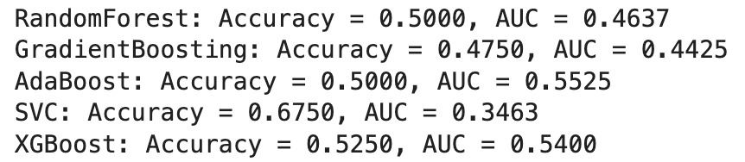
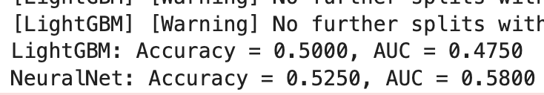
Model Honing
We started with a Random Forest Classifier model, which had a 50% accuracy and 46% AUC
We implemented and compared different machine learning models to find the best one:
  RandomForest
  Gradient Boosting
  AdaBoost
  SVC (Support Vector Classifier)
  XGBoost
  Etc… —>
Notes:
Senait

Slide 20
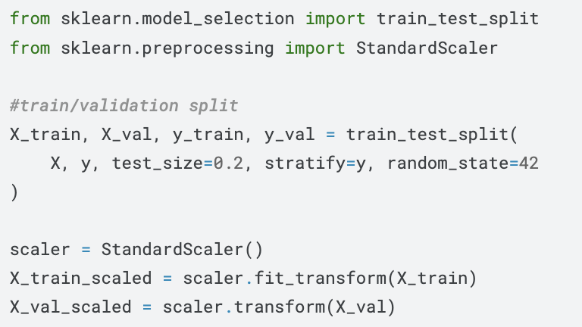
Model Honing
Feature scaling:
  We applied StandardScaler to normalize the features, which was particularly important for the SVC model
Hyperparameter tuning:
  We used GridSearchCV to find the optimal parameters for the SVC model, testing different values for C, kernel type, gamma, and class weights
Notes:
Senait

Slide 21
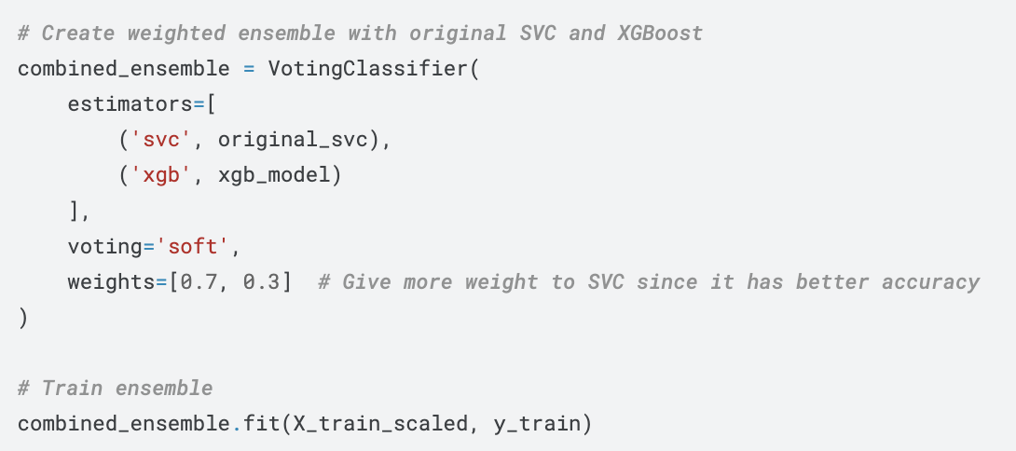
Model Honing
Earliest RandomForest: 45% accuracy, 0.51 AUC
Original SVC: 65% accuracy, 0.41 AUC
Best weighted ensemble: 57.5% accuracy, 0.52 AUC (.7 SVC and .3 XGBoost)
Class balancing: We attempted to use SMOTE for addressing class imbalance, and when that had dependency issues, we used scikit-learn's built-in class_weight parameter for SVC.
Notes:
Senait

Slide 22
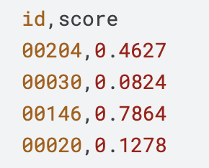
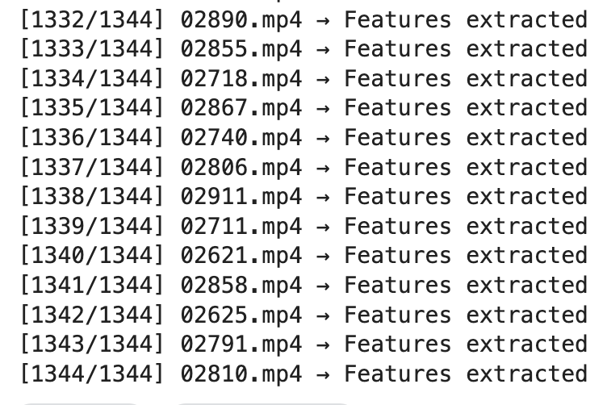
Testing
Example (not our scores)
We then ran our model on the test data
We wanted to be able to give each video in the test data a score
  The test data that was provided contained 1,344 entries
The closer to 1 the score is the more likely it is that that video contains a crash or near miss
Unfortunately it took a very long time to run the notebook (over 6 hours) and the notebook timed out so we were not able to see our scores for the entire test dataset
Notes:
Ana

Slide 23
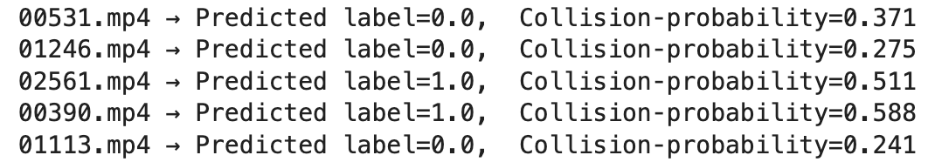
Testing
We decided to test our model on 5 random test videos
We are using the combined-ensemble model and neural net model in this example
  Combined model is the top and neural net is the bottom image
The test data we are given does not contain labels so we are not able to check if our predictions were correct
So we checked manually by printing out a few frames from each video
Notes:
Ana

Slide 24
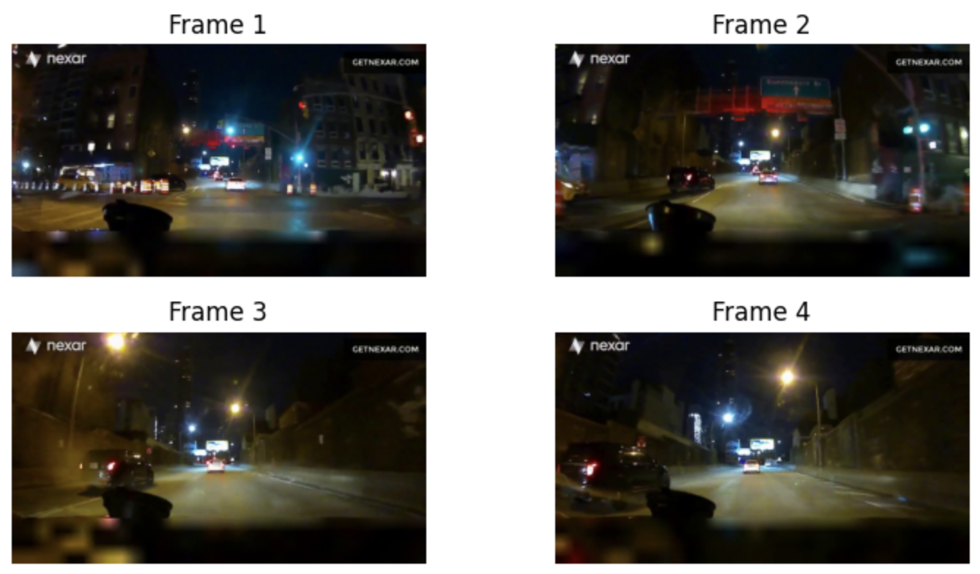
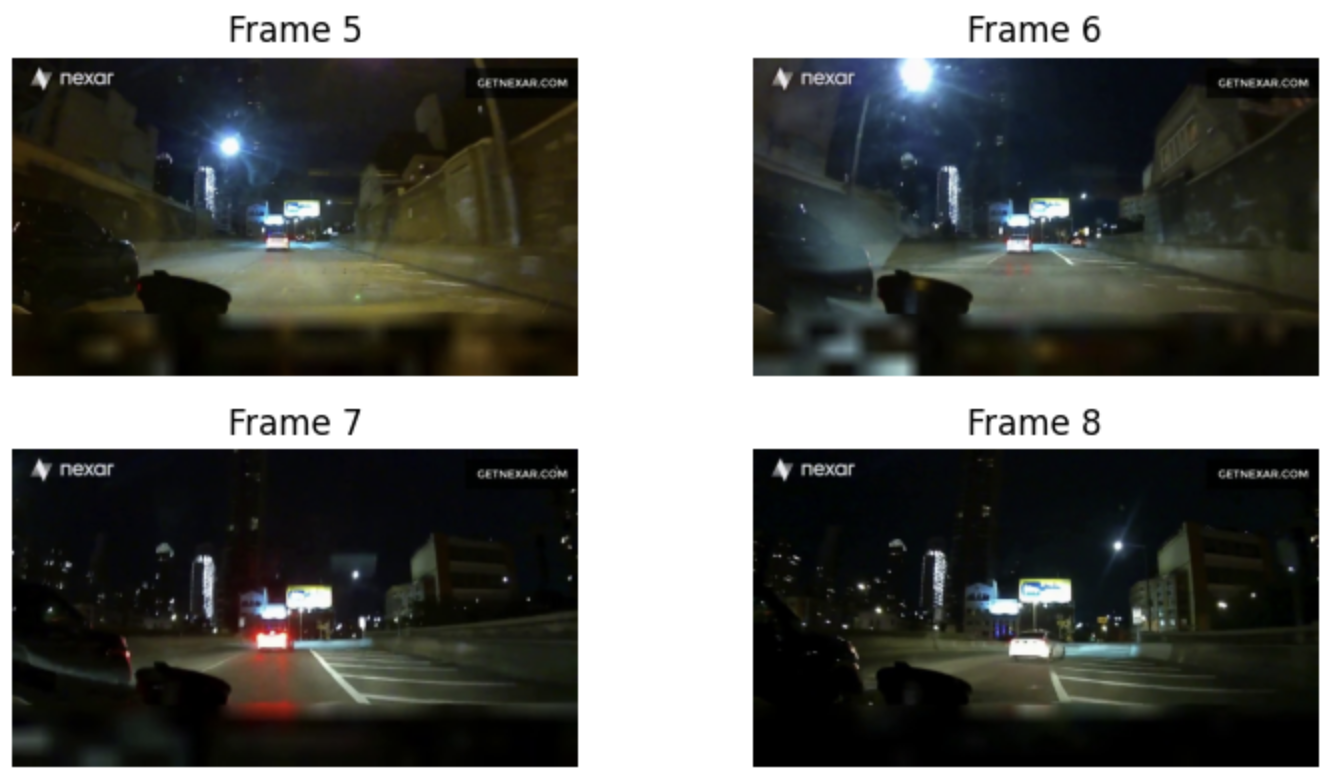
Testing
After looking at 8 frames, it looks there is no crash in this video
Our models predicted that this video would have the label 0
  Which represents safe driving, so this prediction looks to be correct
Notes:
Ana

Slide 25
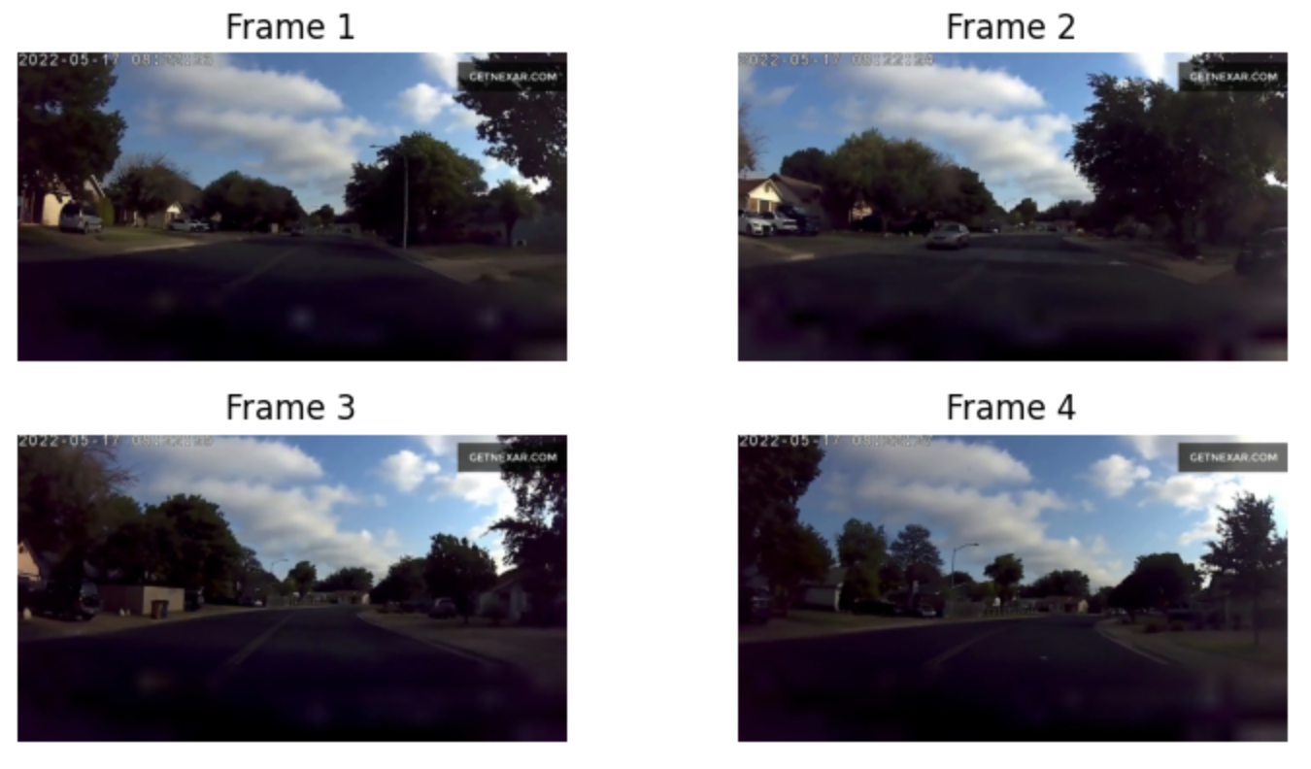
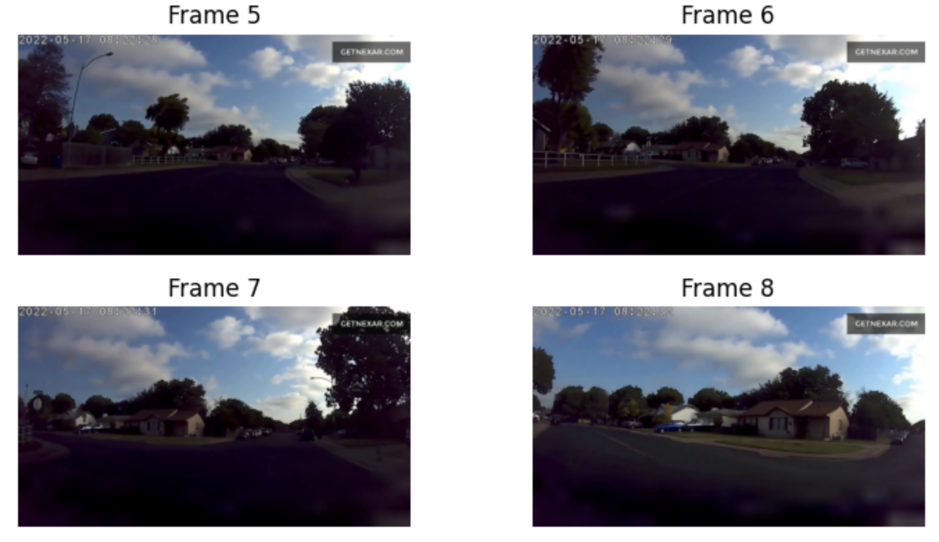
Testing
After looking at 8 frames, it looks there is no crash in this video
Our model predicted that this video would have the label 0
  Which represents safe driving, so this prediction looks to be correct
Notes:
ana

Slide 26
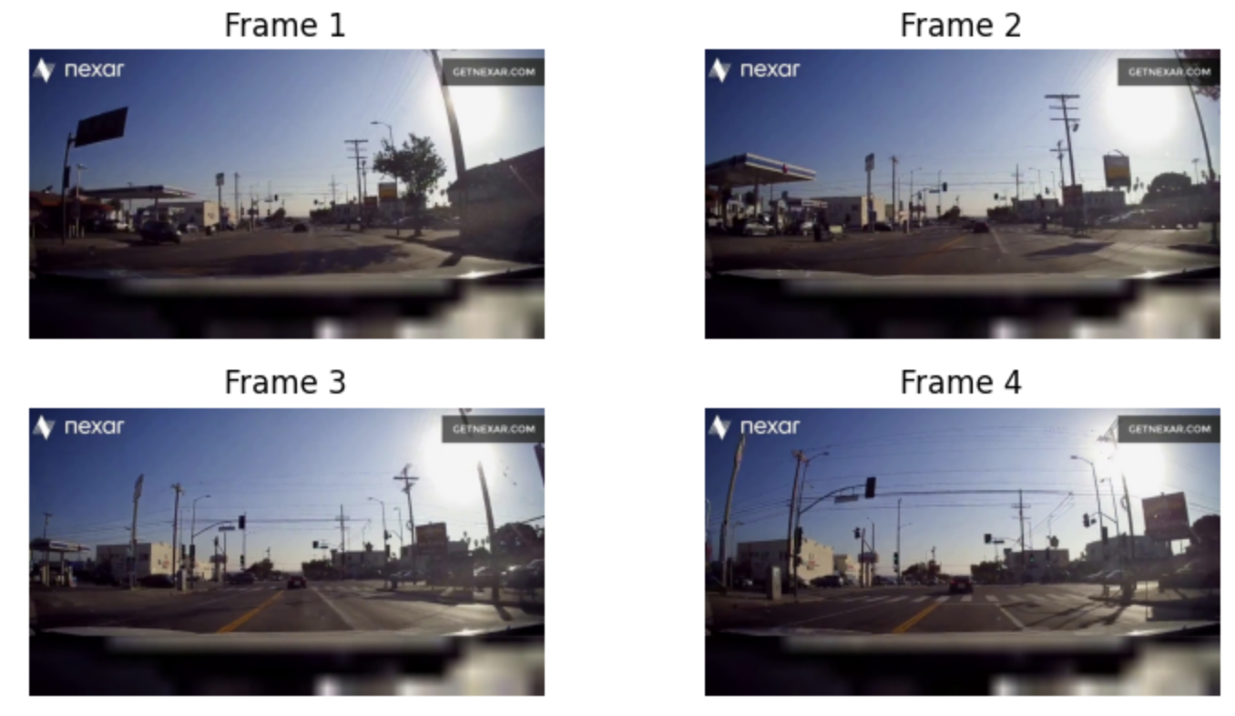
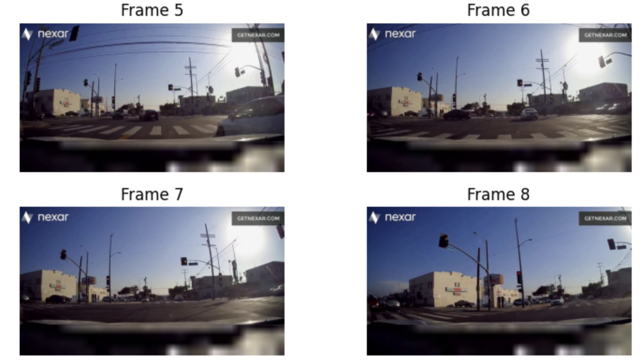
Testing
After looking at 8 frames, it looks there is probably no crash in this video
Our models predicted that this video would have the label 0/1
  So one model was most likely correct while the other was not
Notes:
ana

Slide 27
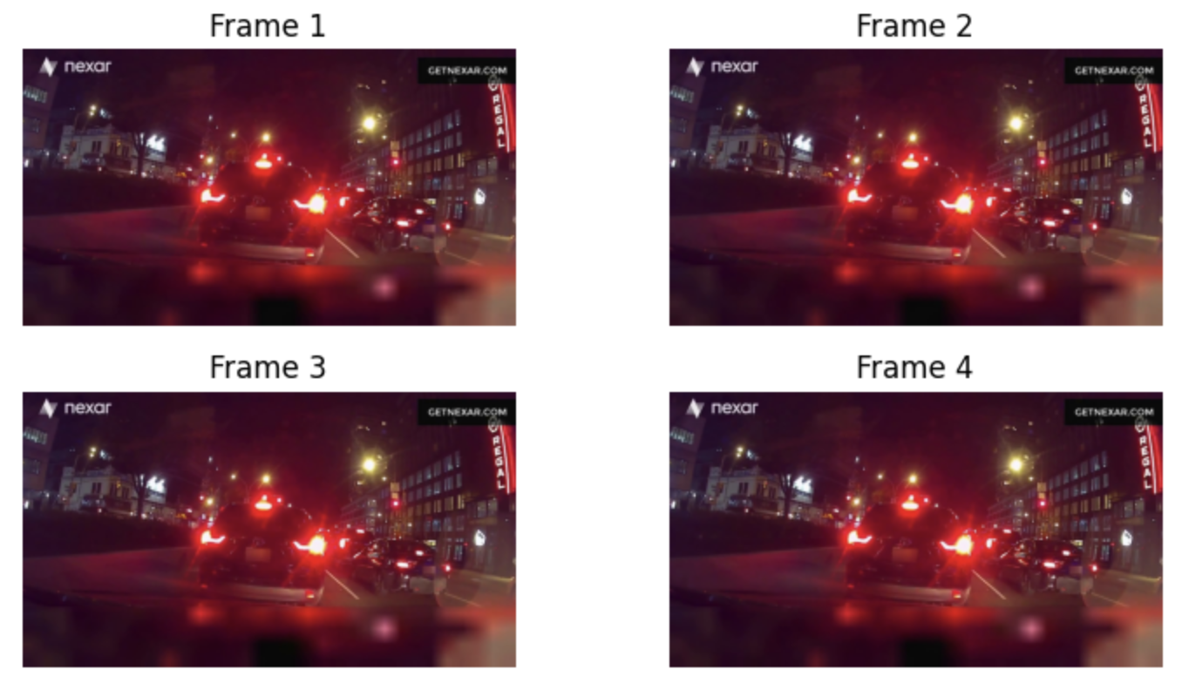
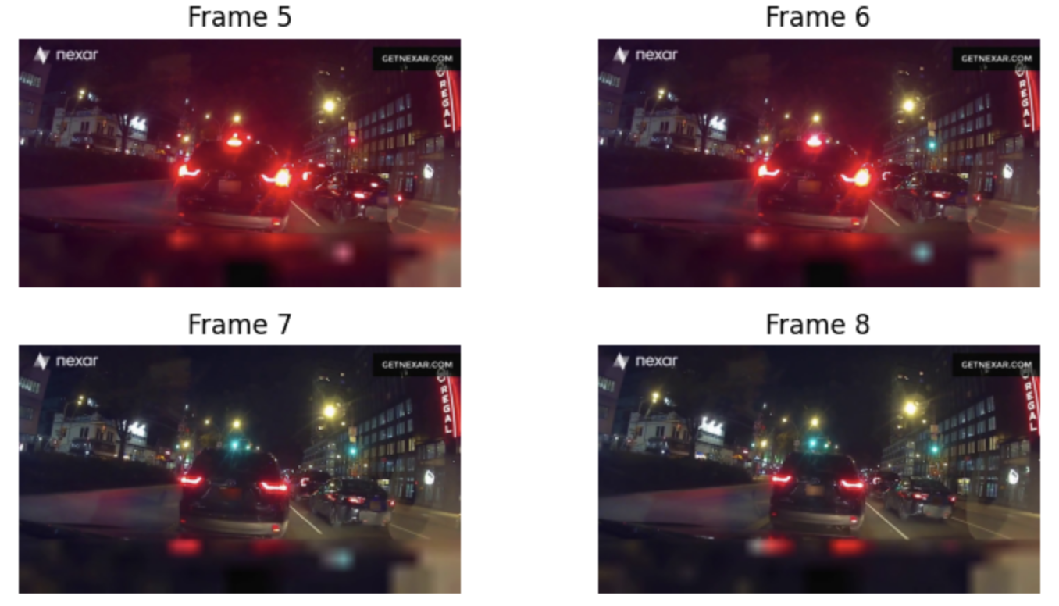
Testing
After looking at 8 frames, it looks there is probably no crash in this video
Our model predicted that this video would have the label 1
  Which represents a crash or near crash, so this prediction looks to be incorrect
Notes:
ana

Slide 28
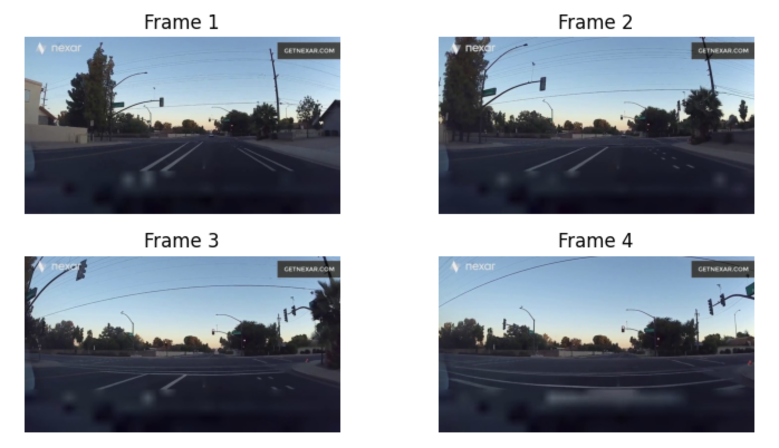
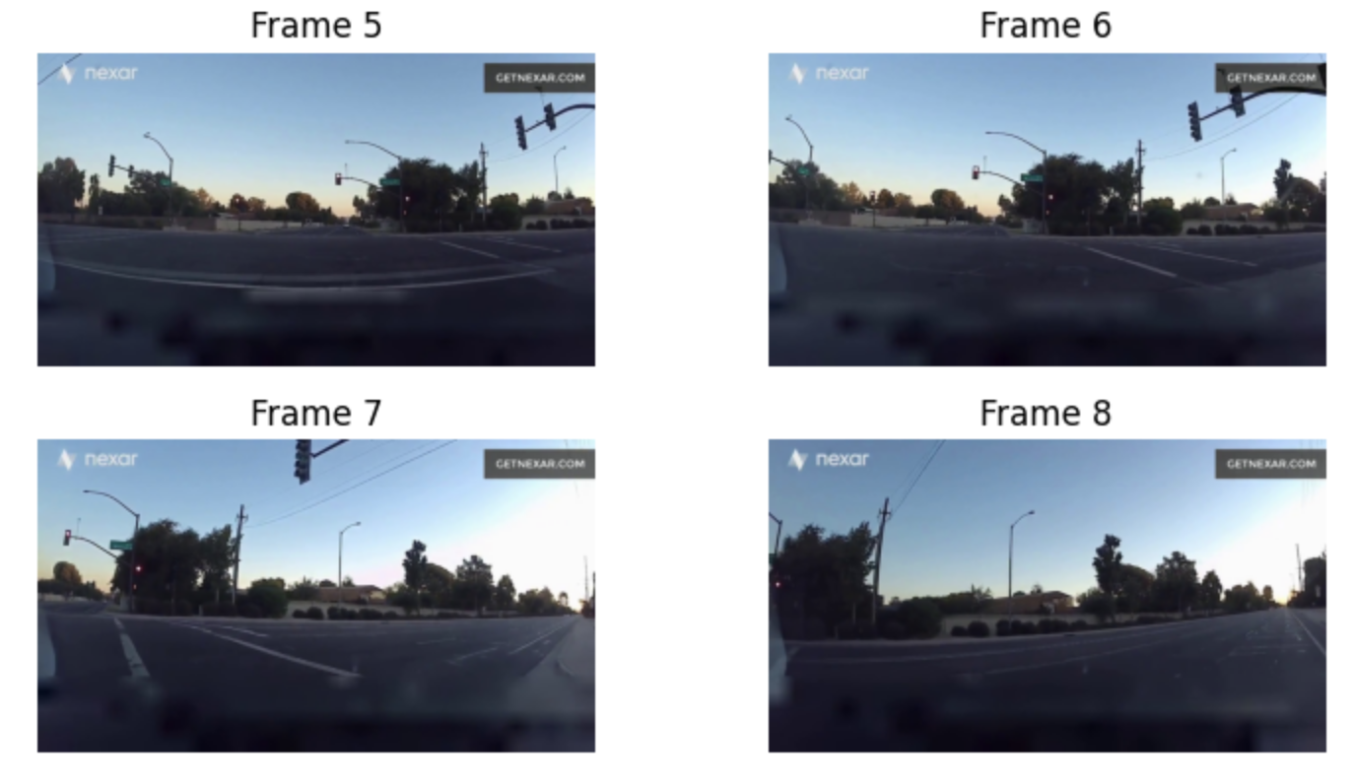
Testing
After looking at 8 frames, it looks there is no crash in this video
Our models predicted that this video would have the label 0
  Which represents safe driving, so this prediction looks to be correct
Notes:
Ana

Slide 29
What we learned
The need for proper data processing
Extracting meaningful features that our model can use
Hyperparameter tuning and model selection
  Finding/tuning the right model prevents overfitting
Optical flow was a key factor in finding potential crash motions
Running time creates a huge set back

Slide 30
Issues Encountered
Long processing times especially during frame processing
  In the future we could attempt processing frames at a lower resolution
Poor model performance
Frame analysis: the fixed number of frames can miss important events in the video
  Might have been better to analyze X amount of frames per second instead of X frames per video
Lots of trial and error- our first time working with videos

