Slide 1
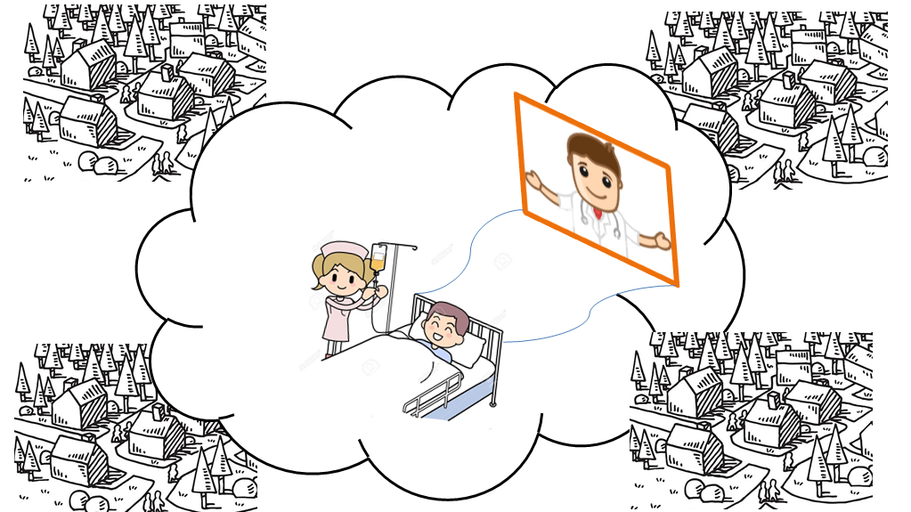
Enabling Universal Healthcare Services With E-Clinics

Slide 2
Enabling Universal Healthcare Services With E-Clinics : The Idea
Government can setup Skype(or any video chatting software) enabled Clinics in remote areas where competent Doctors are not available.
Some selected People from same area(where clinic will set up) can be trained at hospitals and then assigned to a Clinic.
A Doctor will be assigned to every clinic or a group of doctors can together look at a group of clinics.
Patients can schedule appointment wiith a doctor.
Helper(Compounder/Nurse) interacts with doctor using skype and can follow doctor’s instruction to take some reading or do some checkups of patient and tell reading to him(Remeber they are trained).
Doctor can provide Prescription Based on readings.
Thus people can have access to competent doctors even from remote locations.

Slide 3
Enabling Universal Healthcare Services With E-Clinics : Challanges
Internet Connectivity : Projects like Project Loon are already there to provide internet connectivity to remote areas.
Medicines Availability : Using Geographical Analysis, Medical Stores can be established to specific areas such that atleast one store is easily reachable from each clinic.
Doctors Availability : Doctors are assigned an time slot on which they will be live.

Slide 4
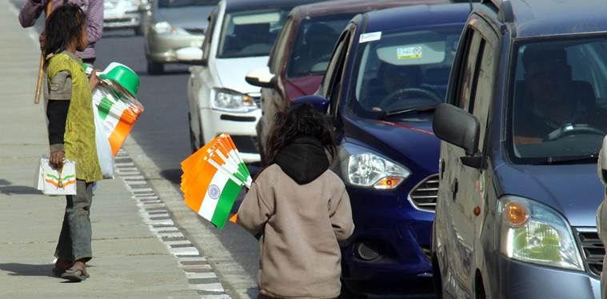
Preventing Child Labour Using Image Processing and Machine Learning

Slide 5
Preventing Child Labour Using Image Processing and Machine Learning
Government vehicles(ambulances, police vehicles, etc) can be equipped with Cameras which capture Live Images/video contineously and send it to central server along with location info.
Our already trained model will apply machine learning to those images and determine wheather there is a child doing some work in shop or selling something roadside.
This Could be indication of Child Labour.
System will Segregate those images/videos and they can be manually examined later.
So, if child labour is detected, concerned authority can be informed to take action.

Slide 6
Questions?

Slide 7
Thanks. Mayank Senani(MT2017067) Sharad Mahajan(MT2017103) Tarun Agrawal(MT2017127)

