Slide 1

Maven

Slide 2
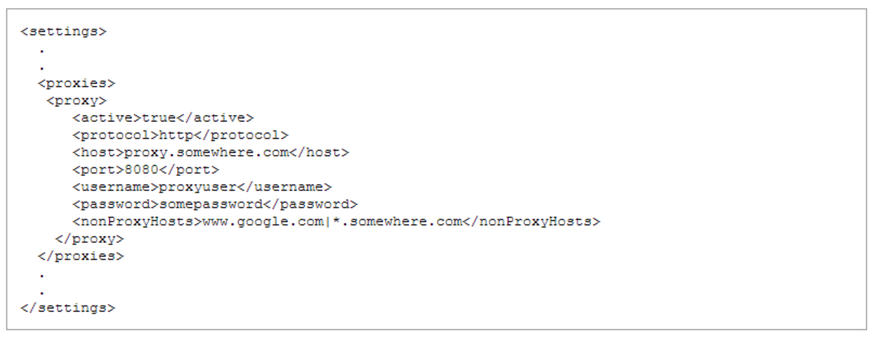
Maven Configure Proxy

Slide 3
POM Environment Settings
SCM (Software Configuration Management): also called Source Code/Control Management or version control
...
<scm>
<connection>scm:git:git://127.0.0.1/my-project.git</connection>
<developerConnection>scm:git:git://127.0.0.1/my-project.git
</developerConnection>
</scm>
...
...
<scm>
<developerConnection>scm:git:[fetch=]http://127.0.0.1/my-project [push=]ssh://username@server:8898/my-project.git
</developerConnection>
</scm>
...
Notes:
connection, developerConnection: how one is to connect to the version control system through Maven. Where connection requires read access for Maven to be able to find the source code (for example, an update), developerConnection requires a connection that will give write access. The Maven project has spawned another project named Maven SCM, which creates a common API for any SCMs that wish to implement it. The most popular are CVS and Subversion, however, there is a growing list of other supported SMCs. All SCM connections are made through a common URL structure.scm:[provider]:[provider_specific], where provider is the type of SCM system. For example, connecting to a CVS repository may look like this:
scm:cvs:pserver:127.0.0.1:/cvs/root:my-project
tag: the tag that this project lives under. HEAD (meaning, the SCM root) should be the default
url: A publicly browsable repository. For example, via ViewCVS

Slide 4
POM Environment Settings SCM
Git Branch and tag
Uses the name of the current local branch
Provider Coniguration
$user.home/.scm/git-settings.xml
<git-settings>
<commitNoVerify>false</commitNoVerify>
</git-settings>
Notes:
connection, developerConnection: how one is to connect to the version control system through Maven. Where connection requires read access for Maven to be able to find the source code (for example, an update), developerConnection requires a connection that will give write access. The Maven project has spawned another project named Maven SCM, which creates a common API for any SCMs that wish to implement it. The most popular are CVS and Subversion, however, there is a growing list of other supported SMCs. All SCM connections are made through a common URL structure.scm:[provider]:[provider_specific], where provider is the type of SCM system. For example, connecting to a CVS repository may look like this:
scm:cvs:pserver:127.0.0.1:/cvs/root:my-project
tag: the tag that this project lives under. HEAD (meaning, the SCM root) should be the default
url: A publicly browsable repository. For example, via ViewCVS

Slide 5
Maven and Incremental builds ?
No need compile is fast (it’s the rest that is slow)
Although nobody removes old .class sometimes consider using #mvn clean install

Slide 6
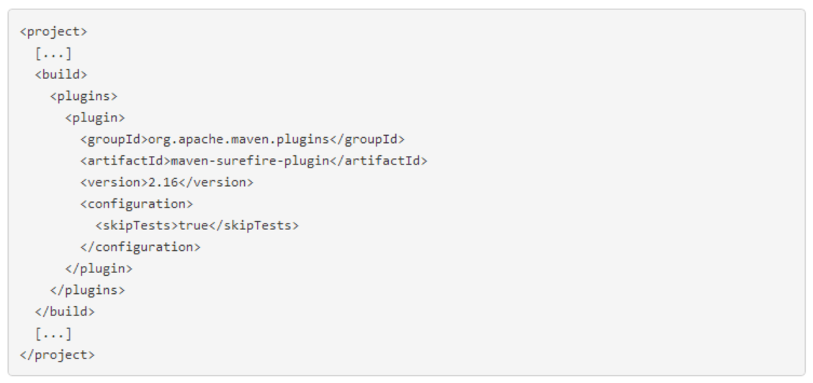
Maven Skipping tests
mvn install –DskipTests
mvn install -Dmaven.test.skip=true

Slide 7
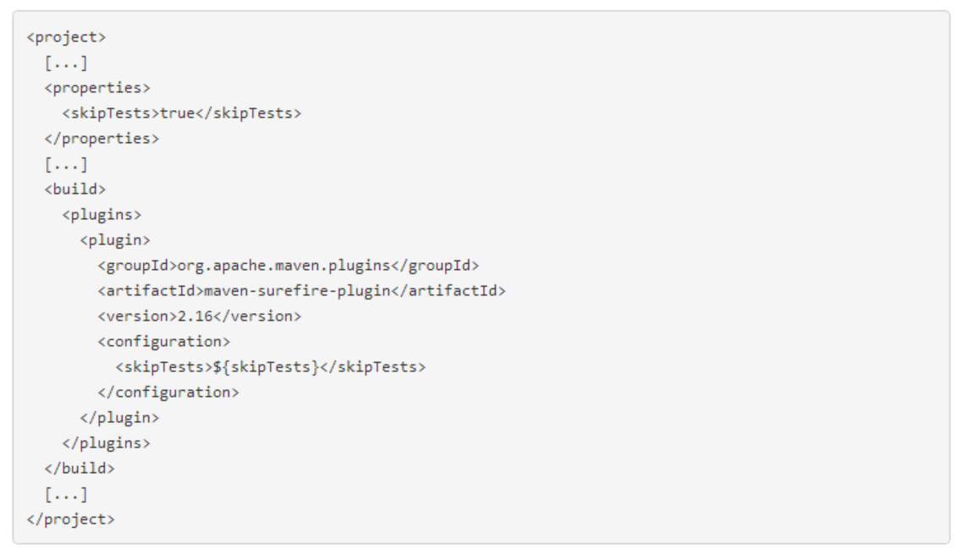
Maven Skipping tests
mvn install -DskipTests=false

Slide 8
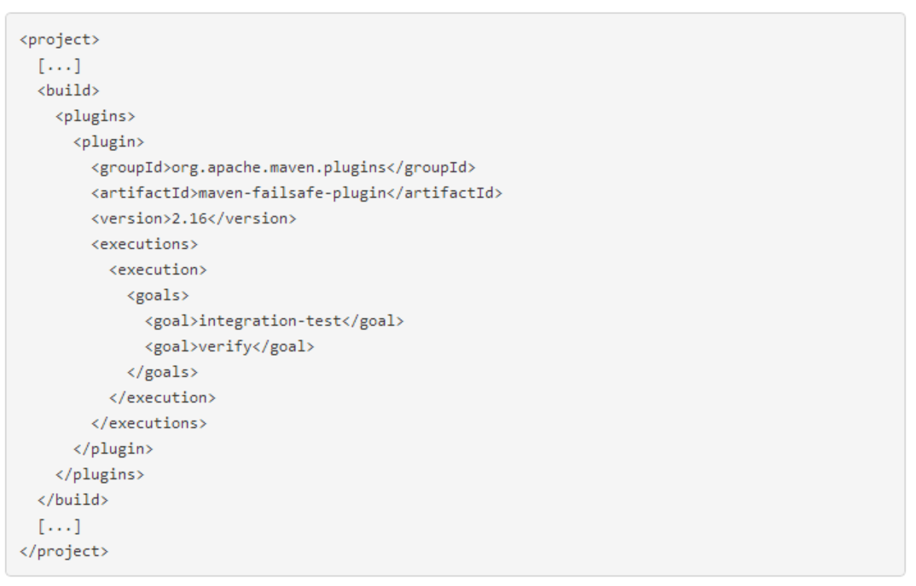
Maven failsafe plugin
mvn verify

Slide 9
Maven Lifecycle is Linear
# mvn install
# mvn test
#mvn package
#mvn verify

Slide 10
Your Local Maven Repository is a poor cache
No lock (concurrency)
Returns whatever you put at maven cordinates

Slide 11
Maven Help
# mvn --help
#mvn install –X –e
# mvn -Dplugin=install help:describe
#mvn install:help
#mvn –pl groupId:artifactId install
#mvn –am –pl groupId:artifactId install
#mvn –amd –pl groupId:artifactId install
#mvn –N install

Slide 12
Maven: What happend to all the promised cool features ?
Maven is still alive release (3.1.1) 2013-10-04
Tesla IO, the future builds with Tesla
Tesla build is a pure super set of Maven, compatible with Maven

