Slide 1

Maven

Slide 2
Maven War Plugin
Simply changing the packaging
<project>
...
<groupId>com.solidbeans</groupId>
<artifactId>web</artifactId>
<packaging>war</packaging>
<version>1.0-SNAPSHOT</version>
...
</project>
#mvn compile war:war
or simply
#mvn package

Slide 3
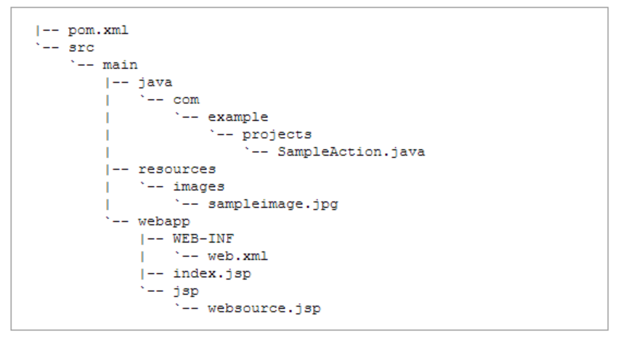
Maven War Plugin
Again simply a matter of putting the right files in the right place

Slide 4
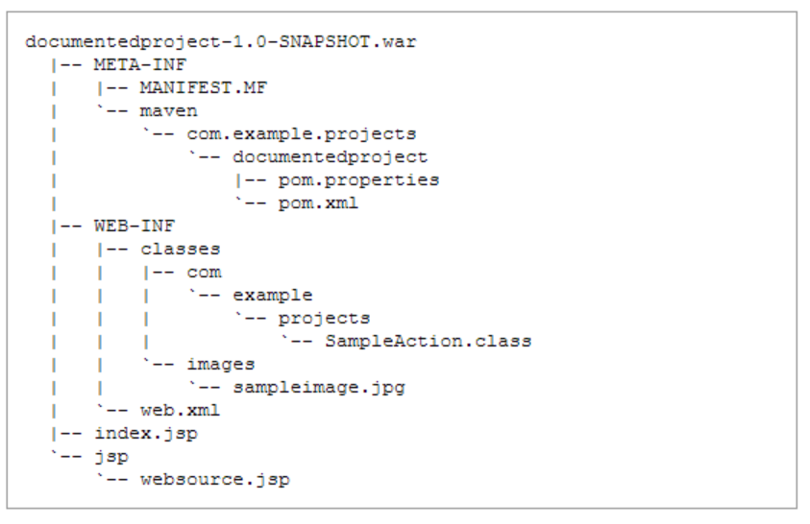
Maven War Plugin

Slide 5
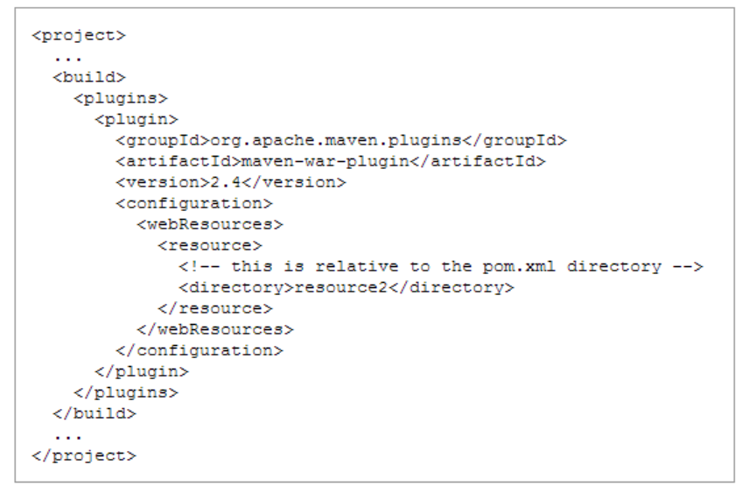
Maven War Plugin
Additional resources are supported using the <webResources>

Slide 6
Maven War Plugin: webResources
Supports:
Includes
Excludes
Multiple resource sets
Filtering
Custom destination directory

Slide 7
Maven War Plugin:Overlay
Overlays are used to share common resources across multiple web applications. The dependencies of a WAR project are collected in WEB-INF/lib, except for WAR artifacts which are overlayed on the WAR project itself.

Slide 8
