Slide 1

Predict On Online Shopper’s Intention On E-Commerce Website
By: Sena Vietrin Sanidya

Slide 2
Content
Item 1
Background
Item 2
Objective
Item 3
Data Introduction
Item 4
Exploratory Data Analysis
Item 5
Model Building
Item 6
Business Recomendation

Slide 3
Background of Study
Customer intentions on e-commerce websites need to be studied to increase sales and find out the pain points experienced by customers based on visit patterns and their influence on transaction completion. Many e-commerce or technology companies are investing in early detection and predicting the behavior of salespersons in virtual shopping environments.
A vast number of people visiting e-commerce websites may not intend to make a purchase. This could be due to various reasons :
1. complex check out process
2. not visible search engines
3. Poor user experience
4. High prices or hidden charges
5. Windows shopping
Notes:
<a href="https://storyset.com/design">Design illustrations by Storyset</a>

Slide 4

OBJECTIVE !
Get insights into visitor intention from duration, page visit, and rates toward revenue
Build model to predict visitor behaviour towards revenue using classification method
Develop business recommendations to increase revenue from visitor sessions

Slide 5
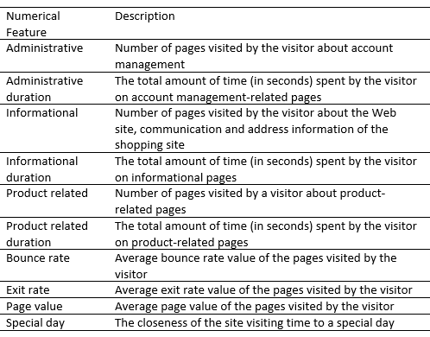
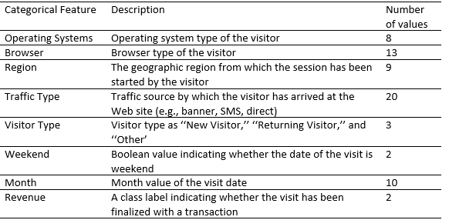
Data Introduction
Historical data of visitors’ sessions at an e-commerce website, The dataset was formed so that each session would belong to a different user in a 1-year period to avoid any tendency to a specific campaign, special day, user profile, or period.
Source : https://archive.ics.uci.edu/ml/datasets/Online+Shoppers+Purchasing+Intention+Dataset

Slide 6
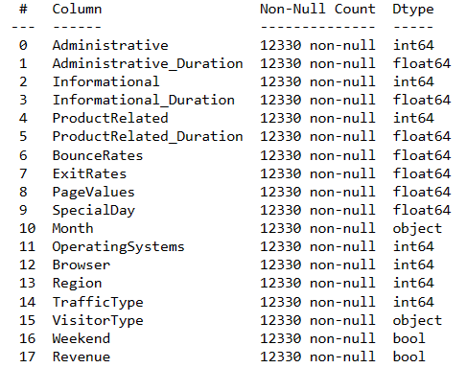
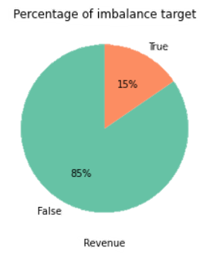


Data target extremely imbalance where the revenue or conversion only 15% among 12330 visitors
No missing value, data types are fine
Dropped 125 duplicates rows
Notes:
Photo by Joseph Gonzalez on Unsplash

Slide 7
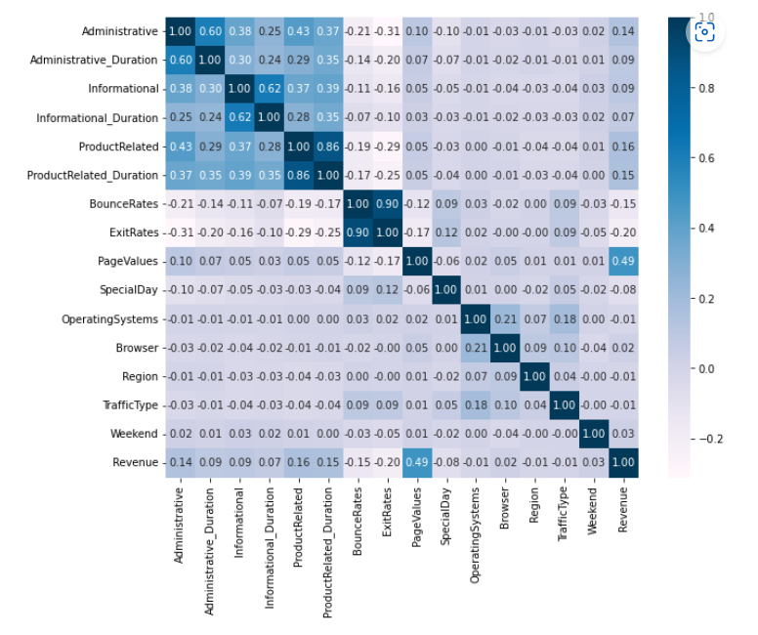
EXPLORATORY DATA ANALYSIS (EDA)
Observation :
Bounce Rates and Exit Rates have a strong positive correlation
Page value have low correlation with bounce rate and exit rate
Page value is the highest correlated to Revenue
Most of the features have low correlation (threshold = 0.8 absolute)

Slide 8
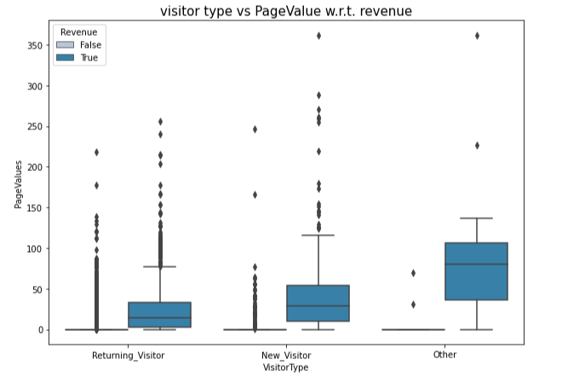
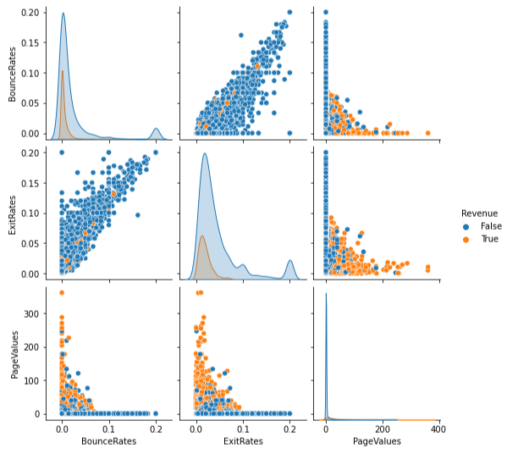
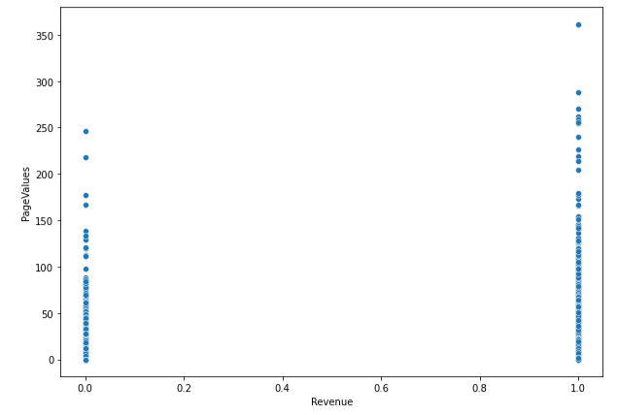
Page Value
A
B
C
Observation :
Visitors with higher Bounce Rate and Exit Rate more likely to have lower Page Value with no Revenue
Visitors with low Page Value doesn’t always mean with no revenue ( landing at home then direct to cart page then purchasing without visiting other pages) but visitors with no revenue mostly have lower page value
New visitors are more likely to have higher Page Value and higher Revenue than returning visitors
Notes:
<a href="https://storyset.com/design">Design illustrations by Storyset</a>

Slide 9
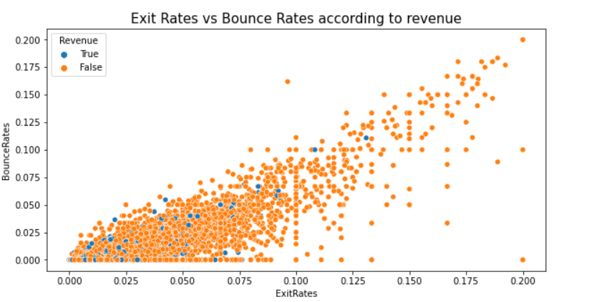
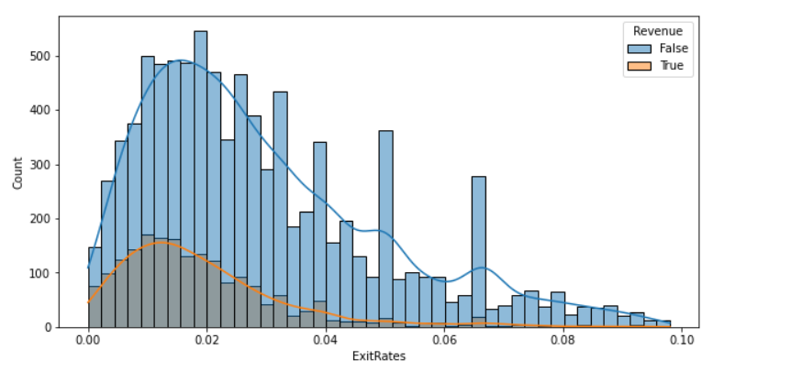
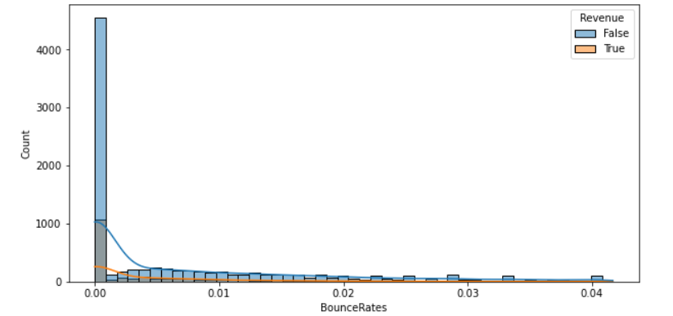
Bounce Rate (BR) and Exit Rate (ER)
Observation :
Visitors who experience high BR are more likely to have high ER as well
BR threshold from the median calculation to the visitor with revenue is 0. When BR is higher than 0 visitors tend to not purchase
ER threshold from the median calculation to the visitor with revenue is 0.015909. When ER is higher than 0.015909 visitors tend to not purchase
Our visitors more likely to have high BR and ER
Notes:
<a href="https://storyset.com/design">Design illustrations by Storyset</a>

Slide 10
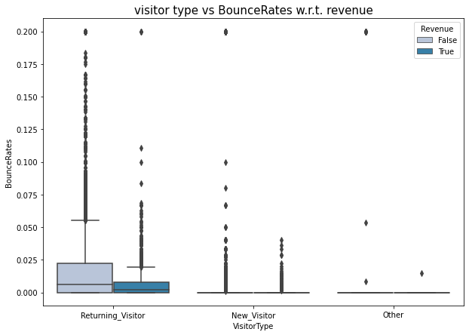
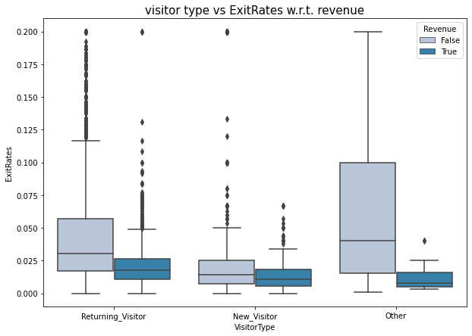
Bounce Rate (BR) and Exit Rate (ER) according to Visitor Type
Returning visitor experience higher BR but they also experience revenue more than new and other visitors
Returning visitors and other visitors experience higher ER than New visitors
Returning visitors or old customer more likely didn’t complete their journey, even though ER and BR for new visitors or new customers are quite high
Notes:
<a href="https://storyset.com/design">Design illustrations by Storyset</a>

Slide 11
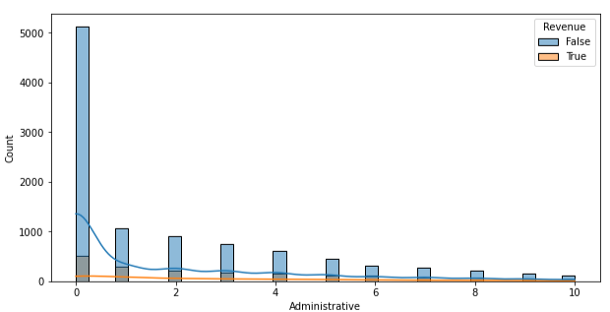
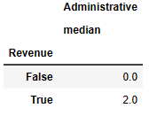
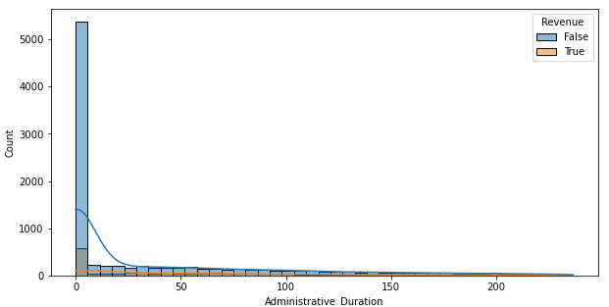
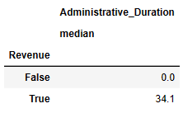
Administrative page and duration
Observation :
Visitors with revenue are more likely to visit the administrative page twice or more in one session
2. Visitors are more likely to spend 34.1 seconds on the administrative page in one session
Notes:
<a href="https://storyset.com/design">Design illustrations by Storyset</a>

Slide 12
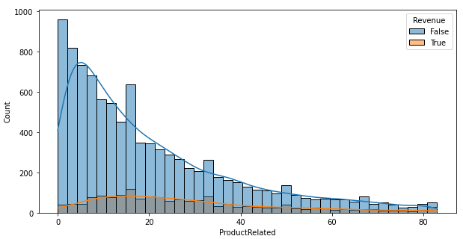
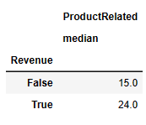
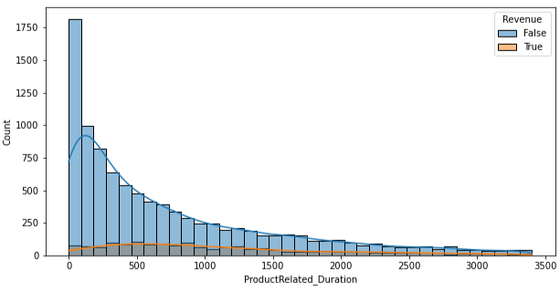
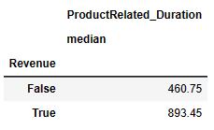
Product Related page and duration
Observation :
Visitors with revenue are more likely to visit the Product Related page 24 times more in one session
2. Visitors are more likely to spend 15 minutes on the Product Related page in one session
Notes:
<a href="https://storyset.com/design">Design illustrations by Storyset</a>

Slide 13
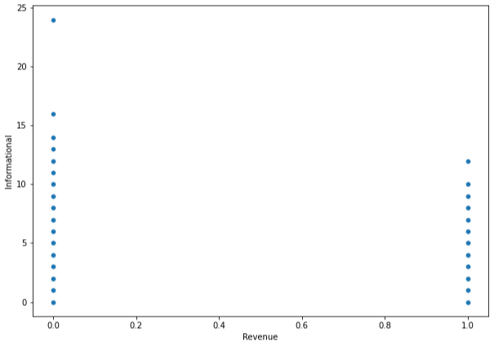
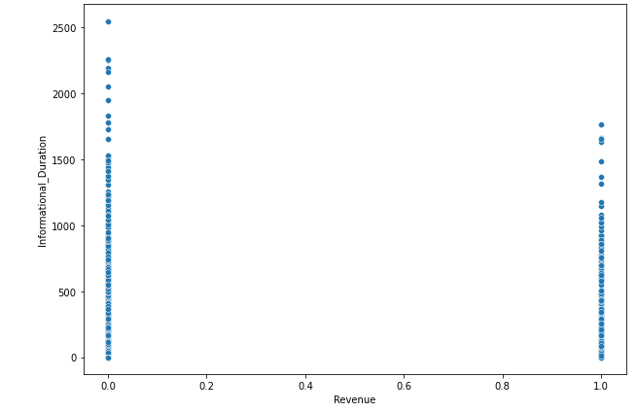
Informational Page and Duration
Observation :
There is no clear difference but we can say visitors who spent more time on informational page are more likely not generates revenue
Notes:
<a href="https://storyset.com/design">Design illustrations by Storyset</a>

Slide 14
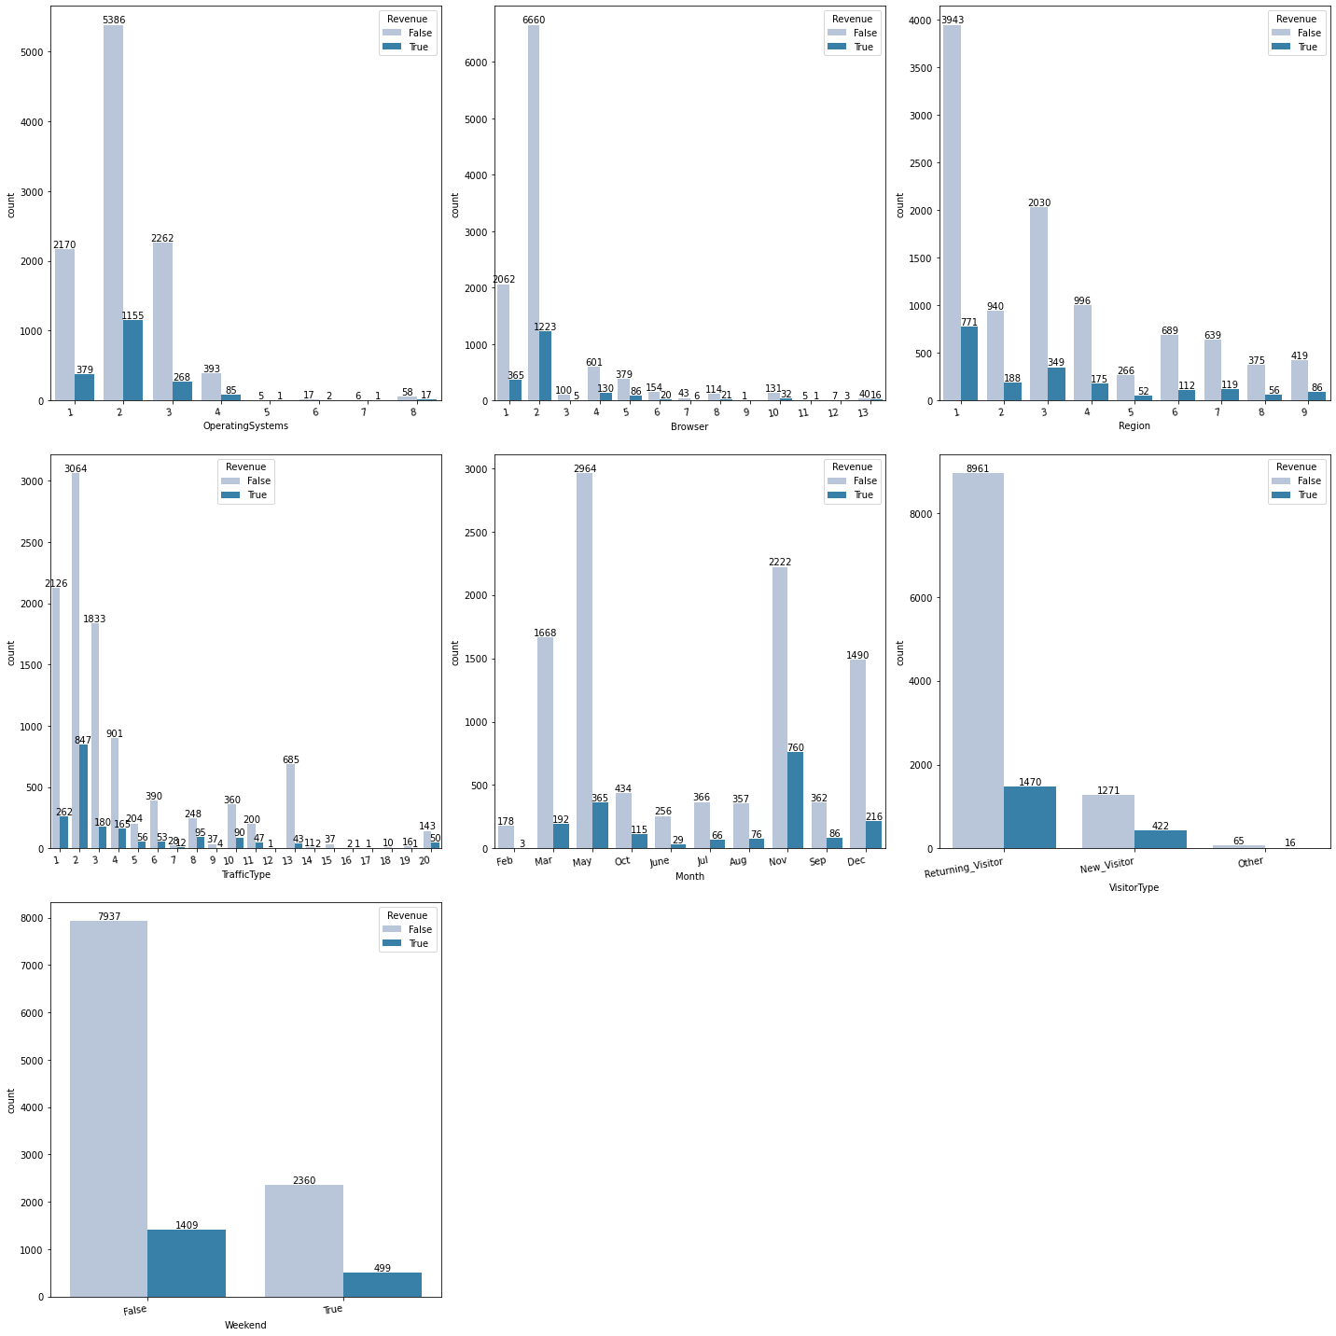
The most popular categorical features
Most popular operating system with higher revenue is type 2
Most popular Browser type with higher revenue is type 2
Most popular region with highest revenue is type 1
Most popular traffic type with highest revenue is type 2
The largest visitors comes in may but November visitors have the largest revenue
Returning visitors dominates the visitors session of this year
most of visitors comes in weekdays

Slide 15
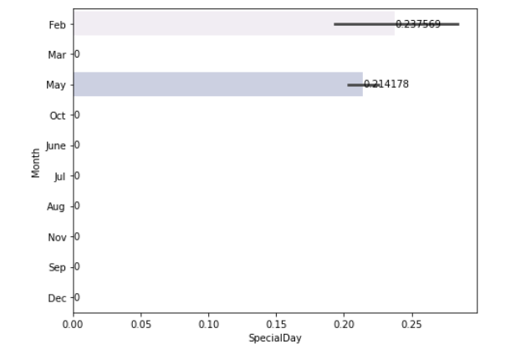
Frequency of purchases close to the special day
Purchased according to special day only happen at May and February, we can imply that the special day has not been used optimally. So that efforts can be made in the form of a special day campaign to attract customers to make purchases and offer discounts on special days

Slide 16
Model Building
Data Cleaning
EDA + encoding
Split Dataset
Scaling
Best Model
Hypertunning Parameter
Imbalance Handling
base line model
Notes:
<a href="https://storyset.com/design">Design illustrations by Storyset</a>

Slide 17
Encoding
1
2
3
LABEL ENCODING FOR BOUNCE RATES AND EXIT RATES
ONE HOT ENCODING
LABEL ENCODING FOR BINARY FEATURES
Bounce Rates :
0 encode as 1
>0 encode as 0
Exit Rates
<= 0.015909 encode as 1
> 0.015909 encode as 0
Operating System
Browser
Region
Traffic Type
Month
Visitor Type
Revenue ( True = 1, False = 0)
Weekend (True =1, False = 0)
Task
Team

Slide 18
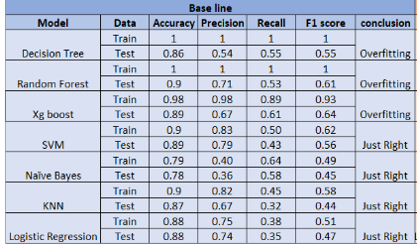
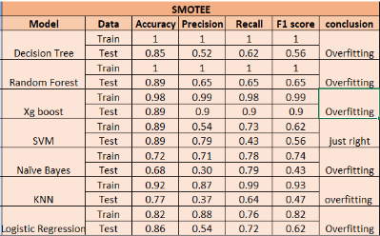
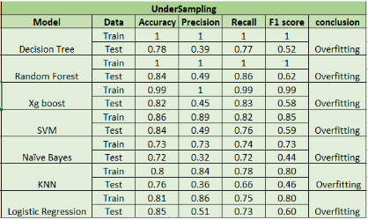

Slide 19
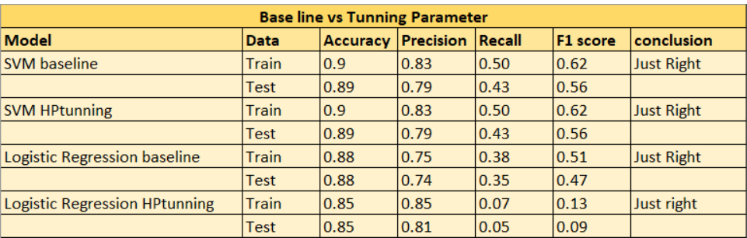
SVM is the best model since it has a higher f1 score than Logistic regression
Accuracy : model accuracy to correctly classify data
Precision : positive rate
Recall : actual positive rate
F1 score : harmonic mean of precision and recall

Slide 20
SUMMARRY
Visitors with higher page value more likely to have revenue
Visitors with Bounce rates >0 and exit rates > 0.015909 tend to not purchase
Returning visitors more likely to experience one session page (Bounce rates) and high exit rates
Revenue visitors are more likely to visit the administrative twice or more and visit the product-related page 24 times in one session
Revenue visitors are more likely to spend 34.1 seconds on the administrative page and 15 minutes on the product-related page in one session
Purchase close to special days are still low
Best model to predict revenue visitor is SVM

Slide 21
Business Recomendation
Provide points or rewards for returning visitors who have made payments and special discounts for new visitors
Giving shipping cost discount for region with lower revenue and keep engange with customer in high revenue region by push notification or email marketing
Lower the bounce rates and exit rates by giving user friendly UI/UX, relavant content, relavant keyword, proper page time load
Perform campagin for upcoming special day to increase users session and provide special price for special day. Highlight relavant product for each special day
Notes:
<a href="https://storyset.com/design">Design illustrations by Storyset</a>

Slide 22
Thank you !

