Slide 1
Are Your APIs Really Secure? Are You Sure?
Sena YAKUT
Developer Summit, 2023

Slide 2






About me
Senior Cloud Security Engineer @Lyrebird Studio
DevSecOps Team Lead & Senior CloudSec Engineer @PurpleBox
Cyber Security & CloudSec Engineer @Vestel
Master @Ege University
Security & Identity
@sena-yakut
senayktt@gmail.com
@senayktt

Slide 3

Overview
Why does API hacking become so popular?
OWASP API Top 10 – 2023 changes
Differences from OWASP API Top 10 - 2019
Example scenarios
Protection Recommendations
Traditional Methods - Scan everything or not?
10 Things You Should Do
Review, Analyze, Detect
Don’t DevOps Do DevSecOps
Scan and Test
Authenticate & Authorize
Validate Everything
Encrypt Everything
Document Everything
Share Minimum Data
Audit & Logging & Monitoring
Use WAF (Web Application Firewall)

Slide 4
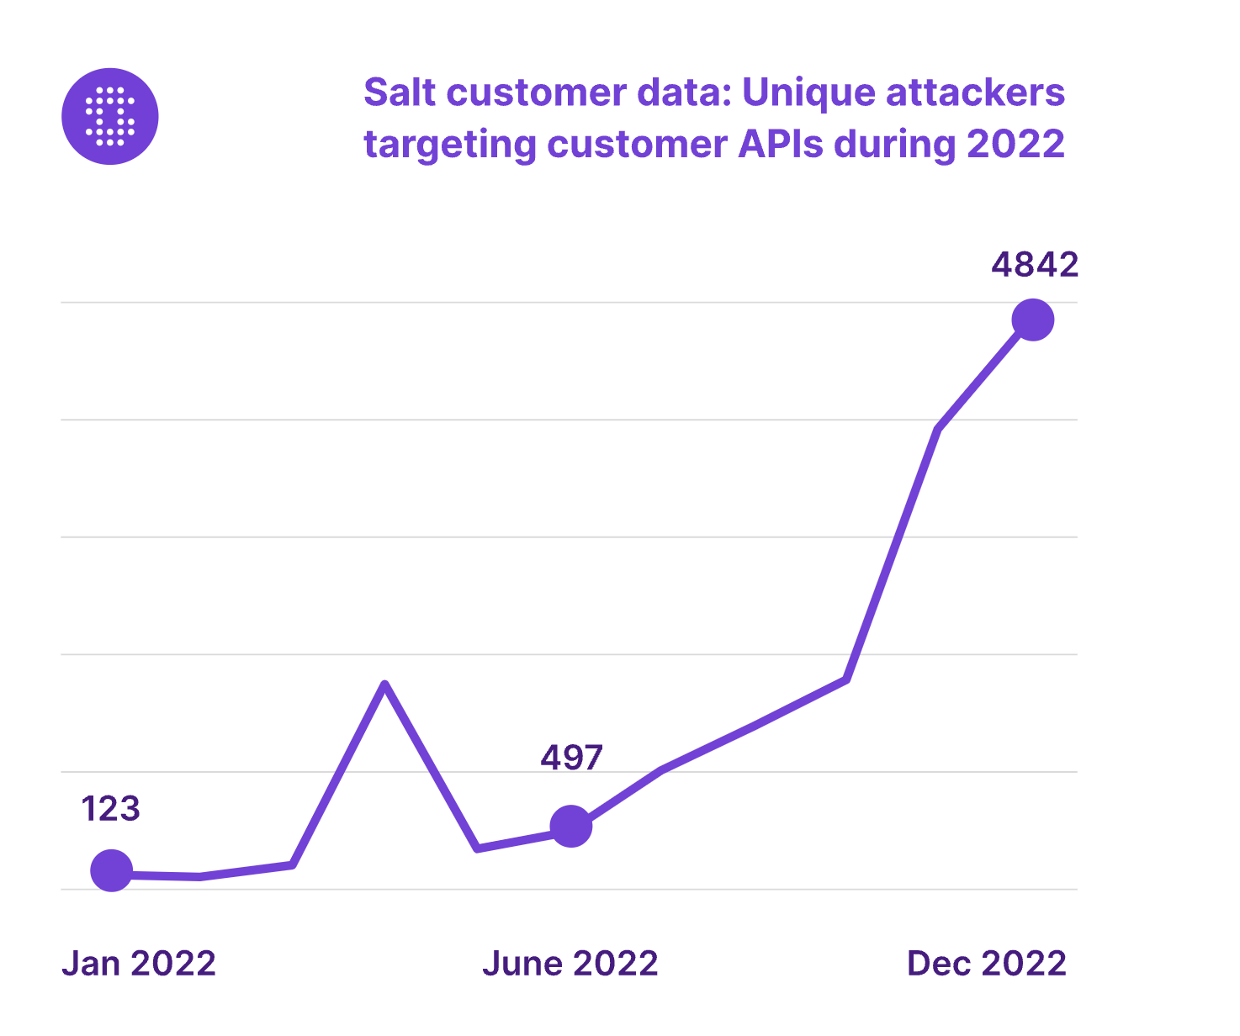
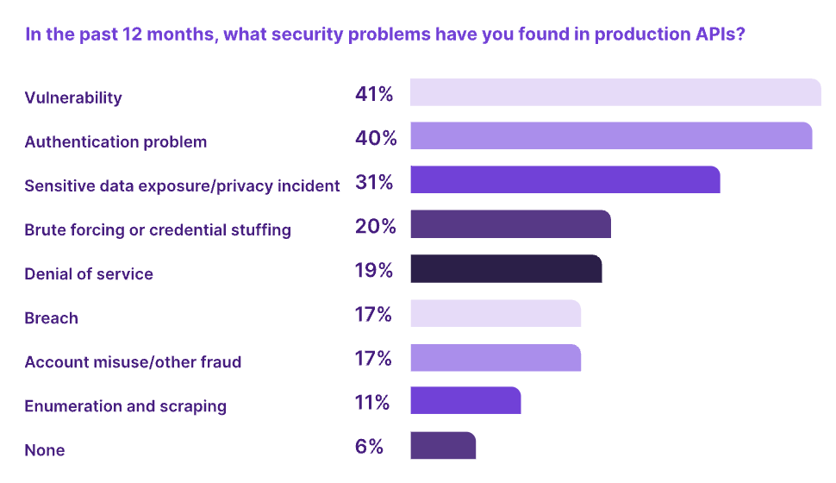
Why does API hacking become so popular?
According to Akamai research, in 2019, 83% of all web traffic is API calls.

Slide 5
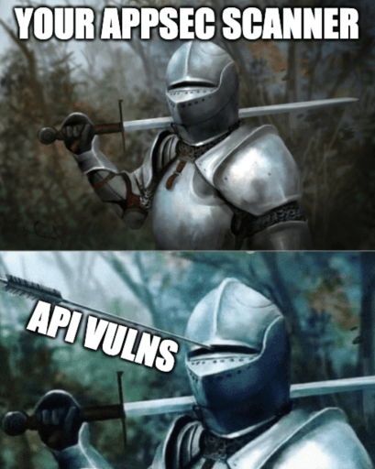

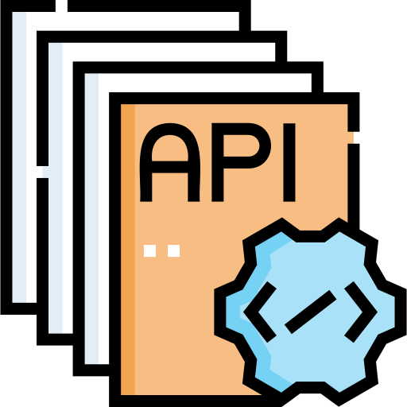

Traditional Methods - Scan everything or not?
Lots of scans, lots of tools → Lots of vulnerabilities
Which APIs do we need to scan?
When should we do scan?
Findings are meaningful or what?

Slide 6

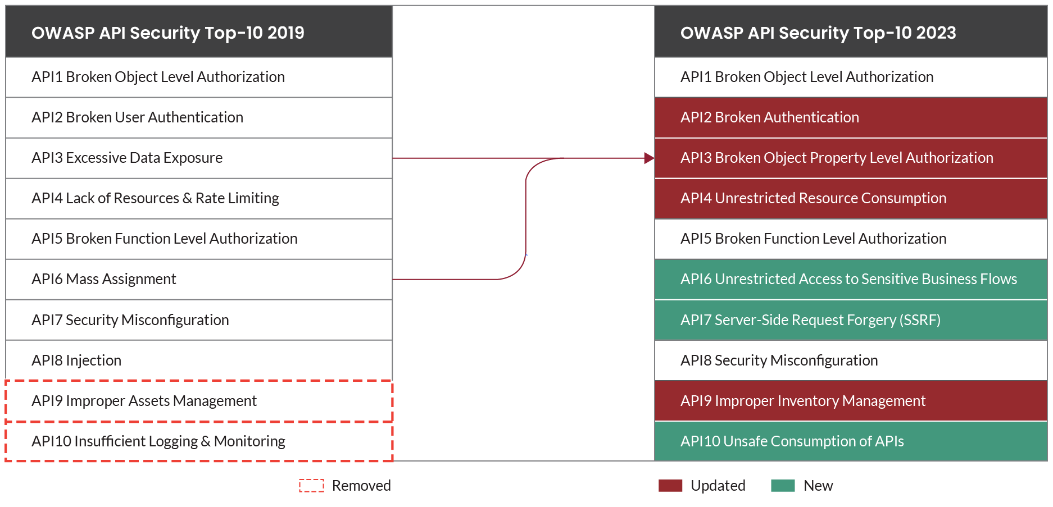
OWASP API Top 10 – 2023 changes

Slide 7
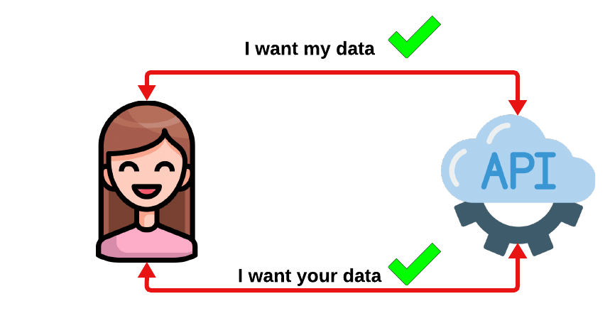
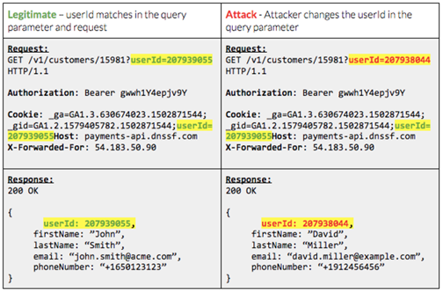
OWASP API Top 10 – 2023 changes
API1:2023 Broken Object Level Authorization
Same thing - Insecure Direct Object Reference (IDOR)
Validate that a user can only access the objects that they should have permissions to access.

Slide 8
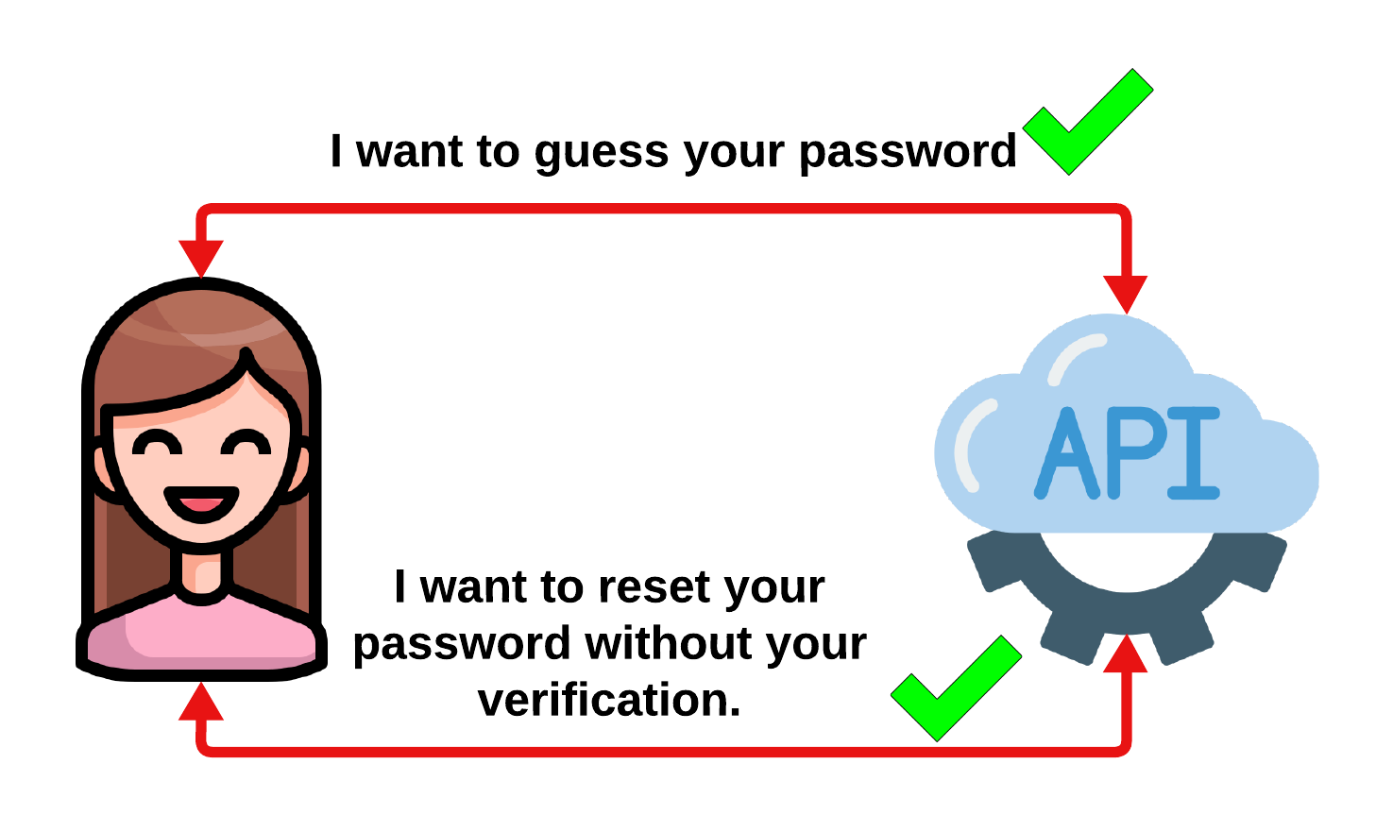

OWASP API Top 10 – 2023 changes
API2:2023 Broken Authentication
Brute forcing username & passwords,
Default or weak user credentials,
Session management misconfigurations,
Allows users to change their email address, current password without verify,
Sensitive data in URL such as passwords,
Misconfigured JWTs (JSON Web Token)

Slide 9
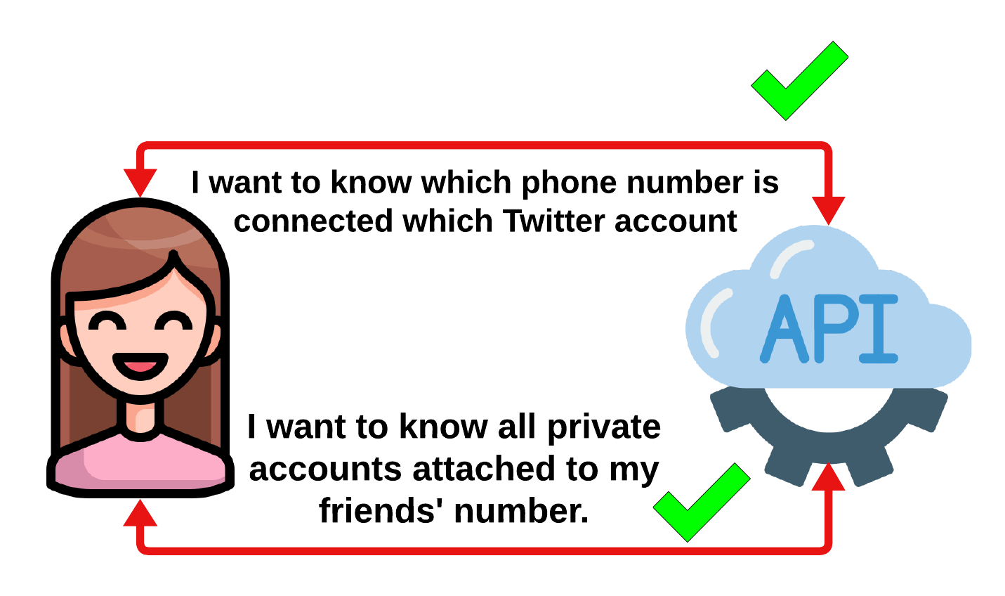
OWASP API Top 10 – 2023 changes
API3:2023 Broken Object Property Level Authorization
Previously named: “Excessive Data Exposure” + “Mass Assignment”,
Exposes lots of information in response,
API allows user to change delete or add a value of a sensitive object property that should not be able to access

Slide 10
OWASP API Top 10 – 2023 changes
API3:2023 Broken Object Property Level Authorization
Twitter Case, 2022
“if you had someone's email address or phone number, you could easily find out whether a Twitter account was tied to that address or number.”
Twitter reviewed a sample of the data, and realized that this person was indeed selling the real thing.

Slide 11
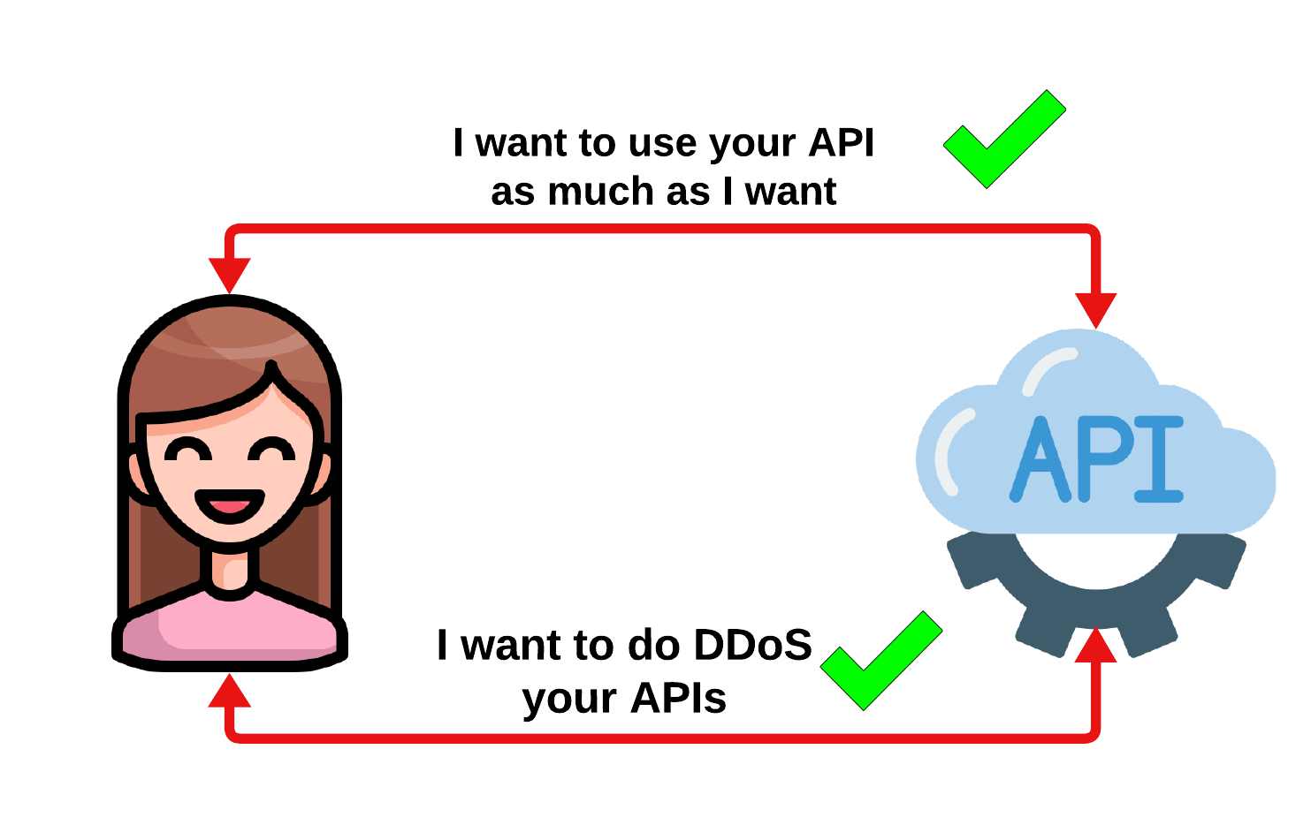
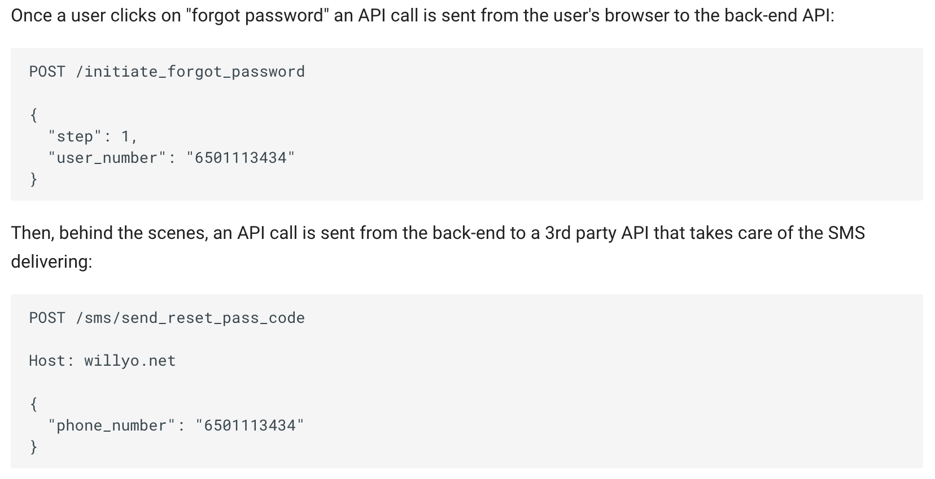


OWASP API Top 10 – 2023 changes
API4:2023 Unrestricted Resource Consumption
Limit your APIs:
Execution timeouts
Maximum allocable memory
Maximum number of processes
Maximum upload file size
Third-party service providers' spending limit

Slide 12
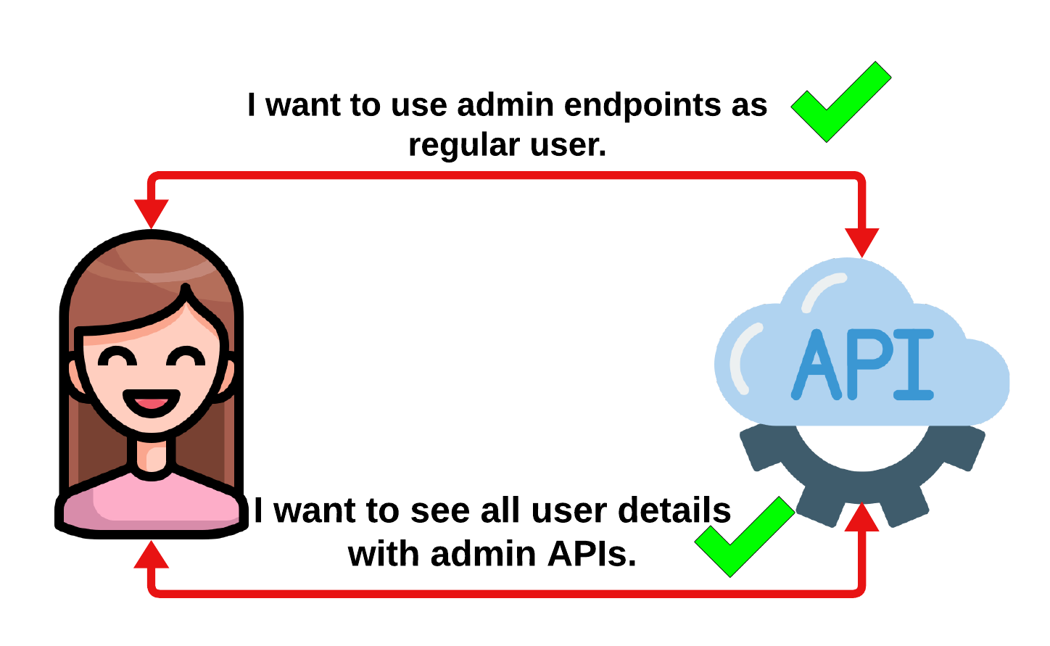
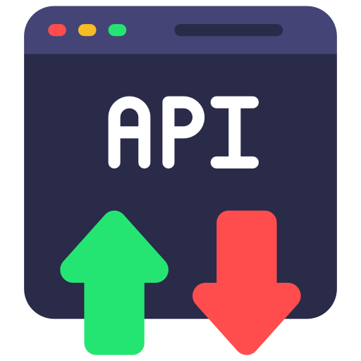
OWASP API Top 10 – 2023 changes
API5:2023 Broken Function Level Authorization
Considered as higher-level version of broken object level authorization (BOLA),
Regular user can access admin endpoints?
Change HTTP method (POST → DELETE)
Change API URL (user/change → admin/change)

Slide 13
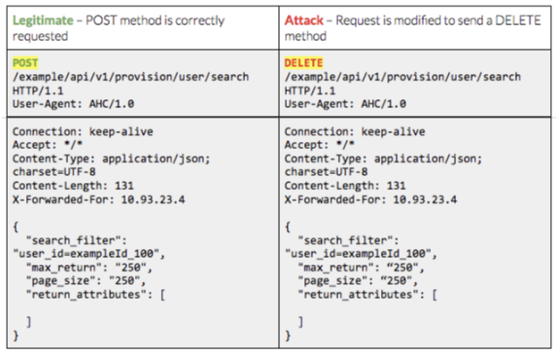
OWASP API Top 10 – 2023 changes
API5:2023 Broken Function Level Authorization

Slide 14
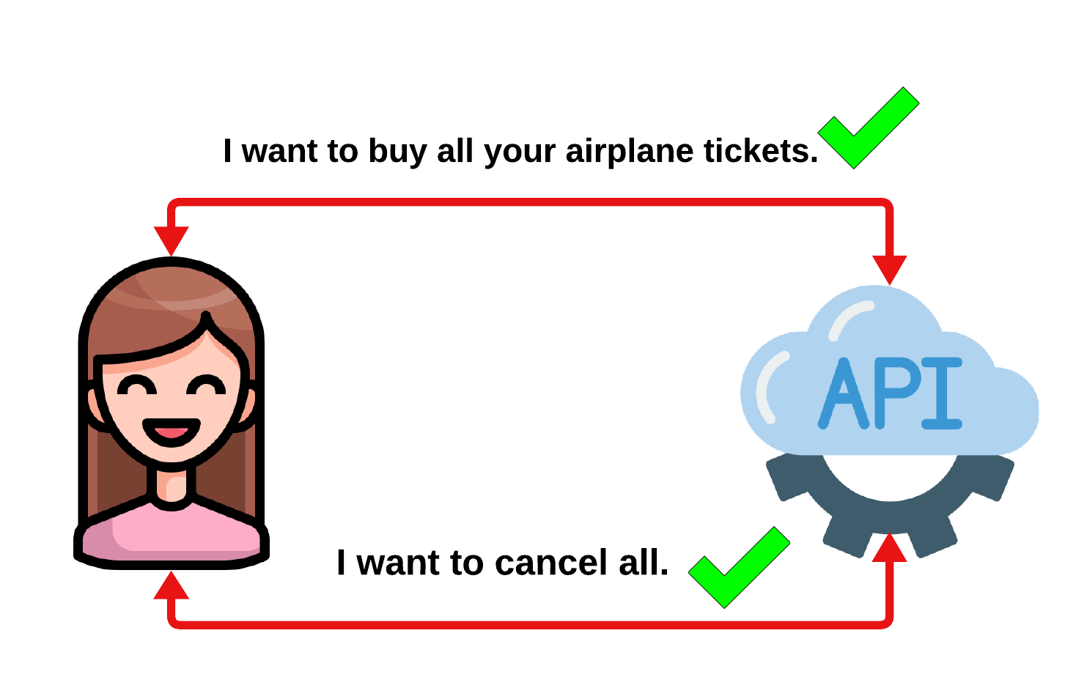
OWASP API Top 10 – 2023 changes
API6:2023 Unrestricted Access to Sensitive Business Flows
Know your business logic → Most important topic
Know your risk → Which API exposures are important than others?
It’s difficult to detect attackers or normal users?
Example: Booking 90% of the seats on a flight online, taking advantage of the fact that the airline would charge no cancellation fee.

Slide 15
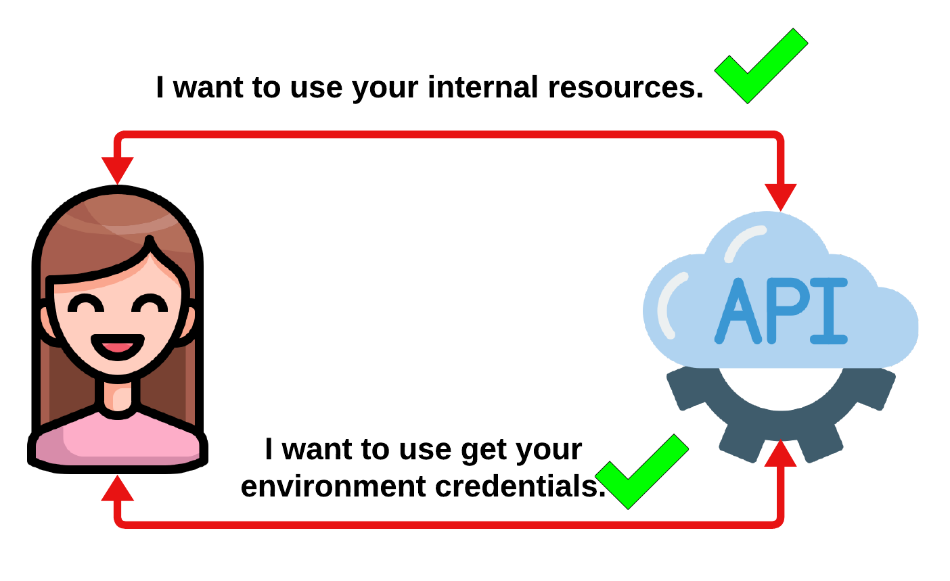
OWASP API Top 10 – 2023 changes
API7:2023 Server Side Request Forgery
Fetching a remote resource without validating the URL
On cloud providers → well known paths (example: 169.254.169.254)
Capital One breach, 2019:
Approximately 100 million individuals in the United States
approximately 6 million in Canada
curl http://example.com/?url=http://169.254.169.254/latest/meta-data/iam/security-credentials/

Slide 16
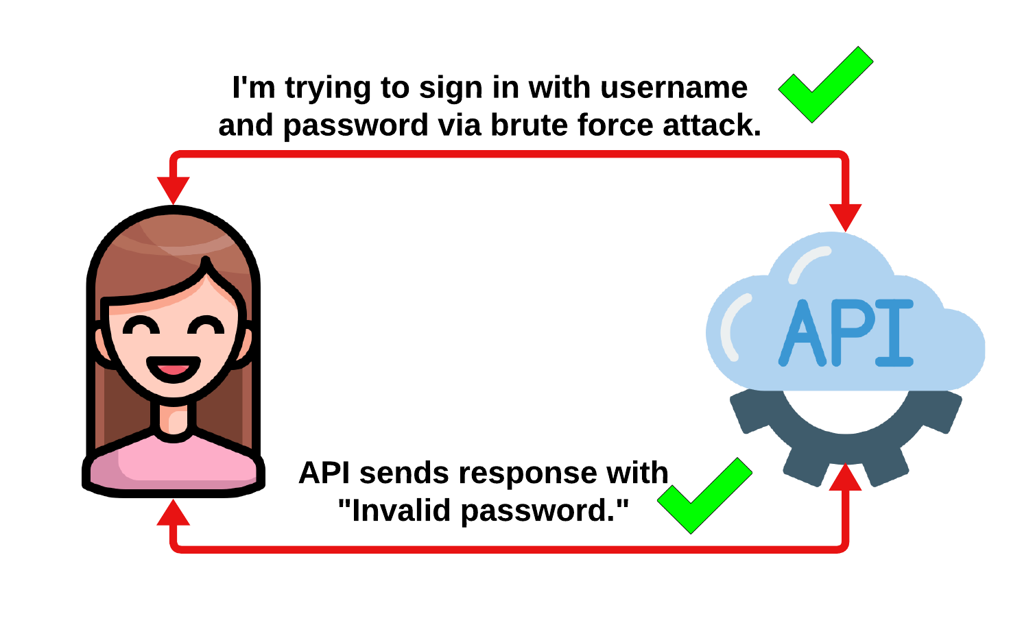
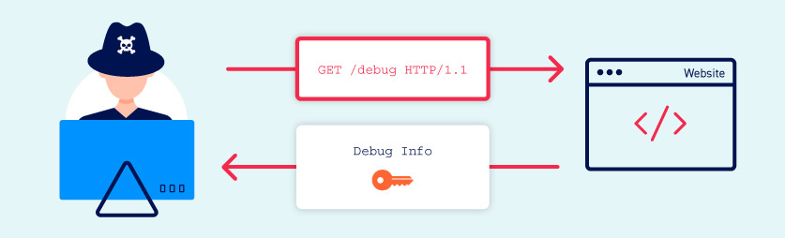
OWASP API Top 10 – 2023 changes
API8:2023 Security Misconfiguration
Security patches,
TLS configurations,
Cross-Origin Resource Sharing (CORS) policy is missing or improperly set,
Error messages that cause information disclosure.

Slide 17
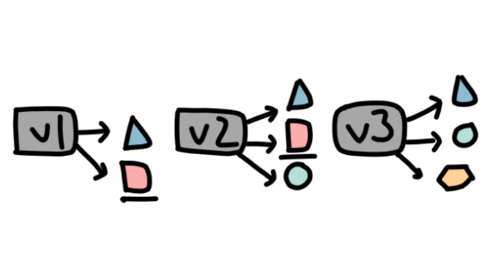
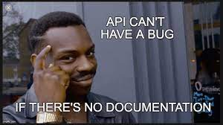
OWASP API Top 10 – 2023 changes
API9:2023 Improper Inventory Management
The purpose of an API host is unclear, and there are no explicit answers to the following questions:
Which environment is the API running in (e.g. production, staging, test, development)?
Who should have network access to the API (e.g. public, internal, partners)?
Which API version is running?
There is no documentation or the existing documentation is not updated.
There is no retirement plan for each API version.
The host's inventory is missing or outdated.

Slide 18



OWASP API Top 10 – 2023 changes
API10:2023 Unsafe Consumption of APIs
3rd party API & library integration,
Using unencrypted channel to interact (HTTP),
No validation,
Blindly follows redirections,
Does not limit the number of resources available to process third-party services responses,
Does not implement timeouts for interactions with third-party services

Slide 19
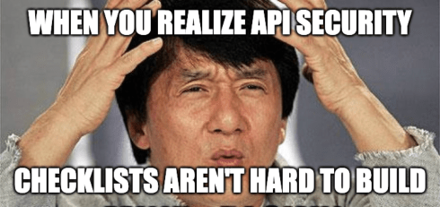
10 Things You Should Do-Review, Analyze, Detect
Always know your architecture, needs and strengths,
What are the possible attack surfaces in my environment?
Do we know who is the responsible of what?
What / When should we need to change to protect?
Regular review will save your life.
Architecture & code base & APIs are always updated.
You need to review all of them.

Slide 20
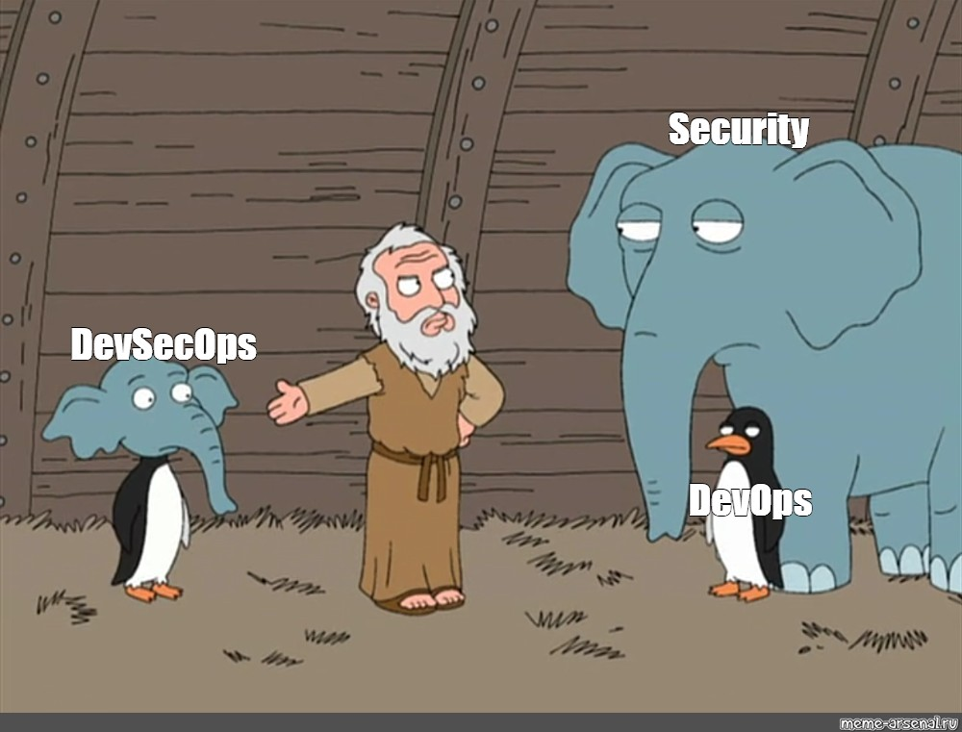
10 Things You Should Do-Don’t DevOps Do DevSecOps
DevSecOps is required.
You need to secure your CI/CD. (APIs are build from CI/CD)
Follow the DecSecOps principles in your development process.
Always think security in every step.

Slide 21
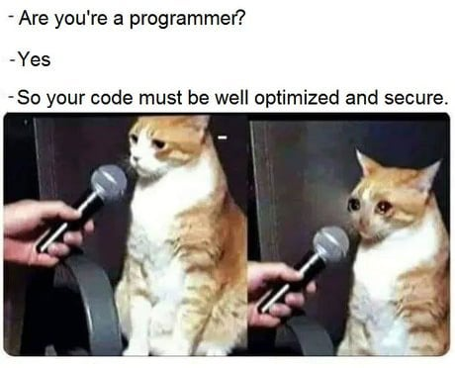
10 Things You Should Do-Scan and Test
Yes, we still need scanning and testing process.
SAST (Static Application Code Testing)
DAST (Dynamic Application Code Testing)
API security testing following OWASP Top 10.
Prioritize vulnerability & finding results, solve them as soon as possible.

Slide 22


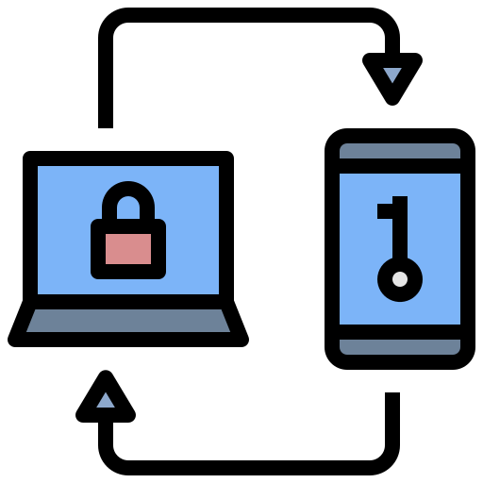
10 Things You Should Do-Authenticate & Authorize
Authenticate everything,
Use strong password policies,
Always implement MFA (yes, it is a necessity)
JWT validation & verification with access control mechanisms,
Use the standards in authentication, password storage and session management (like OAuth 2.0)
Implement a proper authorization mechanism with proper access control policies,
Use unpredictable values for IDs,
Write authorization tests

Slide 23


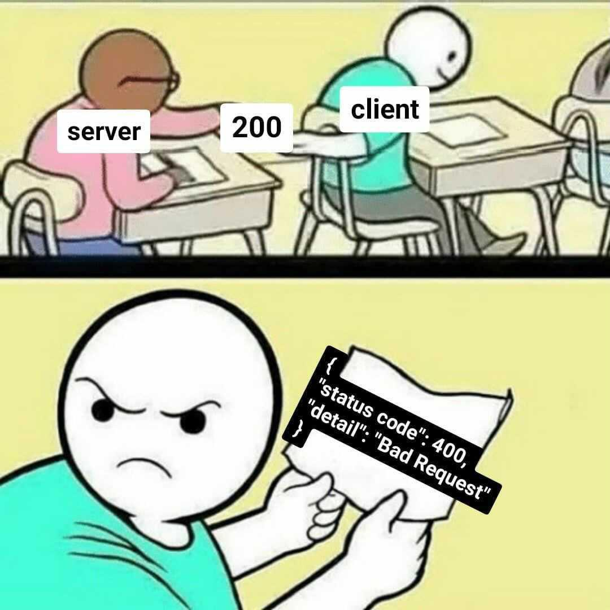
10 Things You Should Do-Validate Everything
Ensure only properly formed data is entering the API.
Check everything your backend accepts.
What types of requests do the API support (GET, POST)?
What are the expected inputs and outputs for each request?
SQL Injection, XML Bomb etc.

Slide 24

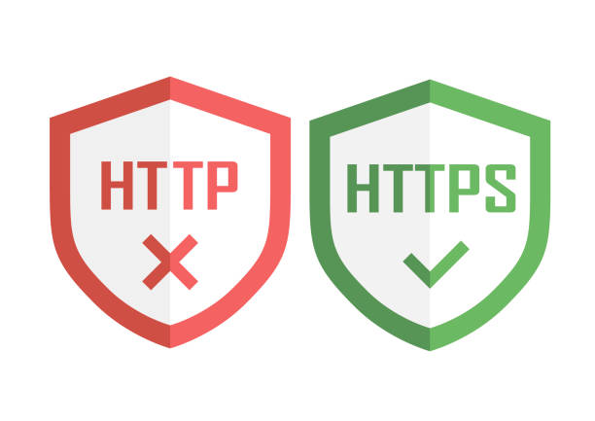
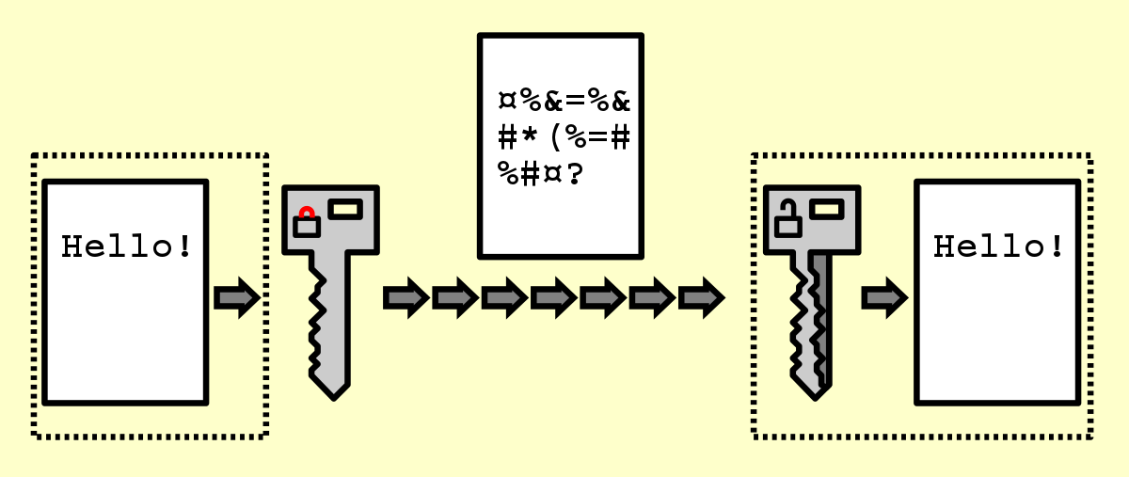

10 Things You Should Do-Encrypt Everything
Be cryptic.
Encrypt in transit.
Use the latest TLS versions.
Encrypt in rest.

Slide 25

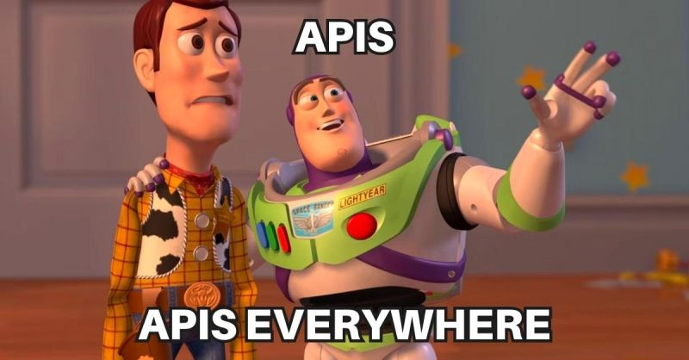
10 Things You Should Do-Document Everything
Documentation is still an issue.
Read & Write
What are the changes?
What are the API security issues?
What are the architectural concerns?

Slide 26
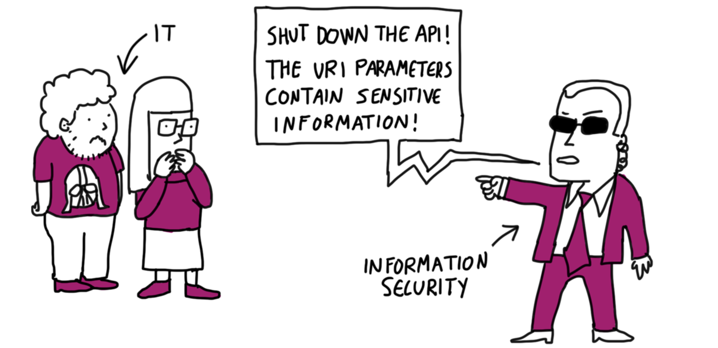
10 Things You Should Do-Share Minimum Data
Be paranoid → Your APIs are your world,
Display as little information as possible in responses,
General error messages and codes,
Use IP whitelist and IP blacklist,
Restrict access to your resources,

Slide 27



10 Things You Should Do-Audit & Logging & Monitoring
Be a stalker,
Log everything,
Use monitoring dashboards,
Use alerts,

Slide 28
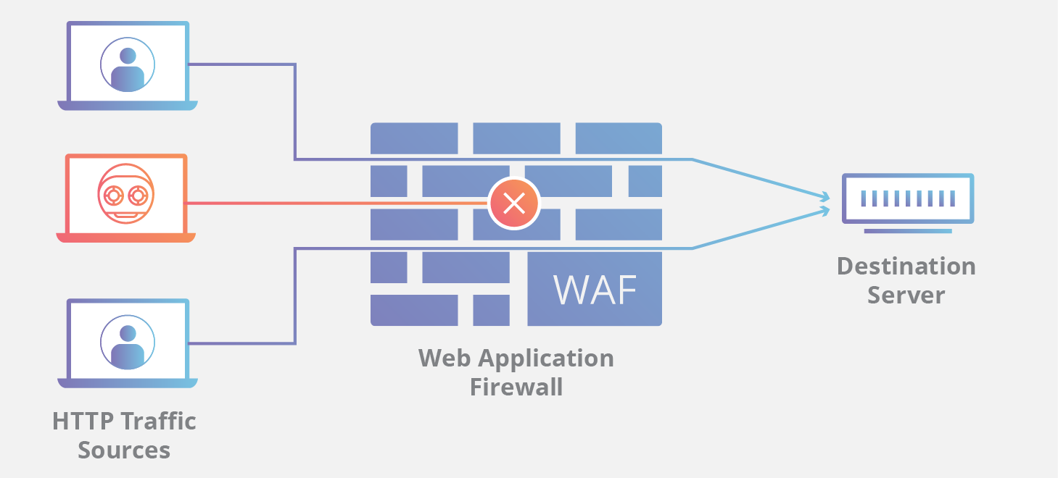
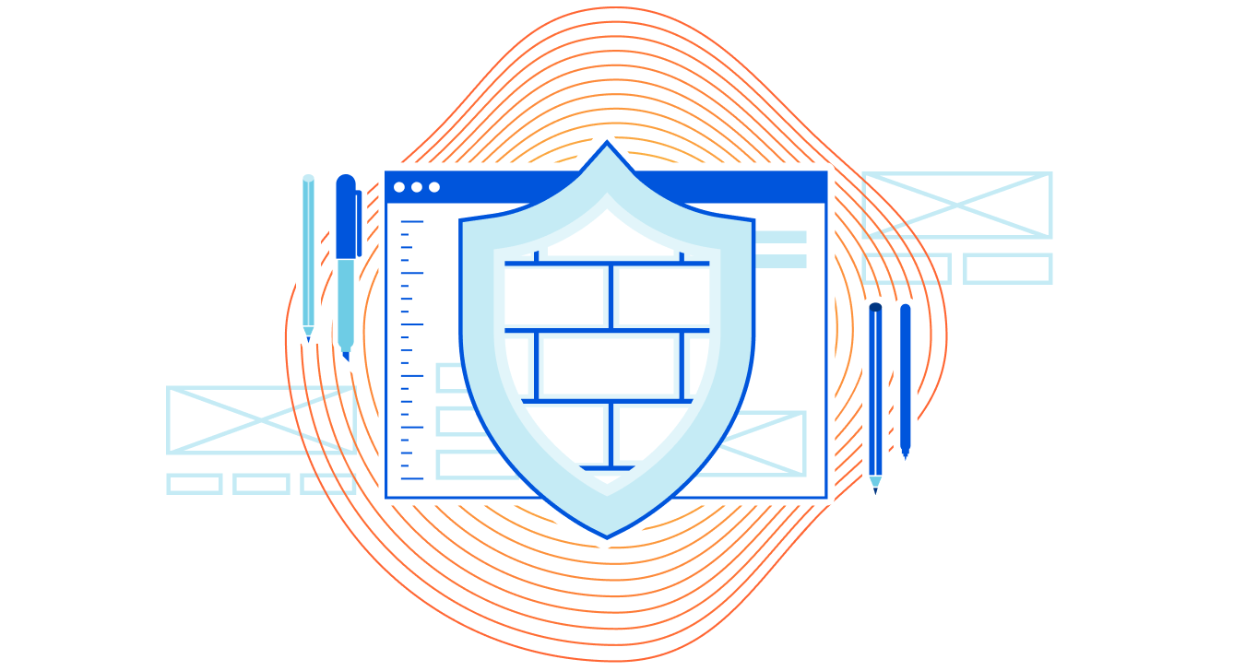
10 Things You Should Do-Use WAF (Web App Firewall)
To protect your REST API from common web exploits, such as SQL injection and cross-site scripting (XSS) attacks,
Bot protection,
Vulnerability scanners protection,
Not enough individually, but it’s a good start.

Slide 29

Questions?
Sena YAKUT
Developer Summit, 2023

