Slide 1
CSE4095 – Introduction to Natural Language Processing
150116021 Mikail Torun
150119841 Zehra Kuru
150117033 Feyza Nur Bulgurcu
150119706 Sena Dilara Yangöz
150117012 Yusuf Talha Erdem
150117050 Alpago Göktenay Göçer
LECTURER : Assoc. Prof MURAT CAN GANİZ

Slide 2

Outline
Introduction
Three Methods for Collocations
Results
Conclusion

Slide 3

Introduction
Aim of the Project
Scope of the Project
Dataset Pre-processing

Slide 4
Three Methods for Collocations
Frequency Method
Bigram
Trigram
Trigram
Mutual Information Method
Bigram
Bigram
T-Value Test Method
Trigram
Frequency Method
Frequency – T-Test Method
T-Value Test Method
Mutual Information Method

Slide 5
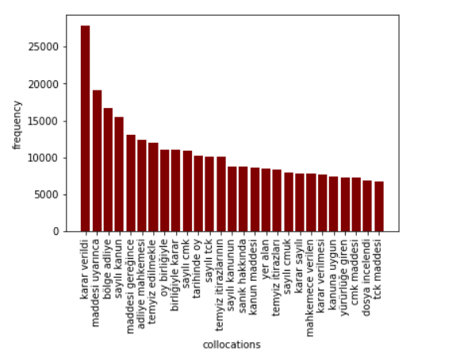
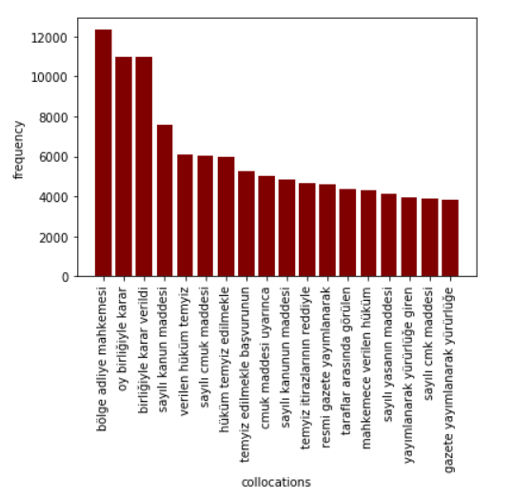
Frequency Method with Bigram and Trigram

Slide 6
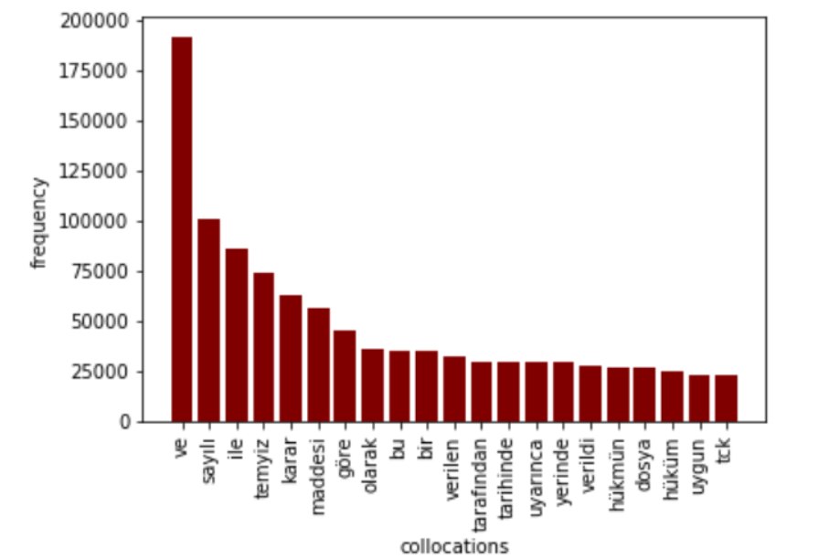
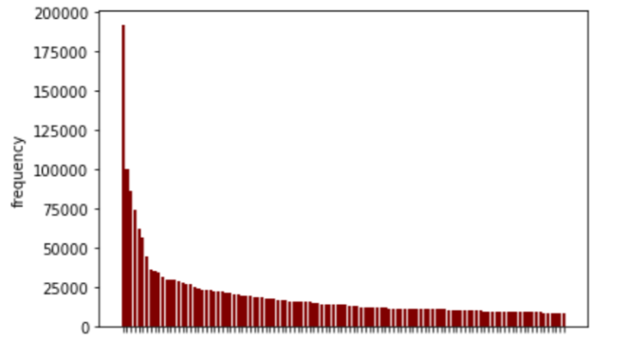
Most Frequent Unigram Words & Heavy Tail (Zip’s Dis.)

Slide 7
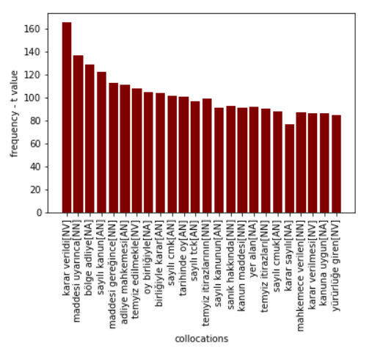
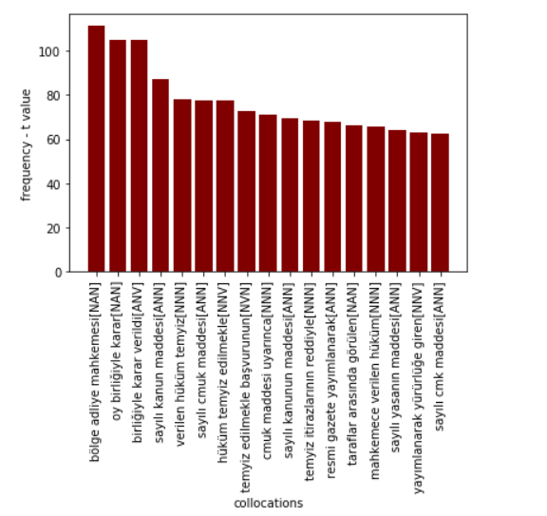
Frequency Method – T-test with Bigram and Trigram

Slide 8
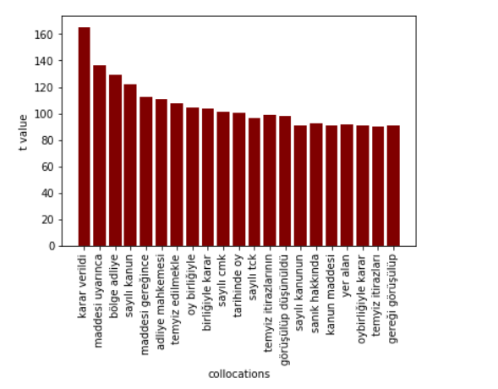
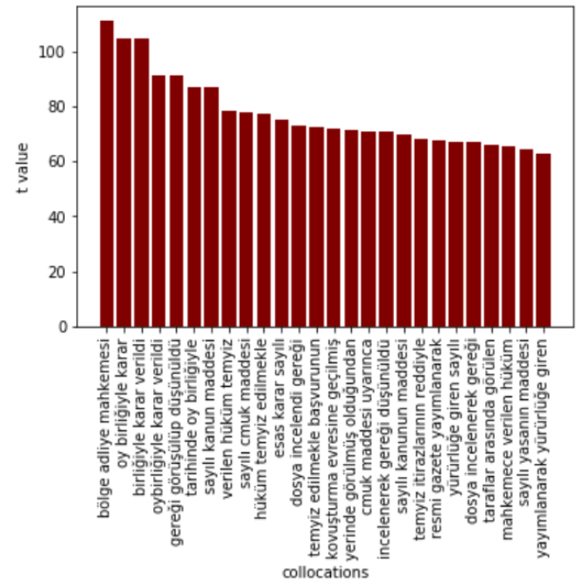
T-Value Test Method with Bigram and Trigram

Slide 9
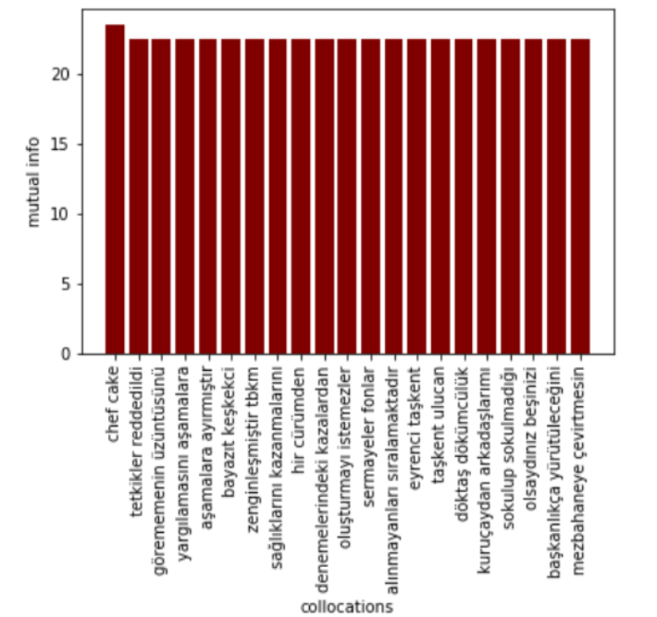
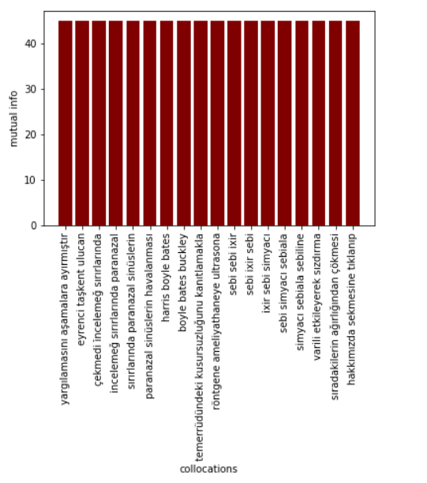
Mutual Information Method with Bigram and Trigram

Slide 10
The Best Method is…
Results & Conclusion
Frequency method

