Slide 1

GMT-458
Full Stack Web Gis Project
Emirhan Bıçkıcı
2210674004

Slide 2
Summary of the Project
A small web app for reporting issues on Hacettepe University Beytepe Campus.
Clicking on the map to create a marker to report an issue
The report contains the the lat and long of the clicked marker
User can describe the issue in the report.
There are 3 roles; admin,student, and staff
Students can create a report and edit/delete own reports
Students can only edit their report’s status as (open / in_progress)
Staff can update status and assignment for any report
Admin has full access (users + reports)
Managing different user types , Crud operations, Authentication, Api development, and AWS integration are carried out in this Project.

Slide 3
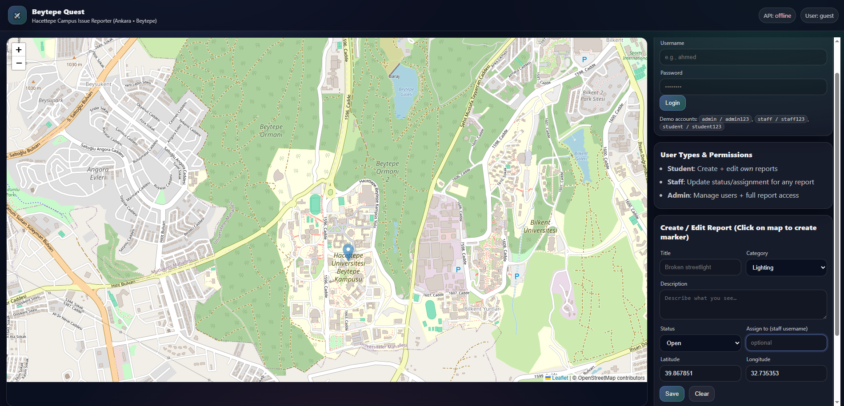
Interface

Slide 4
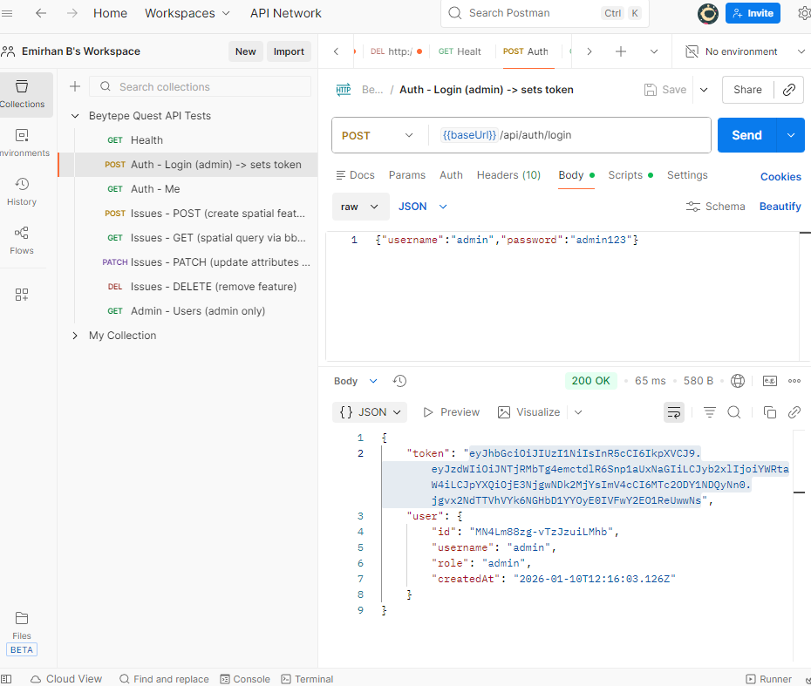
Creating a token in postman

Slide 5
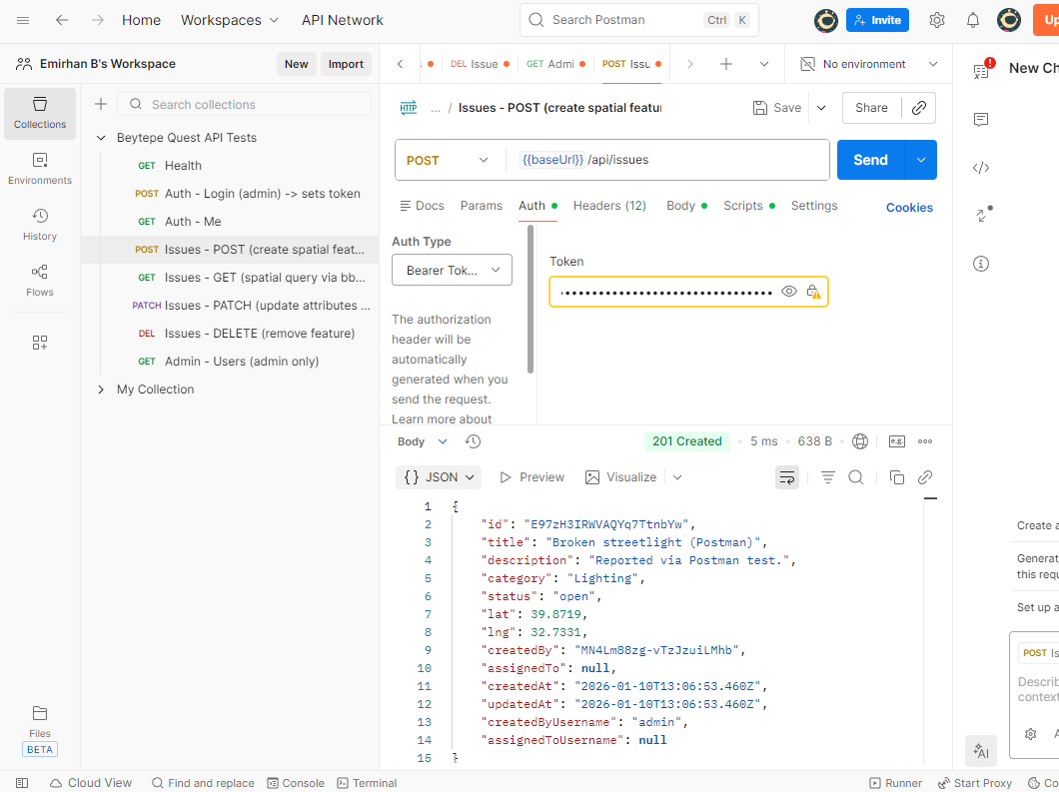
Posting an issue

Slide 6
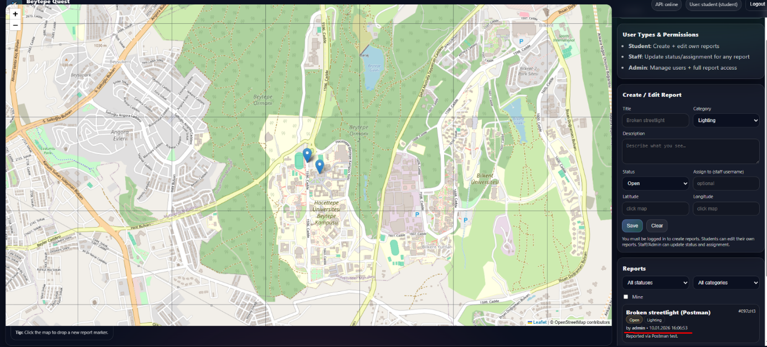
Refreshed Interface

Slide 7
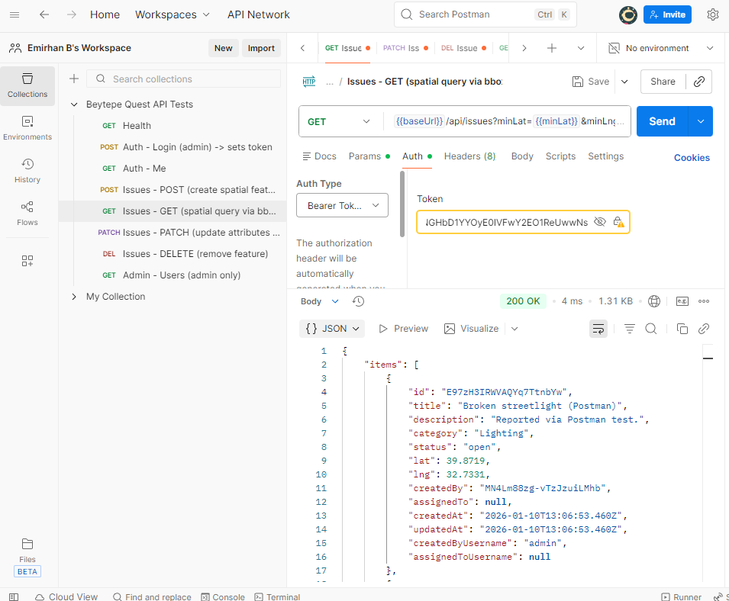
Get the issues

Slide 8
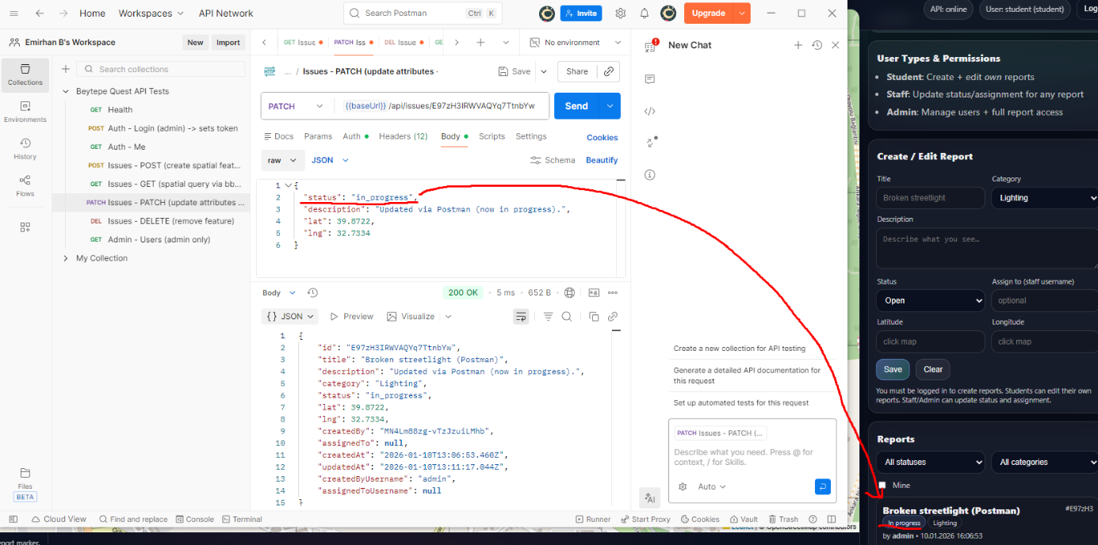
Patch the issues

Slide 9
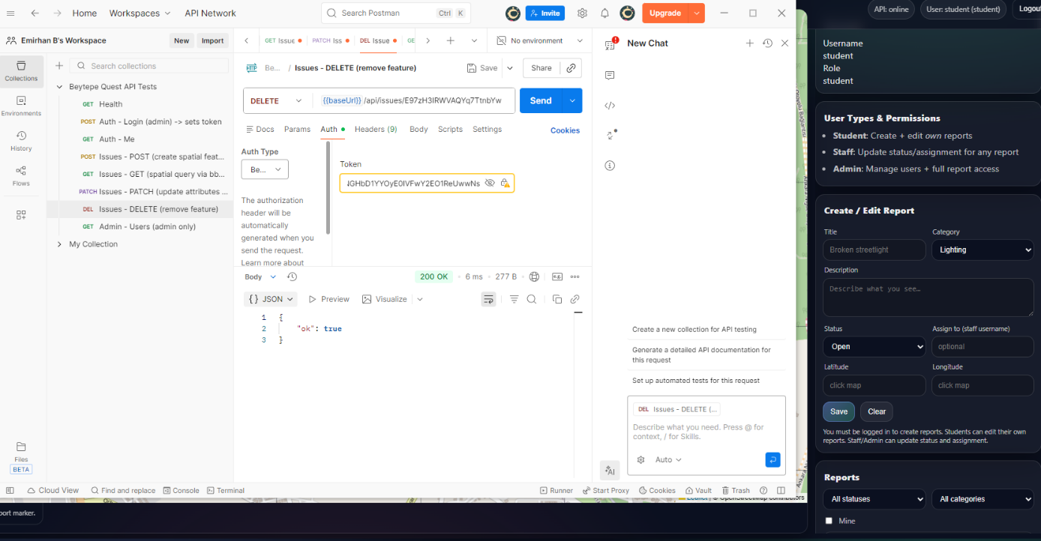
Delete the issues

Slide 10
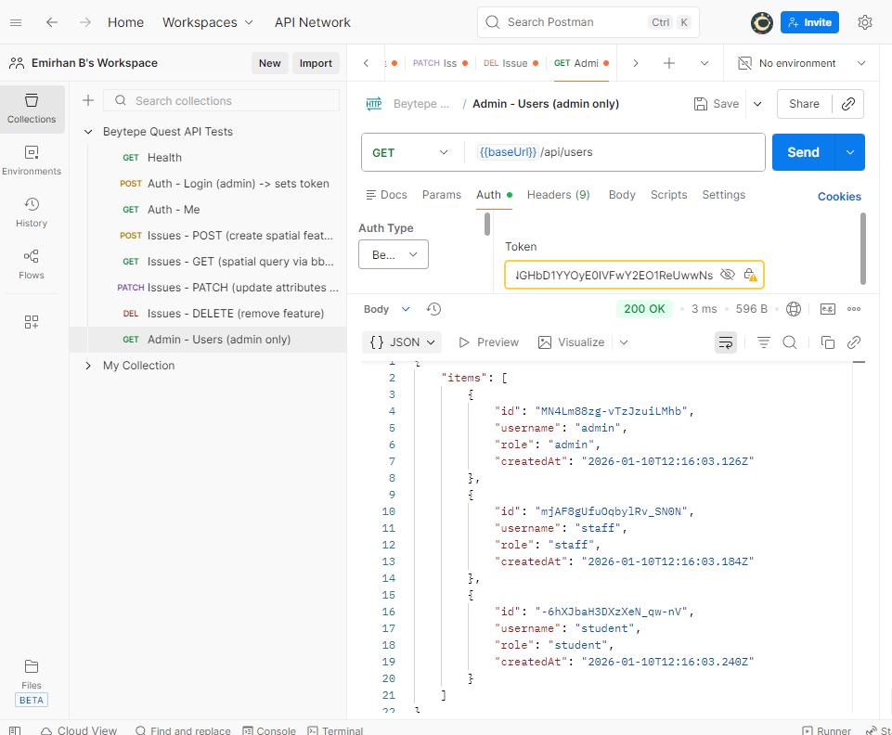
Get the users

Slide 11
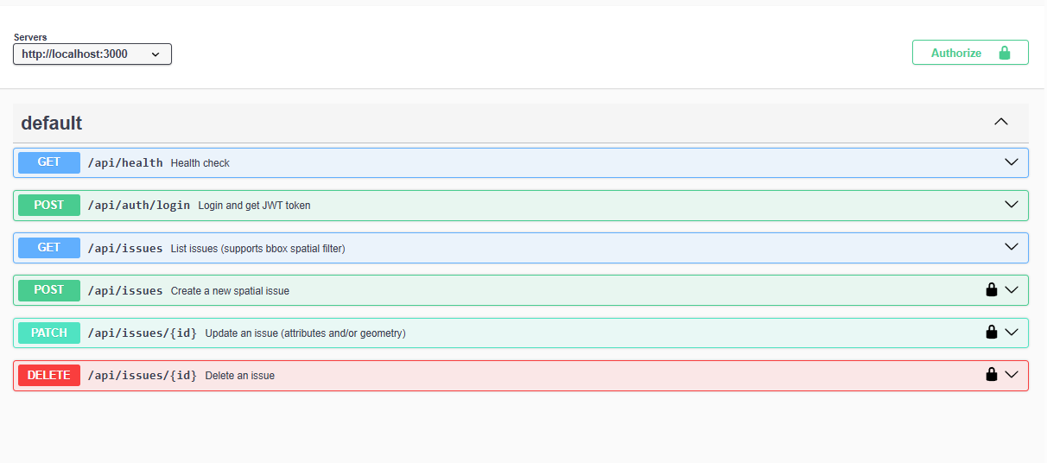
Swagger UI

Slide 12
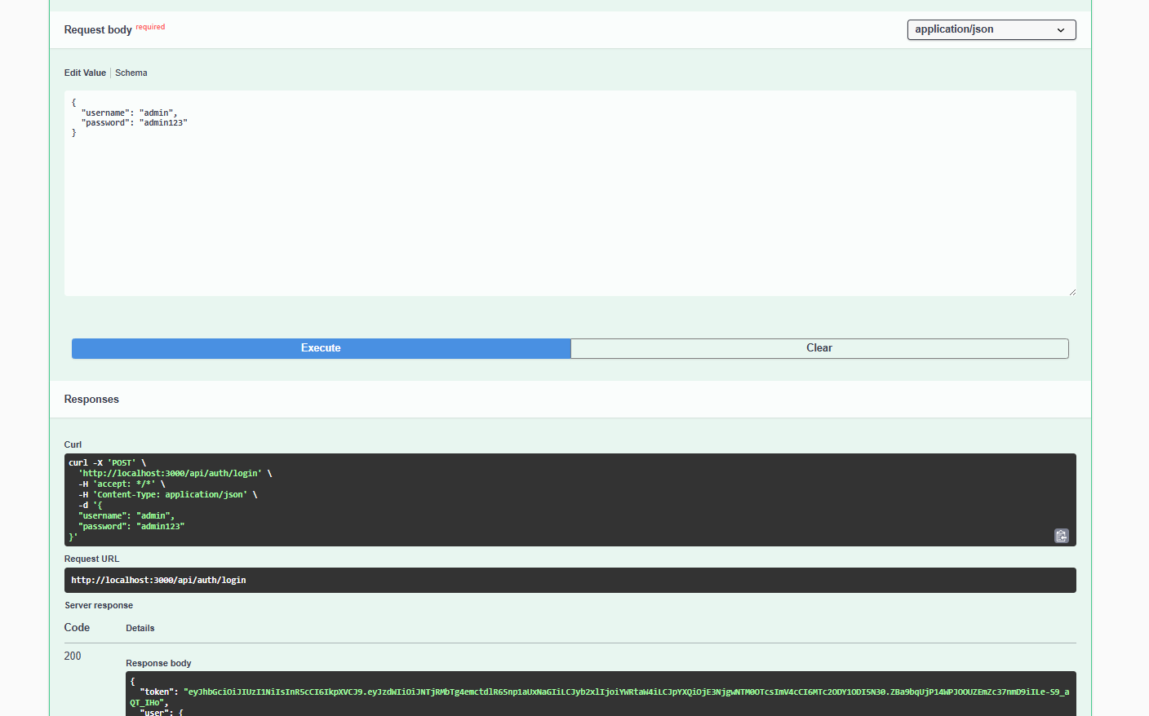
Creating a token

Slide 13
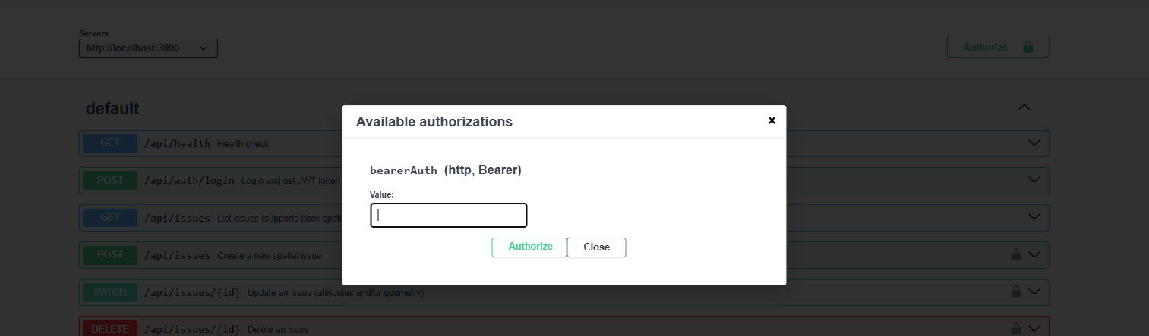
Authorize with the token

Slide 14
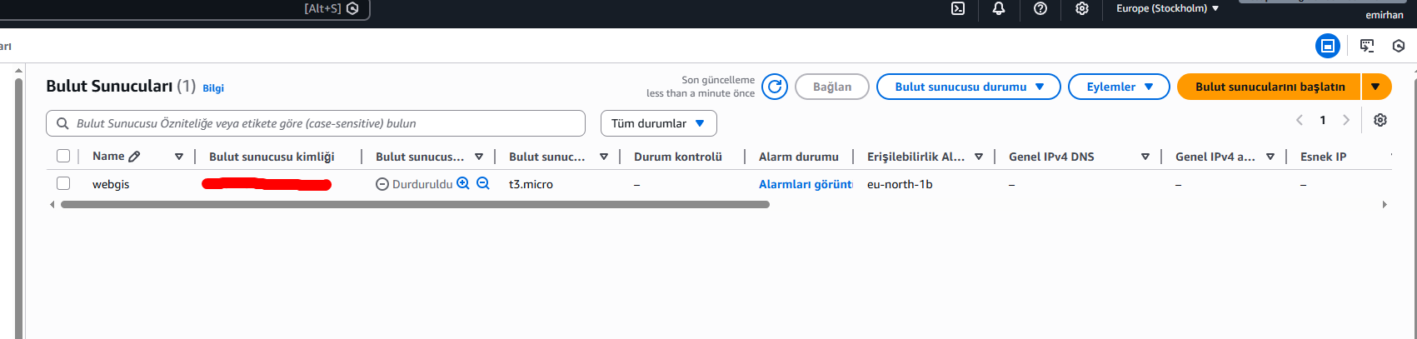
AWS Integration

Slide 15
Links
Site link: http://16.171.165.121:3000/
SwaggerUI link : http://16.171.165.121:3000/api/docs/#/

Slide 16
Thank you for listening

