Slide 1
Week 1:
DIGITAL IMAGE FUNDAMENTALS

Slide 2
OUTLINE
Image formation model
Image sampling and quantization
Spatial and intensity resolution
Image interpolation
Some basic relationships between pixels
Geomteric spatial transformations and image registration

Slide 3
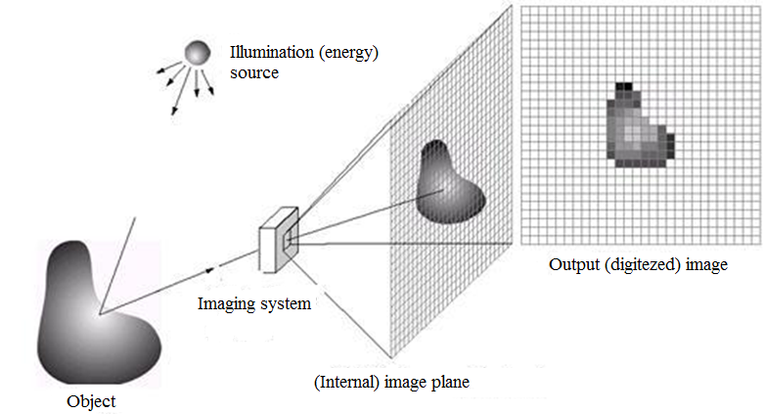
Image Formation Model

Slide 4
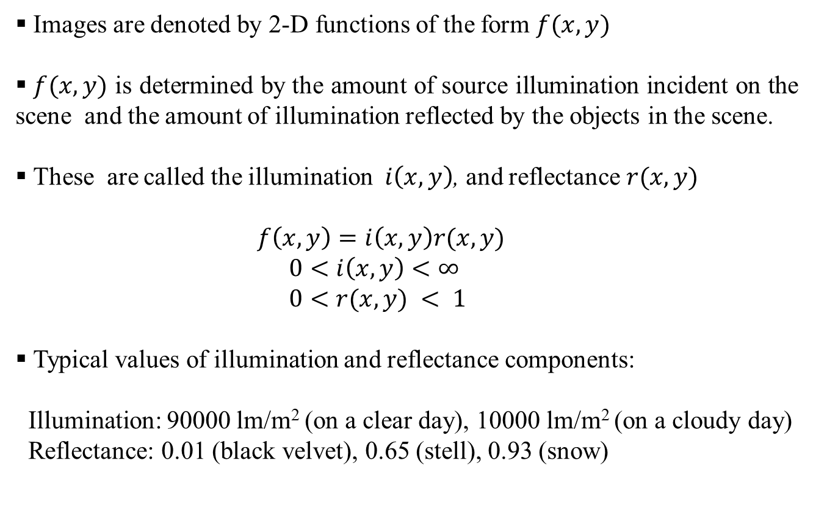
Image Formation Model
Images are denoted by 2-D functions of the form $f(x,y)$
$f(x,y)$ is determined by the amount of source illumination incident on the scene and the amount of illumination reflected by the objects in the scene.
These are called the illumination $i\left(x,y\right)$, and reflectance $r(x,y)$
$f\left(x,y\right)=i\left(x,y\right)r(x,y)$
$0<i\left(x,y\right)<∞$
$0<r(x,y) < 1$
Typical values of illumination and reflectance components:
Illumination: 90000 lm/m² (on a clear day), 10000 lm/m² (on a cloudy day)
Reflectance: 0.01 (black velvet), 0.65 (stell), 0.93 (snow)

Slide 5
Image Sampling and Quantization
The goal in image sampling and quantization is to convert the continuous-time light energy at the output of the imaging sensor into a digital image.
To digitize the continous-time function f(x,y), both its coordinate values and its amplitudes must be digitzed.
Digitizing the coordinate values is called SAMPLING.
Digitizing the amplitude values is called QUANTIZATON.

Slide 6
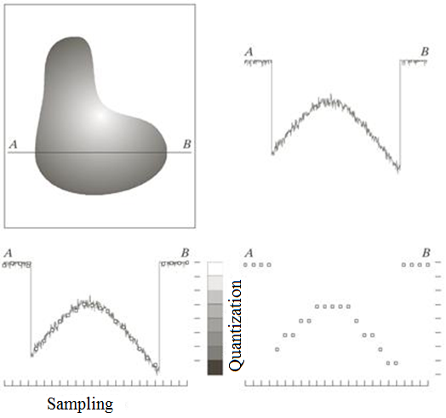
Image Sampling and Quantization

Slide 7
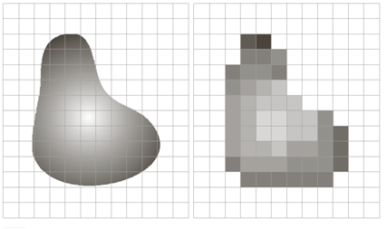
Image Sampling and Quantization

Slide 8
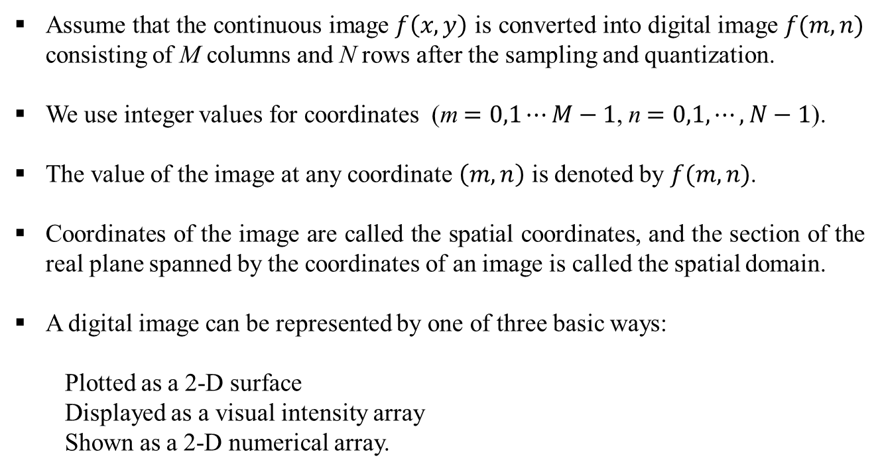
Representing Digital Images
Assume that the continuous image $f\left(x,y\right)$ is converted into digital image $f(m,n)$ consisting of M columns and N rows after the sampling and quantization.
We use integer values for coordinates (m$=0,1⋯M−1$, n$=0,1,⋯,N−1$).
The value of the image at any coordinate $\left(m,n\right)$ is denoted by $f(m,n)$.
Coordinates of the image are called the spatial coordinates, and the section of the real plane spanned by the coordinates of an image is called the spatial domain.
A digital image can be represented by one of three basic ways:
Plotted as a 2-D surface
Displayed as a visual intensity array
Shown as a 2-D numerical array.

Slide 9
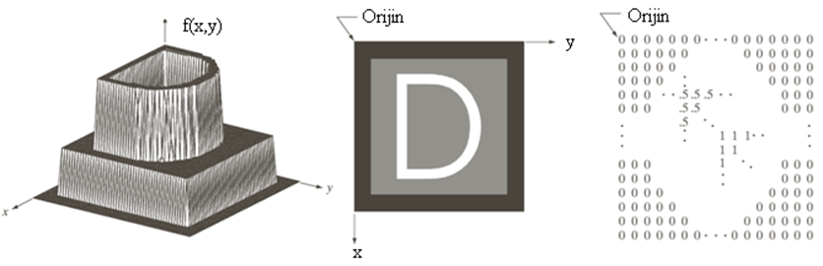
Representing Digital Images
2-D surface
Visual intensity array
2-D numerical array

Slide 10
Representing Digital Images
When digitizing a digital image, we should decide on the dimensions (M, N) and the number of intensity levels (L). Other than being positive, there are no constraints on M and N. Since the processors perform algebraic expressions in base 2, L is chosen such that it is an integer multiple of 2
L = 2^{k}
Intensity values are assumed to be an integer in the interval [0, L-1].
The ratio of the maximum measurable intensity to the minumum discrenbile intensity is called the dynamic range.
The difference between the maximum and minimum intensity levels is called the contrast.
The number of bits b required to represent a digital image is computed from
b= M x N x k
If M = N, then b = N²k

Slide 11
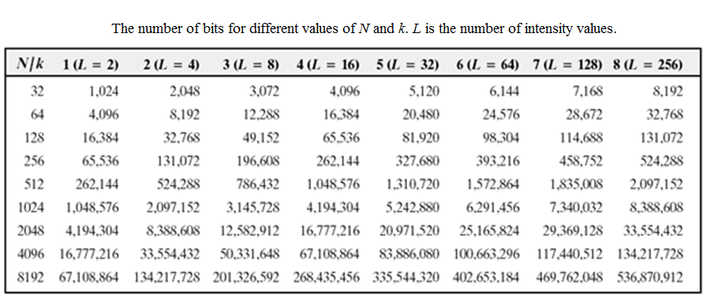
Representing Digital Images

Slide 12
Spatial and Intensity Resolutions
The spatial resolution is the largest number discernible line pairs per unit distance.
The unit frequently used for the spatial resolution is the number of dots per unit distance. If the unit distance is chosen as inch, the spatial resolution becomes number of dots per inch (dpi).
Specifying M and N is not enough for the spatial resolution. We must also specify the dimensions of the image in terms of the distance.
Intensity resolution is the smallest discernible change in intensity level.
Intensity resolution is represented by numbers that are an integer power of 2 such as 8, 16. For istance, if an image has 256 intensity levels, its intensity resolution is 8 bits.

Slide 13
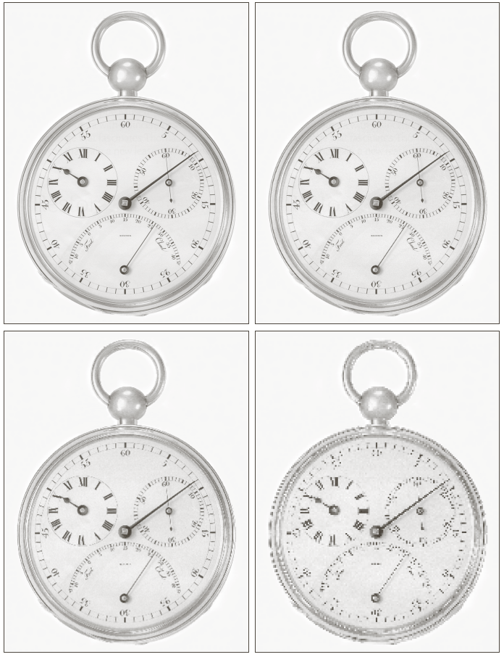
Spatial and Intensity Resolutions
The spatial resolutions are: 1250, 300, 150, 7 (dpi).

Slide 14
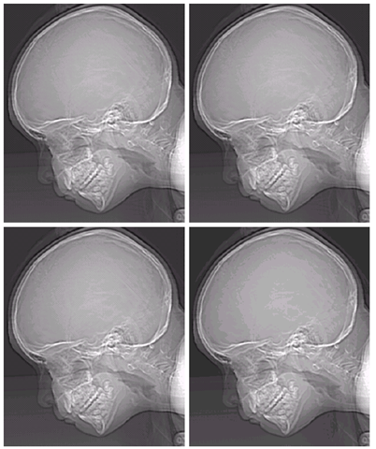
Spatial and Intensity Resolutions
Intensity resolutions are L = 256, 128, 64, 32.

Slide 15
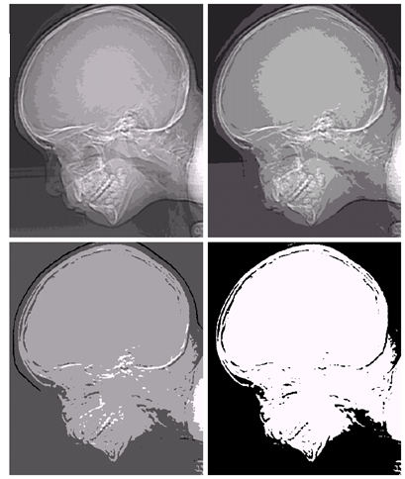
Spatial and Intensity Resolutions
Intensity resolutions are L = 16, 8, 4, 2.

Slide 16
Image Interpolation
Interpolation is the process of using known data to estimate values at unknown locations.
Suppose that an image of size 500 x 500 pixels has to be enlarged 1.5 times to 750 x 750 pixels.
An imaginary 750 x 750 grid with the same pixel spacing as the original is created. Then, it is shrinked so that it fits excatly over the original image.
The pixel spacing in the shrunken 750 x 750 grid will be less than the pixel spacing in the original grid. Hence, the intensity values at newly created pixel locations must be determined. For this purpose, there are several methods such as
Nearest-neighbor interpolation
Bi-linear interpolation
Bi-cubic interpolation

Slide 17
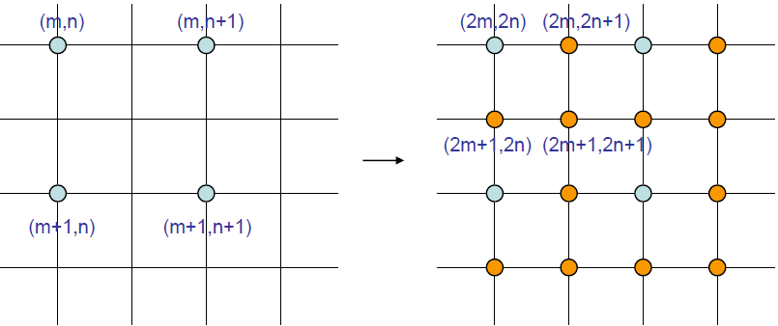
Image Interpolation
Example: Factor of 2 upsampling
image to be interpolated
interpolated image
Blue samples are retained in the interpolated image.
Orange samples are estimated from the surrounding blue samples.

Slide 18
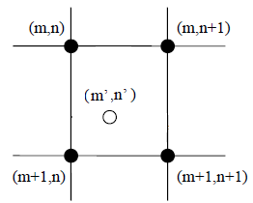
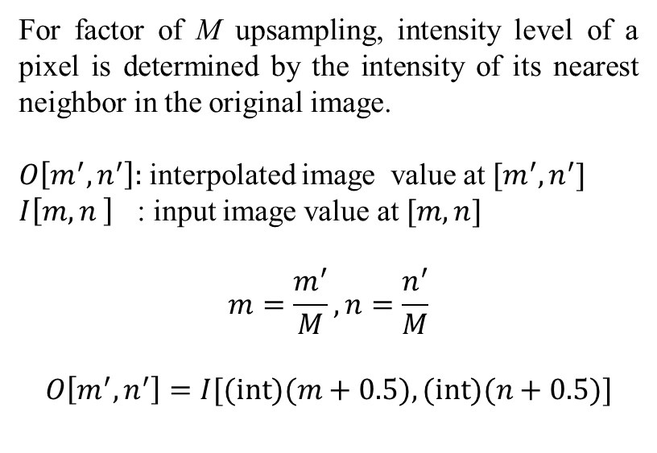
Image Interpolation (Nearest Neighbor Interpolation)
For factor of M upsampling, intensity level of a pixel is determined by the intensity of its nearest neighbor in the original image.
$O\left[m^{′},n^{′}\right]:$ interpolated image value at $[m^{′},n^{′}]$
$I\left[m,n \right]$ : input image value at $[m,n]$
$$m=\frac{m^{′}}{M}, n=\frac{n^{′}}{M}$$
$$O\left[m^{′},n^{′}\right]=I[(\text{int})(m+0.5),(\text{int})(n+0.5)]$$
NNI is also known as pixel replication because each pixel value in the input image is replaced by $M×M$ pixels of the sample value in the output image.

Slide 19






Image Interpolation (Nearest Neighbor Interpolation)
Example: Factor of 2 interpolation by NNI
$$I[m,n]$$
$$O[m,n]$$
$$O\left[2m,2n\right]=I\left[m,n\right]$$
$$O\left[2m,2n+1\right]=I\left[m,n\right]$$
$$O\left[2m+1,2n\right]=I\left[m,n\right]$$
$$O\left[2m+1,2n+1\right]=I\left[m,n\right]$$

Slide 20
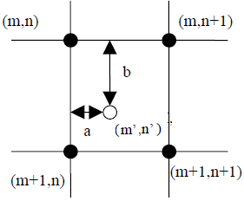
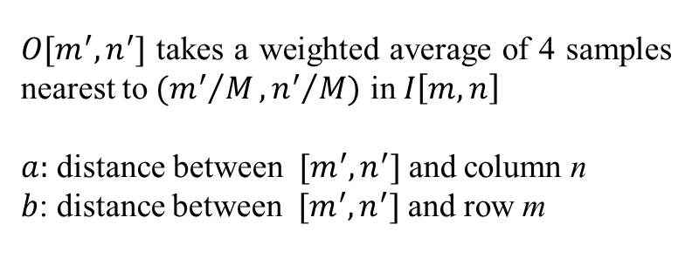
Image Interpolation (Bi-linear Interpolation)
$O[m^{′},n^{′}]$ takes a weighted average of 4 samples nearest to $({m^{′}}/M,{n^{′}}/M)$ in $I\left[m,n\right]$
$a:$ distance between $[m^{′},n^{′}]$ and column n
$b$: distance between $[m^{′},n^{′}]$ and row m
$$O\left[m^{′},n^{′}\right]=\left(1−a\right)\left(1−b\right)I\left[m,n\right]+a\left(1−b\right)I\left[m,n+1\right]+\left(1−a\right)bI\left[m+1,n\right]+abI\left[m+1,n+1\right]$$

Slide 21

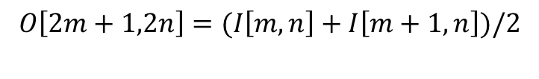
Image Interpolation (Bi-linear Interpolation)
Example: Factor of 2 up-sampling by bi-linear interpolation
$$I[m,n]$$
$$O[m,n]$$
$$O\left[2m,2n\right]=I\left[m,n\right]$$
$$O\left[2m,2n+1\right]=(I\left[m,n\right]+I\left[m,n+1\right])/2$$
$$O\left[2m+1,2n\right]=(I\left[m,n\right]+I\left[m+1,n\right])/2$$
$$O\left[2m+1,2n+1\right]=\left(I\left[m,n\right]+I\left[m,n+1\right]+I\left[m,n\right]+I\left[m+1,n\right]\right)/4$$

Slide 22
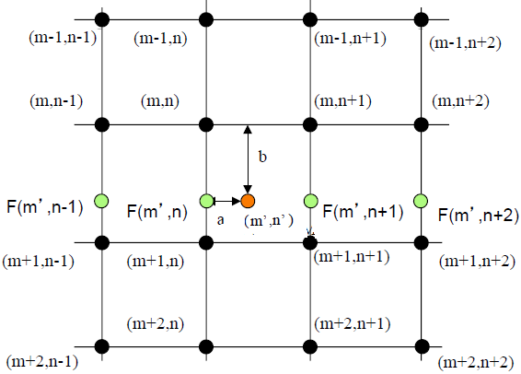
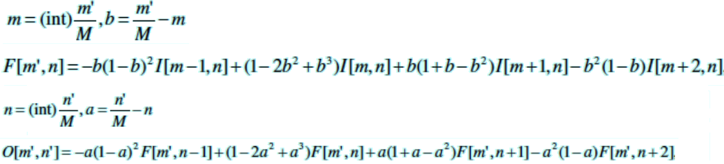
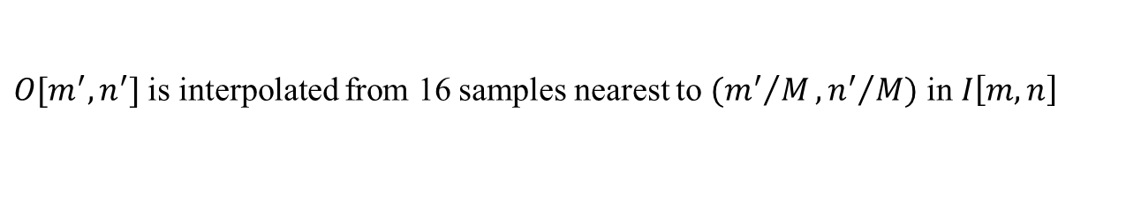
Image Interpolation
$O[m^{′},n^{′}]$ is interpolated from 16 samples nearest to $({m^{′}}/M,{n^{′}}/M)$ in $I\left[m,n\right]$

Slide 23
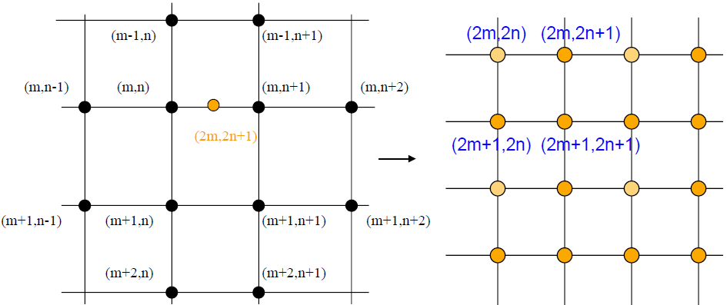
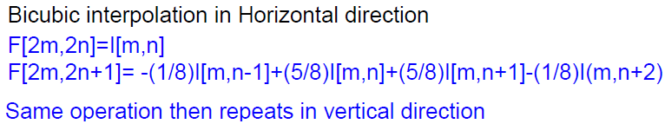


Image Interpolation
Example: Factor of 2 up-sampling by bi-cubic interpolation
$$I[m,n]$$
$$O[m,n]$$

Slide 24
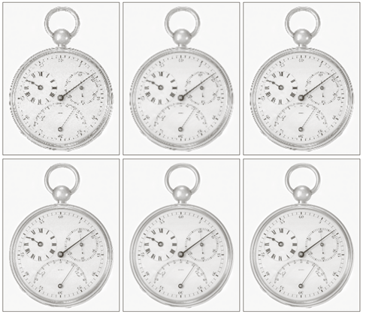
Image Interpolation
Top row : nearest neighbor, bi-linear and bi-cubic (72 dpi)
Bottom row : nearest neighbor, bi-linear and bi-cubic (150 dpi)

Slide 25
Geometric Spatial Transformations and Image Registration
Geometric transformations change the spatial relationships between the pixels in an image. However, color values of pixels are kept unchanged.
Geometric transformations can be used for the following purposes:
- to create special effects
- to register two images taken of the same scene at different times or view angles
- to morph one image into another
A geometric transformation consists of two steps:
(1) spatial transformations of coordinates,
(2) interpolation that assigns intensity levels to spatially transformed pixel.

Slide 26
Geometric Spatial Transformations and Image Registration
Let (v,w) and (x,y) represent the coordinates in the original and transformed images. The coordinate transformation is given by (x,y) = T{(v,w)}.
Affine transformation is one of the widely used transformations. An image can be scaled, rotated, shifted and sheered in a direction by using affine transformation.
The general expression for the affine transformation is given below. The elements of the matrix T determine how the transformation affects the image.

Slide 27
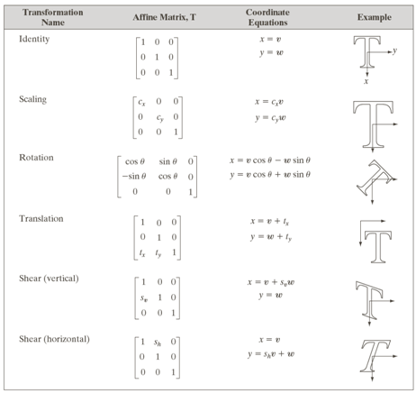
Geometric Spatial Transformations and Image Registration

Slide 28
Geometric Spatial Transformations and Image Registration
In practice, coordinate transformation can be performed by using any of the two methods called FORWARD and INVERSE mapping.
In forward mapping, pixels of the input image are scanned and the the corresponding pixel in the output image is determined by using T. This approach has two flaws:
more than one pixel in the input image can be transformed to the same pixel in the output image,
(ii) some output locations may not be assigned a pixel.

Slide 29
Geometric Spatial Transformations and Image Registration
In inverse mapping, pixels in the output image are scanned and the corresponding pixels in the input image are determined by using the inverse of T
After coordinate transformation, pixels in the input image are moved to their corresponding locations in the output image.
If new pixel locations are created, one of the interpolation methods is used to to determine their intensity values.

Slide 30
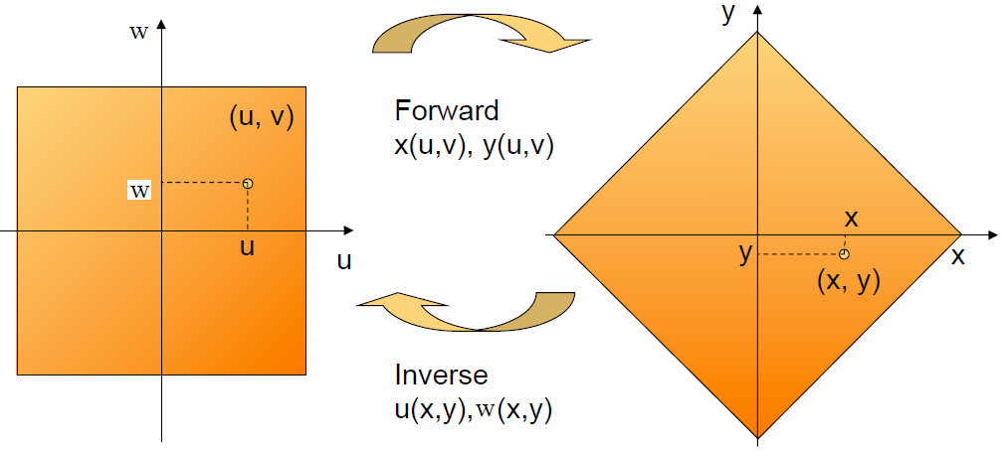
Geometric Spatial Transformations and Image Registration

Slide 31

Geometric Spatial Transformations and Image Registration
The original image at 300 dpi resolution
Image rotated 21 degrees by using nearest neighbor interpolation
Image rotated 21 degrees by using bi-linear interpolation
Image rotated 21 degrees by using bi-cubic interpolation

Slide 32
Geometric Spatial Transformations and Image Registration
Image registration is used to align two or more images of the same scene.
In geometric transformations, T is assumed to be known. In image registartion, the input and output images are known and the goal is to estiamte T.
To estimate T, control points are chosen in the two images. For example, suppose that we determined 4 control points in the images. If the transformation between the images is bi-linear, then the relationship between the coordinates can be written as
Wrting these equations for 4 control points we get a set of 8 equations with 8 unknowns. Then, solution of the set of equations gives us the transformation.

Slide 33
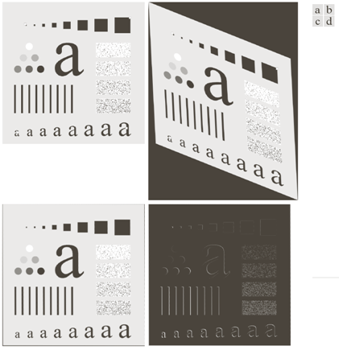
Geometric Spatial Transformations and Image Registration
Reference image
Image to be aligned (small white squares are control points)
Aligned image (errors occur at the boundries!)
Alignment error image

Slide 34
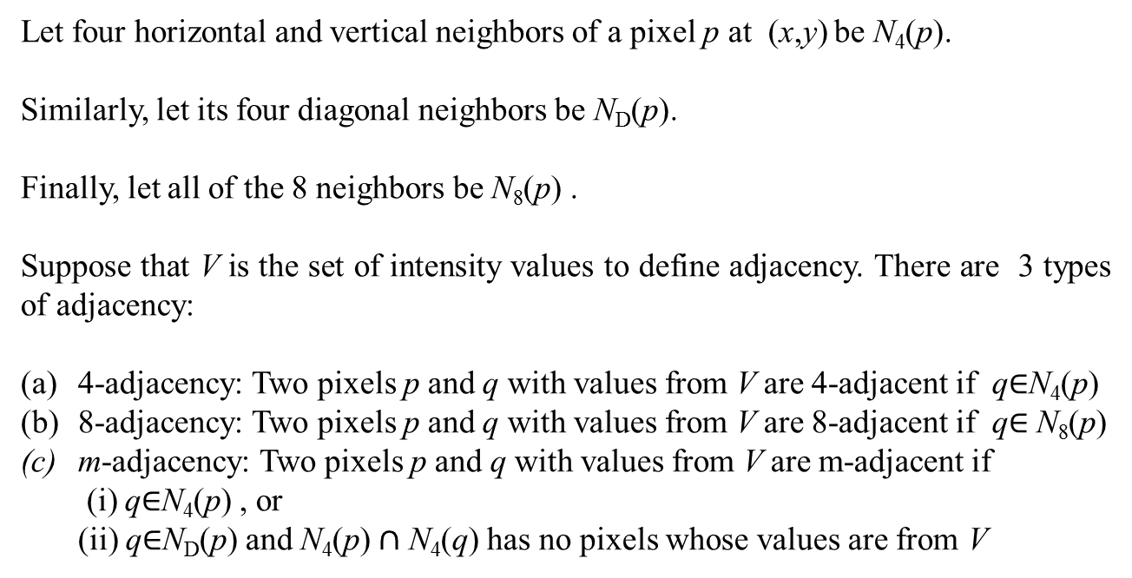
Some Basic Relationships Between Pixels
Let four horizontal and vertical neighbors of a pixel p at (x,y) be N₄(p).
Similarly, let its four diagonal neighbors be N_{D}(p).
Finally, let all of the 8 neighbors be N₈(p) .
Suppose that V is the set of intensity values to define adjacency. There are 3 types of adjacency:
4-adjacency: Two pixels p and q with values from V are 4-adjacent if q$∈$N₄(p)
8-adjacency: Two pixels p and q with values from V are 8-adjacent if q$∈$N₈(p)
m-adjacency: Two pixels p and q with values from V are m-adjacent if
(i) q$∈$N₄(p) , or
(ii) q$∈$N_{D}(p) and N₄(p)$∩$ N₄(q) has no pixels whose values are from V

Slide 35

Some Basic Relationships Between Pixels
An arragement of pixels
8-ajacent pixels (note the uncertainities)
m-adjacency

Slide 36
Some Basic Relationships Between Pixels
Definition: Let (x₀,y₀) = (x,y), (x_{n},y_{n}) = (s,t). A digital path (or curve) from the pixel p at (x,y) to the pixel q at (s,t) is a sequence of pixels that has the following coordinates
(x₀,y₀), (x₁,y₁), …,(x_{n},y_{n})
where (x_{i},y_{i}) and (x_{i-1},y_{i-1}) are adjacent.
Remarks:
n is the length of the path.
It is possible to define 4-, 8- or m-path according to the type of adjacency.

Slide 37
Some Basic Relationships Between Pixels
Definition: Let S be a subregion in an image. Two pixels in p and q in S are connected if there is a path between them consisting of pixels entirely in S. For any pixel p in S, the set of pixels connected to it in S is called a connected component of S. If there is only one connected component, S is called a connected set.
Definition: Let R be subregion in an image. If R is a connected set, R is called a region of the image. If the union of two regions form a connected set, the regions are adjacent (the type of adjacency must be specified in order for the definition to make sense!).
Definition: The boundary of a region R is the set of pixels that are adjacent to the pixels in the complement of R.

