Slide 1
Validation Rules
13 February 2014
Notes:
Guidewire training materials contain Guidewire proprietary information that is subject to confidentiality and non-disclosure agreements. You agree to use the information in this manual solely for the purpose of training to implement Guidewire software solutions. You also agree not to disclose the information in this manual to third parties or copy this manual without prior written consent from Guidewire. Guidewire training may be given only by Guidewire employees or certified Guidewire partners under the appropriate agreement with Guidewire.

Slide 2
Lesson objectives
By the end of this lesson, you should be able to:
  Describe the validation techniques in ClaimCenter
  Describe the categories of validation rules
  Describe basic validation rule behavior
  Create validation rules that raise warnings and errors
  Create validation rules that identify invalid fields
  This lesson uses the notes section for additional explanation and information.
  To view the notes in PowerPoint, choose View→Normal or View→Notes Page.
  If you choose to print the notes for the lesson, be sure to select “Print hidden slides.”

Slide 3
Lesson outline
Types of validation
Validation rule basics
Validation rules in the user interface
Warnings and errors
Identifying invalid fields

Slide 4
Types of validation in ClaimCenter
Two types of validation
  Validation which prevents invalid data from getting saved
  Validation which manages and enforces object maturity
Notes:
The first type of validation is common to all Guidewire products. The second type of validation is somewhat unique to ClaimCenter, at least in terms of how it is implemented.

Slide 5
Logic that prevents invalid data
rating = no fault
state = CA
null
if Fault Rating is "no fault",
state is required
cc
data
rating = no fault
state = CA
NY
When condition is not met
  Save is not allowed
When condition is met
  Save is allowed
Notes:
In the example, the validation logic states that if a claim's fault rating is "no fault", then the state where the loss occurred is required. (This is because different states have different laws surrounding "no fault" accidents.)
In the top example, the claim is modified in a way that does not meet the validation logic. When the user clicks Update, the save is prevented.
In the bottom example, the claim is modified in a way that meets the validation logic. When the user clicks Update, the save is allowed.

Slide 6
Logic tied to object maturity level (1)
level = 2
county = null
state = null
CA
at level 3,
county is
required
cc
data
level = 2
county = null
state = null
3
Kern
CA
promote to
level 3
When object is below level and doesn't meet condition
  Save is allowed but object does not get promoted
When object is below level and meets condition
  Save is allowed and object gets promoted
Notes:
In the example, the validation logic states that when a claim is at or beyond "level 3", then the county is required.
In the top example, the claim is modified in a way that does not meet the validation logic. When the user clicks Update, the save is allowed, but the object does not get promoted. (Because the object is not yet at level 3, the county is not yet required. Because is county is not specified, the object cannot be promoted to level 3.)
In the bottom example, the claim is modified in a way that meets the validation logic. When the user clicks Update, the save is allowed and the object is promoted. (This assumes that the object also meets all other conditions at its current level and at level 3.)

Slide 7
Logic tied to object maturity level (2)
level = 4
county = Kern
null
at level 3,
county is
required
cc
data
level = 4
county = Kern
Dade
When object at or above level and doesn't meet condition
  Save is not allowed
When object at or above level and meets condition
  Save is allowed
Notes:
In the example, the validation logic states that when a claim is at or beyond level 3, then the county is required. (This could be because an external system requires the county to execute its work.)
In the top example, the claim is modified in a way that does not meet the validation logic. When the user clicks Update, the save is prevented. This is because allowing the save would cause the object to logically fall below level 3. Objects in ClaimCenter are not allowed to move backwards in maturity. (This is often a requirement because levels correspond to information being sent to external systems. For example, at level 3, information may be sent to an external system to verify that same claim has not been filed elsewhere. In order to do this, the county is required. If the county were to be set to null, then this would cause the external system to be out of sync with regards to the claim.)
In the bottom example, the claim is modified in a way that meets the validation logic. When the user clicks Update, the save is allowed. Because the object is already at or beyond level 3, promotion does not occur. (If the change causes the claim to meet other conditions at levels beyond the current level (such as level 5), then it is possible the claim could be further promoted to those higher levels.)

Slide 8
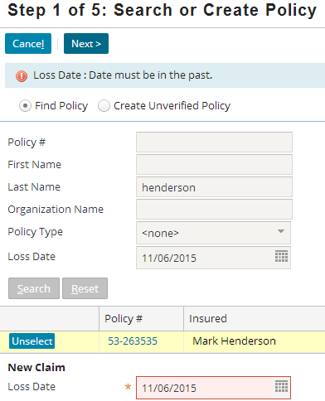
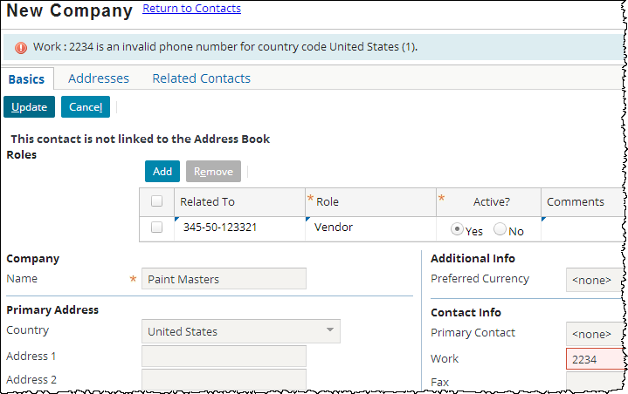
Enforcing validation of invalid data
"Invalid data" validation is typically enforced by field validators and validation expressions
  Complex invalid data validation can be enforced by validation rules
"Object maturity" validation is enforced exclusively by claim and exposure validation rules
Notes:
Validation Rules can be thought of as “Maturity Validation Rules” since their main purpose is to ensure data is valid at a certain level of object maturity, and that changes to data do not let the object move to a lower level of maturity. That is the focus of this lesson. The examples shown are a review of field validators and validation expressions.
A field validator is a "pattern" tied to a datatype. Any field of that datatype must match the pattern.
A validation expression is an expression tied to a widget. When the expression returns null, validation succeeds. When the expression returns a string, validation fails and the string is displayed.
Both field validators and validation expressions are used for simple "invalid data" validation and are discussed in the "Configuration Fundamentals" course.

Slide 9
Lesson outline
Types of validation
Validation rule basics
Validation rules in the user interface
Warnings and errors
Identifying invalid fields

Slide 10
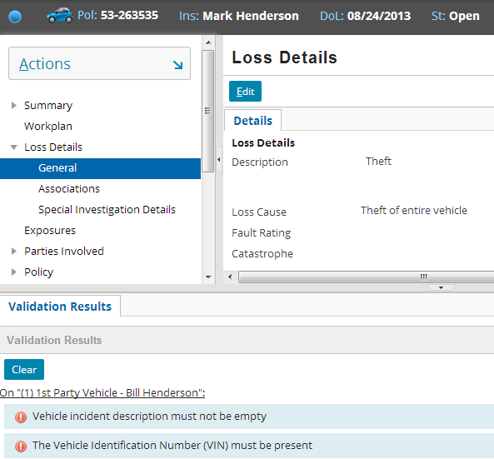
Claim and exposure validation rules
Execute when claim or exposure is created or changed
  Used to promote object to higher level of maturity when it meets that level
  Used to prevent changes that would cause object to fall backwards to less mature state
Notes:
The only validation rule sets which enforce object maturity are the claim and exposure validation rule sets. There are other validation rule sets.
Claim Closed, Claim Reopened, Exposure Closed, Exposure Reopened, Matter Closed, and Matter Reopened rules are used to control whether a claim, exposure, or matter in a given state can be closed or reopened. These rules are not discussed in detail in this course.
Transaction Validation rules are used to enforce the complex processing inherent to transaction validation. These rules are discussed in the "Transaction Validation Rules" lesson.
Policy Validation rules exist as a way of ensuring some basic validation for unverified policies. Verified policies, that come from the policy system of record, shouldn’t require any validation if the data is good. Having said that, policies are validated when they are retrieved, so you could also use these rules to catch bad data.
There are additional validation rule sets, but there is rarely a reason to create rules within these rule sets.

Slide 11
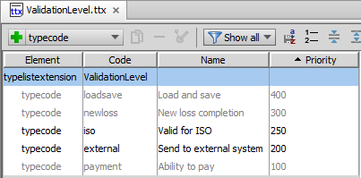
Validation levels
Maturity
Internal
Levels
Defined in ValidationLevel typelist
  Three internal levels cannot be deleted
  Non-internal levels can be modified or deleted
  New levels can be added
Notes:
The validation levels are defined in the ValidationLevel.ttx (extended) typelist, including the code that you use in Gosu to refer to the levels. The loadsave, newloss, and payment levels are required by ClaimCenter and can not be removed. You can remove iso or external levels or configure additional levels. The priority specifies the ordering, with the highest priority being the earliest validation level.
There is no built-in behavior attached to the "Valid for ISO" and "Send to external system" levels. The first could be used to enforce compliance for claims submitted to ISO, and the second could be used to verify an object is mature enough that data bout it can be sent to external systems. Integration programs can be written to take validation level into account. For example, a claim might exist in ClaimCenter at the "New loss completion" level, but not be sent to a back-end system until "Send to external system" is achieved. (One reason why claims are not allowed to "go backwards" in validation level is that they may have already been sent to an external system based on validation level achieved.)
In general, customers can add as many validation levels as they need to support their business and integration requirements.

Slide 12
Behavior tied to internal levels
Claim and exposure
  Cannot be imported below "loadsave"
  Cannot be created via new claim wizard below "newloss"
  Cannot create payments below “payment”

Slide 13


Pre-update and validation
Whenever validatable object is created or modified:
  Pre-update rules for object are run first
  “Maturity” Validation rules for object are run next
If object fails validation, any work done by pre-update rules is rolled back
Notes:
Preupdate rules are for editing or creating objects.
Validation rules are for validating that the objects are ready to be saved in their current state.
reject() functions are never called in preupdate rules.
Changes or additions are never made in validation rules.

Slide 14
Object promoted to highest possible level
at level 3,
county is
required
at level 4,
inspection
is done
level = 2
county = null
state = null
inspection = done
cc
data
CA
level = 2
county = null
state = null
inspection = done
4
promote to
level 3
promote to
level 4
Kern
cc
data
CA
Object always promoted to highest possible level
  Single change could result in promotion of multiple levels
Notes:
Validation rules always promote an object to the highest possible level of maturity.
As the result of a change, if an object does not meet all of the conditions at the next higher level (and does not violate any conditions at the current or lower levels), then the given change is allowed, but no promotion occurs. This is true even if the object meets all conditions at some level beyond the next highest level. In the example above, the object meets all conditions at level 4. But it is at level 2, and promotion occurs only when it meets all conditions at the next highest level, which is level 3.
As the result of a change, if an object does meet all of the conditions at the next higher level (and does not violate any conditions at the current or lower levels), then the given change is allowed, and promotion occurs as far as possible. This could result in a promotion only to the next highest level. Or, as shown in the example above, this could result in a promotion of multiple levels.

Slide 15



Related objects can trigger validation
claim
Validation is triggered
on a validatable object when:
  The object is created
  The object is changed
  One of the object's sub-objects is created, changed, or removed
    Assuming "triggersValidation" attribute is set on array, onetoone, or fk
document
service request
creation of document triggers
claim validation
change to service request triggers
claim validation
Notes:
Claims can have related sub-objects. Whenever the claim itself is created or modified, claim validation rules are run. Whenever a sub-object of the claim is created or changed (such as the creation of a document or a change to the progress of a service request), claim validation rules are also run. This is because validation logic might exist at the claim level which pertains to information at the sub-object level. (There could be a claim validation rule which says you can have only one "policy not in force at time of loss" document, or a claim validation rule which says you cannot create an invoice related to a service request with a null reference number.) The same holds true for exposure validation.
This hierarchy of validation is sometimes referred to as the "validation graph".
Some data model tags such as <array>, <onetoone>, and <foreignkey> have an attribute called "triggersValidation". This Boolean attribute, when set to true, ensures that changes to any entities pointed to by these tags trigger validation of the parent entity.

Slide 16
Related claim objects trigger validation
claim
claim
contact
service request
incident
exposure
activity
document
note
matter
All these existing sub-objects trigger validation
Some sub-objects do not trigger validation
  Example: Associations and MedicalProcedures do not
User-created arrays can trigger validation on the parent
Notes:
The diagram above does not exhaustively list all sub-objects which can trigger validation. For a complete list, refer to the ClaimCenter Data Dictionary or the ClaimCenter Rules Guide (Documentation resource).
Every array depicted in the above slide has the triggersValidation attribute set to true. This is easily configurable for existing as well as new arrays.

Slide 17
Lesson outline
Types of validation
Validation rule basics
Validation rules in the user interface
Warnings and errors
Identifying invalid fields

Slide 18

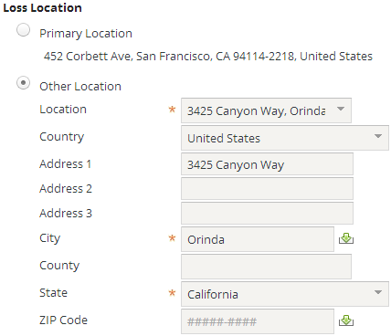
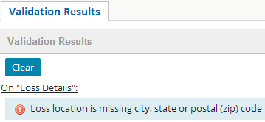
Validation rule errors
Displayed when user attempts to make change which would cause object to move backwards in maturity
  Not displayed if object is not yet at level to which error is associated
  Save is prevented
Notes:
The example shown is not taken from the base application but the result of creating and configuring a new Claim Validation Rule.
In the example above, if the address of the Claim’s Loss Location contains a null city, state or postal (zip) code, then an error is raised at the "iso" level with the error appearing in the Validation Results workspace. The field in question has a “Zip Code” label (in the US Language Pack), but the field is named PostalCode. For the purposes of this lesson, a Zip Code and a Postal Code are the same thing.
It must be noted that in the example, while the claim is at “iso”, if the claim was validated above that maturity level, the error would still appear, it is still a change that is triggering a lower validation level acceptance.

Slide 19

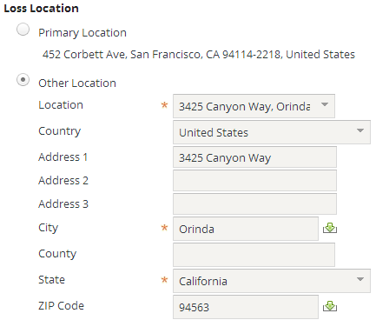
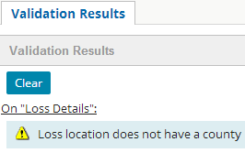
Validation rule warnings
User can be alerted of possibly problematic issue
  Save is still allowed (upon second attempt to save)
Condition can be executed as warning at earlier level and error at later level
Notes:
The example shown is not taken from the base application but the result of creating and configuring a new Claim Validation Rule.
The only visual distinction in the user interface between a warning and an error is the icon.

Slide 20
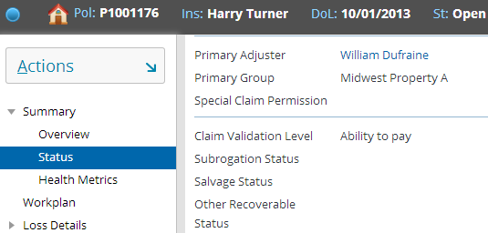
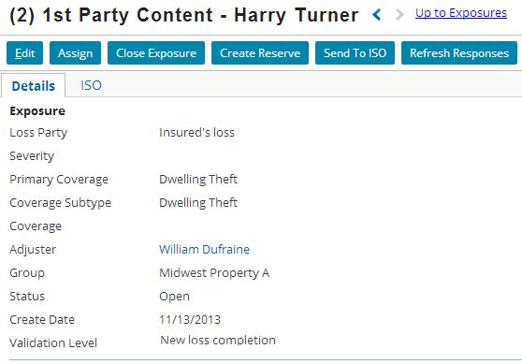
Validation level for given object
In base application:
  Claim level displayed on Claim Status screen
  Exposure level displayed on exposure's Details card
Notes:
Claim and exposure validation levels are independent of one another. A claim could be at "ability to pay" even though all of its exposures are at "new loss completion". Similarly, a claim could be at "new loss completion" even though all of its exposures are at "ability to pay".
In the base application, one of the primary aspects of functionality tied to validation levels is the payment wizard. You cannot initiate the payment wizard if the claim is not at ability to pay (regardless of the maturity of the exposures). If the claim is at ability to pay, you can initiate the payment wizard. However, you can create payments only from reserve lines whose exposures are at "ability to pay". If the claim is at "ability to pay" but none of its exposures are, then you can start the payment wizard, but you have no reserve lines from which to make payments.

Slide 21
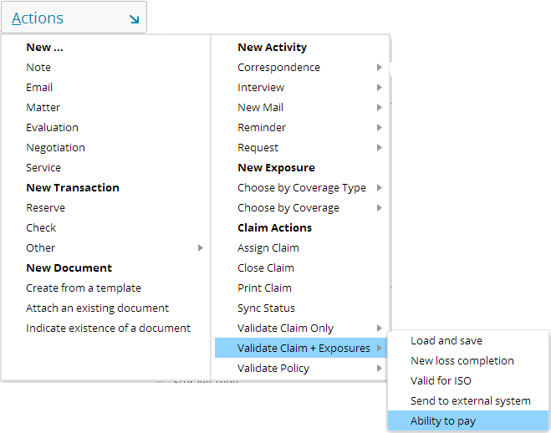
Review: Running validation rules manually
Notes:
Recall that a user can validate a claim (and its exposures) at a certain validation level using the menu actions shown above. This lets the user check for errors at validation levels that the object has not yet attained. The user can specify which validation level to check for a claim or a claim and its exposures. ClaimCenter will check all validation rules for the specified validation level and below. Any warnings or error messages generated by the validation rules for this claim or the claim's exposures are displayed for the user.

Slide 22
Lesson outline
Types of validation
Validation rule basics
Validation rules in the user interface
Warnings and errors
Identifying invalid fields

Slide 23

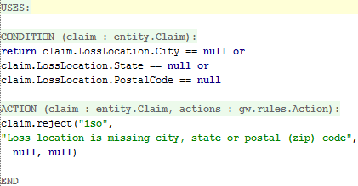
The reject method
Used for both warning and errors
Syntax: object.reject (errorLevel, errorMessage,
warnLevel, warnMessage)
Notes:
In the example above, if a claim's loss location's city, state or postal code is null, then an error is raised at the "iso" level (or higher) with the associated text message.
If the claim is not yet at the "iso" level, then this condition will prevent the claim from being promoted to "iso". However, no error message is displayed. (In this situation, a user has created or modified a claim in which the city, state, or postal code is blank. Because the claim is not at "iso" level, the creation or change is permitted, but the claim cannot yet be promoted to "iso" level.)
If the claim is already at or beyond the "iso" level, then this condition will prevent the change from occurring. The error message will be displayed. (In this situation, a user has modified a claim in which the city, state, or postal code is blank. Because the claim is at or beyond "iso" level, the creation or change not allowed. Allowing the change would logically move the claim backwards in maturity.)

Slide 24
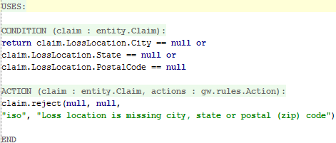
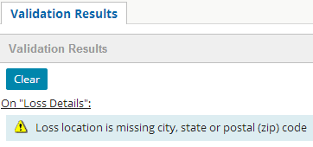
reject method: warning vs. error
Notes:
The only difference between a reject warning and a reject error is the arguments passed to the reject method.
Many customers use validation levels to trigger integration programs. However, not all customers will want to provide proactive warnings to users about what they need to do to achieve the next level. In this case, for every error on level N, it is not necessary to provide a corresponding warning on level N-1. The customer may decide that it is sufficient for the adjuster to run into the error when he needs to. In addition, the user can always find out what is blocking a claim from achieving a new level by using the menu action described previously (Actions > Validate Claim Only).

Slide 25
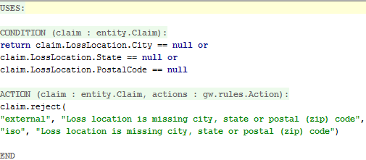
reject method: warning and error
When claim reaches "iso" (but not yet at "external")...
When claim reaches "external"...
Notes:
Typically, if a single condition raises both a warning and an error, the warning should be at an earlier level of maturity. Otherwise, the user will never be warned, because the error gets enforced first.

Slide 26
Lesson outline
Types of validation
Validation rule basics
Validation rules in the user interface
Warnings and errors
Identifying invalid fields

Slide 27
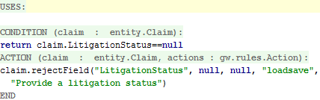
The rejectField method
Used for both warning and errors
Highlights the offending field in the UI
Syntax: object.rejectField (strRelativeFieldPath,
errorLevel, errorMessage,
warnLevel, warnMessage)
path is already relative to claim;
does not start with "claim"
Notes:
The difference between reject() and rejectField() is that rejectField() highlights the field containing the data that triggers the error or warning. rejectField() possesses an additional argument for this purpose (the first argument).
The strRelativeFieldPath argument is the relative path rendered as a string from the root object (where the root object is the object the method is on) to the field that failed validation. Do not specify the root object in the relative path string. ClaimCenter implicitly adds the root object at the beginning of the path. If you specify the root object (for example, if you specify "claim.LossLocation.County" in the example above), then ClaimCenter will typically not be able to find the desired field to highlight. (It will look for a field following the path "claim.claim.LossLocation.County". Given that no such field exists, no field will get highlighted.)

Slide 28
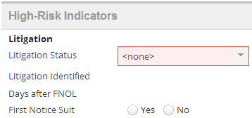
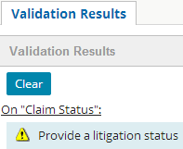
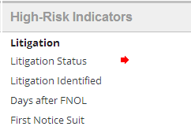
rejectField Example
Edit mode screen
Read-only screen
Notes:
When the screen is in read-only mode, the validation results in the workspace at bottom appears but the red outline does not. Instead, a red arrow identifies the offending field.
When the screen is in edit mode the field appears in red outline.
If the user is on another screen, an underlined navigation link to the screen with the maturity validation problem is provided (On “Claim Status”:).
Again, this is not a base application claim validation rule.
NOTE: The navigation link and field highlighting cannot be provided through the use of rejectfield() alone – configuration of the appropriate PCF (in this case ClaimLossDetails.pcf) is required. More on this will be covered at the end of the lesson.

Slide 29
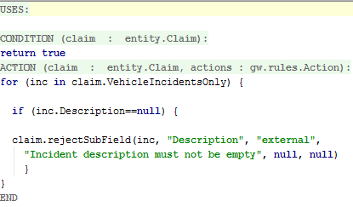
The rejectSubField method
Recommended for highlighting fields on related objects, such as those on an array element or a foreign key element
Syntax:
object.rejectSubField (relatedObject, strRelativeFieldPath,
errorLevel, errorMessage,
warnLevel, warnMessage)
Notes:
When rejecting a sub-field, the strRelativeFieldPath argument should be written relative to the relatedObject. For example, the code above shows the related object to be inc (which is the current value of the iterator on the VehicleIncidentsOnly array.) Therefore, "inc." is implicitly added to the second parameter. The parameter itself only needs to specify the field on the related object, which in this case is "Description".
Note that the above rejection could have been done using rejectField, but it would be somewhat uglier since the call to rejectField would need to explicitly call out the specific item in the array being rejected:
for (inc in claim.VehicleIncidentsOnly index i) {
if (inc.Description == null) {
claim.rejectField("VehicleIncidentsOnly[" + i +"].Description", "external",
"Incident description must not be empty", null, null)
}
}

Slide 30
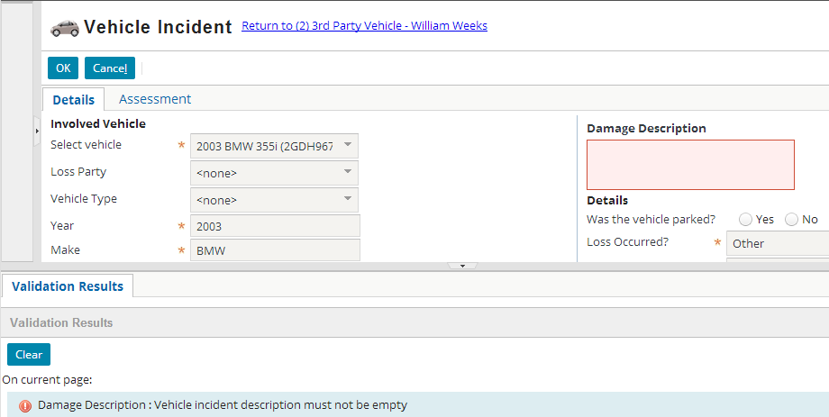
rejectSubField Example

Slide 31
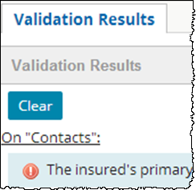
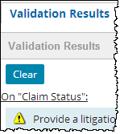
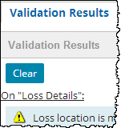
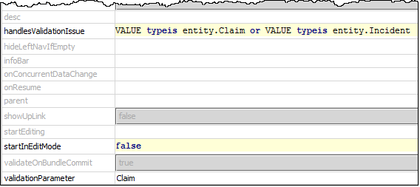
Page Navigation and Highlighting Fields
If using rejectField() or rejectSubField(), a navigation link should be provided to the page containing the offending field, and the field should be highlighted
This is accomplished by use of two advanced properties on the Page:
  handlesValidationIssue
  validationParameter
Navigation provided if user is on a different page
Provide navigation to this page which involves both Claim and Incident entity (types)
Notes:
Most pages in ClaimCenter involved in maturity validation in the base application already have these advanced properties specified (such as ClaimLossDetails.pcf and ClaimContacts.pcf).
However, if the ClaimStatus page contains the offending field, you will need to specify these advanced properties on the ClaimStatus.pcf for your validation to work properly. It is important to check that these required properties are set properly for validation to work correctly.
The validationParameter property provides the object variable. The handlesValidationIssue property is there to support related objects and specifies the type. Both properties are required. This to support validation of related objects to the ValidationParameter object, as in Claim.LossLocation or one of the Claim’s Incidents (as shown on the previous slide).

Slide 32
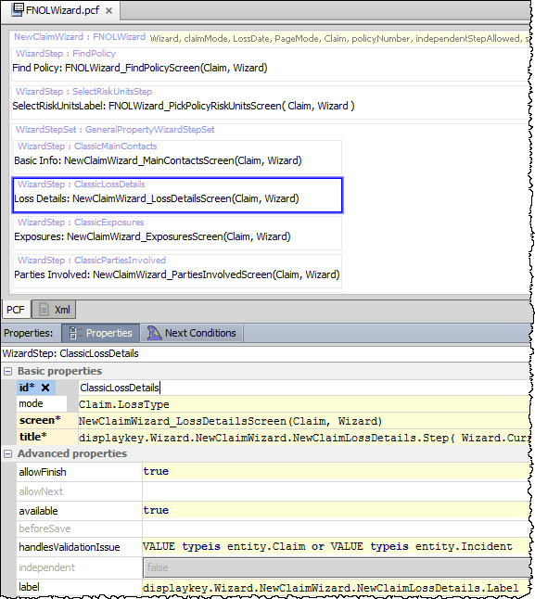
Validation of FNOL Steps
The FNOL Wizard in the base application also uses same advanced property; but object variable not needed (claim)
FNOL Wizard steps validate claims and incidents using this property only:
  handlesValidationIssue
Notes:
Because the FNOLWizard’s root object is a claim, the validationParameter advanced property is not needed. In this particular example, the WizardStep deals with Loss Details, therefore Incidents are also potential related objects to be validated.

Slide 33
Lesson objectives review
You should now be able to:
  Describe the validation techniques in ClaimCenter
  Describe the categories of validation rules
  Describe basic validation rule behavior
  Create validation rules that raise warnings and errors
  Create validation rules that identify invalid fields

Slide 34
Review questions
Name a business requirement which could be implemented only with validation rules (as opposed to field validators or validation expressions).
Can existing validation levels be removed from ClaimCenter? Can new levels be added?
If you have an existing reject statement which raises only a warning, how would you change it to instead raise an error?
The first argument of rejectField is a "relative path" to the object to highlight. Why is it relevant to keep in mind that the path is relative?
Notes:
Answers
1. Possible answers: Any requirement which should not always be enforced, but rather be enforced only at a certain point in the claim or exposure's life cycle; Any requirement which involves a warning.
2. Yes, any of the non-internal level can be removed. However, the three internal levels (loadsave, newloss, ability to pay) cannot be removed. Yes, new levels can be added.
3. You would swap the order of the final two pairs of arguments. The first pair should be the last pair and vice versa.
4. It is important to keep this in mind because the root object must be omitted from the path. If you include the root object, then ClaimCenter will not be able to find the field to highlight.

Slide 35
Notices
Copyright © 2001-2014 Guidewire Software, Inc. All rights reserved.
Guidewire, Guidewire Software, Guidewire ClaimCenter, Guidewire PolicyCenter, Guidewire BillingCenter, Guidewire Reinsurance Management, Guidewire ContactManager, Guidewire Vendor Data Management, Guidewire Client Data Management, Guidewire Rating Management, Guidewire InsuranceSuite, Guidewire ContactCenter, Guidewire Studio, Guidewire Product Designer, Guidewire Live, Guidewire DataHub, Guidewire InfoCenter, Guidewire Standard Reporting, Guidewire ExampleCenter, Guidewire Account Manager Portal, Guidewire Claim Portal, Guidewire Policyholder Portal, ClaimCenter, BillingCenter, PolicyCenter, InsuranceSuite, Gosu, Deliver Insurance Your Way, and the Guidewire logo are trademarks, service marks, or registered trademarks of Guidewire Software, Inc. in the United States and/or other countries.
All other trademarks are the property of their respective owners.
This material is confidential and proprietary to Guidewire and subject to the confidentiality terms in the applicable license agreement and/or separate nondisclosure agreement.
This file and the contents herein are the property of Guidewire Software, Inc. Use of this course material is restricted to students officially registered in this specific Guidewire-instructed course, or for other use expressly authorized by Guidewire. Replication or distribution of this course material in electronic, paper, or other format is prohibited without express permission from Guidewire.
Guidewire products are protected by one or more United States patents.

