Slide 1




ATMO402 “Applied Atmospheric Dynamics”
Chapter 4 Circulation, Vorticity, and Potential Vorticity A Rotational View of the Atmosphere
$$V$$
L
Coriolis
H
PGF
$$n$$
$$n$$
PGF
Centrifugal
Coriolis
Centrifugal
$$V$$
Cyclonic low
Anti-cyclonic high
GOALS
Diagnosis - Understand dynamics of large scale motion in atmosphere
Circulation, Vorticity and Potential Vorticity
Prognosis - Predict future atmospheric motions
Equations of Circulation, Vorticity and Potential Vorticity
Sen Zhao, Email: zhaos@hawaii.edu

Slide 2
Rotation Measurements
Circulation is a scalar integral quantity - a macroscopic measure of rotation for a finite area of the fluid.
Vorticity is a vector field that gives a microscopic measure of the rotation at any point in the fluid.
Potential vorticity combines vorticity and thermodynamic constraints on the motion, yielding a powerful framework for interpreting atmospheric dynamics.

Slide 3
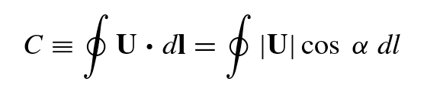
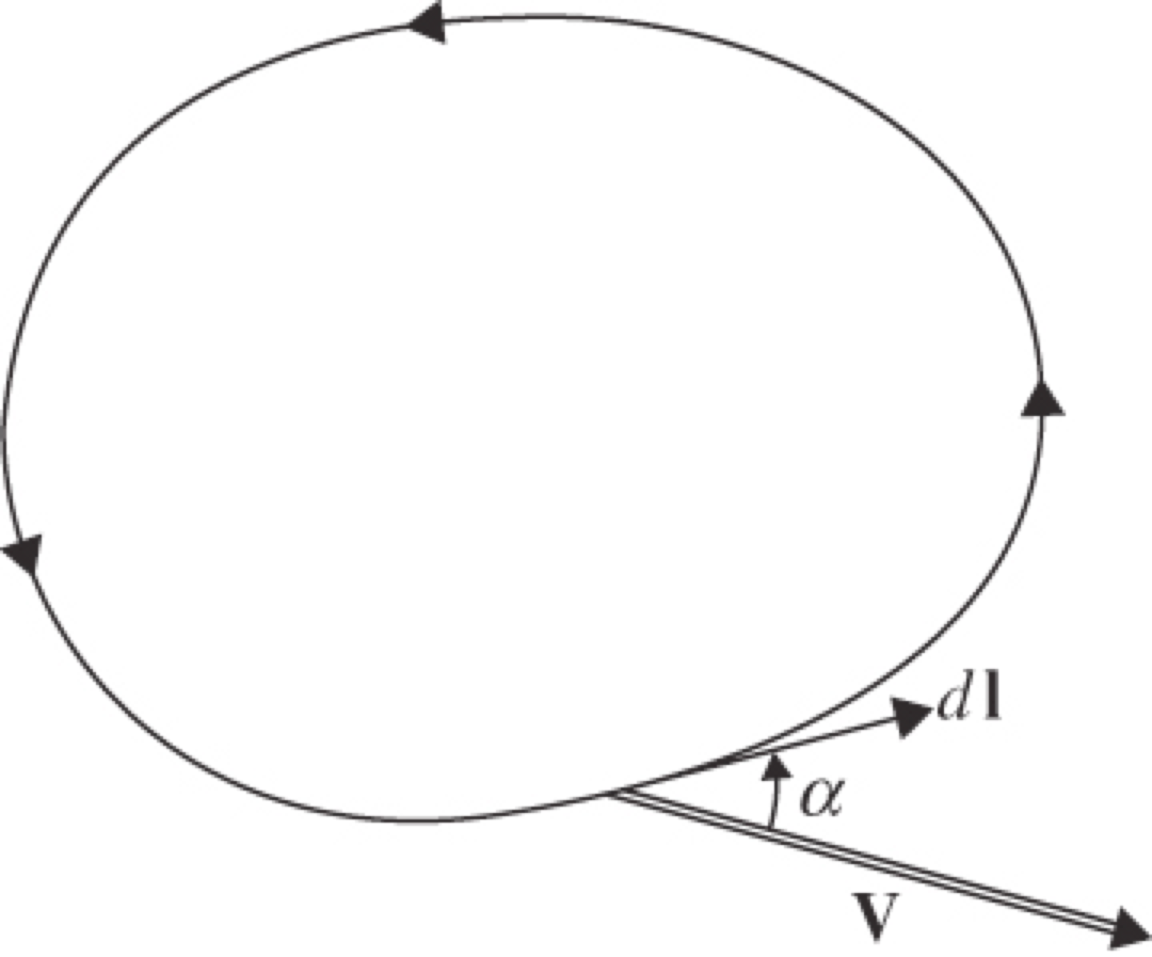
Circulation
The circulation (C), is defined as the line integral along the contour of the component of the velocity vector that is locally tangent to the contour.

Slide 4
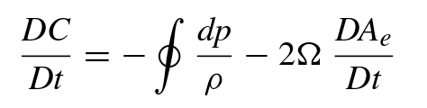
Circulation theorem
Bjerknes’s circulation theorem
Term 1: rate of change of relative circulation
Term 2: solenoidal term ((for a barotropic fluid, the density is a function only of pressure, and the solenoidal term is zero.)
Term 3: rate of change of the enclosed area projected on the equatorial plane
Kelvin’s circulation theorem (for a barotropic fluid)
Relative circulation changes as the horizontal area enclosed by the loop changes or the latitude changes.

Slide 5
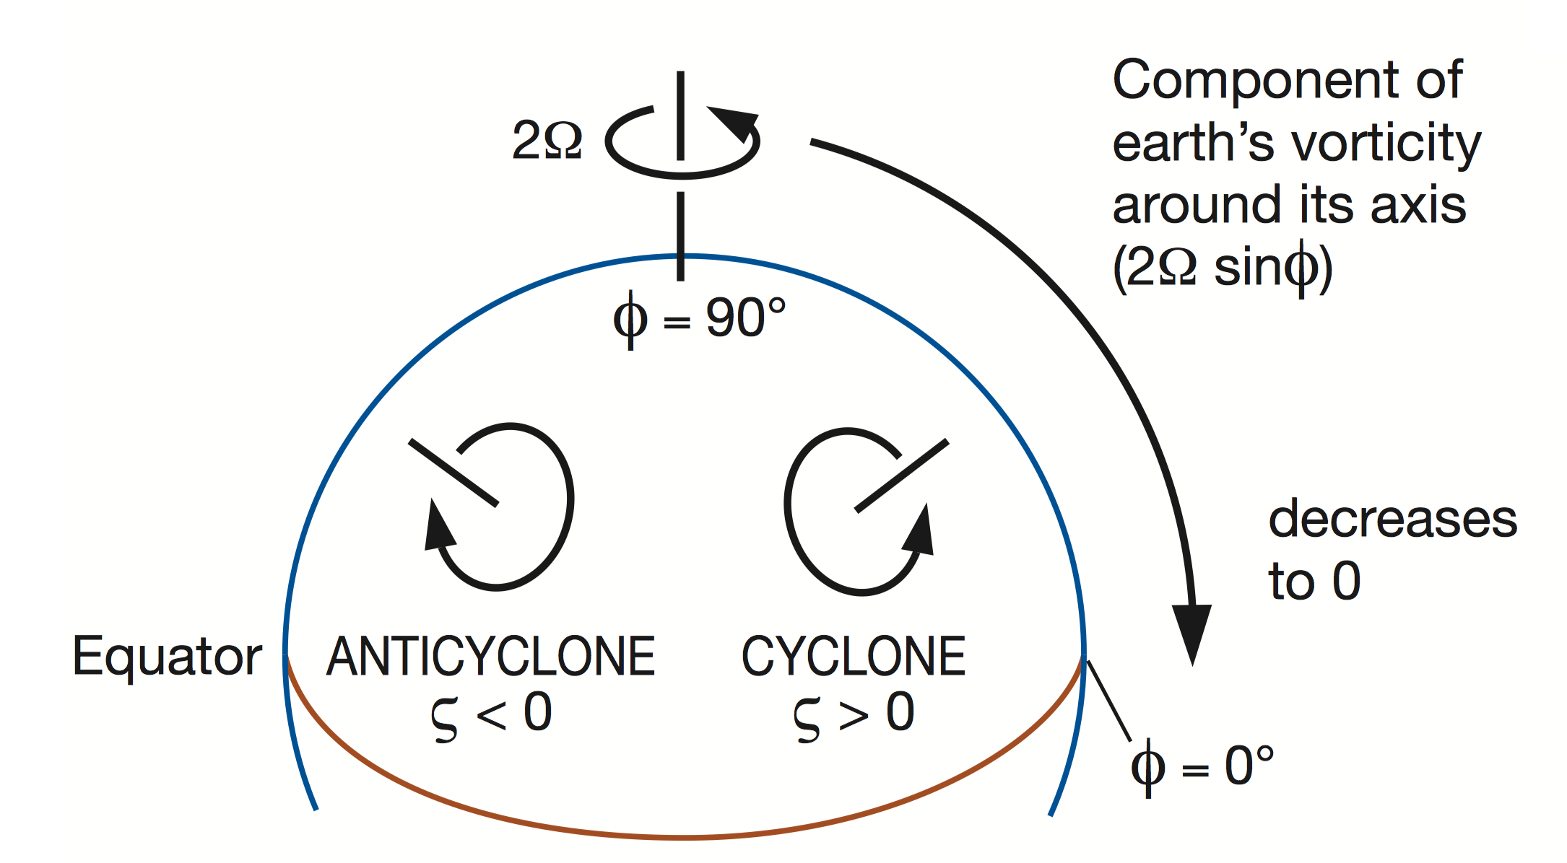
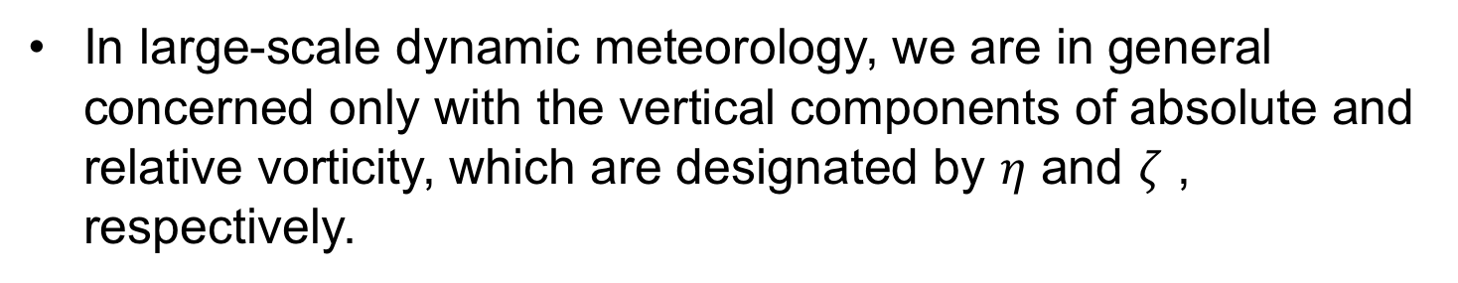
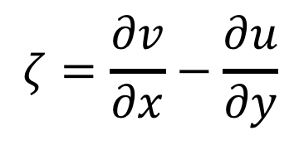
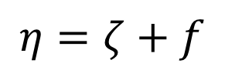
Relative and Absolute Vorticity
In large-scale dynamic meteorology, we are in general concerned only with the vertical components of absolute and relative vorticity, which are designated by $η$ and $ζ$ , respectively.
$$ζ=\frac{∂v}{∂x}−\frac{∂u}{∂y}$$
$$η=ζ+f$$

Slide 6
THE VORTICITY EQUATION
Derivation of the vorticity equation in different coordinates
Simplifying vorticity equations (Scale analysis for synoptic scale system)
Simplifying vorticity equations even further (Barotropic vorticity equations)
Notes:
I

Slide 7
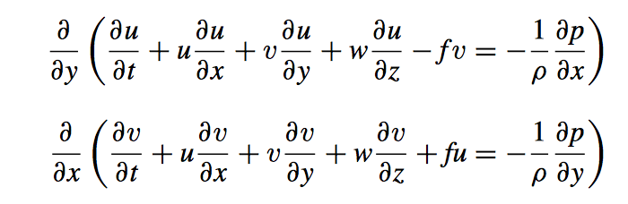
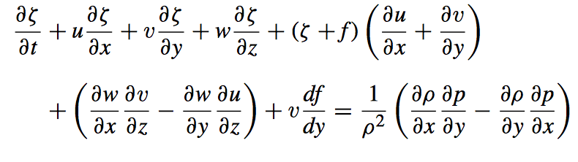
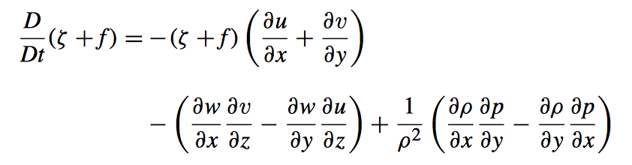
Derivation of Vorticity Equation
(1) Begins with the Eqs of horizontal momentum
(2) Use the definition of relative vorticity ($ζ=\frac{∂v}{∂x}−\frac{∂u}{∂y}$ )
(3) We get the vorticity equation:
(1) divergence term
(2) tilting or twisting term
(3) Solenoidal term

Slide 8
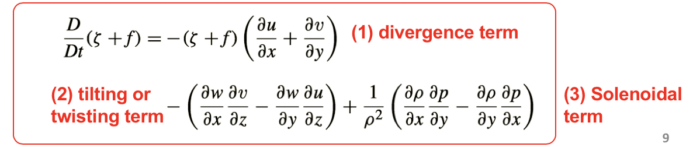
Change of absolute vorticity may result from
Divergence (vortex stretching) –similar to a change in the moment of inertia of a solid body when angular momentum is conserved
Tilting (twisting) – tilting of horizontally oriented components of vorticity into the vertical by a non-uniform vertical motion field.
Solenoidal – in baroclinic fluid

Slide 9
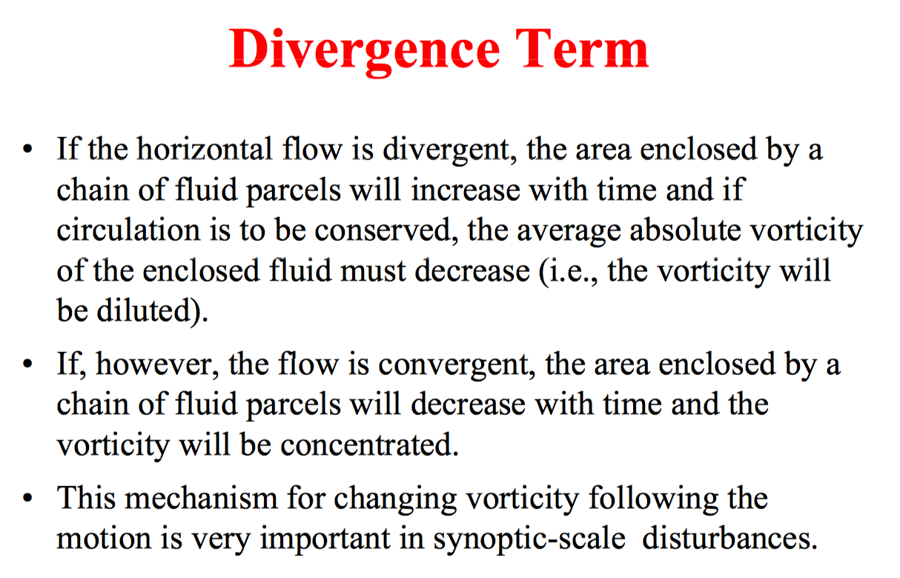
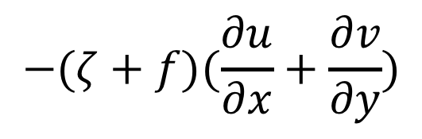
$$−(ζ+f)(\frac{∂u}{∂x}+\frac{∂v}{∂y})$$

Slide 10
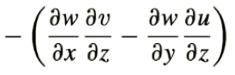
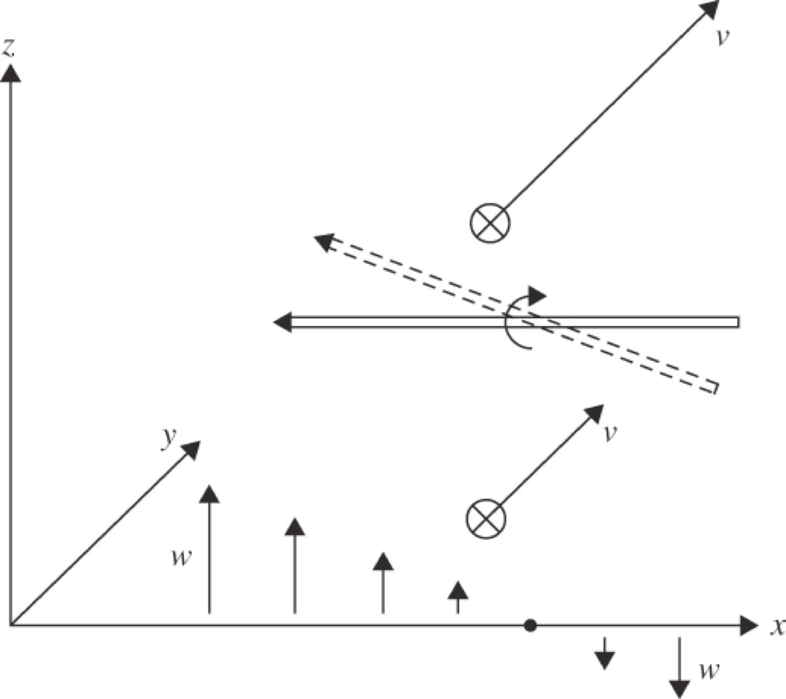
Tilting Term
If ∂v/∂z > 0 and ∂w/∂x < 0, there will be a generation of positive vertical vorticity.

Slide 11
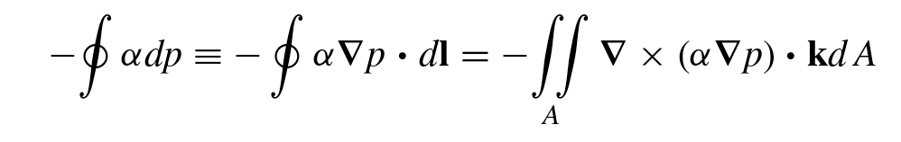
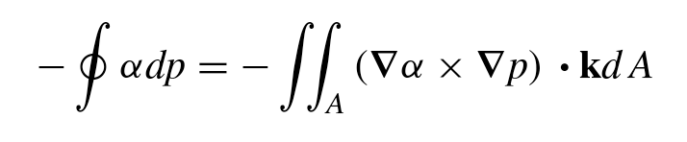

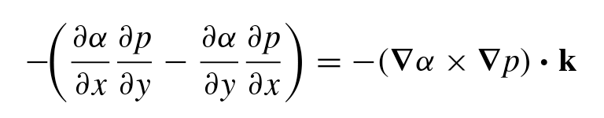
Solenoidal Term (Baroclinic)
The solenoidal term in the circulation theorem divided by the area (A) when A→0.

Slide 12
EXERCISES Derivation of Vorticity Equation in Isobaric Coordinates
Starting with the momentum equations in isobaric coordinates

Slide 13
Vorticity Equation
Change of relative vorticity are caused by:
Advection
Divergence
Tilting
Beta effect
Baroclinicity
Question: Which of these terms are most important for large scale (synoptic or larger) flows?
Scale analysis

Slide 14
THE VORTICITY EQUATION
Derivation of the vorticity equation in different coordinates
Simplifying vorticity equations (Scale analysis for synoptic scale system)
Simplifying vorticity equations even further (Barotropic vorticity equations)
Notes:
I

Slide 15
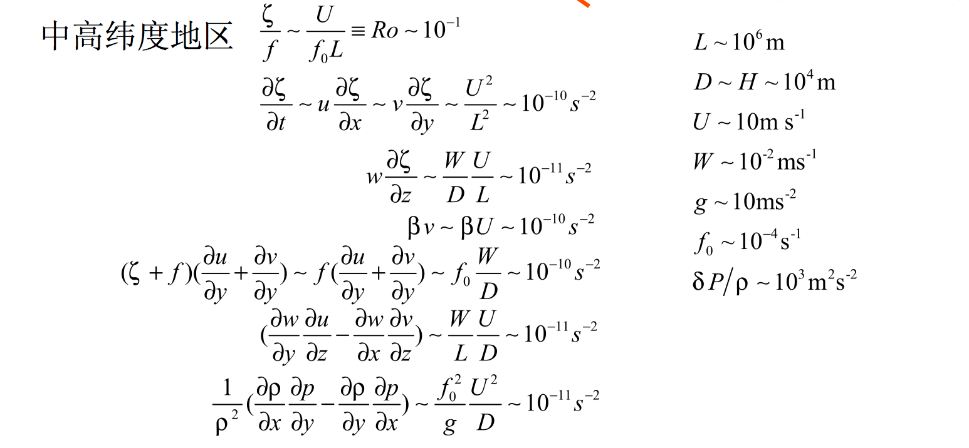


Scale analysis of Vorticity Equation
Synoptic scale system in midlatitudes

Slide 16
What does it mean?
The above equation states that on the synoptic scale the absolute vorticity of a fluid parcel changes mainly in response to divergence or convergence.
Divergence leads to a decrease in absolute vorticity.
Convergence leads to an increase in absolute vorticity.

Slide 17
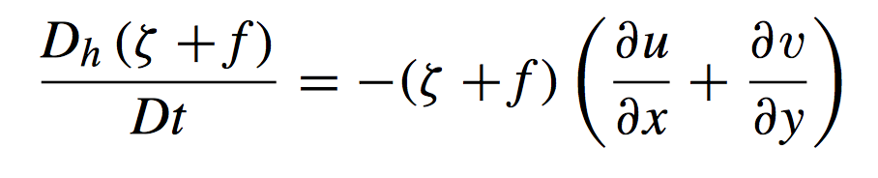
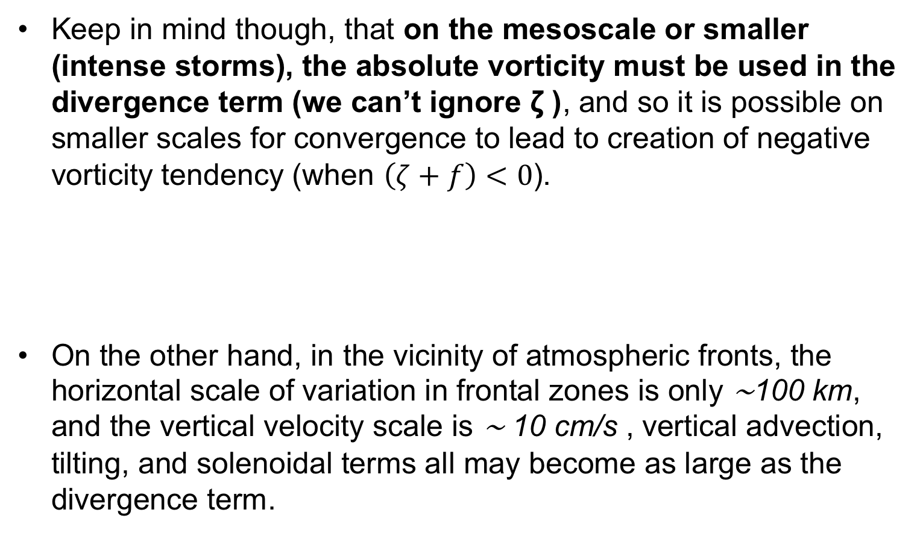
Caution: the approximate form do not remain valid
Keep in mind though, that on the mesoscale or smaller (intense storms), the absolute vorticity must be used in the divergence term (we can’t ignore ζ ), and so it is possible on smaller scales for convergence to lead to creation of negative vorticity tendency (when $\left(ζ+f\right)<0$).
On the other hand, in the vicinity of atmospheric fronts, the horizontal scale of variation in frontal zones is only ∼100 km, and the vertical velocity scale is ∼ 10 cm/s , vertical advection, tilting, and solenoidal terms all may become as large as the divergence term.

Slide 18
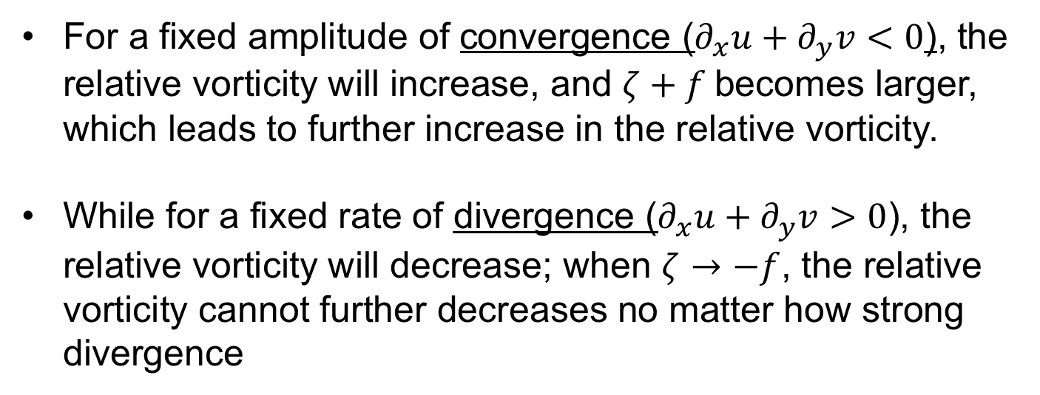
Application
Why cyclonic disturbances can be much more intense than anticyclones?
For a fixed amplitude of convergence ($∂_{x}u+∂_{y}v<0$), the relative vorticity will increase, and $ζ+f$becomes larger, which leads to further increase in the relative vorticity.
While for a fixed rate of divergence ($∂_{x}u+∂_{y}v>0$), the relative vorticity will decrease; when $ζ→−f$, the relative vorticity cannot further decreases no matter how strong divergence

Slide 19

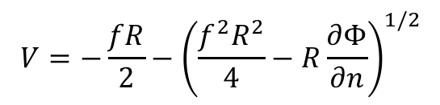
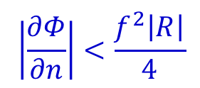

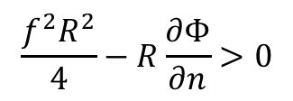


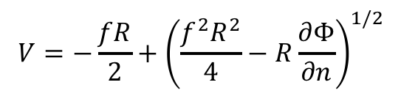
Why cyclonic disturbances can be much more intense than anticyclones?
Gradient wind
$$V$$
$\frac{∂Φ}{∂n}<0$, $R<0$
$\frac{∂Φ}{∂n}<0$, $R>0$
H
PGF
L
Coriolis
$$n$$
$$n$$
PGF
Centrifugal
Coriolis
Centrifugal
$$V$$
$$V=−\frac{fR}{2}+{\left(\frac{f^{2}R^{2}}{4}−R\frac{∂Φ}{∂n}\right)}^{1/2}$$
$$V=−\frac{fR}{2}−{\left(\frac{f^{2}R^{2}}{4}−R\frac{∂Φ}{∂n}\right)}^{1/2}$$
$$\frac{f^{2}R^{2}}{4}−R\frac{∂Φ}{∂n}>0$$
For both regular lows and highs, it is required
$$\left|\frac{∂Φ}{∂n}\right|<\frac{f^{2}\left|R\right|}{4}$$
Always be true for Low
High needs to satisfy
As |R| → 0, pressure gradient approach zero. The pressure field near the center of a high is always flat, the wind is usually gentle.
No limit for pressure gradient

Slide 20
THE VORTICITY EQUATION
Derivation of the vorticity equation in different coordinates
Simplifying vorticity equations (Scale analysis for synoptic scale system)
Simplifying vorticity equations even further (Barotropic vorticity equations)
Notes:
I

Slide 21
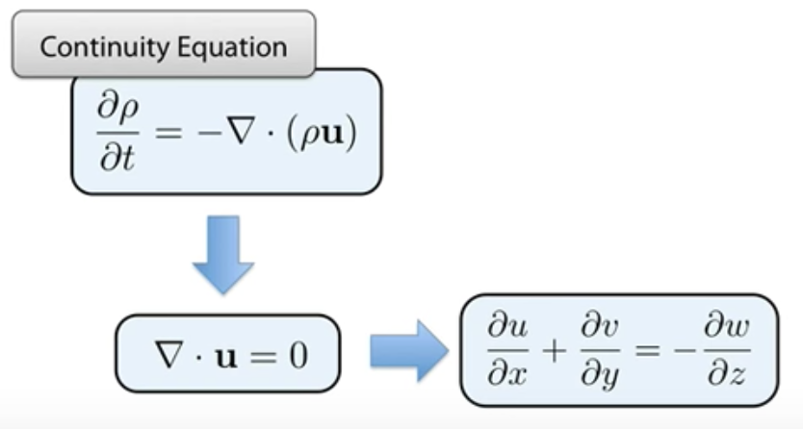
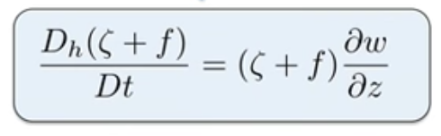
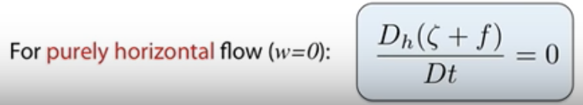
Barotropic Vorticity Equation
Assume a homogeneous, incompressible fluid (constant density)
Vorticity Equation
Barotropic flow
Conservation of absolute vorticity when there is no vertical velocity

Slide 22
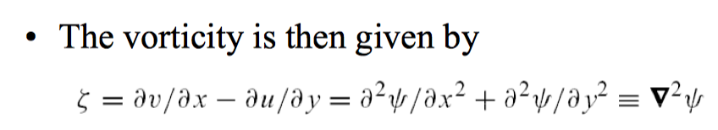
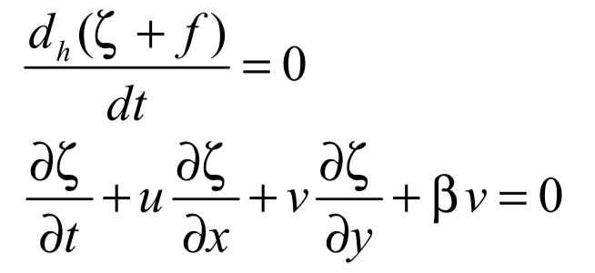
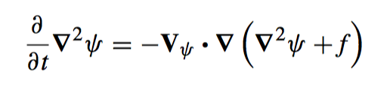
Barotropic Vorticity Equation
For horizontal motion that is non-divergent (∂u/∂x +∂v/∂y = 0), the flow field can be represented by a stream function ψ (x, y) defined so that the velocity components are given as
u = −∂ψ/∂y,
v = +∂ψ/∂x.

Slide 23
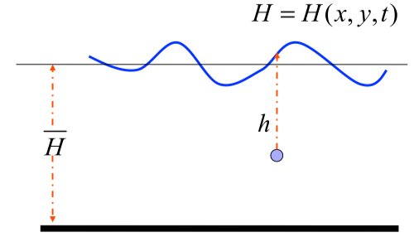
Shallow Water Equation
Shallow water equations describe a thin layer of constant density fluid in hydrostatic balance, rotating or not, bounded from below by a rigid surface and from above by a free surface,
Question: How to derive the vorticity equation in the shallow water system?
Notes:
I

Slide 24


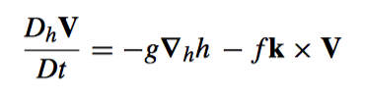
Dynamics of a single shallow layer of atmosphere
Hydrostatic approximation
Integrating the hydrostatic equation over the depth of the ﬂuid, h(x, y), gives
where p(h) is the pressure at the top of the layer of shallow water due to the layer above, which we take to be a constant.
Horizontal momentum equation

Slide 25



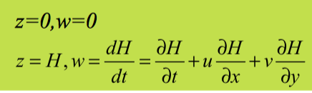

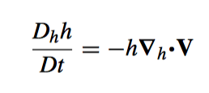
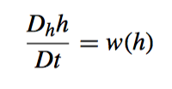
Dynamics of a single shallow layer of atmosphere
Since the fluid is incompressible,
Integrating from the surface to the depth of the ﬂuid, h(x, y), gives
Water pressure is a function of density and temperature, p = f(T, ρ), but following the motion incompressibility implies
Mass conservation equation
Use the relation
We get

Slide 26
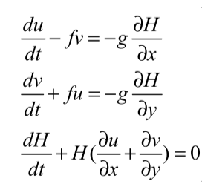
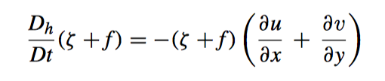
Shallow water vorticity equation
Horizontal momentum equation
Mass conservation equation
Following a derivation similar to derivation of vorticity equation, the shallow water vorticity equation yields

Slide 27
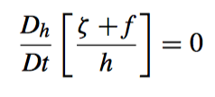
Shallow water potential vorticity conservation
Horizontal momentum equation
Rossby Potential Vorticity Conservation Law
Mass conservation equation
The shallow water potential vorticity,(ζ + f)/h, is given by the absolute vorticity divided by the ﬂuid depth. Following the motion, if the absolute vorticity increases, then the depth of the ﬂuid must as well

Slide 28
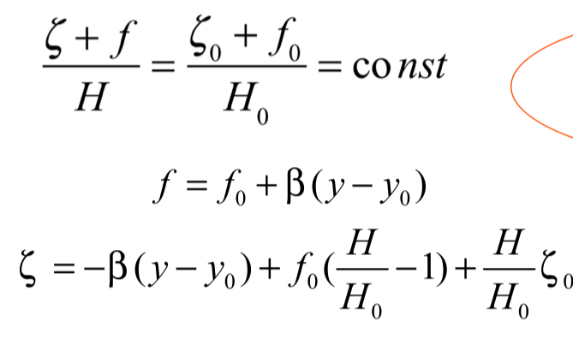
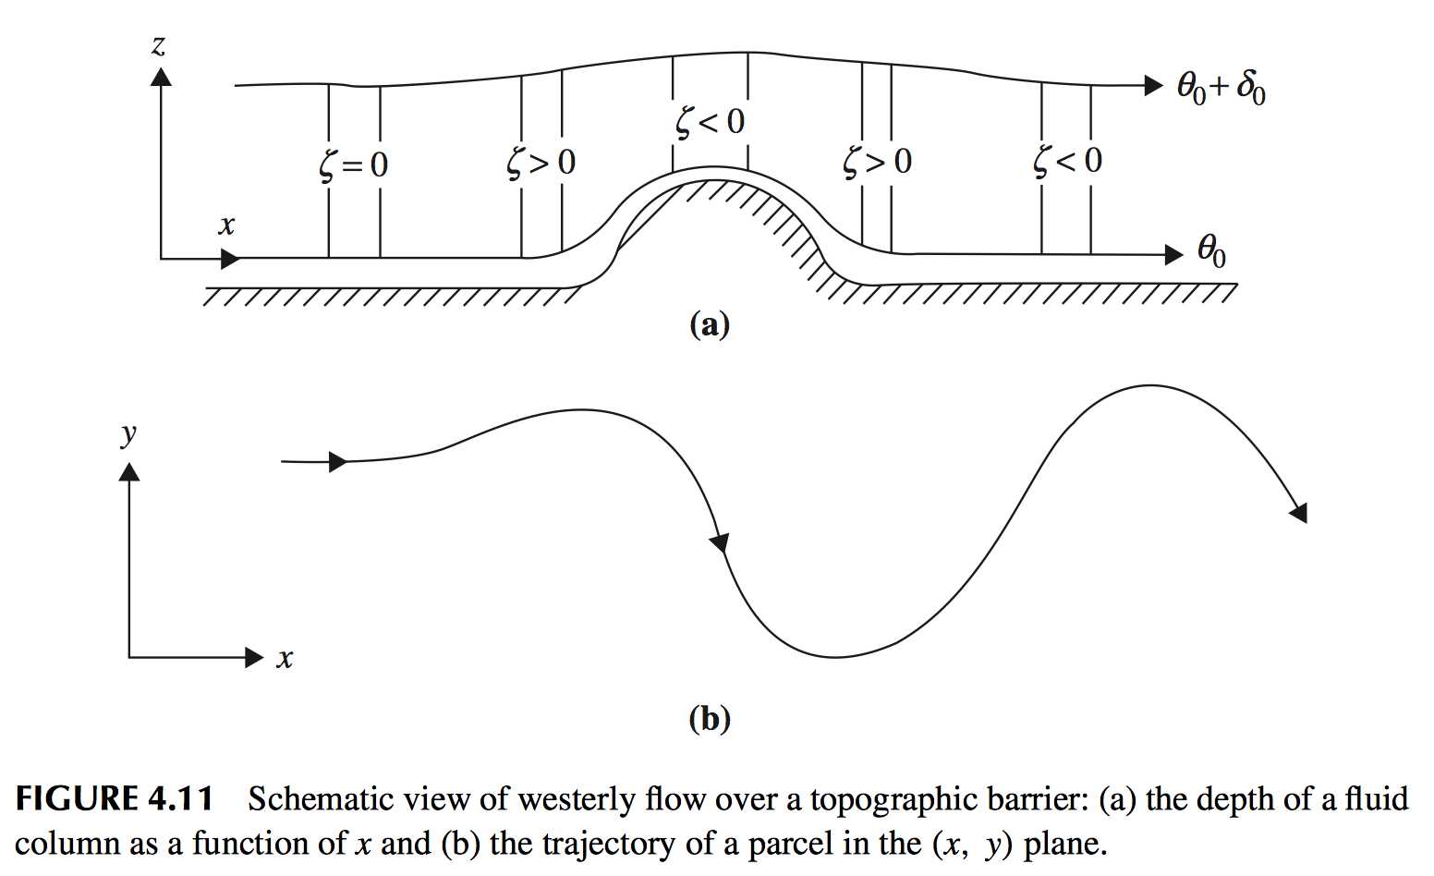
Application: Flows Cross Over a Mountain
Before:
the air column will acquire anticyclonic vorticity and move southward
After:
acquire cyclonic curvature and the air column will be deﬂected poleward
wave train downstream.

Slide 29
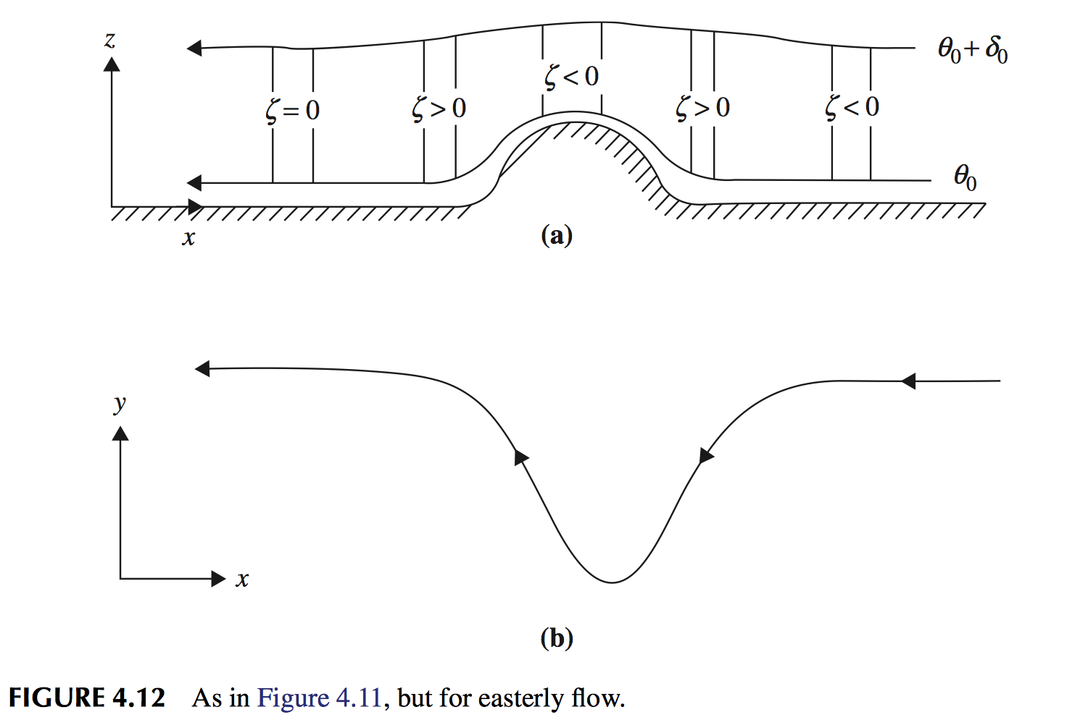
Application: Flows Cross Over a Mountain
Notes:
Upstream stretching leads to a cyclonic turning of the ﬂow, which results in an equatorward component of motion. As the column moves westward and equatorward over the barrier, its depth contracts and its absolute vorticity must then decrease so that potential vorticity can be conserved. This reduction in absolute vorticity arises both from development of anticyclonic relative vorticity and from a decrease in f due to the equatorward motion.

Slide 30
Next Lecture The Potential Vorticity And Its Equation
Notes:
I

