Slide 1
From Data to Action—Building a Reproducible Analytical Pipeline to Achieve Rapid, Sustained Improvements in MRSA Admission Screening Compliance Rates.
Daniel Weiand; Paul Bradley; Caroline Cullerton; Geoff Dines; Joanne Field; Peta Le Roux; Jamie Lupton; Shraddha Pathak; Julie Samuel; Chris Plummer

Slide 2
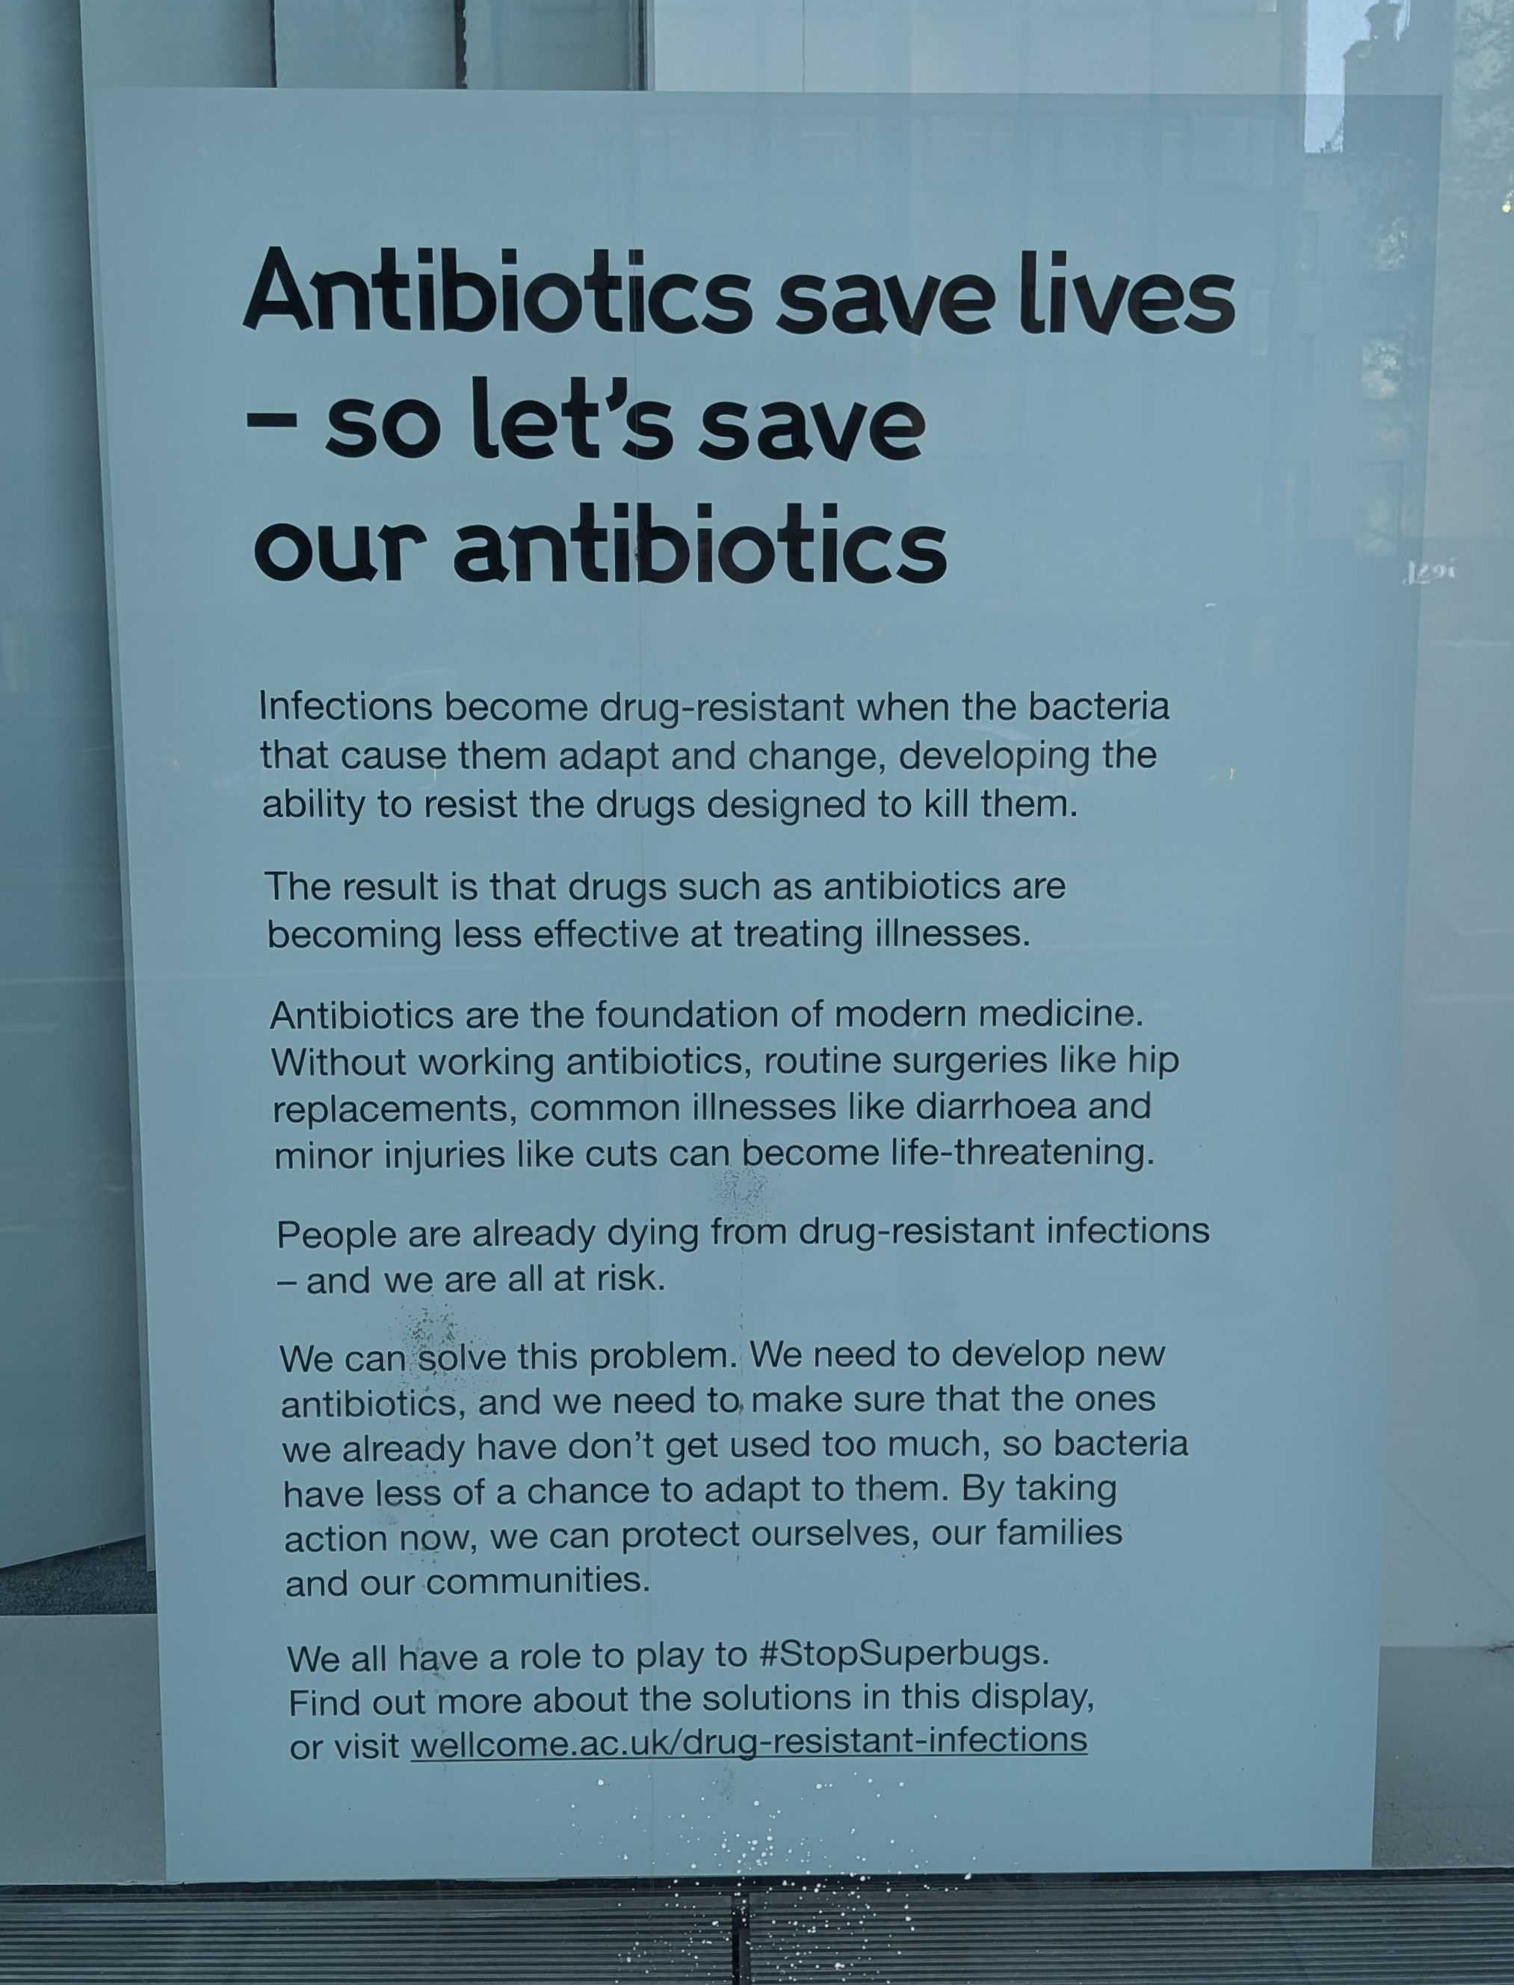
Problem description (1)
MRSA:
- Epidemiologically important organism (1,2).
- Intrinsically multidrug resistant (MDR).
- Significant morbidity and mortality.
National frameworks to mandate reporting of MRSA bacteraemia rates (3).
Wellcome Trust [2025]

Slide 3
Problem description (2)
Admission screening recommended for almost all patients who need hospitalisation (4–8)
BUT…
Significant variability in MRSA admission screening practices, e.g. indications, specimen types, and duration of test validity (2).
Wellcome Trust [2025]

Slide 4
Problem description (3)
@ NUTH: MRSA admission screening mandated by Trust policy for all inpatients
Screening must be undertaken between:
  [18 weeks preceding admission] –
  [admission date]
Prior to this project, MRSA admission screening compliance levels were effectively unknown at NUTH.
Wellcome Trust [2025]

Slide 5

Normalisation Process Theory (NPT) (1)
How to embed (‘normalise’) interventions into everyday practice (10,11).
‘Reflexive monitoring’: key driver of any embedding process (11,12).
Feedback enables healthcare workers [HCWs] to develop a shared understanding of an intervention’s value and importance (‘coherence’)
Per Nilsen [2024]

Slide 6
Feedback/
‘Reflexive monitoring’
Routine embedding/
‘Normalisation’
Shared understanding/
‘Coherence’

Slide 7
Aims
To develop and implement a RAP (13–15)
…That triangulates data from different sources
…To prospectively evaluate, report, monitor and improve compliance with MRSA admission screening practices

Slide 8
Setting
Newcastle upon Tyne Hospitals NHS Foundation Trust (NUTH)
Major tertiary care NHS provider
Approximately 16,000 staff (17)
Serving around two million patient contacts annually.
The microbiology laboratory at NUTH is fully UKAS-accredited to ISO 15189:2022 (18,19)

Slide 9
Defining compliance with MRSA admission screening
“Compliance” required …
specimen(s) collected within the 18 weeks preceding admission or up to one day after admission; and
documented, valid date and time of collection.

Slide 10
RAP
Modification of an existing RAP
Extract standardised dataset, on a weekly basis
Processed, cleaned, quality-checked, and analysed
Final output: standardised HTML format report,
Automatically uploaded to a secure, central intranet hub
from secure data warehouse (DWH), using SQL (22) and R programming (23).
modular, re-usable, git version-controlled code
using R programming (23).
generated using Quarto (24).
data science intranet site [IIS]

Slide 11
Team Structure and Governance
The RAP was developed collaboratively by:
Data scientists,
Data warehouse architect,
IT development manager, and
Consultant medical microbiologists.
Formal approval from the Trust’s information governance team;
In compliance with IG, Caldicott & GDPR (26).

Slide 12
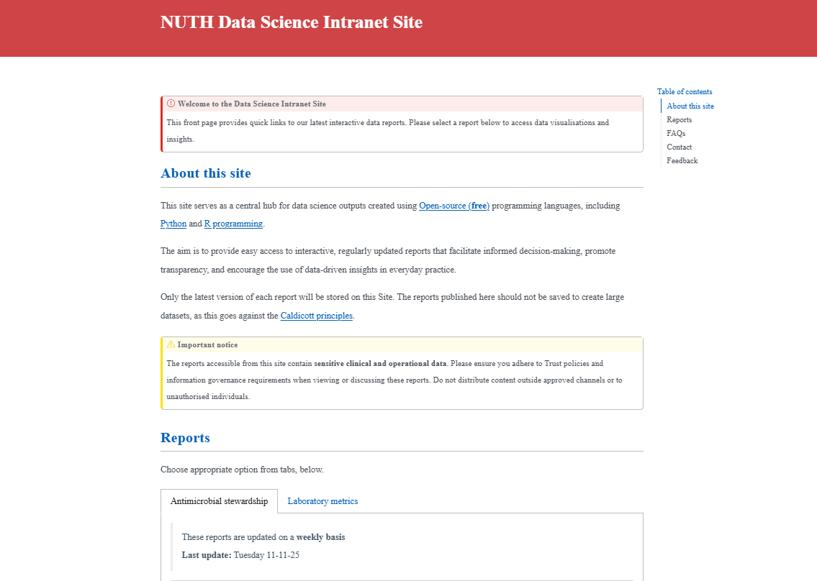

Slide 13
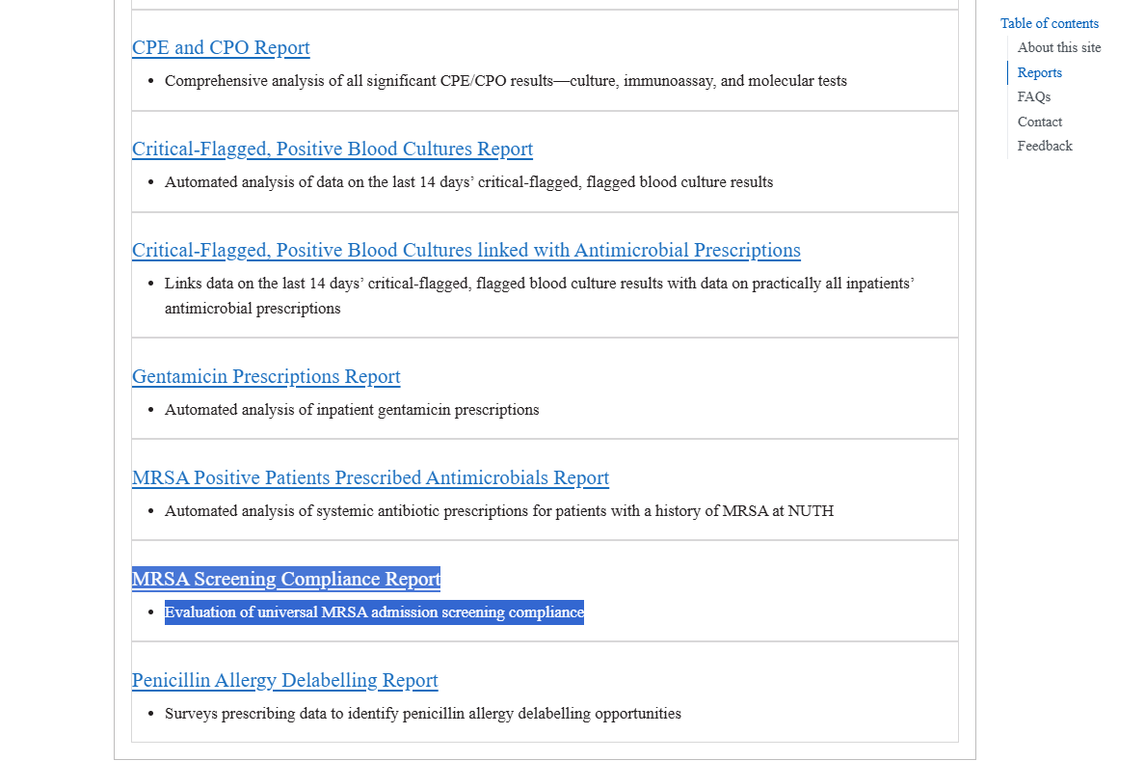
The kicker…
All these reports are generated weekly through modification of existing modular, re-usable, git version-controlled SQL and R code

Slide 14
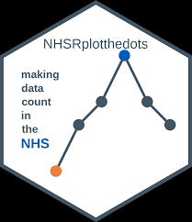
Approach to Assessing Impact
Design: Prospective weekly surveillance study
Systematic outcome measurement commenced on 07/01/25
Time series analysis using Statistical Process Control (SPC) methods used to detect meaningful changes in compliance

Slide 15
Selection of participants
Inclusion criteria:
all current inpatients at NUTH; with
length of stay of at least 24 hours; and
prescribed a new inpatient medication within the previous 7 days.
Exclusion criteria:
Inpatients admitted >6 weeks prior to the date of analysis; or
Inpatients exempt from MRSA screening according to Trust policy.
i.e. pragmatic approach

Slide 16
Results
Between Tuesday 07/01/2025 and Tuesday 11/11/2025
47,382 inpatient records analysed.
Each week, on average: 1077 distinct MRSA admission screening-eligible inpatients (standard deviation: 75, range: 904–1241).

Slide 17
Details about missing data
For the week ending Tuesday 11 November 2025:
Collection date and time were available for 1540 out of 1542 specimens (99.87%).
All other key variables—including patient identifiers, admission details, and MRSA screening sample characteristics—were complete across the dataset.
Missing data were not imputed; analyses were conducted on complete cases only.

Slide 18
Contextual elements that interacted with the intervention(s)
Between Tuesday 07 January 2025 and Tuesday 11 November 2025:
45 weekly reports scheduled for publication to the data science intranet site.
Reports were successfully published for 43 weeks (95.6%)
Two weeks of missed reporting:
one week during the summer holiday period due to data science team staffing constraints, and
one week owing to unscheduled Pathology LIMS downtime, preventing data extraction.
Both incidents resolved without requiring modifications to the RAP workflow.

Slide 19
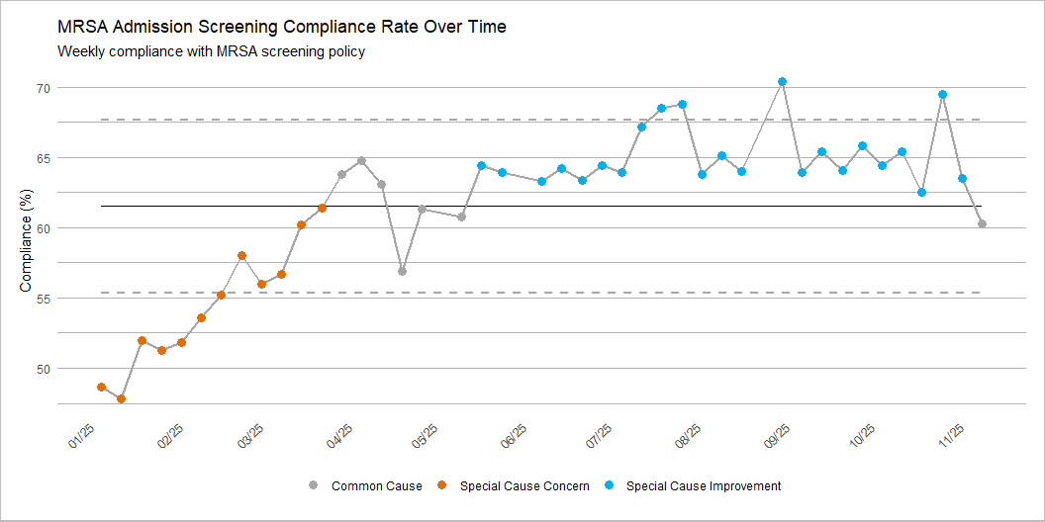
The kicker…
At NUTH I can’t think of any IPC interventions that achieved such rapid, sustained improvements in the primary outcome of interest

Slide 20
Temporal trend in compliance rates
Mean compliance across the study period was 61.5%
(SD 5.6%; median 63.6%)
Range: 47.8% to 70.4%.
Linear regression analysis demonstrated a statistically significant positive trend

Slide 21
Temporal trend in compliance rates
Compliance increased by 0.328 percentage points per week
(95% CI [0.241, 0.416]; p < 0.001).
This temporal trend explained 59.1% of the observed variation in weekly compliance rates.

Slide 22
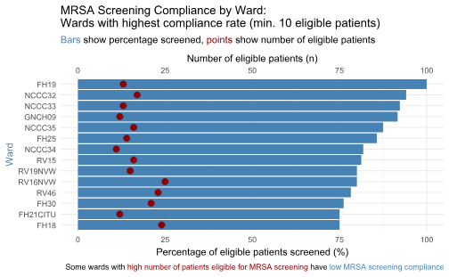
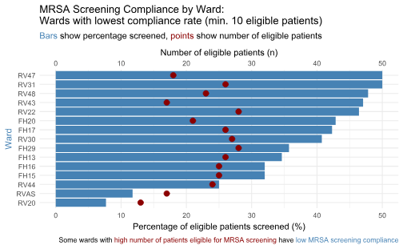
Best performers
Requiring improvement
Data for the week ending Tuesday 11/11/2025

Slide 23
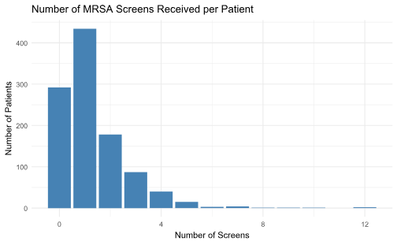
Data for the week ending Tuesday 11/11/2025

Slide 24
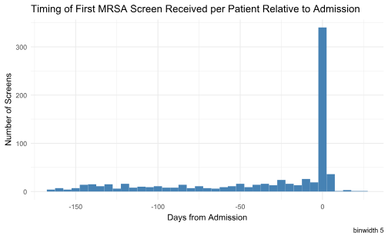
Data for the week ending Tuesday 11/11/2025

Slide 25
Interpretation (1)
RAP-generated, patient-level feedback constitutes an effective mechanism to achieve rapid and sustained improvements in MRSA admission screening rates.
Relatively-speaking: extremely resource- and time-efficient (7).

Slide 26
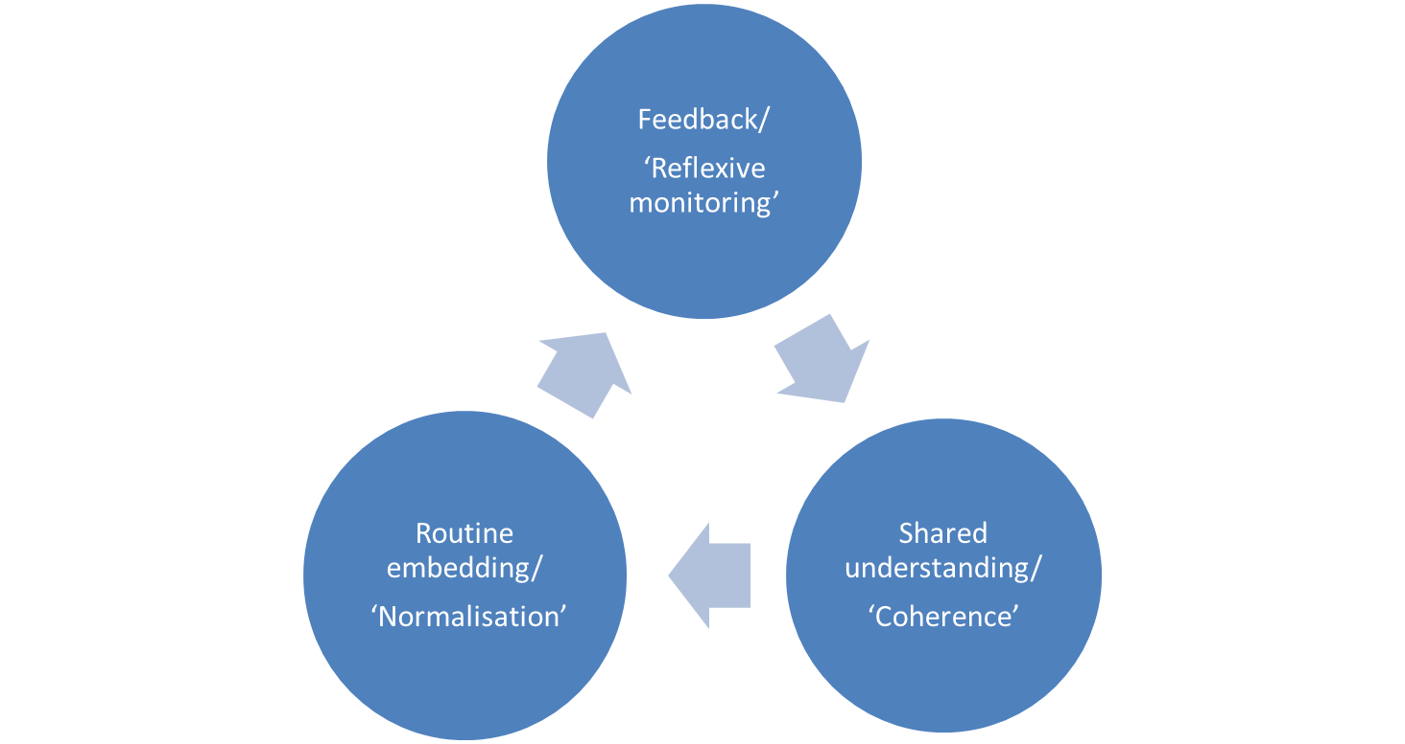
Interpretation (2)
From a theoretical perspective, the results support the application of Normalisation Process Theory in explaining how complex interventions become routinely embedded in clinical practice (9–12).
Per Nilsen [2024]

Slide 27
Interpretation (3)
The relatively modest baseline compliance with MRSA admission screening compliance is not unexpected
Published benchmarks point at varying performance levels:
Swiss study, baseline compliance rate of 32% (33)
English study, only 61% of emergency admissions (median 67.3%), screened for MRSA (34).
Scottish study, audit data from self-selected areas, compliance of 81% (5).

Slide 28

Conclusions
Investing in RAP represents a strategic opportunity for healthcare organisations committed to embedding evidence-based practices.
Beyond MRSA admission screening, this approach should be applied to monitor and improve compliance with other time-sensitive measures requiring ongoing performance monitoring.
This methodology should be scaled to achieve sustained, system-wide improvement in multiple dimensions of healthcare safety and quality.

Slide 29
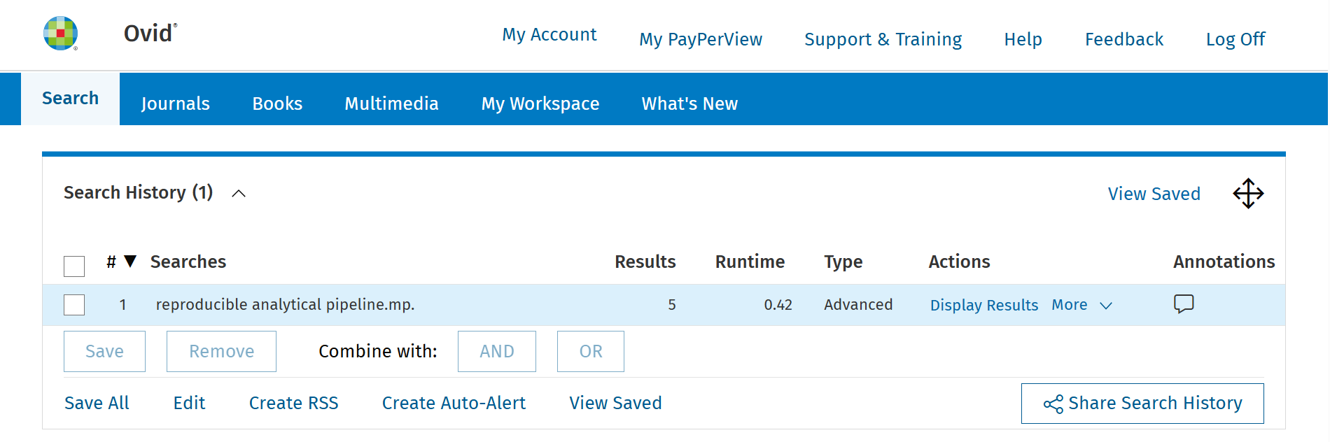
We will submit our results for publication in peer-reviewed journal

Slide 30
References (1)
1. Siegel JD, Rhinehart E, Jackson M, Chiarello L. 2007 guideline for isolation precautions: Preventing transmission of infectious agents in health care settings. American Journal of Infection Control [Internet]. 2007 Dec;35(10):S65–164. Available from: http://dx.doi.org/10.1016/j.ajic.2007.10.007
2. NHS England. Delivering a standardised approach to screening for MRSA [Internet]. 2025. Available from: https://gettingitrightfirsttime.co.uk/delivering-a-standardised-approach-to-screening-for-mrsa/
3. Dickmann P, Keeping S, Döring N, Schmidt AE, Binder C, Ariño-Blasco S, et al. Communicating the risk of MRSA: The role of clinical practice, regulation and other policies in five european countries. Frontiers in Public Health [Internet]. 2017 Mar;5. Available from: http://dx.doi.org/10.3389/fpubh.2017.00044
4. Coia JE, Duckworth GJ, Edwards DI, Farrington M, Fry C, Humphreys H, et al. Guidelines for the control and prevention of meticillin-resistant staphylococcus aureus (MRSA) in healthcare facilities. Journal of Hospital Infection [Internet]. 2006 May;63:S1–44. Available from: http://dx.doi.org/10.1016/j.jhin.2006.01.001
5. Currie K, King C, McAloney-Kocaman K, Roberts NJ, MacDonald J, Dickson A, et al. Barriers and enablers to meticillin-resistant staphylococcus aureus admission screening in hospitals: A mixed-methods study. Journal of Hospital Infection [Internet]. 2019 Jan;101(1):100–8. Available from: http://dx.doi.org/10.1016/j.jhin.2018.08.006
6. Department of Health. Implementation of modified admission MRSA screening guidance for NHS [Internet]. 2014. Available from: https://assets.publishing.service.gov.uk/government/uploads/system/uploads/attachment_data/file/345144/Implementation_of_modified_admission_MRSA_screening_guidance_for_NHS.pdf
7. NHS England. GIRFT guide to preoperative testing: Adult MRSA screening and suppression/eradication prophylaxis for patients who are on an elective surgical pathway [Internet]. 2025. Available from: https://gettingitrightfirsttime.co.uk/wp-content/uploads/2025/05/GIRFT-Guide-to-preoperative-testing-MRSA-May-2025.pdf
8. Coia JE, Wilson JA, Bak A, Marsden GL, Shimonovich M, Loveday HP, et al. Joint healthcare infection society (HIS) and infection prevention society (IPS) guidelines for the prevention and control of meticillin-resistant staphylococcus aureus (MRSA) in healthcare facilities. Journal of Hospital Infection [Internet]. 2021 Dec;118:S1–39. Available from: http://dx.doi.org/10.1016/j.jhin.2021.09.022
9. May C, Finch T, Rapley T. Normalization process theory. In: Nilsen P, Birken SA, editors. Handbook on implementation science [Internet]. Edward Elgar Publishing; 2020. p. 144–67. Available from: https://www.elgaronline.com/downloadpdf/edcollchap/edcoll/9781788975988/9781788975988.00013.pdf
10. May CR, Mair FS, Dowrick CF, Finch TL. Process evaluation for complex interventions in primary care: Understanding trials using the normalization process model. BMC Family Practice [Internet]. 2007 Jul;8(1). Available from: http://dx.doi.org/10.1186/1471-2296-8-42
11. Nilsen P. Making sense of implementation theories, models and frameworks. Implementation Science [Internet]. 2015 Apr;10(1). Available from: http://dx.doi.org/10.1186/s13012-015-0242-0
12. Murray E, Treweek S, Pope C, MacFarlane A, Ballini L, Dowrick C, et al. Normalisation process theory: A framework for developing, evaluating and implementing complex interventions. BMC Medicine [Internet]. 2010 Oct;8(1). Available from: http://dx.doi.org/10.1186/1741-7015-8-63
13. Goldacre B, Morley J, Hamilton N, et al. Better, broader, safer: Using health data for research and analysis [Internet]. Department of Health; Social Care; 2022. Available from: https://assets.publishing.service.gov.uk/government/uploads/system/uploads/attachment_data/file/1067053/goldacre-review-using-health-data-for-research-and-analysis.pdf
14. Elliott A. Better, broader, safer: Using health data for research and analysis (the goldacre review). Journal of Radiological Protection [Internet]. 2022 Sep;42(3):030101. Available from: http://dx.doi.org/10.1088/1361-6498/ac89f8
15. NHS Digital RAP Community of Practice. What is RAP? https://nhsdigital.github.io/rap-community-of-practice/introduction_to_RAP/what_is_RAP/; n.d.
16. Keegan NM, Vasselman SE, Barnett ES, Nweji B, Carbone EA, Blum A, et al. Clinical annotations for prostate cancer research: Defining data elements, creating a reproducible analytical pipeline, and assessing data quality. The Prostate [Internet]. 2022 May;82(11):1107–16. Available from: http://dx.doi.org/10.1002/pros.24363
17. Newcastle upon Tyne Hospitals NHS Foundation Trust. About newcastle hospitals [Internet]. 2020 [cited 2025 Aug 21]. Available from: https://www.newcastle-hospitals.nhs.uk/about/

Slide 31
References (2)
18. Newcastle upon Tyne Hospitals NHS Foundation Trust. Newcastle hospitals laboratories. https://laboratories.newcastle-hospitals.nhs.uk/; 2025.
19. UKAS. Medical laboratory accreditation - ISO 15189. https://www.ukas.com/accreditation/standards/medical-laboratory-accreditation/; 2025.
20. NHS Digital RAP Community of Practice. Introduction to git. https://nhsdigital.github.io/rap-community-of-practice/training_resources/git/introduction-to-git/; n.d.
21. GitHub. GitHub. GitHub; https://github.com/; 2025.
22. Müller K, Wickham H, James DA, Falcon S. RSQLite: SQLite interface for r [Internet]. 2024. Available from: https://rsqlite.r-dbi.org
23. R Core Team. R: A language and environment for statistical computing [Internet]. Vienna, Austria: R Foundation for Statistical Computing; 2024. Available from: https://www.R-project.org/
24. Allaire J, Dervieux C. Quarto: R interface to quarto markdown publishing system [Internet]. 2024. Available from: https://github.com/quarto-dev/quarto-r
25. Microsoft. Internet information services (IIS) for windows server. https://www.iis.net/overview; 2025.
26. ICO. UK GDPR guidance and resources. ICO; https://ico.org.uk/for-organisations/uk-gdpr-guidance-and-resources/; 2025.
27. Benneyan JC. Statistical process control as a tool for research and healthcare improvement. Quality and Safety in Health Care [Internet]. 2003 Dec;12(6):458–64. Available from: http://dx.doi.org/10.1136/qhc.12.6.458
28. Mohammed MA. Using statistical process control to improve the quality of health care. Quality and Safety in Health Care [Internet]. 2004 Aug;13(4):243–5. Available from: http://dx.doi.org/10.1136/qhc.13.4.243
29. Anhøj J, Hellesøe AMB. The problem with red, amber, green: The need to avoid distraction by random variation in organisational performance measures. BMJ Quality &amp; Safety [Internet]. 2016 Mar;26(1):81–4. Available from: http://dx.doi.org/10.1136/bmjqs-2015-004951
30. NHS England. Making data count [Internet]. 2019. Available from: https://www.england.nhs.uk/publication/making-data-count/
31. Smith T, Reading C, Wellesley-Miller S, Turner Z, Jemmett T, Mainey C, et al. NHSRplotthedots: Draw XmR charts for NHS making data count programme [Internet]. 2025. Available from: https://nhsrplotthedots.nhsrcommunity.com
32. Chen LF, Vander Weg MW, Hofmann DA, Reisinger HS. The hawthorne effect in infection prevention and epidemiology. Infection Control &amp; Hospital Epidemiology [Internet]. 2015 Sep;36(12):1444–50. Available from: http://dx.doi.org/10.1017/ice.2015.216
33. Joubert D, Cullati S, Briot P, Righi L, Grauser D, Ourahmoune A, et al. How to improve hospital admission screening for patients at risk of multidrug-resistant organism carriage: A before-and-after interventional study and cost-effectiveness analysis. BMJ Open Quality [Internet]. 2022 Apr;11(2):e001699. Available from: http://dx.doi.org/10.1136/bmjoq-2021-001699
34. Fuller C, Robotham J, Savage J, Hopkins S, Deeny SR, Stone S, et al. The national one week prevalence audit of universal meticillin-resistant staphylococcus aureus (MRSA) admission screening 2012. Kluytmans J, editor. PLoS ONE [Internet]. 2013 Sep;8(9):e74219. Available from: http://dx.doi.org/10.1371/journal.pone.0074219

Slide 32
Thanks for listening!
Daniel Weiand; Paul Bradley;
Caroline Cullerton; Geoff Dines;
Joanne Field; Peta Le Roux;
Jamie Lupton; Shraddha Pathak;
Julie Samuel; Chris Plummer
github: send2dan

