Slide 1
Survivability Analysis for Complex Networked Systems:
A Case Study on Smart Grids
Koosha Marashi
Mark Woodard
Sahra Sedigh Sarvestani

Slide 2
Introduction
Modern critical infrastructures are Cyber-Physical Systems (CPSs)
Examples: smart grids, intelligent water distribution, and intelligent transportation systems
Benefits:
improved functionality of physical infrastructures by utilizing cyber components
Hazards:
deployed in environments defined by uncertainty
require modeling and analysis of response to cyber and physical faults, errors, and attacks
Our approach is to:
simulate failure cases of a networked system and evaluate survivability
find susceptible critical components that need to be fortified for an improved design

Slide 3
Our Contribution
An approach to evaluate networked system survivable behavior using simulation.
A method for ranking components for hardening based on survivable behavior.

Slide 4
Motivation
Catastrophic failures of power systems:
Italian blackout on 28 September 2003
cascading power failure left half of Italy without power for multiple days
exacerbated by Internet communication nodes failing due to the power failure, causing further breakdown of power stations communication and control
Arizona-Southern California blackout on 8 September 2011
11-minute loss of a single 500 kV transmission line triggered a cascading outage leaving approximately 2.7 million customers without power for up to 12 hours
exacerbated by higher than normal demand during peak demand hours combined with lower than peak generation level

Slide 5
Related Work
Chopade and Bikdash in 2012:
Survivability evaluation of smart grids using a graph-theoretic approach
Statistical topology-based measures can not accurately model the behavior of the system

Slide 6
Related Work
Menasche et al. in 2012:
A new metric, ESAIDI (extended SAIDI) for analyzing consequences of failures
An analytical approach based on Markov chains with rewards
Avritzer et al. in 2013:
Extending the previous work to account for disruptions in the communication infrastructure
Menasche et al. in 2014:
Concurrent failures of the power system are also considered
The model captures time-to-recover: the boundary between survivability and resilience is not clear

Slide 7
Related Work
Yi and Dohi in 2015:
Survivability evaluation of mobile ad hoc networks by measuring the probability that all active nodes are k-connected to the network
Connectivity solely, is not appropriate for capturing survivable behavior of complex networks

Slide 8
Related Work
Ref. | Definition |  | Modeling |  | Evaluation | Simulation | System Topology
 | Qual. | Quan. | Qual. | Quan. |  |  | Known | Random
Avritzer et al. [1] |  |  |  |  | ✓ |  | ✓ | ✓
Heegaard and Trivedi [2] |  |  | ✓ | ✓ | ✓ | ✓ | ✓
Knight and Sullivan [3] | ✓
Ma [4] |  | ✓
Ellison et al. [5] | ✓ |  |  |  | ✓
Menasche et al. [6] |  |  |  | ✓ | ✓ |  | ✓
Avritzer et al. [7] |  |  |  | ✓ | ✓ |  | ✓
Koziolek et al. [8] |  |  |  | ✓ | ✓ |  | ✓
Menasche et al. [9] |  |  |  | ✓ | ✓ |  | ✓
Chopade and Bikdash [10] |  |  |  | ✓ | ✓ | ✓ |  | ✓
Yi and Dohi [11] |  |  |  | ✓ | ✓ | ✓ |  | ✓
Linger et al. [12] | ✓
Christie [13] |  |  |  |  | ✓ | ✓
This work |  |  |  | ✓ | ✓ | ✓ | ✓

Slide 9
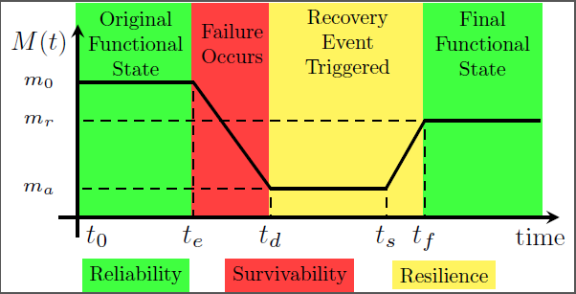
System Metrics
Binary system states:
Reliability (t₀, t_{e}), Availability (t₀, t∞)
Multiple system states:
Performability (t_{e}, t_{d}), Resilience (t_{d}, t_{f}), Survivability (t_{e}, t_{d}), Robustness (t₀, t_{e})

Slide 10
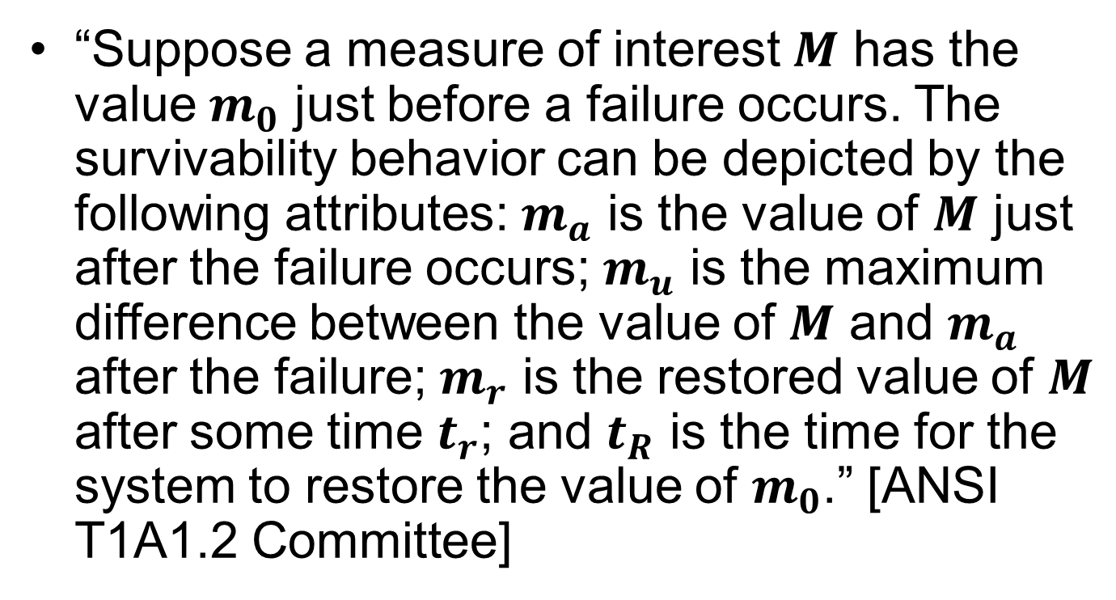
Survivability Definitions
“Suppose a measure of interest $M$ has the value $m_{0}$ just before a failure occurs. The survivability behavior can be depicted by the following attributes: $m_{a}$ is the value of $M$ just after the failure occurs; $m_{u}$ is the maximum difference between the value of $M$ and $m_{a}$ after the failure; $m_{r}$ is the restored value of $M$ after some time $t_{r}$; and $t_{R}$ is the time for the system to restore the value of $m_{0}$.” [ANSI T1A1.2 Committee]

Slide 11
Survivable Behavior
From T1A1.2 definition of survivability, we conclude that a system with the following behavior attains a higher level of survivability:
“Graceful Degradation” minimizes rate of failure
“Failure Resistance” minimizes maximum “depth of failure”
Failures can be compared and analyzed based on their survivable behavior.

Slide 12
Survivability Evaluation Approach
First, a set of failure cases is selected to evaluate the system. Each failure case is simulated producing a figure-of-merit (FOM) over time.
Second, survivability analysis of the simulation results is conducted by examining the rate and depth of degradation of the FOM.
Third, critical components are selected and hardened. Components of the systems whose failures are comparatively more important based on the severity and/or relative frequency of involvement in system-level failures are selected for hardening.
The process is repeated as necessary until the desired survivable behavior is achieved.

Slide 13
Failure Cases to Simulate
Important and difficult task for large systems
Infeasible to cover all possible system states as set of system states grows exponentially with the growth of the system.
Missing plausible cases with catastrophic consequences will severely impact the quality of the evaluation.
The number of concurrent failures in cyber and physical networks is determined based on respective probabilities of their failure.

Slide 14
Survivable Behavior Analysis
Compare failures cases based on survivable behavior
Each simulation produces a set of FOM levels at time observations
Extract maximum rate and depth of failure from the results
Plotted on a 2-dimensional color intensity histogram
Detect clusters using visual analysis or any clustering algorithm
Ideal system: one cluster near the origin characterized by slow and minimal degradation
Clusters outside of this area demonstrate non-survivable behavior.
Clusters can be used to compare systems using various clustering metrics.

Slide 15
System Hardening
Components ranked based on their contribution to the overall survivability of the system determined by their Fragility and Criticality
Fragility: the number of times a component of the system has experienced failure among all simulated failure cases
Criticality: the immediate impact (survivable behavior) of a component’s failure

Slide 16
Hardening Priority
Fragility and Criticality are combined to rank components based on their Priority for hardening.
Priority = Fragility + Criticality
Components are hardened using Redundancy and Diversity

Slide 17
Case Study: IEEE Power Bus Systems
Test cases for research purposes
Commonly studied in the literature
Different sizes: 9-bus, 14-bus, ..., 300-bus
Composed of generators, transmission lines, transformers, buses, loads, and compensators
No cyber infrastructure

Slide 18
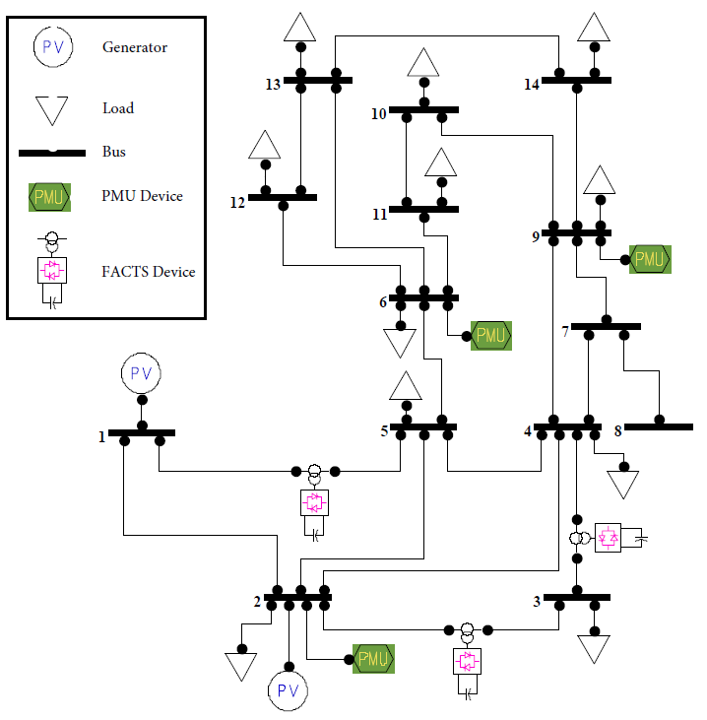
IEEE 14-Bus Systems

Slide 19
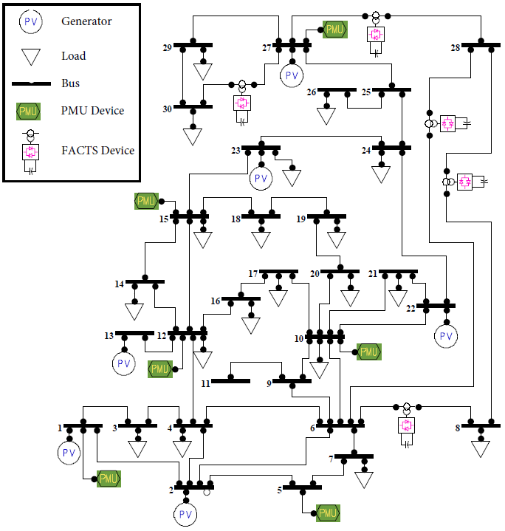
IEEE 30-Bus Systems

Slide 20
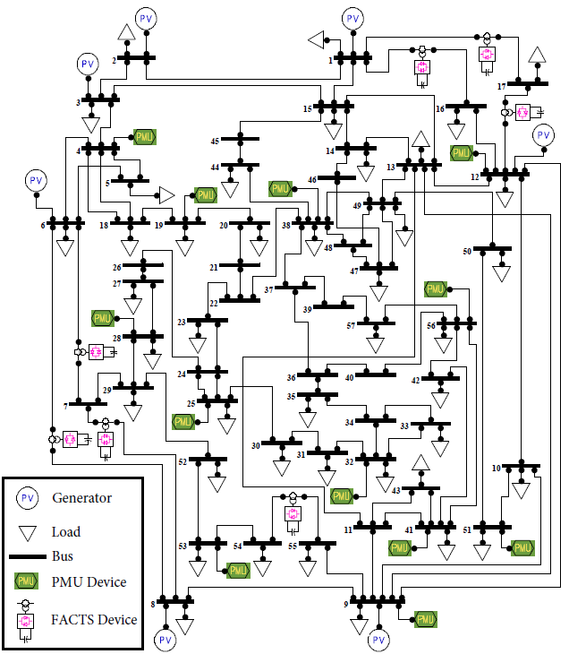
IEEE 57-Bus Systems

Slide 21
Smart Grid Simulator
Power System Analysis Toolbox (PSAT) :
Open-source MATLAB based toolbox for simulating power systems
Includes basic protection and monitoring devices
Our modifications:
Measurement system
Dynamic decision making algorithm
Programmatically modify component functional state and settings

Slide 22
Power System Metrics
Customer Service Index (CSI)
Average Nominal Voltage Error (ANVE)

Slide 23
Failure Cases Simulated
Hardware faults
Outage of a transmission line
Fault in a power regulator (FACTS device)
Cyber faults (manifestations of data corruption)
Wrong data from PMUs
Wrong commands generated by control algorithm
Undetected errors in the communications

Slide 24
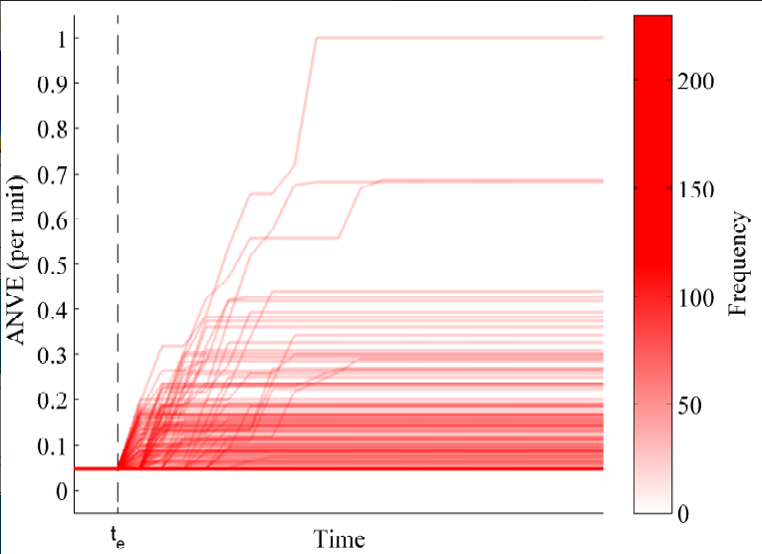
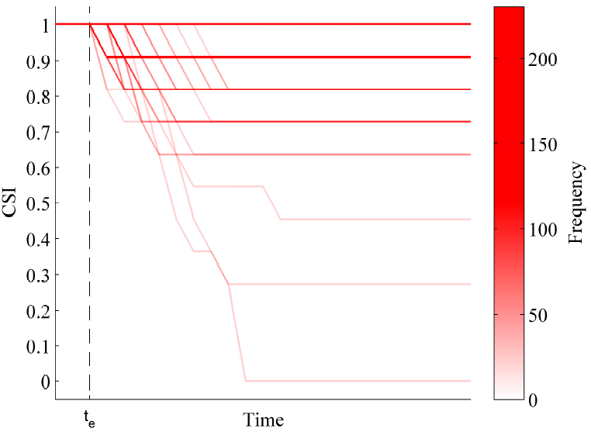
FOM vs. Time Results: IEEE-14

Slide 25
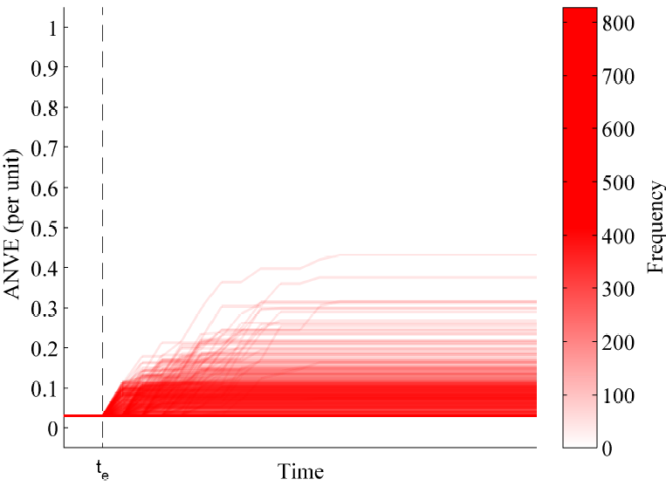
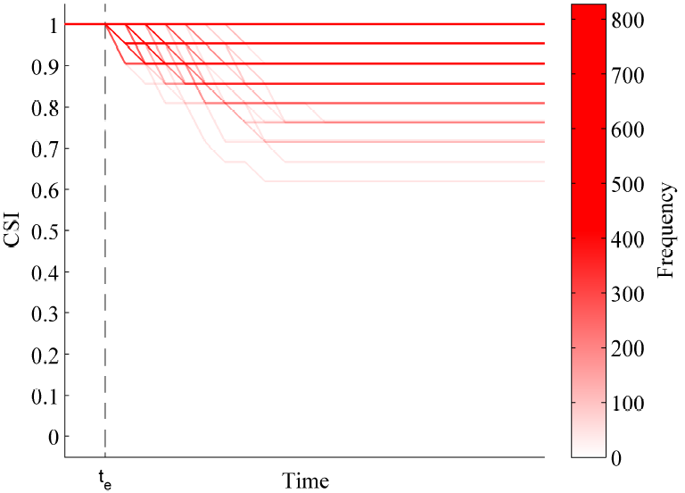
FOM vs. Time Results: IEEE-30

Slide 26
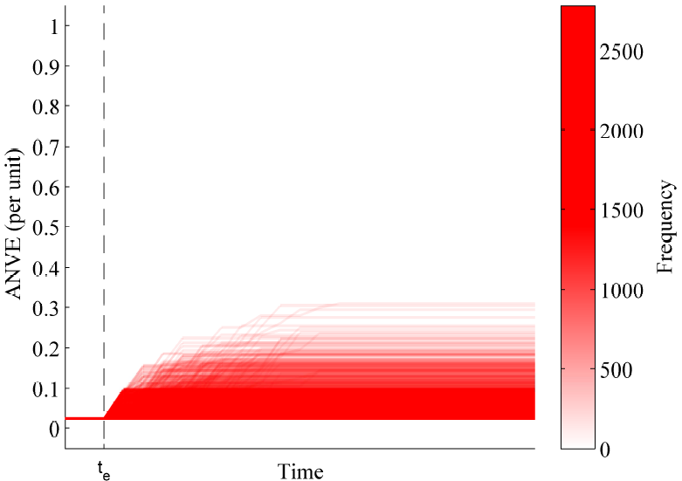
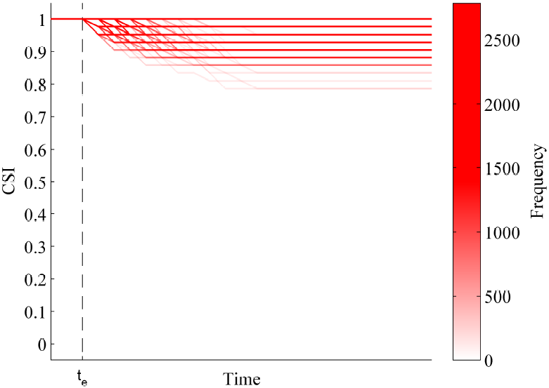
FOM vs. Time Results: IEEE-57

Slide 27
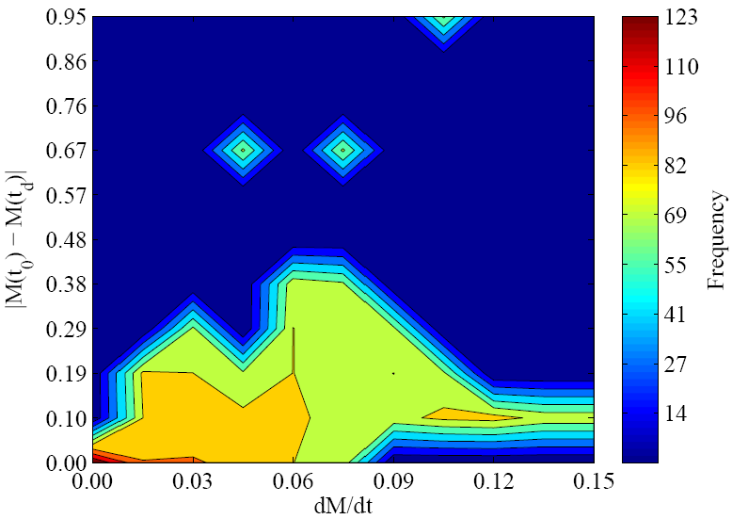
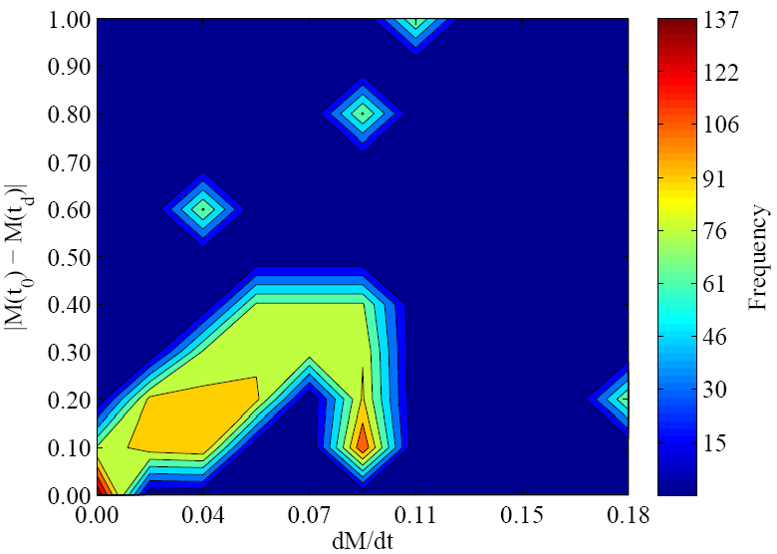
Survivable Behavior Analysis: IEEE-14
ANVE
CSI

Slide 28
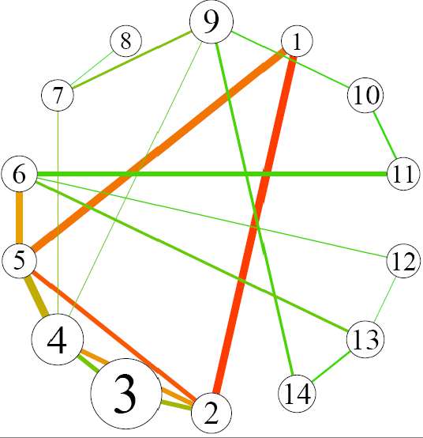
Survivable Behavior Analysis: IEEE-14

Slide 29
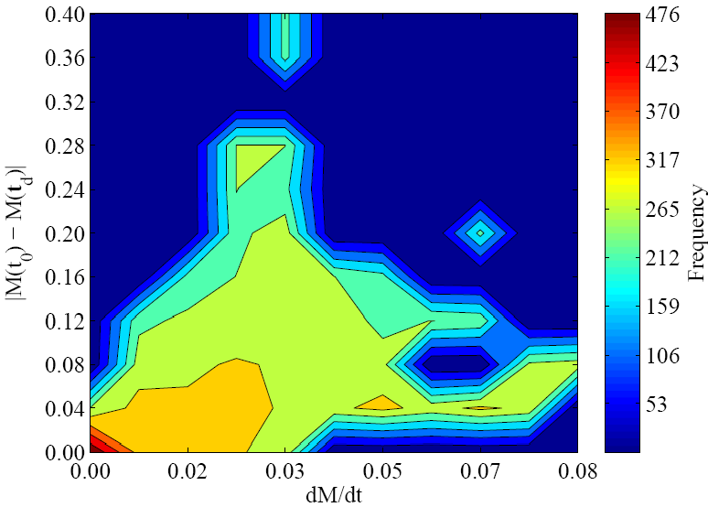
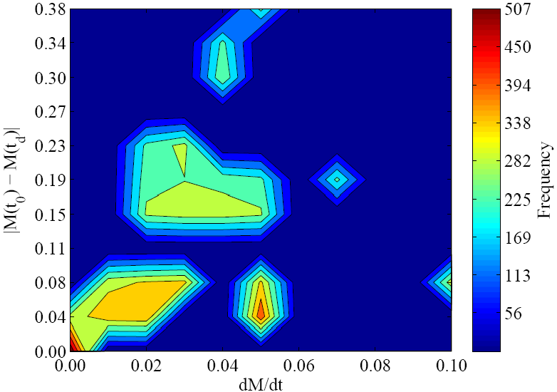
Survivable Behavior Analysis: IEEE-30
ANVE
CSI

Slide 30
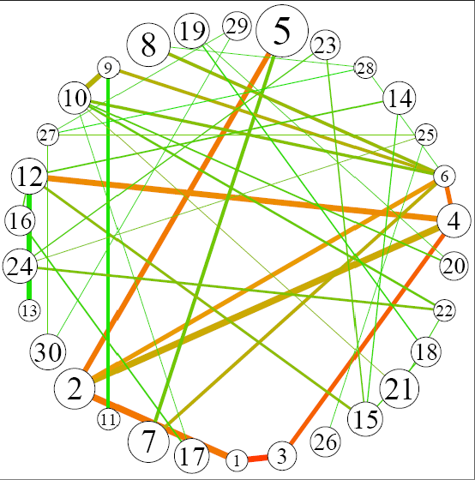
Survivable Behavior Analysis: IEEE-30

Slide 31
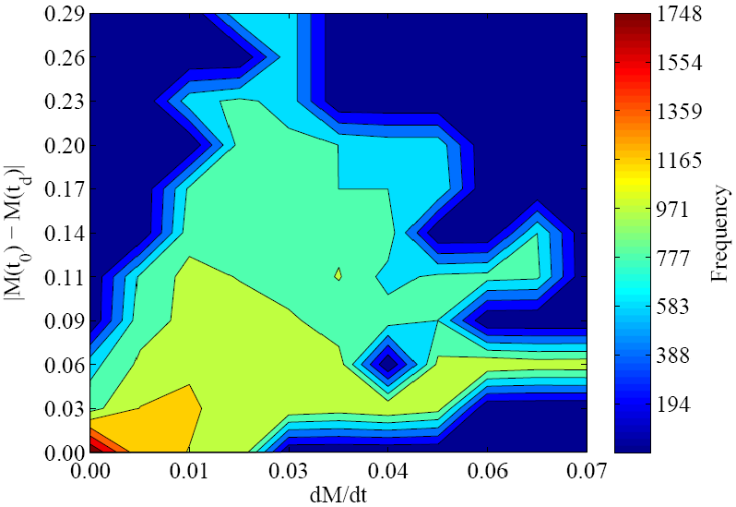
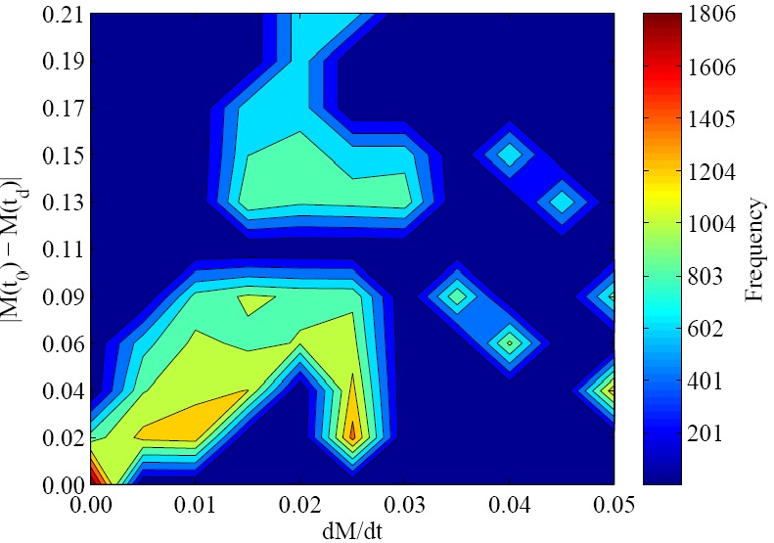
Survivable Behavior Analysis: IEEE-57
ANVE
CSI

Slide 32
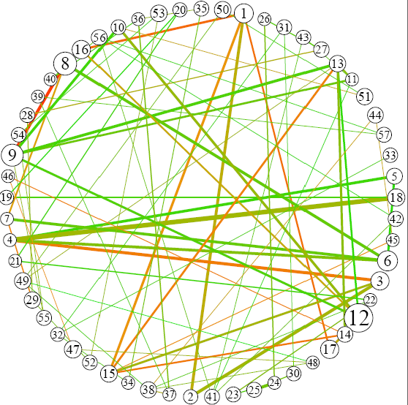
Survivable Behavior Analysis: IEEE-57

Slide 33
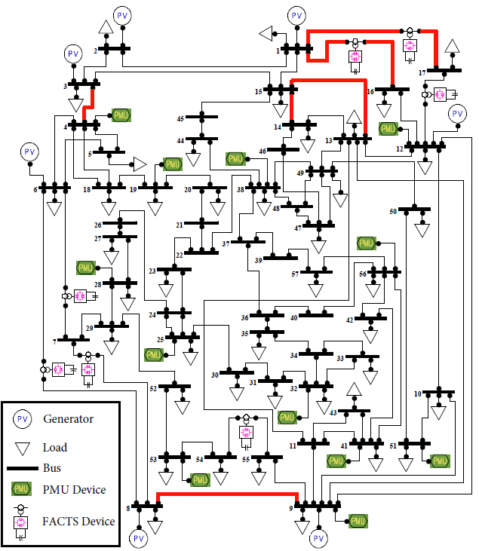
Components Hardened in IEEE-57

Slide 34
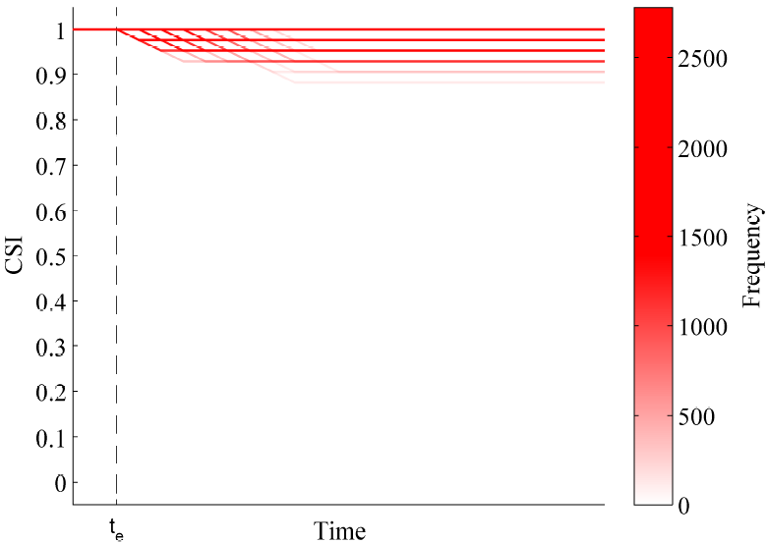
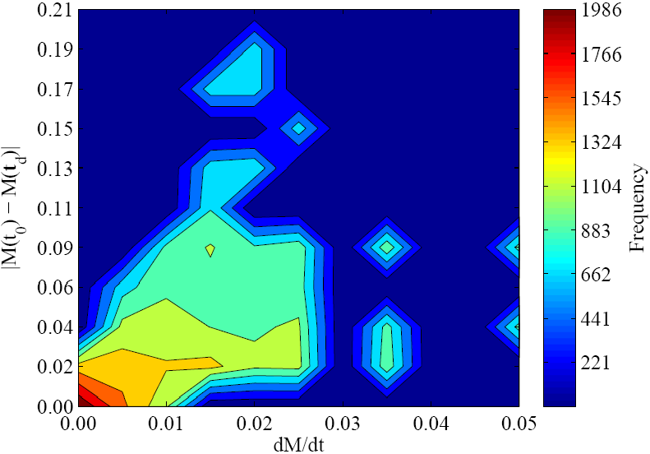
Post Hardening Results
CSI

Slide 35
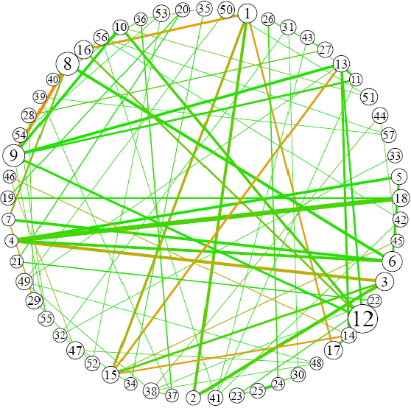
Post Hardening Results

Slide 36
Conclusion and Future Work
Summary:
Simulation based evaluation of smart grid survivability
Detection of components that have diminishing affect on survivable behavior and hardening them
Future Work:
Applying clustering techniques to automate recognition of common failure sequences
Refining the selection of failure cases to be simulated for a better scalability and accuracy

Slide 37
References
[1] A. Avritzer, L. Carnevali, H. Ghasemieh, L. Happe, B. R. Haverkort, A. Koziolek, D. Menasche, A. Remke, S. S. Sarvestani, and E. Vicario, “Survivability evaluation of gas, water and electricity infrastructures,” in Proc. of the 7th Int. Workshop on Practical Applications of Stochastic Modelling (PASM), January 2015.
[2] P. E. Heegaard and K. S. Trivedi, “Network survivability modeling,” Computer Networks, vol. 53, no. 8, pp. 1215-1234, 2009.
[3] J. C. Knight and K. J. Sullivan, “On the definition of survivability,” University of Virginia, Department of Computer Science, Technical Report CS-TR-33-00, 2000.
[4] Z. S. Ma, “A unified definition for reliability, survivability and resilience inspired by the handicap principle and ecological stability,” Int. J. of Critical infrastructures, vol. 8, no. 2-3, pp. 242-272, 2012.
[5] R. J. Ellison, D. A. Fisher, R. C. Linger, H. F. Lipson, and T. Longsta, “Survivable network systems: An emerging discipline,” DTIC Document, Tech. Rep., 1997.

Slide 38
References
[6] D. S. Menasche, R. M. Meri Leao, E. de Souza e Silva, A. Avritzer, S. Suresh, K. Trivedi, R. A. Marie, L. Happe, and A. Koziolek, “Survivability analysis of power distribution in smart grids with active and reactive power modeling,” SIGMETRICS Perform. Eval. Rev., vol. 40, no. 3, pp. 53-57, January 2012.
[7] A. Avritzer, S. Suresh, D. S. Menasche, R. M. M. Leao, E. de Souza e Silva, M. C. Diniz, K. Trivedi, L. Happe, and A. Koziolek, “Survivability models for the assessment of smart grid distribution automation network designs,” in Proc. of the 4th ACM/SPEC Int. Conf. on Performance Eng. (ICPE), New York, NY, USA, 2013, pp. 241-252.
[8] A. Koziolek, A. Avritzer, S. Suresh, D. Sadoc Menasche, K. Trivedi, and L. Happe, “Design of distribution automation networks using survivability modeling and power flow equations,” in IEEE 24th Int. Symposium on Software Rel. Eng. (ISSRE), November 2013, pp. 41-50.
[9] D. S. Menasche, A. Avritzer, S. Suresh, R. M. Leao, E. de Souza e Silva, M. Diniz, K. Trivedi, L. Happe, and A. Koziolek, “Assessing survivability of smart grid distribution network designs accounting for multiple failures,” Concurrency and Computation: Practice and Experience, vol. 26, no. 12, pp. 1949-1974, 2014.

Slide 39
References
[10] P. Chopade and M. Bikdash, “Modeling for survivability of smart power grid when subject to severe emergencies and vulnerability,” in Proc. of IEEE Southeastcon, March 2012, pp. 1-6.
[11] Z. Yi and T. Dohi, “A simulation approach to quantify network survivability on MANETs,” in IEEE 39th Computer Software and Applications Conference (COMPSAC), vol. 3, July 2015, pp. 268-273.
[12] R. C. Linger, N. R. Mead, and H. F. Lipson, “Requirements definition for survivable network systems,” in Proc. of the 3rd Int. Con. on Requirements Engineering: Putting Requirements Engineering to Practice, Washington, DC, USA, 1998, pp. 14-23.
[13] A. M. Christie, “Network survivability analysis using Easel,” Software Engineering Institute of Carnegie Mellon University, Tech. Rep., 2002.

Slide 40
Questions?

Slide 41
Survivability vs. Performability
Performability is defined as “quantitative measure of how well the system performs in the presence of faults over a specified period of time”
It is a unified measure of performance and reliability for the systems that have performance degradation
Both survivability and performability are of quantitative nature
Survivability is a probability, while performability has the same dimension as the performance metric deployed
What affects the survivability of a system the most is the relationship between its building blocks
But, performability of a system is affected the most by behavior of its components in the presence of faults

