Slide 1
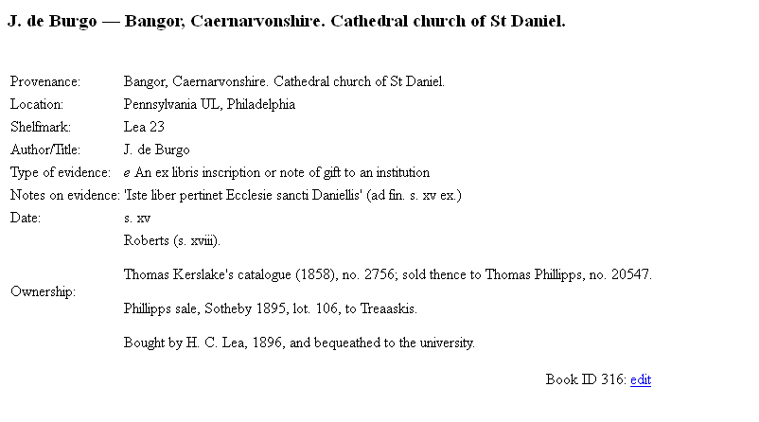
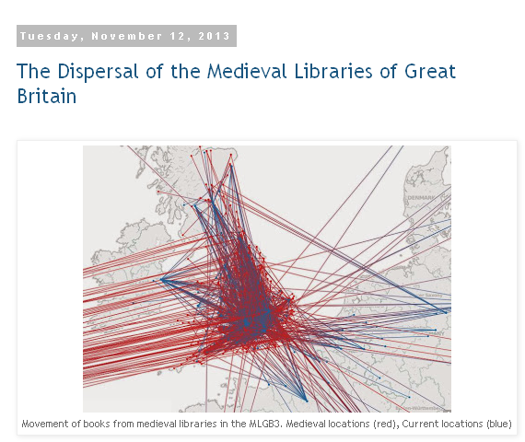
Screen Scraping:
Making web data useful

Slide 2
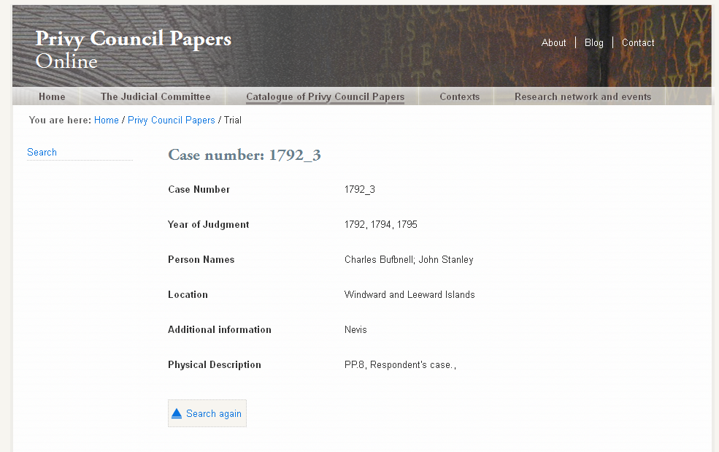
Web databases, one entry at a time…
http://www.privycouncilpapers.org/privy-council-papers/9119

Slide 3
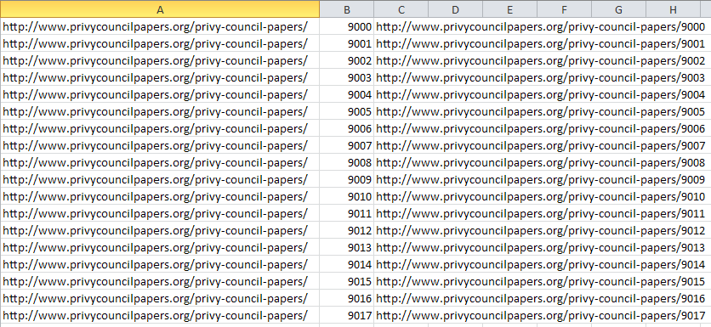
If I already have a list of URLs I want….

Slide 4
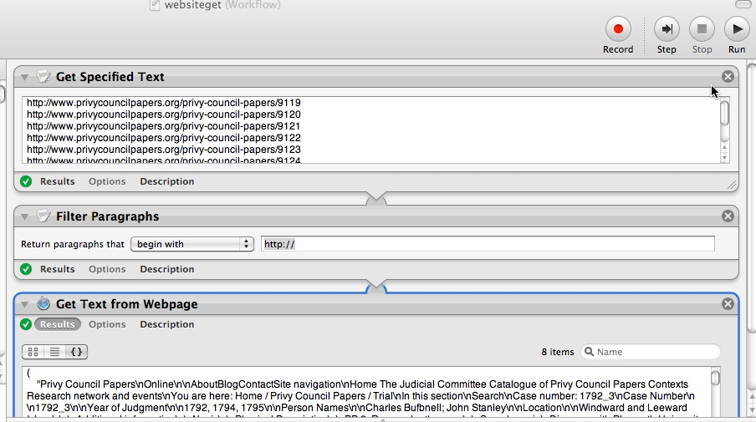
On Mac: Mac Automator
Output, just text
http://mac.tutsplus.com/tutorials/automation/10-awesome-uses-for-automator-explained/

Slide 5
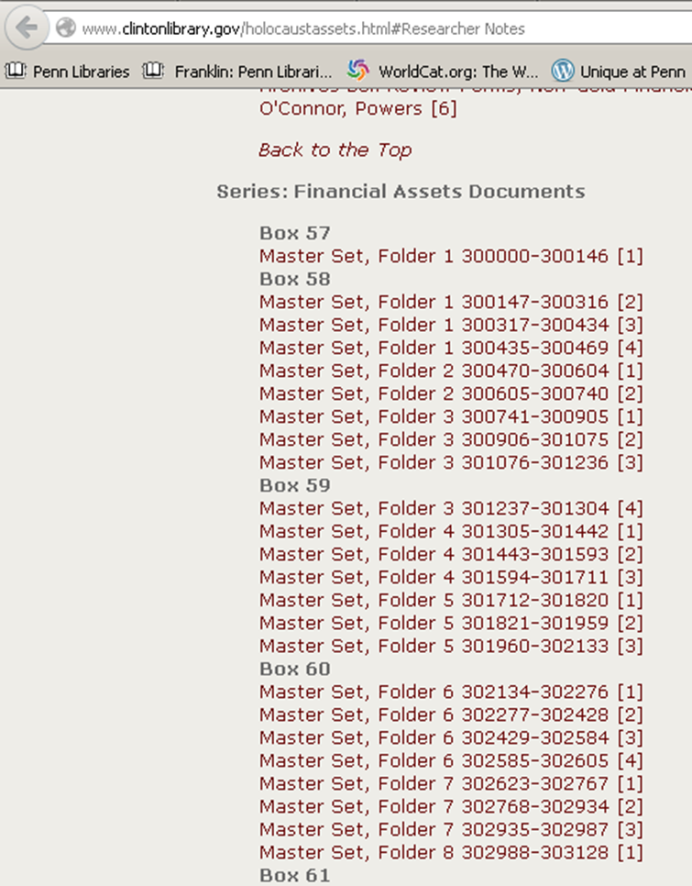
Lists of files where manual downloading would be excruciating

Slide 6
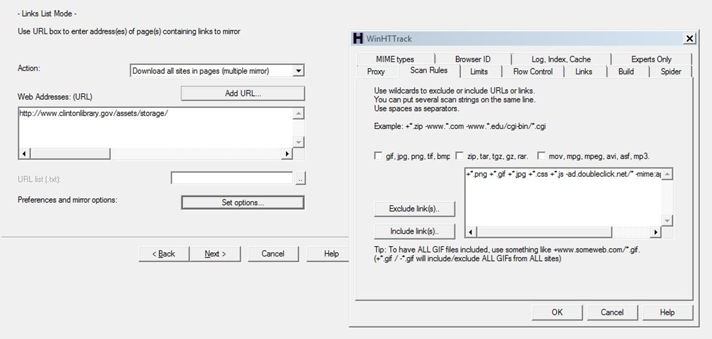
http://www.httrack.com/page/2/en/index.html or
http://sitesucker.us/mac/mac.html

Slide 7
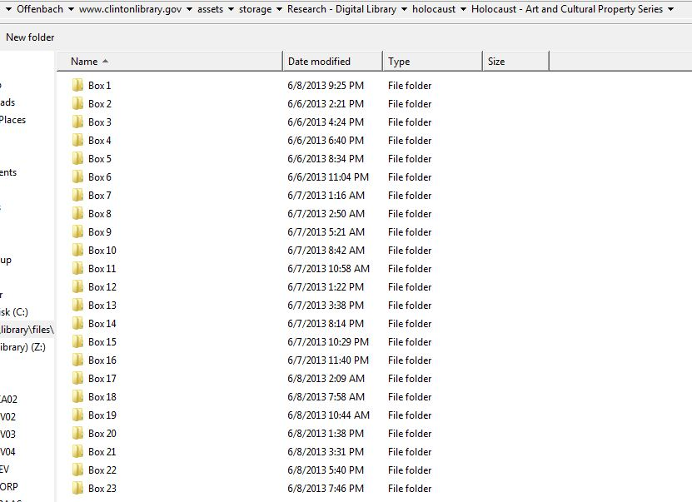
Mirrors website file structure to my machine

Slide 8

Download: http://www.gnu.org/software/wget/
Wget Manual:
http://www.gnu.org/software/wget/manual/wget.html
http://en.wikipedia.org/wiki/Wget
For Windows the best options are:
http://users.ugent.be/~bpuype/wget/#download
http://gnuwin32.sourceforge.net/packages/wget.htm
http://sourceforge.net/projects/gnuwin32/files/latest/download?source=files

Slide 9

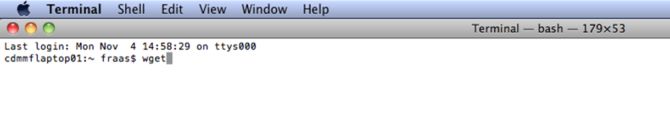
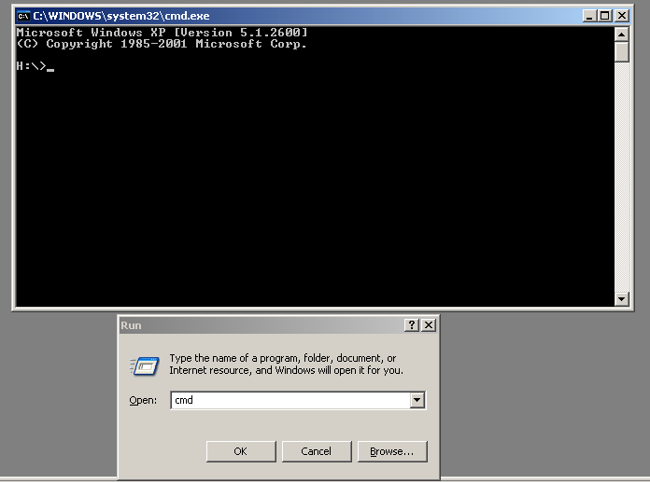
Command line in Windows

Slide 10
wget [URL] simply downloads the URL target and spits it out into your local directory
wget -i [Filename]
Downloads all the URLs you have listed in a text file and spits them out into your local directory one by one
wget –i [Filename] –O ->>[New File]
Downloads all the URLs you have listed in a text file and spits out their contents one after the other into a single file [New File].
wget –i [Filename] –O ->>[New File] –w 3
Does the same as above but waits three seconds in between each URL retrieved.

Slide 11
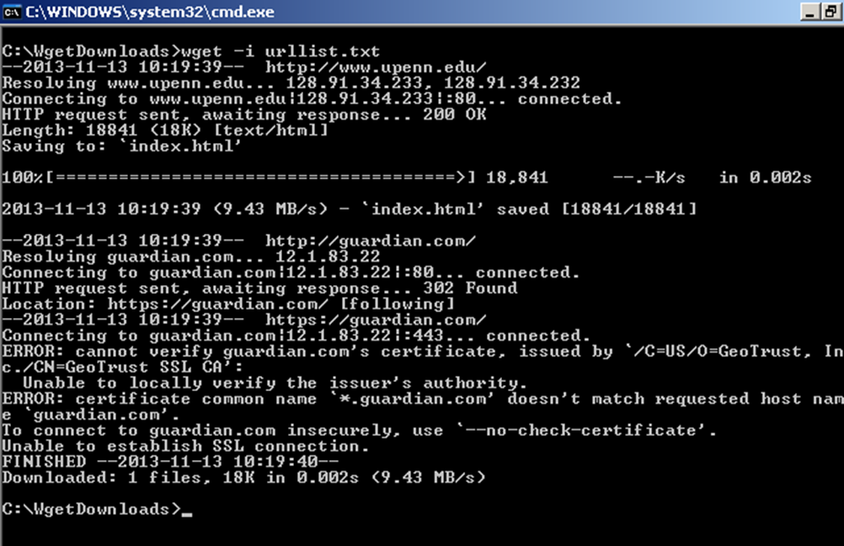
Note the command
And the result

Slide 12
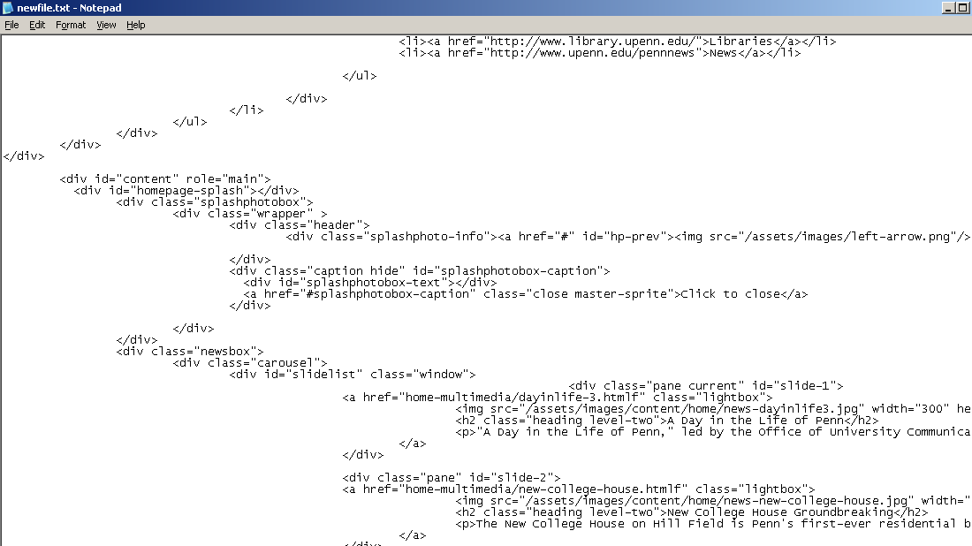
Resulting File – raw html

Slide 13
A simple bash script to download a sequence of web pages structured in a regular way
for i in {1..999}; do wget http://ipi.cerl.org/cgi-bin/search.pl?query=00000$i -O ->> plitest.txt; sleep 10; done
The bit at the beginning tells the computer that we want to cycle through all the numbers between 1 and 999. We want the computer to stick each of these numbers (in computer speak “$i”) in turn at the end of our URL string: “search.pl?query=00000”
i.e. search.pl?query=00001,
search.pl?query=00002,
search.pl?query=00003
search.pl?query=00004 etc. etc. until
search.pl?query=00999
We also want the computer to wait 10 seconds between retrieving each URL and to stick all the results of what it pulls down into one file.

Slide 14
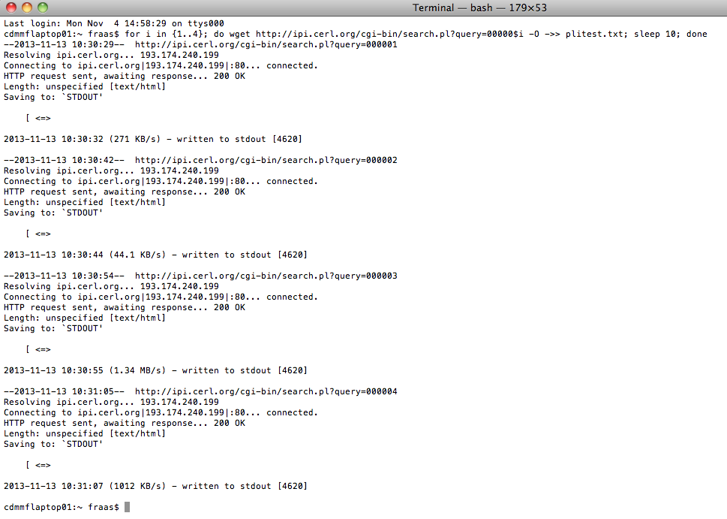

Slide 15
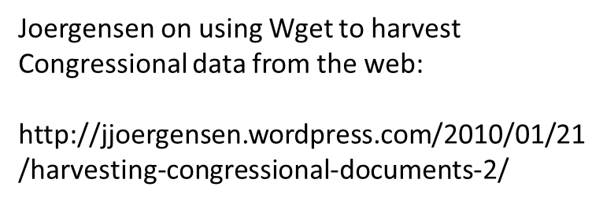
Contact me anytime at
fraas@upenn.edu
For a practical example see

