Slide 1
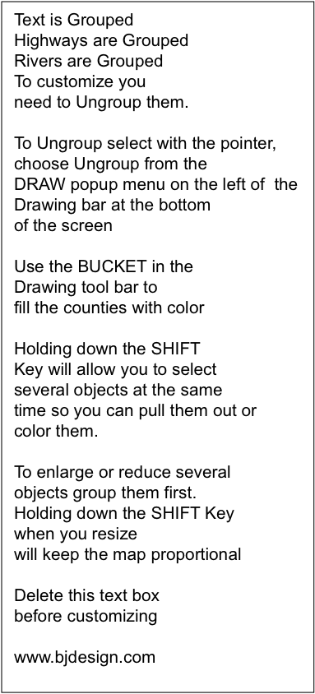
St. John
Caribou
River
Moosehead
Lake
Millinocket
St.
Croix
River
Kennebec
River
Dixville
MAINE
89
Notch
95
Bangor
91
Connecticut
Penobscot
Lamoille
River
W
aterville
River
Lake
River
Champlain
Burlington
St. Johnsbury
Berlin
Winooski
ACADIA
River
Montpelier
Augusta
NA
TIONAL
Lewiston
P
ARK
89
93
495
Bath
Rutland
Portland
Merrimack
Lake
Biddeford
River
Winnipesauke
VERMONT
Connecticut
89
River
Concord
Dover
91
NEW HAMPSHIRE
Portsmouth
Bennington
Brattleboro
Keene
Manchester
93
95
Nashua
3
Lawrence
MASSACHUSETTS
Merrimack
Lowell
95
91
Quabbin
2
River
3
93
Pittsfield
Reservoir
190
290
495
W
oburn
Boston
90
Connecticut
W
orcester
90
River
Sturbridge
395
95
3
CONNECTICUT
Springfield
84
Brockton
Plymouth
295
495
T
orrington
91
84
Providence
Hartford
Scituate
Fall
Housatonic
Res.
River
New
6
River
W
aterbury
2
395
W
arwick
195
Bedford
691
Connecticut
Norwich
95
Housatonic
Meriden
River
Thames
Newport
84
River
91
River
NANTUCKET
Danbury
New Haven
95
New London
RHODE ISLAND
MAR
THA
'
S
New England
Norwalk
Bridgeport
VINEY
ARD
Stamford
95
© Copyright Bruce Jones Design 2004

