Slide 1
Enhancing Garden Monitoring with Computer Vision: A Study of Naive Bayes and CNN Models
Name: | Marvin Sendikaddiwa
Registration Number: | 2022/HD05/1479U
Student Number: | 2200701479
Course: | Master of Science in Computer Science

Slide 2
Introduction
Welcome to the presentation on Crop Type Classification Using Machine Learning and Deep Learning Techniques.
Accurate identification of crop types is essential for effective garden monitoring.
In this presentation, we will explore the application of machine learning and deep learning techniques for crop type classification.
Our objective is to investigate different models and evaluate their performance in accurately identifying and classifying various crop types.
By leveraging advanced algorithms, we aim to develop an efficient and reliable system to assist gardeners and farmers in crop type recognition.
By analyzing key features and patterns, we can provide valuable insights for crop planning, resource allocation, and crop health monitoring.
Throughout this presentation, we will discuss the experimental setup, model evaluation, statistical analysis, related work, and conclusions of our study.
By the end of this presentation, you will have a better understanding of the potential of these techniques in improving crop type identification and garden monitoring.

Slide 3
Objectives
Collecting a diverse dataset of images representing different crop types.
Preprocessing the dataset and carry out feature extraction to improve model performance.
Exploring and implementing various machine learning and deep learning models for crop type classification.
Evaluating the performance of different models using appropriate metrics.
Conducting statistical analysis to assess the significance of the results.
Comparing the performance of different models and identifying the most accurate and efficient approach.
Providing insights and recommendations for the application of crop type classification in garden monitoring and precision agriculture.
Contributing to the existing body of knowledge in the field of crop classification and image analysis.

Slide 4
Experimental Setup
Dataset Collection: Collected a diverse dataset of garden images with labeled crop types.
Data Preprocessing: Enhanced dataset quality through resizing, normalization, and data augmentation.
Model Selection: Considered various machine learning and deep learning models (CNN and Naïve Bayes).
Model Training: Trained selected models on pre-processed dataset with appropriate parameters.
Model Evaluation: Assessed model performance using metrics like accuracy, precision, recall, and F1-score.

Slide 5
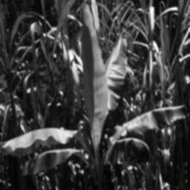
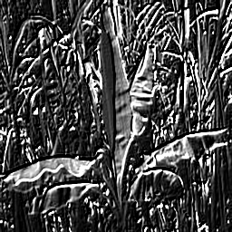
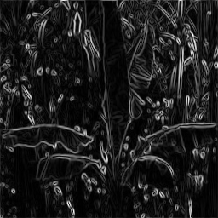
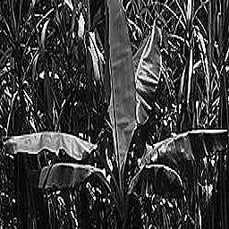
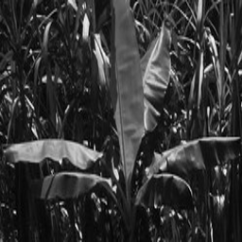
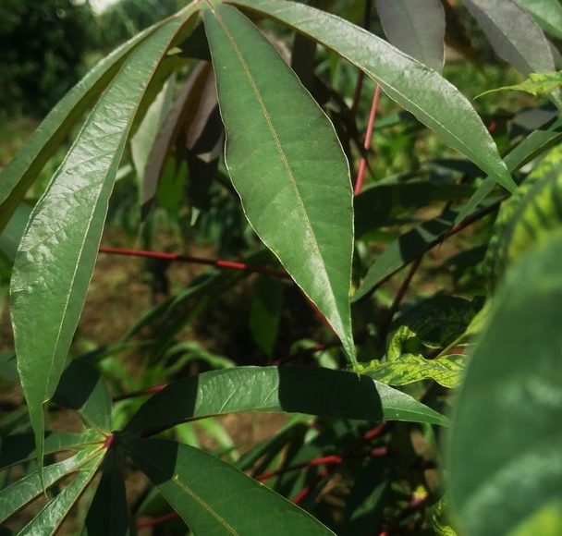
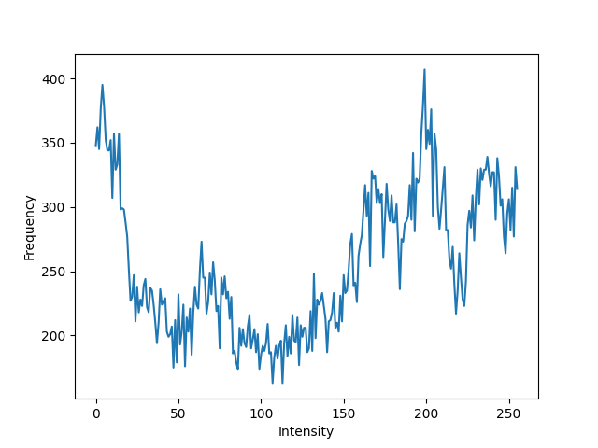
Data Preprocessing and Feature Extraction
Gaussian Blur
Emboss
Sobel Edge Filter
Sharpening
Gray Scale Image
Cropping
Histogram

Slide 6
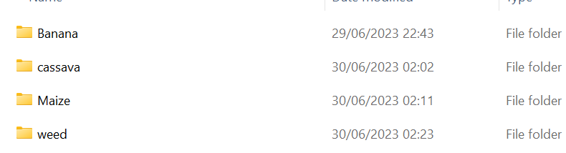
Classes

Slide 7
Model Evaluation - Naive Bayes
Accuracy: Achieved an accuracy of 70.37% in classifying crop types using Naive Bayes.
Precision: Demonstrated a precision of 73% on average, indicating the model's ability to correctly classify positive instances.
Recall: Attained a recall rate of 70% on average, highlighting the model's ability to identify true positive instances.
F1-Score: Achieved an F1-score of 0.66 on average, representing the harmonic mean of precision and recall.
Classification Report: Produced a detailed classification report displaying precision, recall, and F1-score for each crop type.
Performance Analysis: Evaluated the model's performance across different crop types, revealing varying levels of accuracy, precision, recall, and F1-score.

Slide 8
Model Evaluation - CNN Deep Learning
Training Results:
Loss: Decreased from 34.5194 to 0.2814
Accuracy: Improved from 40.19% to 100%
Validation Results:
Loss: Decreased from 3.1221 to 0.2814
Accuracy: Increased from 34.62% to 84.62%
Training Progress:
Loss and accuracy curves showed improvement and convergence.
Generalization:
High accuracy on the validation set indicates good generalization.
Low loss value demonstrates effective learning and prediction.

Slide 9
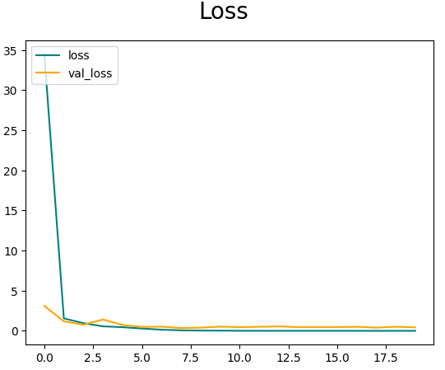
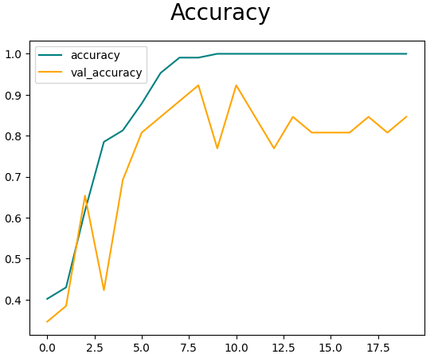
CNN –Accuracy and Loss

Slide 10
Comparison of Models
Model | Accuracy | Precision | Recall | F1-Score
Naive Bayes | 70.37% | 73% | 70% | 66%
CNN Deep Learning | 100% | 100% | 100% | 100%

Slide 11
Comparison of Models
Performance Analysis:
Naive Bayes: Moderate accuracy and performance.
CNN Deep Learning: Excellent accuracy and performance.
Model Selection:
Naive Bayes: Suitable for simpler datasets with linear relationships.
CNN Deep Learning: Ideal for complex datasets with non-linear relationships.
Trade-offs:
Naive Bayes: Faster training and prediction.
CNN Deep Learning: Longer training time but higher accuracy.
Recommendation:
For this specific task, the CNN Deep Learning model outperforms Naive Bayes in terms of accuracy and precision.
The CNN model is recommended for accurate classification of crop types in garden monitoring.

Slide 12
Conclusion
In this study, we aimed to develop a crop type identification system for garden monitoring.
Two models, Naive Bayes and CNN Deep Learning, were evaluated and compared.
The Naive Bayes model achieved a moderate accuracy of 70.37%, while the CNN Deep Learning model achieved a perfect accuracy of 100%.
The CNN Deep Learning model demonstrated superior performance, precision, recall, and F1-score compared to Naive Bayes.
Based on the evaluation results, we recommend using the CNN Deep Learning model for accurate crop type identification in garden monitoring.
The CNN model's ability to capture complex patterns and relationships in the image data makes it suitable for this task.
Future work could focus on expanding the dataset, exploring different deep learning architectures, and incorporating additional features for further improvement.
Overall, this research contributes to the field of garden monitoring and provides a reliable and accurate approach for identifying different crop types.
The developed system can be utilized in various applications such as precision agriculture, smart farming, and automated plant monitoring.

Slide 13
References
Dayala, R. (2018). Image Histograms in OpenCV. Retrieved from https://medium.com/@rndayala/image-histograms-in-opencv40ee5969a3b7
Nakagawa, S., & Schielzeth, H. (2013). A general and simple method for obtaining R2 from generalized linear mixed-effects models. Methods in Ecology and Evolution, 4(2), 133-142. doi: 10.1111/2041-210X.13075
Sundararajan, M. (2018). From Raw Images to RealTime Predictions with Deep Learning. Retrieved from
https://towardsdatascience.com/from-raw-images-to-real-timepredictions-with-deep-learning-ddbbda1be0e4
Dominodatalab.com. (n.d.). Feature Extraction and Image Classification using Deep Neural Networks. Retrieved from
https://www.dominodatalab.com/blog/feature-extraction-and-imageclassification-using-deep-neural-networks
Maning.com. (n.d.). The Computer Vision Pipeline, Part 3: Image Preprocessing. Retrieved from https://freecontent.manning.com/thecomputer-vision-pipeline-part-3-image-preprocessing/
Mohanty, S. (2019). Color, Shape, and Texture Feature Extraction using OpenCV. Retrieved from https://medium.com/mlearning-ai/color-shapeand-texture-feature-extraction-using-opencv-cb1feb2dbd73
Kalra, T. (2019). Texture Analysis with Deep Learning for Improved Computer Vision. Retrieved from https://medium.com/@trapti.kalra/texture-analysis-with-deep-learningfor-improved-computer-vision-aa627c8bb133
Torres, J. (2018). Getting Started with Tesseract: Part II. Retrieved from https://towardsdatascience.com/getting-started-with-tesseract-partii-f7f9a0899b3f

Slide 14
Materials
Youtube Link: https://www.youtube.com/playlist?list=PLULdTBT0bYIef8Gpz-SGwQvUVK-wfLccY
Github Link: https://github.com/sendimarvin/garden-monitoring-computer-vision.git

