Slide 1

IPC144 – Introduction to C Programming
Shi, Yue (Sunny)
Office: DB2095
sunny.shi@senecacollege.ca
SENECA COLLEGE

Slide 2
Outline
Welcome
Introduction
Course overview
Course Delivery
Course introduction
2

Slide 3
Welcome to IPC144
Get acquainted with each other

Slide 4
Course Overview
Seneca Academic Policy:
http://www.senecacollege.ca/academic-policy/index.html
Course Outline:
https://www.senecacollege.ca/ssos/findwithoutsemester/ipc144/sict

Slide 5
Course Overview
Course material:
https://scs.senecac.on.ca/~ipc144/pages/timeline.html
5

Slide 6
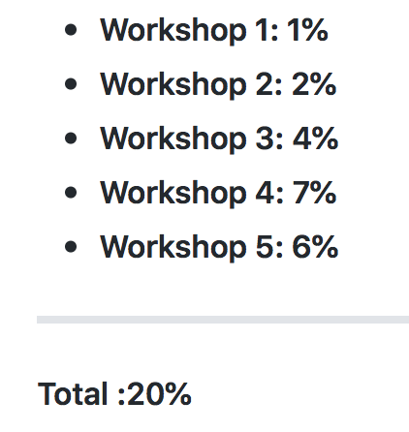
Evaluation
Workshops (5): 20%
Assignments (2): 30%
Quizzes (10): 15%
Midterm Test(1): 20%
Final Exam: 15%
------------------------------
Total: 100%

Slide 7
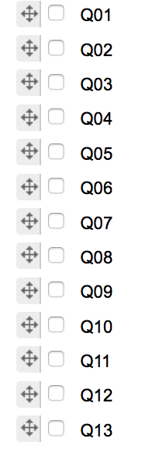
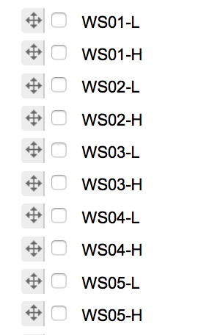
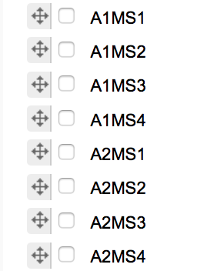


Work In Summary
Final Exam

Slide 8
Course Standards
Promotion Policy
To obtain a credit in this subject you must achieve the following:
Successfully complete all assignments
Achieve an average of 50% or better for all quizzes
Achieve 50% or better for final exam
Achieve a weighted average of 50% or better for the course

Slide 9
Course Standards
Midterm Test
If you miss the midterm test for an acceptable reason (defined by Seneca College Policy),
you may be arranged a make-up test in 5 school days. After 5 school days, the missed test will be marked as zero.

Slide 10
Course Standards
Quizzes
A quiz missed for any reason will receive a grade of zero (0).
This includes the cases of illness, travel delays, personal reasons, etc. etc.
No make-up quizzes.
Take the best 10 quizzes for final grade.

Slide 11
Course Standards
Late Submission - Workshops
10% penalty each day for up to 5 school days.
Workshops will not be accepted after 5 school days.
Late Submission - Assignments
10% penalty each day for up to 5 school days.
If assignments are submitted later than 5 school days, the best mark will be 50%.
Note: Students must successfully complete all assignments to get the course credit.

Slide 12
Teaching Strategy
Goal:
to encourage students to become accustomed to self-directed learning, and retention through repetition.

Slide 13
Teaching Strategy
The Learning Pyramid explains how people learn:
90% of what they learn when they teach someone else/use immediately.
75% of what they learn when they practice what they learned.
50% of what they learn when engaged in a group discussion.
30% of what they learn when they see a demonstration.
20% of what they learn from audio-visual.
10% of what they learn when they've learned from reading.
5% of what they learn when they've learned from lecture.

Slide 14
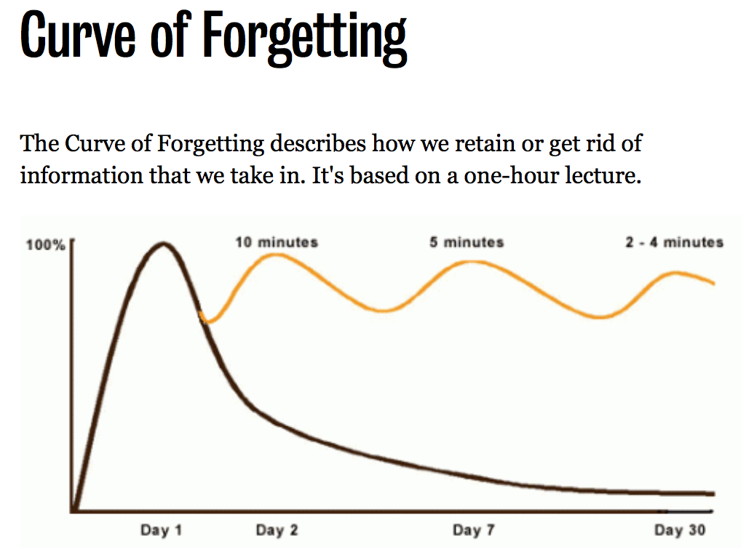
Reference: https://uwaterloo.ca/campus-wellness/curve-forgetting

Slide 15
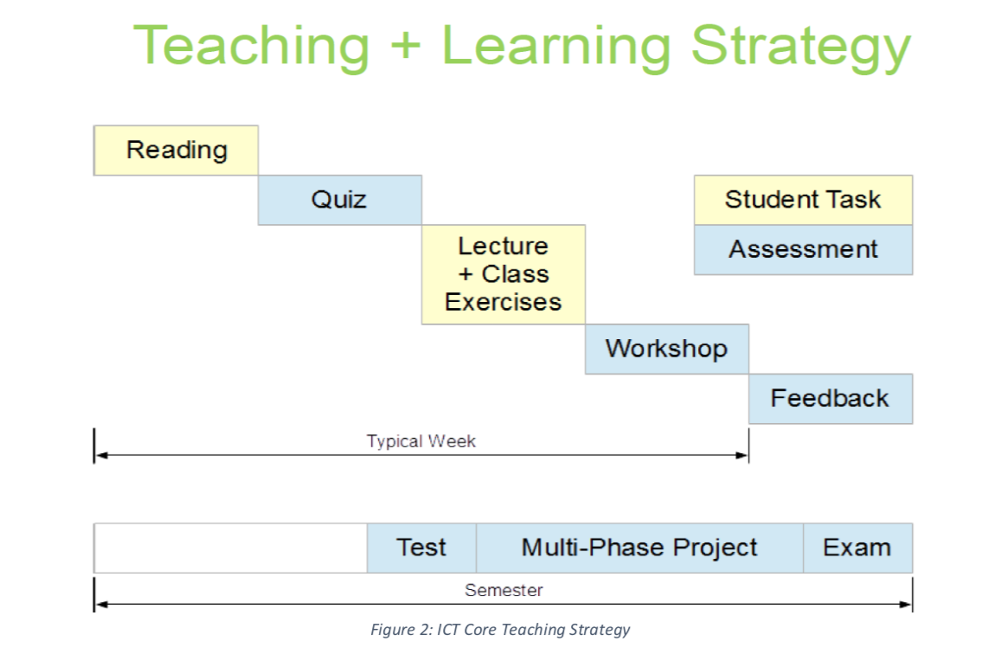

Slide 16
Pedagogy- “Flipped Classroom”
At Home
You read the materials/ the course website/ textbook
Try/ practice example code
Understand the concept
Work on workshops at-home part
Note the questions and challenges
Prepare for the quizzes
In the regular lecture room
Have the quizzes in the beginning of the class based on your home preparation, such as reading, note, practice
Review/discuss the quizzes, concepts, and your questions
Prepare for labs/ workshops.
In the lab room
Discuss the workshops. The workshops include the in-class part and take-home parts.
You work on workshops. I answer your questions and may help on your workshops.
You submit the in-class workshops before classes end.
The concepts/ content of workshops may be quizzed/ tested in next quizzes/tests.

Slide 17
Summary
Each set of topics will be visited 8 times,
assigned reading,
quiz about the reading,
discussion of the quiz,
discussion of the lab,
do the in-lab workshop,
do the at-home workshop,
Answer the reflection questions,
review teachers’ feedback.
You are highly recommended to classes. The questions, discussions, and activities are not “recorded” or “documented” anywhere. They are only available in class! If you miss it, you miss it.

Slide 18
Communication
In, before, or after class
Blackboard
Email:
sunny.shi@senecacollege.ca
Important: include your Section, zenit, subject
Office: DB2095 (individual appointment)

Slide 19
Course Introduction
https://scs.senecac.on.ca/~ipc144/pages/timeline.html

Slide 20
Thank you!

