Slide 1

FlowRoute
Automated Workflow & Resource Manager
Design Presentation - System Requirements & Software Design Specification
Team: FlowRoute | Supervisor: Dr. Nalin Warnajith | Date: June 2026
Notes:
1

Slide 2






The Problem
Video production agencies are forced into project tools built for software teams
No Client-Friendly View
Generic Kanban boards expose internal workflow noise clients don't need to see.
Tool Overload
Clients abandon intake forms in tools like Jira - too many fields, too much jargon.
Manual Routing Delays
Producers manually triage and assign incoming briefs, adding hours to every job.
3
Days
average manual brief-to-assignment turnaround reported by our client
"We just need clients to drop a file and a brief - not learn an entire PM system."
- Client Interview #2, Sept 2025
Notes:
2

Slide 3
Who We're Building For
Three actor groups defined in the SRS use-case model
Client
Producer
Routing Engine
Submits video briefs and tracks delivery status. Wants minimal friction.
Triages incoming requests and assigns them to the right editor or team.
Automated actor (Python service) that scores and assigns jobs by priority and load.
Notes:
3

Slide 4






SRS Summary - Core Requirements
Five functional requirement clusters derived from client interviews and competitive analysis
Client Intake
FR-01-03: Drag-and-drop upload, project metadata form, success/failure states
Auto-Routing
FR-04-06: Priority-based assignment of briefs to producers/editors
Status Tracking
FR-07-09: Real-time project status visible to client and team
Delivery
FR-10-12: Final asset packaging and secure client download
Notes:
4

Slide 5




System Architecture
Layered architecture - decided in ADR-01, optimized for independent scaling of the routing engine
Client Tier
Gateway Tier
React SPA
API Gateway
Application Tier
Data Tier
Node.js API + Python Routing Engine
MongoDB + File Storage
Notes:
5

Slide 6


Why This Stack - ADR-01
Decision
Alternatives Considered
Node.js API + separate Python service for routing logic
Option
Trade-off
Verdict
Rationale
Monolith (Node only)
Simpler, but couples routing logic to API scaling
Rejected
Routing/assignment logic benefits from Python's data/ML ecosystem for future scoring improvements
Decouples scaling - routing engine can scale independently under load spikes
Node.js keeps the REST/auth layer in the team's strongest skill set
Full microservices
Over-engineered for an 8-week design scope
Rejected
Node + Python (chosen)
Slight ops overhead, but clean separation of concerns
Accepted
Quality attributes addressed: scalability, maintainability, independent deplorability
Notes:
6

Slide 7
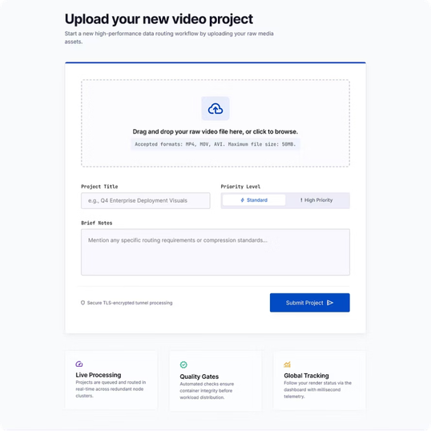
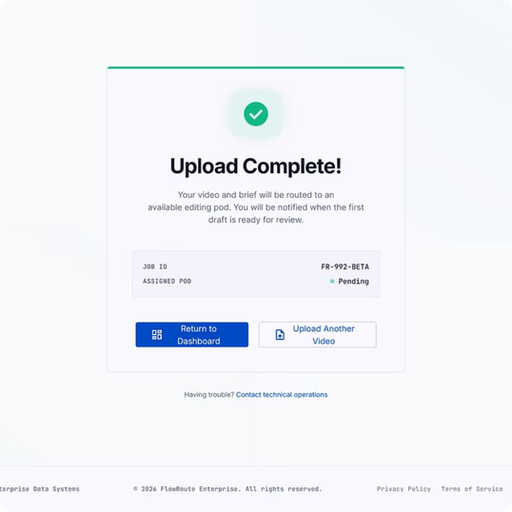
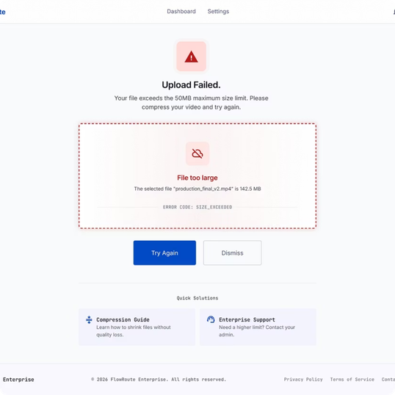
UI Prototype - Client Intake Portal
Three-screen flow: minimal, drag-and-drop first, clear success/failure states
01 - Upload Form
02 - Success State
03 - Failure State
Drag-and-drop zone + project title, priority, and brief fields
Confirmation with reference ID and submission summary
Inline, specific error messages with retry path
Notes:
7

Slide 8
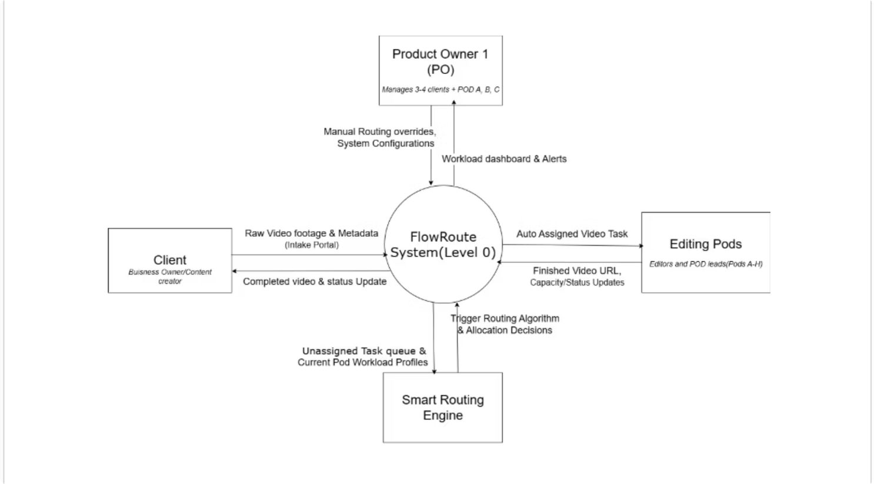
From Design to Development
What's locked in for SENG 34213, and what's still open
Finalized
SRS with 12 functional requirements, signed off
Architecture (ADR-01) and component diagrams
Client intake portal wireframes, team-approved
Database schema for projects, users, assets
Notes:
8

Slide 9
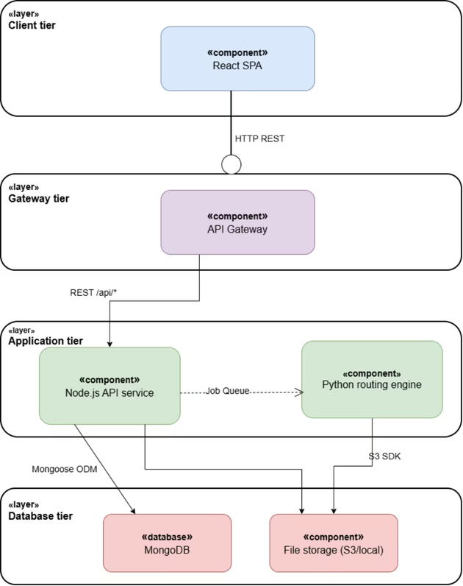
From Specification to Implementation
Routing algorithm scoring weights - needs real usage data
Authentication provider selection (Auth0 vs. custom JWT)
Load testing plan for concurrent uploads
CI/CD pipeline - GitHub Actions becomes mandator
Notes:
9

Slide 10
Thank You
Questions & Discussion
Notes:
10

