Slide 1
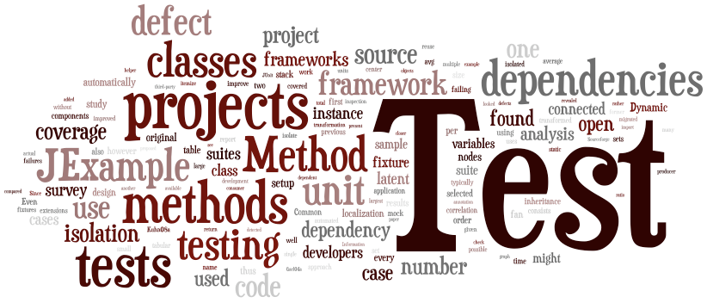
SENG 637 Software Testing, Reliability & Quality
Assignment 3

Slide 2

Assignment 3
Code coverage
Part 1 – control flow coverage
Part 2 – data flow coverage
Part 3 – test suite development

Slide 3
Assignment 3 – Part 1
Using one or multiple tools, calculate 3 control-flow coverage measures for your Assignment 2 test suites

Slide 4
Assignment 3 – Part 2
For a given method calculate your data-flow coverage, manually

Slide 5
Assignment 3 – Part 3
Set a goal like improving the coverages by 10%
Write new tests to achieve that
In cases you could not, discuss why it is not possible
Infeasible?
Works with JMock? Which configurations it works or does not?
Any other discussion

Slide 6
Activities
1st week: Familiarization with coverage concepts
1st week: Familiarization with coverage tools
2nd week: Coverage demo (two parts)
2nd week: Reporting the results

