Slide 1
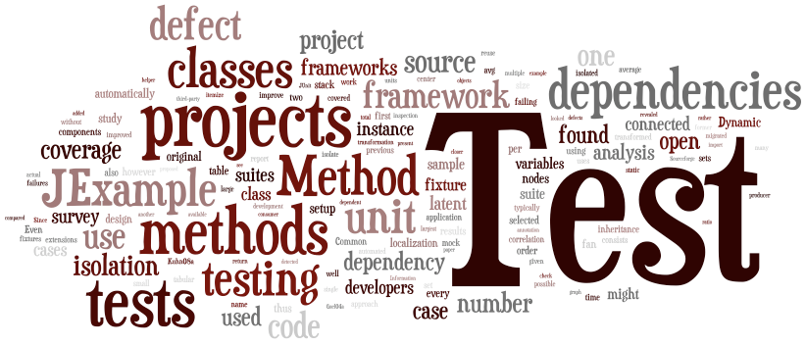
SENG 637 Dependability and Reliability of Software Systems
Assignment 2

Slide 2

Assignment 2
Requirement-based testing
SUT - JFreeChart
Requirements
Test design
Test execution

Slide 3
Activities
1st week: Familiarization (setup Eclipse, Junit, mock framework, ensure they work together)
1st week: Writing tests (write test cases and suite for Junit, prepare stubs or mocks)
2nd week: Executing unit test using Junit and demo
2nd week: Reporting the results

Slide 4
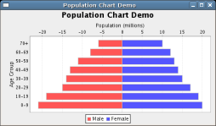
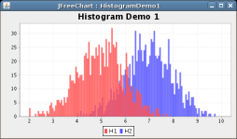
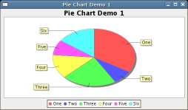
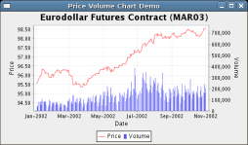
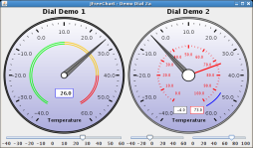
SUT: JFreeChart
The JFreeChart framework is a free/open-source chart library intended to be integrated into other systems as a quick and simple way to add charting functionality to Java applications
http://www.jfree.org/jfreechart

Slide 5
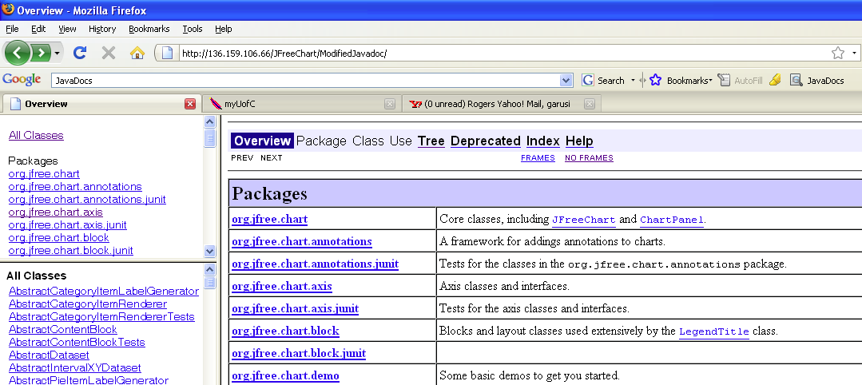
JFreeChart – Requirements
Reminder: SW Requirements can come in many different formats, e.g., plain English, UML models, Javadoc, …
In Assignment 2, we will use the Javadoc documentation of JFreeChart as its requirements
Online now

Slide 6
Test Requirements
JFreeChart classes under test
org.jfree.data.DataUtilities
Has 9 methods
org.jfree.data.Range
Has 19 methods
You have to write tests for 5 methods from each class

Slide 7
Test Design
Equivalence class testing
Boundary value analysis
Robustness testing
Worst case testing

Slide 8
Test Execution
Junit 4 or 5
You need to use mocking
For “Values2D” and “KeyedValues”
You are free to choose your mocking framework
Example of jMock tests for the SUT of the Assignment 2 will be given
jMock or any other mocking framework
Notes:
Q. Why to create a mock when I have the dependent objects?
A. You may not have the complete implementation of the methods of the dependent objects (BB testing) but may have the expected behavior of them (from spec). Or even if you have the code (WB testing) you may not be able to locate whether the bug is in the caller object or the implementation of the called one.

