Slide 1

AlOo
Video Streaming Platform

Slide 2
Tech Stack Used: MERN
HTML, SCSS
React.js
Node.js
MongoDB
Firebase

Slide 3


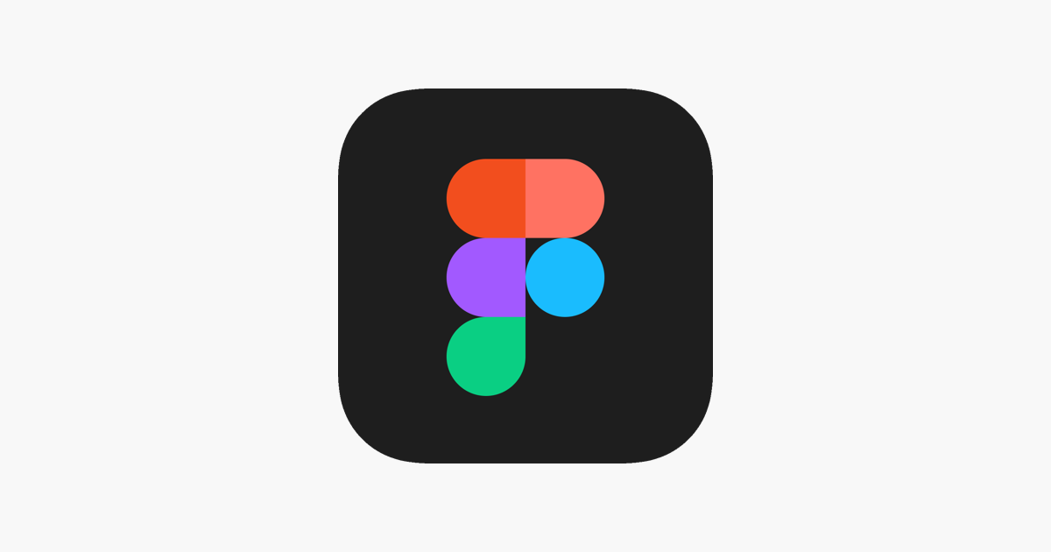
Workflow : Front-End

Slide 4






Workflow: Back-End

Slide 5

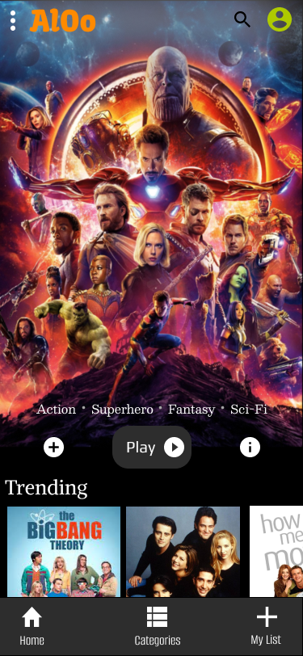

Expectations : Android
Our team has the potential to build top notch android and .Net applications, but we need time

Slide 6
Contributions
Team Lead – Deepesh Sengar
UI/UX – Vasu Ruhela
Front End – Harsh Vardhan
Back End – Venkat Raja Ch
Architecture – Krishnanshu Agrawal
Core Concepts – Basant Raj Dhama
Support – Satyam Vaishnav

Slide 7

Thank You

