Slide 1

Assignee
Type
Milestone
GITHUB
How to create an issue
WORKSHOP
How to monitor an issue
How to link GIT commit to this issue
How to interact with customer using the issue
How to define a milestone
How to view the developer statistics
By Assignee
By Type
By Milestone
How to filter the list of issues
JUL 08 - 2020

Slide 2
GITHUB WORKSHOP
DEMO

Slide 3




A list of issues
A milestone
A due date
A delivery

Slide 4
A delivery version
2.12
MAJOR CHANGES
MINOR CHANGES

Slide 5
An issue
#45 Mailbox view
TYPE
DESCRIPTION
BUG
IMPROVEMENT
DOCUMENT
DELIVERY
ASSIGNEES
MILESTONE
STATUS
TODO
ON PROGRESS
TO REVIEW

Slide 6

An issue can have many related commits
ISSUE
COMMITS
#45 Create the mailbox view
#45 Update the model table for mailbox
#45 Now the SEND button can send a mail
#45 Mailbox panel
#45 List of mails are well updated
#45 Fixed a bug when refreshing the view

Slide 7
GO
DO IT !

Slide 8
Initialize your GitHub project
#1
Create a REPOSITORY
Create a PROJECT on repository
Using template Kamban
Create a Review COLUMN before done
Invite your VC2 members on your project
Create LABELS
IMPROVEMENT
BUG
DOCUMENTATION
URGENT (additional label)
Create MILESTONES
Create 2 milestones : V1.0 V2.0
#2
#3
#4
#5

Slide 9
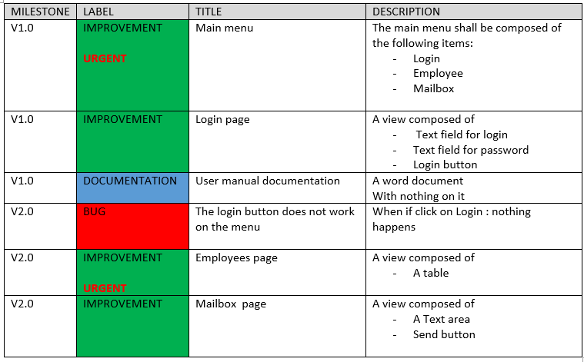
Create issues
#5
Create issues following this table

Slide 10
Implement and close an SMALL issue (< 3 hours)
Repeat those steps for all issues of V1.0 of your project
VS Code
#6
Checkout MASTER
GitHub
#7
Move the issue you want to implement: ON PROGRESS
VS Code
#8
Implement the code related to this issue
#9
Commit/Push using following comment syntax:
#issueId YourComment
GitHub
#10
Check commit is linked with the GitHub issue
#11
Move the issue to : REVIEW
#12
The project manager will move the issue to : DONE and will CLOSE the issue if validated + ARCHIVE

Slide 11
Implement and close an BIG issue (> 3 hours)
Repeat those steps for all issues of V2,0 of your project
GitHub
#6
Move the issue you want to implement: ON PROGRESS
#7
Create branch from MASTER with the name of the issue
VS Code
#8
Checkout the branch
#9
Implement the code related to this issue
#10
Commit/Push using following comment syntax:
#issueId YourComment
#11
Checkout MASTER and merge the branch into MASTER
- Or do it on GitHub (pull request)
GitHub
#12
Check commit is linked with the GitHub issue
#13
Move the issue to : REVIEW
#14
The project manager will move the issue to : DONE and will CLOSE the issue if validated

Slide 12
Validate and close the milestone
GitHub
#13
Go to issue/milestone view and check all issues for your milestone are completed
VS Code
#14
Test all features of your milestone to be sure everything work properly
- If not, fix the bugs on the MASTER branch
GitHub
#15
Create a TAG with the name of the version
#16
Go to issue/milestone view close milestone

