Slide 1
Mutual Fund Analytics & Performance Evaluation System
Capstone Project Presentation
Submitted By: Suraj Narayan
Bluestock Fintech Internship

Slide 2
Problem Statement
Large volumes of mutual fund data are difficult to analyze manually.
Investors require insights into performance, risk, and market trends.
Fund managers need tools for monitoring growth and investor behavior.
The project aims to transform raw data into actionable business insights.

Slide 3
Project Objectives
Build ETL pipeline.
Perform Exploratory Data Analysis.
Analyze fund performance.
Calculate advanced risk metrics.
Study investor behavior.
Develop Power BI dashboard.
Generate actionable insights.

Slide 4
Dataset Overview
Dataset | Purpose
Fund Master | Scheme Information
NAV History | Return Analysis
AUM Data | Industry Growth
SIP Inflows | Investor Activity
Category Inflows | Market Trends
Investor Transactions | Investor Analytics
Portfolio Holdings | Sector Analysis
Scheme Performance | Risk & Returns

Slide 5
Project Workflow
Data Collection
↓
ETL Pipeline
↓
Data Cleaning
↓
EDA
↓
Performance Analytics
↓
Advanced Analytics
↓
Power BI Dashboard
↓
Insights & Reporting

Slide 6
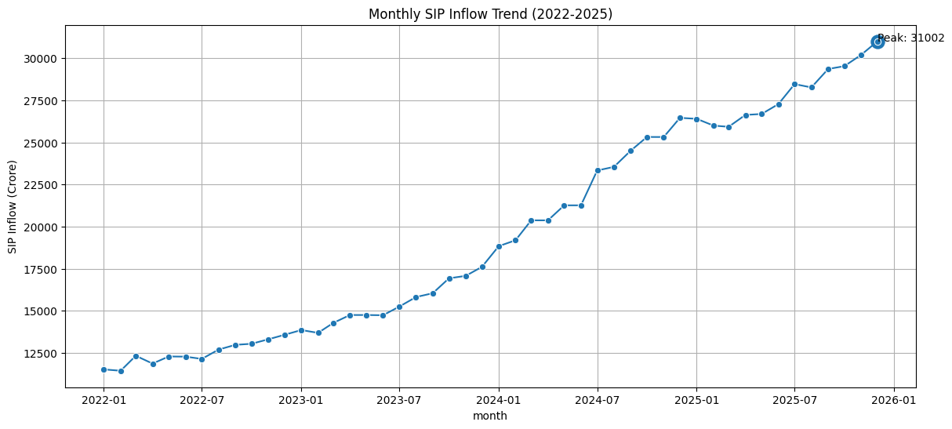
EDA Highlights
Key Findings:
SIP inflows increased significantly over time.
Investor participation remained strong.
Consistent long-term growth trend observed.

Slide 7
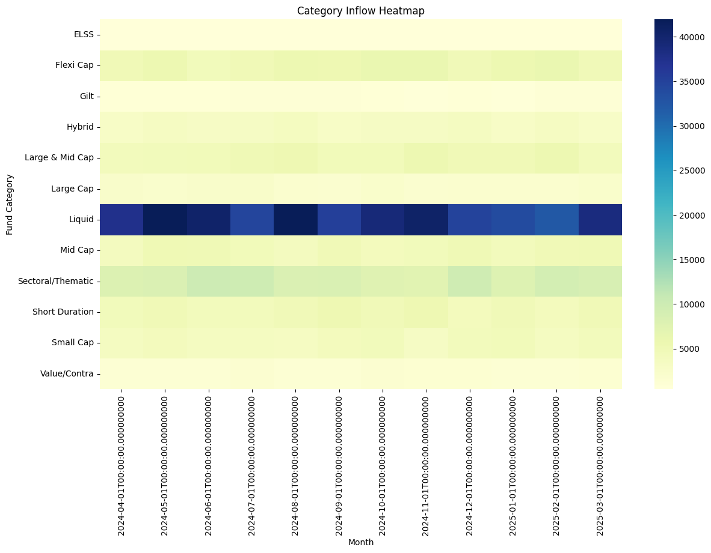
EDA Highlights (Continued)
Key Findings:
Liquid Funds attracted the highest inflows.
Mid Cap and Flexi Cap categories showed strong interest.
Category performance varied across periods.

Slide 8
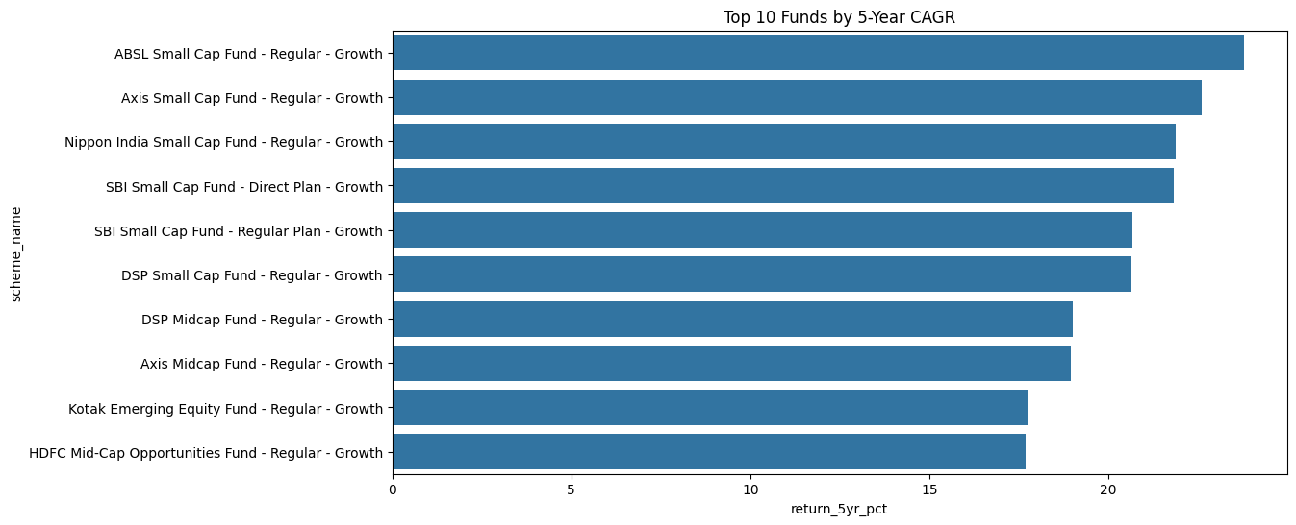
Performance Analytics
Key Metrics: CAGR Analysis, Sharpe Ratio, Sortino Ratio, Alpha & Beta , Maximum Drawdown.

Slide 9
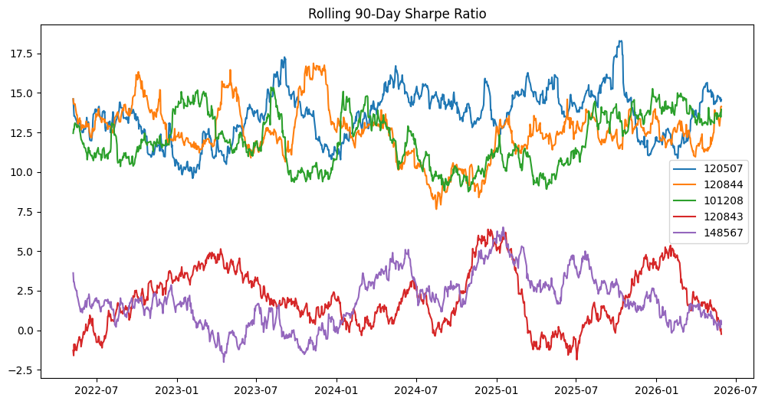
Advanced Analytics & Risk Metrics
Highlights: VaR (95%), CVaR (95%), Rolling Sharpe Ratio, Cohort Analysis, SIP Continuity Analysis , Fund Recommendation Engine.

Slide 10
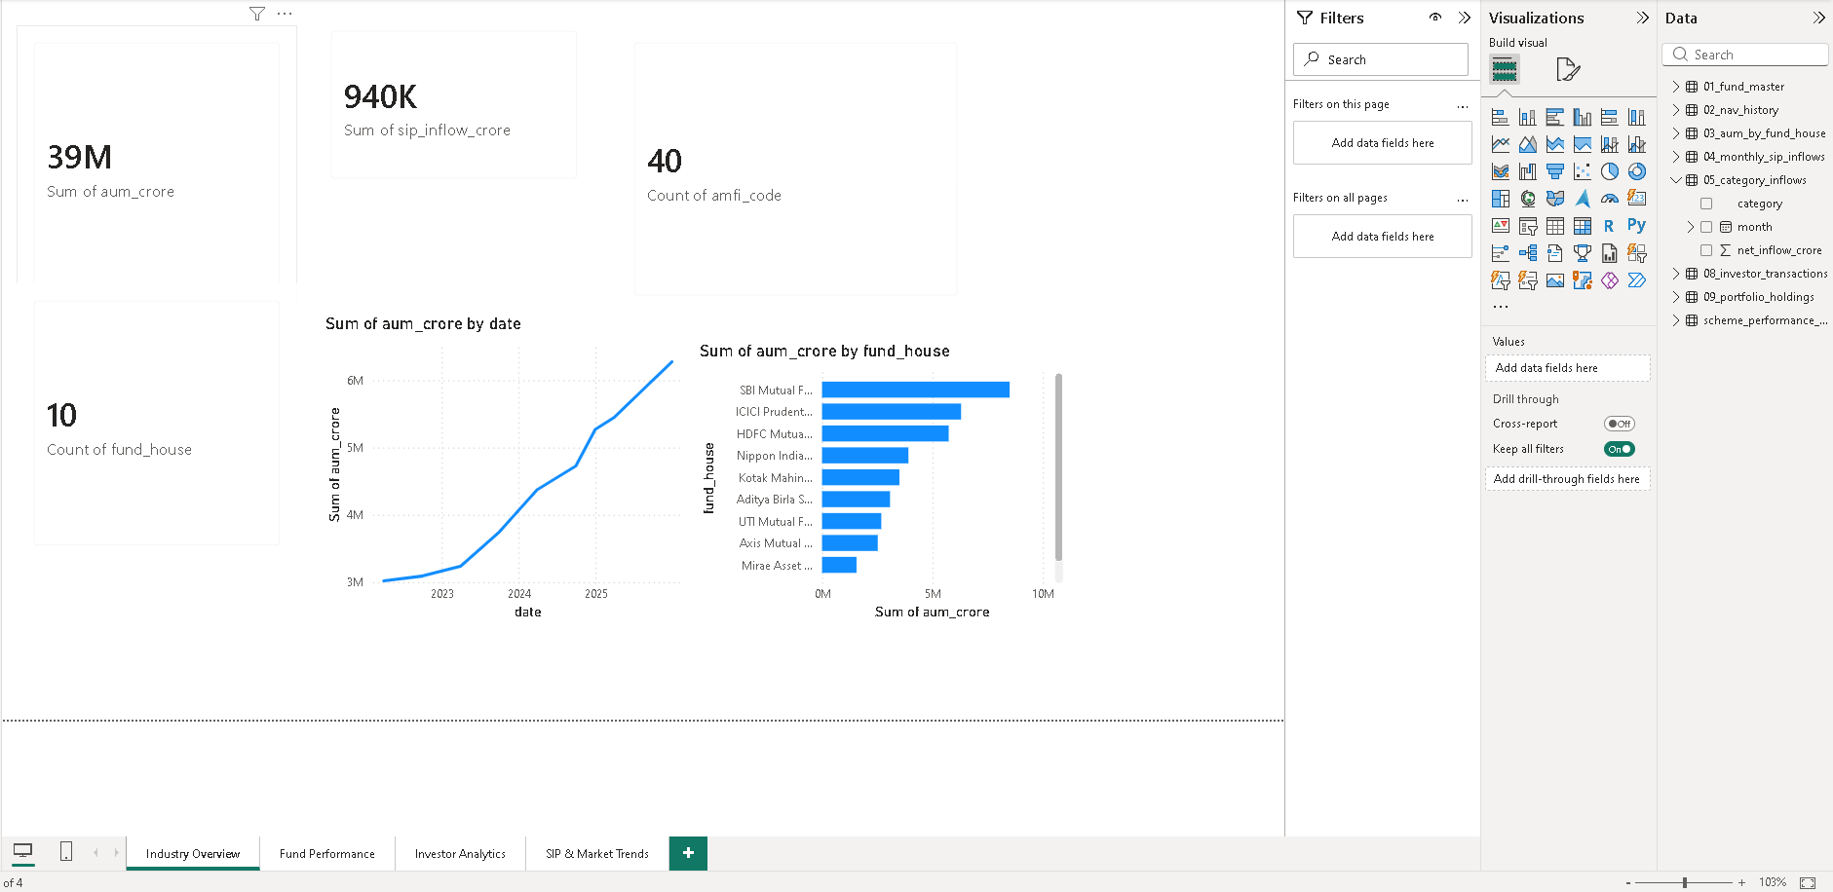
Dashboard Overview

Slide 11
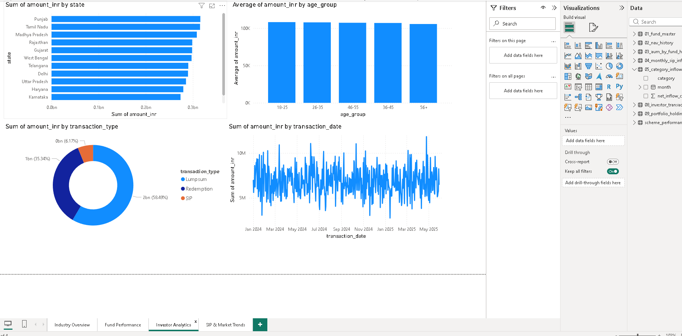
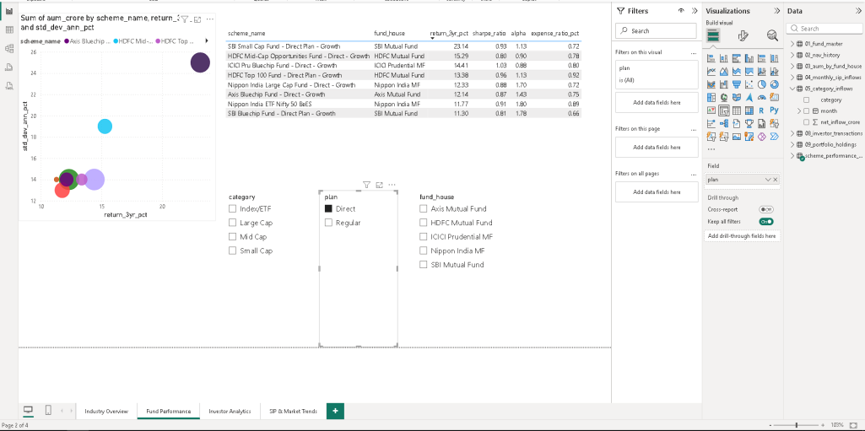
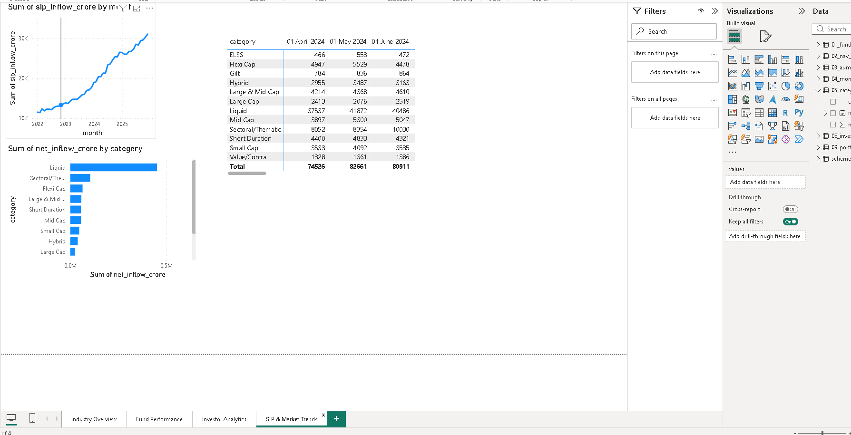
Dashboard Analytics

Slide 12
Key Findings & Conclusion
Key Findings:
SIP investments continue to grow steadily.
Risk-adjusted performance varies significantly across funds.
Investor participation is concentrated in key demographic groups.
Interactive dashboards improve decision-making.
Conclusion:
Successfully built an end-to-end mutual fund analytics solution.
Combined ETL, analytics, risk metrics, and visualization techniques.
Delivered actionable insights for investors and analysts.

