Slide 1
by Senthil Gopal, Mahendar and Ranjith Google DevFest, jsFoo, AWS Dev Conf. and DroidCon
a tour of our conferences
Notes:
Need for attending conferences
Significance of these conferences and who conducts them

Slide 2
Enhancing Your Knowledge
1
2
3
4
Google Dev Fest 2011
JS Foo
2011
AWS Tour 2011
Droid Con 2011
A slew of features
Notes:
Google Dev Fest
Conducted by google
To encourage dev community to use Google tools and develop on their APIs
JS FOO
Conducted by HasGeek
For Developers only by developers – from yahoo, startups, cleartrip etc.,
Simple setup. Loads of knowledge gains
AWS Tour
Conducted by AWS
For developers, customers and potential customers
Great intro to how people use AWS and what are the best practices
Customer Booths
Droid Con
Coducted by HasGeek
Part of the DroidCon being conducted worldwide
Brings together great devs from startups, Design engineers, Google’s very own android developers
Wonderful Customer booths – Directi, Vserv, arowboat etc.,
2 day program

Slide 3
Google Dev Fest 2011
1
Bangalore

Slide 4





Itinerary
Android market place
Android ADK and fragment Accessory overview
Open Accessory and ADK
Cloud Technology
Launching and Growing your Business
Chrome Developer Tools
Web applications on High Replication Datastore
Android User Experience
Google Dev Fest 2011
Notes:
Main focus for Google is evidently Android, Cloud [App Engine], Chrome and Apps marketplaces in that order
All of the sessions were informative – especially about Android growth, introduction of fragments structure
Usage of ADK for android supported hardware – great demo based on accelerometer
Cloud technology is primarily about how to use the Pricing model, languages supported and how to integrate/create apps on top of Google APIs
Chrome Developer tools is the best hands on session. Where within 30 minutes, a slew of features of how superior to Firebug is Chrome Dev tools and fast it is because of native availability
DataStore is how we can use the Prediction API,
Android User Experience is about how we can showcase our apps in a better way using the themes available with Android itself.

Slide 5

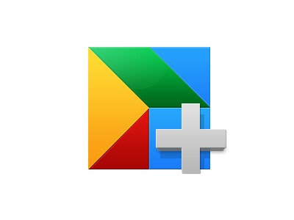

App Marketplace – Quick steps
Search for Google Apps marketplace
Install ManyMoon Project management [sample]
Create the manifest – the definition of applications to use and publish to marketplace
Build your application with any tools and provider
Integrate the application by adding SSO using OpenID
Sell your application with a one time fee of 100$

Slide 6
JS FOO
2
Bangalore

Slide 7


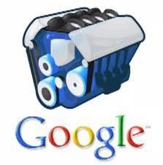

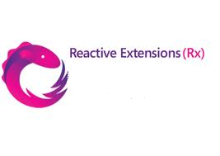


Itinerary
Theme – Interactive, Real-time and Highly-scalable
internet applications
Node.js – asynchronous I/O, event-driven, V8 engine
WebSockets & Socket.IO – that’s true, real bi-directional
async. communication happening
RxJS – nothing but, Observables + LINQ + Schedulers.
It’s like getting back to Observables and Observers
IndexedDB – API for client-side storage of structured data &
high performance searches using indexes.
Open Data – New Level of data integration and
interoperability.
CouchDB – Just Relax. Schema-free, offline
supportive DDS.
Videos
V8 engine
Js Foo 2011

Slide 8

AWS Tour 2011
3
Chennai

Slide 9




Itinerary
Customer Booths
Keynote: State of the Cloud
Architecting for the Cloud: Demo & Best Practices
Developing Mobile Apps on AWS Cloud
Fault Tolerant Applications on AWS
Delivering Solutions in Partnership with AWS
Customer Panel
How Amazon Migrated to AWS
http://aws.amazon.com/apac/awstour-india-1/
AWS Tour India 2011
Notes:
Customer Booths:
CloudFront[CSS]
Cognizant[LaaS]
Riverbed Steelhead Product Family
CSS CORP - HAPX Managed Enterprise Cloud , Enterprise Cloud Gateway, Smar Test [On demand testing]
Right scale - Cloud Management System
Trend Micro - Secure Cloud, Deep Security 8.0
Welcome & Introduction - Shane Owenby, Managing Director, Asia Pacific, AWS
Opening Keynote: State of the Cloud, Dr Werner Vogels, CTO, Amazon
Architecting for the Cloud: Demo and Best Practices, Janakiram MSV, Technology Evangelist, AWS
Developing Mobile Apps on AWS Cloud, Simone Brunozzi, Technology Evangelist, APAC, AWS
Designing Fault Tolerant Applications on AWS Janakiram MSV, Technology Evangelist, AWS Partner Presentations: Delivering Solutions in Partnership with AWS – Rightscale, Josh Fraser, VP Business Development – Vishal Malik, Head Cloud CoE, Cognizant
Customer Panel, moderated by Dr Werner Vogels – Cognizant, Raj Bala, CTO – Consim, R. Chandrasekar, Senior Vice President – Classle Knowledge, Vaidya Nathan, Founder & CEO – Ventuno Technologies, Mahul Shah, CTO
Closing Keynote: How Amazon Migrated to AWS, Dr Werner Vogels, CTO, Amazon

Slide 10


$25 AWS Credit
Gifted with a

Slide 11
Droid Con 2011
4
Droid Con 2011
Bangalore

Slide 12



Itinerary
CyanogenMod
Making Cross platform Apps suck less
HoneyComb Codelab Part I and II
Android Services Pattern
Android Multimedia Internals
Cloud to Device Messaging
New Features in Android 4.0
Apps Demo
Mobile Computing – The Next Growth Wave
DroidCon Bangalore 2011 – I
Notes:
Customer booths:

Slide 13



Keynote
An Android App – A De-Construction
Infusing Android with Social
ICS: Communication, Connectivity & Camera
From Stock to CyanogenMod: The Sony Ericsson case
ListViews, Custom Controls and Memory Optimized Apps
Android Porting for Dummies
DroidCon Bangalore 2011 – II

Slide 14
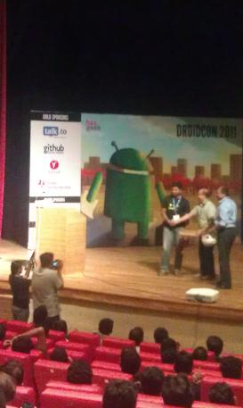
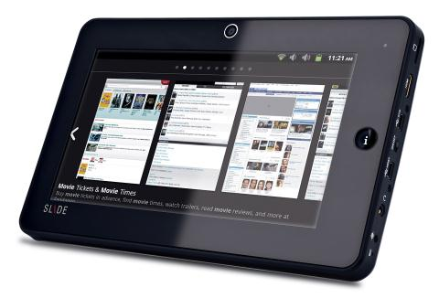
iBall Slide

Slide 15
Any Questions!
?
sengopal@ebay.com

Slide 16

Sign Up!
Its your turn now

