Slide 1
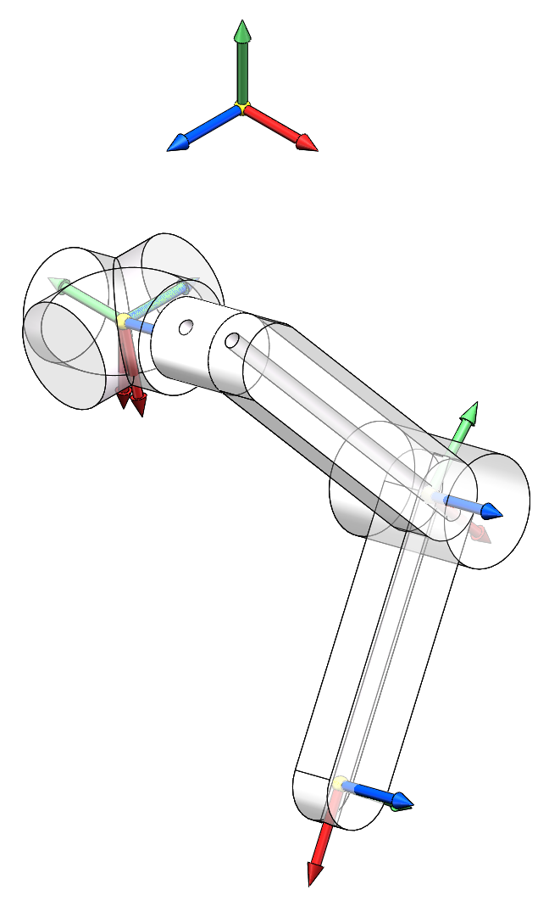
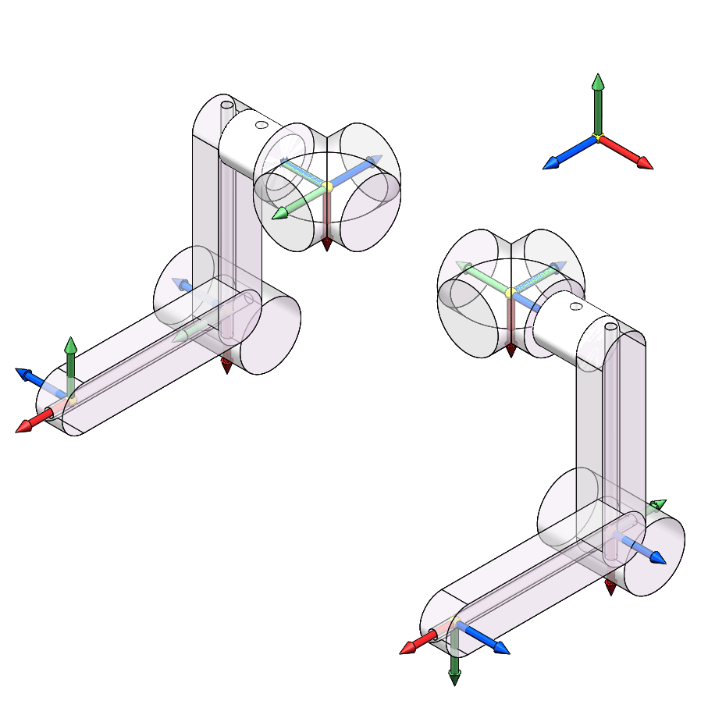










$$y$$
Legs in right side
Legs in left side
$$z$$
$$x$$
$$z_{0}$$
$$l_{1}$$
$$z_{1}$$
$$d$$
$$z_{2}$$
$$l_{2}$$
$$z_{h}$$
Zero position and positive rotation direction

Slide 2
