Slide 1
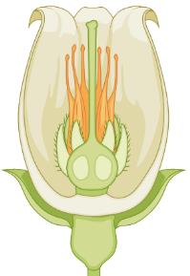

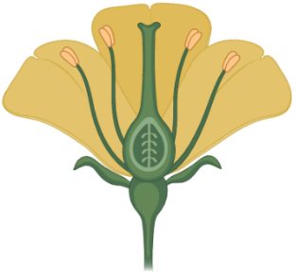
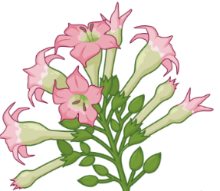
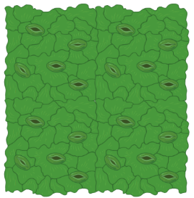


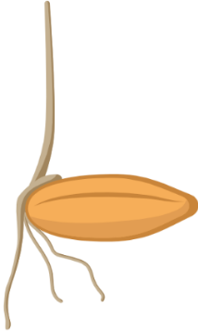

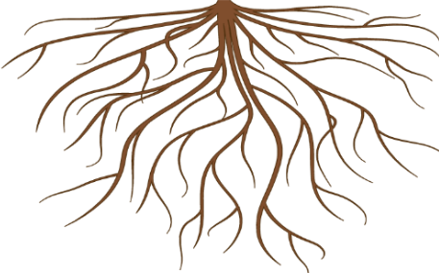
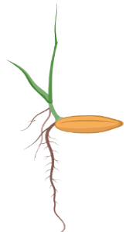
bHLH
Responsive genes
Stamen Development
COI1
JAZ
OPR3
MYB21&24
Responsive genes
OPDA
bHLH
Petal Expansion
COI1
JAZ
Responsive genes
Early Flowering
APETALA/ERF
Delay Flowering
COI1
JAZ13A
TOE1&2
COI1
JAZ
FT
ABA
P
OPDA
MeJA/COI1
(Ca²⁺)
ROS
(Cl⁻)
Stomatal Closure
(H⁺-ATPase)
(H⁺)
ROS
ROS
(K⁺)
YABBY1&3
Chlorophyll degradation
JAZ7
MYC2,3,4
IIId
bHLH
Responsive genes
JA-I1e
COI1
JAZ
GC box
Leaf senescence & Chlorophyll degradation
JAZ4/8
WRKY57
COI1
MYC2,3,4
EIN3
EIL1
Responsive genes
JAZs
Apical hook
Shorter hypocotyl
Responsive genes
COI1
JAR1
MYC2/JIN1
Hypocotyl
coi1
Longer hypocotyl
MYC2,3,4,5
NINJA
MYC25
InsP5
TPR
MYC2
Root Growth
COI1
JAZ
TPL
JAZ8
GC box
(High conc.)
JAZ9
RNA polymerase II
P
SAPK10
bZIP72
Responsive genes
GC box
AOC
Seed Germination

