Slide 1
– Senior Design –
Online Processing for Molten Salt Reactors
– Week 7 –
David Barnett, davidbb2
Nathan Glaser, nglaser3
Joseph Specht, jspecht3

Slide 2
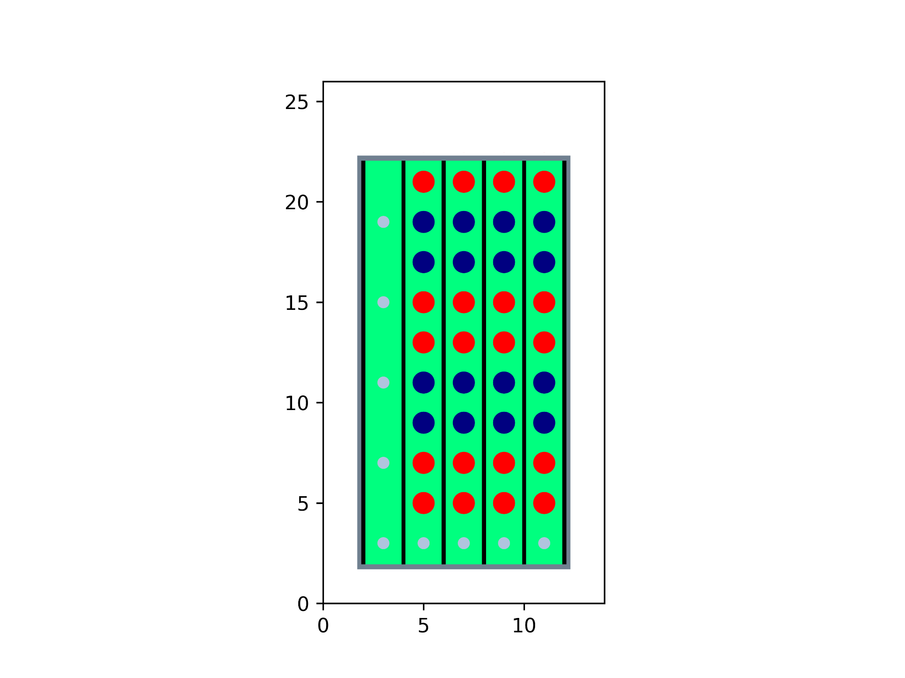
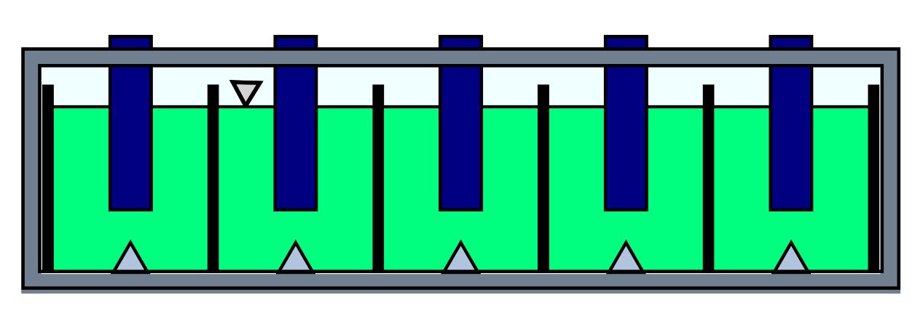
Project Overview
Modular Online Processing in MSRs (MOP)
replace batch-wise/offline
Adaptive Processing Modules (APM)
each module removes specific nuclide
He bubbler for fission gasses
Lower equilibrium concentrations

Slide 3

Accomplishments
ANS abstract submissions
Forgor to say last week 💀
Submitted preliminary report with 2 hours to spare

Slide 4
Future Work

Slide 5
Exigent Calculations
APM Spacing
MHD Pressure of FLiBe
Length, Channel #
Removal Efficiency
Desired Concentration
Energy cost
Parallel Graphene Plates
Processing Module A
Processing Module B
He Bubbler

Slide 6
Further Considerations
Electrode Species
Processing System Removal
Mechanical
Electrode
Per-channel shutdown in APM

Slide 7



Project Github
Notes:
Nathan

Slide 8
Thank You!
Questions?

