Slide 1
– Senior Design –
Online Processing for Molten Salt Reactors
– Project Overview –
David Barnett, davidbb2
Nathan Glaser, nglaser3
Joseph Specht, jspecht3

Slide 2
Overview
Background
Project Description

Slide 3
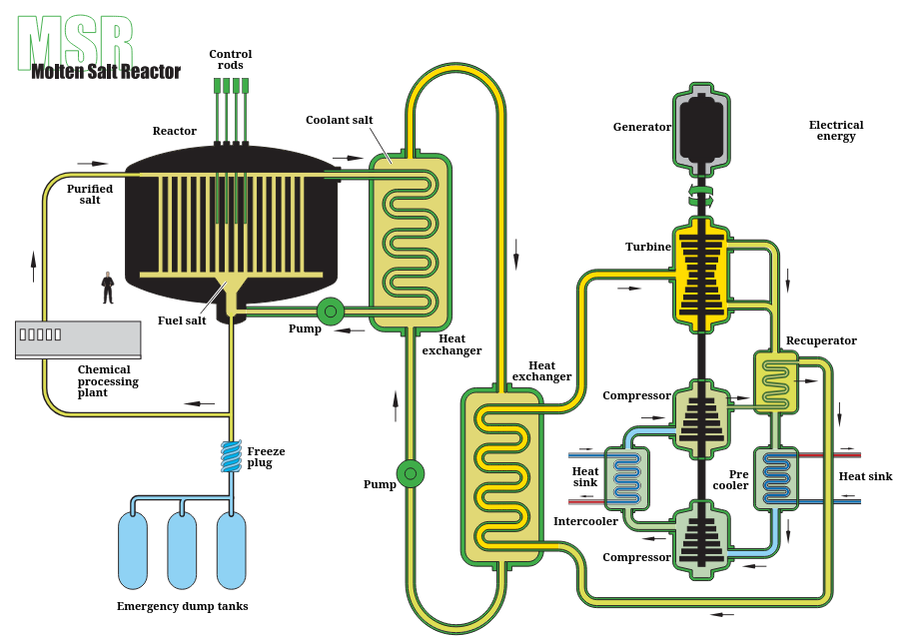
Background
Molten Salt Reactors (MSRs) are a GEN IV reactor
FLiBe as coolant
⅔ LiF and ⅓ BeF₂
LE uranium fluorides (UF₄)
FLiBe is not corrosive, impurities in the salt cause corrosion
Goal is removing impurities from FLiBe
Notes:
Joe’s Slide

Slide 4
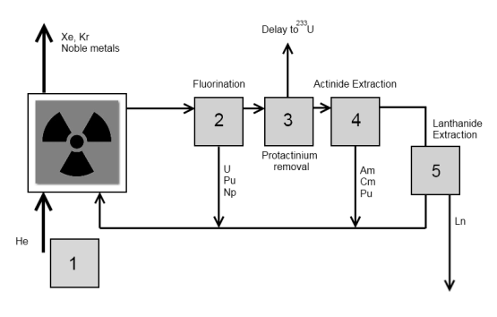
Project Description
Design a series of components to remove contaminants from MSR fuel
Not designing an MSR, using MSRE as our reactor
Current processing mostly off-line. Goal to move to on-line
Removing contaminants to
extend component lifetime
improve neutron economy
Flowsheet for current reprocessing [2]
Notes:
David’s Slide

Slide 5
Contamination
Contaminants
Potential Contaminants
Contaminant Removal

Slide 6
Contaminants
Thermal Neutron Poisons
Xenon-135
gaseous fission product
XS of 3.1 Mb (0.1 eV)
Samarium-149
stable fission product
XS of 100k b (0.1 eV)
For reference, U-235 has XS of ~300 b (0.1 eV)
Corrosive Substances
Tritium
partially soluble hydrogen isotope
highly corrosive to metals at high temps in MSRS
Notes:
Joe’s Slide
Xe-135 has a fission yield of 6%
Sm-149 has a fission yield of 0.4%

Slide 7

Potential Contaminants
Protactinium-233
In thorium based fuel cycles (n+Th-232)
Decays into U-233, but transmutes to Pa-234 → U-234 (parasitic absorber) via neutron absorption
Useful when high control of enrichment is required (fuel injection, downblending or weaponry)
Removal is classified (one paper, 1968)
Notes:
Nathan’s Slide

Slide 8
Tritium Removal
Example Methods of Tritium Removal [5]
Strategy | Description | Pros | Cons
Permeator | Takes hydrogen through a tortuous path & leverages H permeability of H in metals. | - similar to heat exchangers | - large pressure drop - only extracts molecular H (H₂, HT, T₂) and not TF
Gas-Liquid Contractor | Pump fuel into an atmosphere to remove gases. | - diffusion sped up two orders of magnitude - removes all gases | - frequent nozzle replacements - high bubble fraction
Absorption Column | High surface area solids absorb T as salt flows past. | - mature technology - could absorb Xe, Kr, and noble metals w/ Ni film | - low efficiency - optimal material is graphene $$$
Permeation Barriers | Metal oxide layers on pipes preventing permeation into structural members | - no permeation - applied to current pipe designs | - require complete seal - most promising designs are metals that dissolve in FLiBe
Notes:
Joe’s Slide
Noble Metals: Ru Rh Pd Ag Os Ir Pt Au
Only viable permeation barrier is W

Slide 9
Xe-135 Removal
Helium Bubble Injection
Chemically inert
Gaseous fission products (Kr, Xe, ~T) are not soluble in carrier salt
Inject bubbles into salt stream, flow with stream allowing products to diffuse into bubbles
Bubble Separator
Similar to separator in LWR systems
Downstream from Injection
Separate bubbles from salt flow
Notes:
David’s Slide

Slide 10
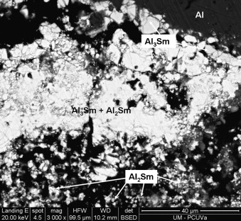
Sm-149 Removal
Normally in lanthanide extraction step
Aluminum coated tungsten electrodes.
Chemically reactive
Usage poses problems for continual reprocessing
Will need some way to remove either the electrodes or clean them while in use
Micrograph of an Aluminium Electrode After Electro-Reduction [4]
Notes:
David’s Slide

Slide 11
Computational Simulations
Computational Methods
Computational Models

Slide 12
Computational Methods
Full depletion is required for inlet and outlet conditions of the core
SaltProc
MSRs require multiphysics
We require depletion capabilities
Must use codes capable of solving coupled physics
Moltres + MOOSE HT / NS / PF
OpenMC for mgxs generation
Moltres for neutronics (FEM)
MOOSE HT / NS / PF for TH (FV)
Notes:
Nathan’s Slide

Slide 13
Computational Models
Steady-State operation
Core inlet / outlet concentrations of isotopes — SaltProc
MGXS generation (temp dependence) — OpenMC
Neutron flux, DNP (drift),multiplication factor, Power — Moltres
Temperature, velocity profiles — MOOSE HT, NS
Porous-Media flow through graphene (P / v drop) — MOOSE PF
Transient Scenarios (system start-up and failure)
Poison feedback, time-dependence — Moltres
Notes:
Nathan’s Slide

Slide 14
References

Slide 15
[1] “Molten-Salt Reactor.” Wikipedia, Wikimedia Foundation, 18 Dec. 2024, en.wikipedia.org/wiki/Molten-salt_reactor.
[2] Journée, Dirkjan. “Helium Bubbling in a Molten Salt Fast Reactor.” Filelist, filelist, Jan. 2014, filelist.tudelft.nl/TNW/Afdelingen/Radiation%20Science%20and%20Technology/Research%20Groups/RPNM/Publications/MSc_Dirkjan_Journee.pdf.
[3] Jr. Vicente Valdez, Pedro, et al. "Modeling Molten Salt Reactor Fission Product Removal with SCALE." , Feb. 2020. https://doi.org/10.2172/1608211
[4] Fernandez, P., et al. “Electrochemical Extraction of Samarium from Molten Chlorides in Pyrochemical Processes.” Sciencedirect, sciencedirect, 22 July 2011, www.sciencedirect.com/science/article/pii/S0013468611011030.
[5] Humrickhouse, Paul W and Fuerst, Thomas F. "Tritium Transport Phenomena in Molten-Salt Reactors." , Sep. 2020.

Slide 16
Thank you!
Any Questions?

