Slide 1
– Senior Design –
Online Processing for Molten Salt Reactors
– Week 2 –
David Barnett, davidbb2
Nathan Glaser, nglaser3
Joseph Specht, jspecht3

Slide 2
Progress
So far, only reading
General Overview of
Fissile Breeder Reactors
Off-line Molten Salt Reprocessing
Corrosion resistance (Hastelloy)
Looking into various designs and constraints
FUJI, MOSART, AMSTER
All roads point to the MSBR…
Notes:
David

Slide 3
MSBR
Off-line processing
Xenon removal
Rare Earth metals
Protactinium (technically online)
Fuel processing
Siphons small stream of fuel salt
Fine control of enrichment injection (Pa233 & U233)
High mass flow rates (2955 kg/s)
Online processing intractable
Notes:
Nathan

Slide 4
Potential
MSBR Design
Changes

Slide 5
Slower Pump Speeds
Longer processing times
Now trackable to reinject wholly decontaminated salt
Less DNP decaying outside of core
DNP decay in the core
Fission localized in center of core
Greater ꞵ_{eff}
Potential heating issues
Less heat removal w/ lower flow rates
FLiBe has high Pr
Further investigation required
Notes:
Nathan’s Slide, do you want me to do the start slide

Slide 6
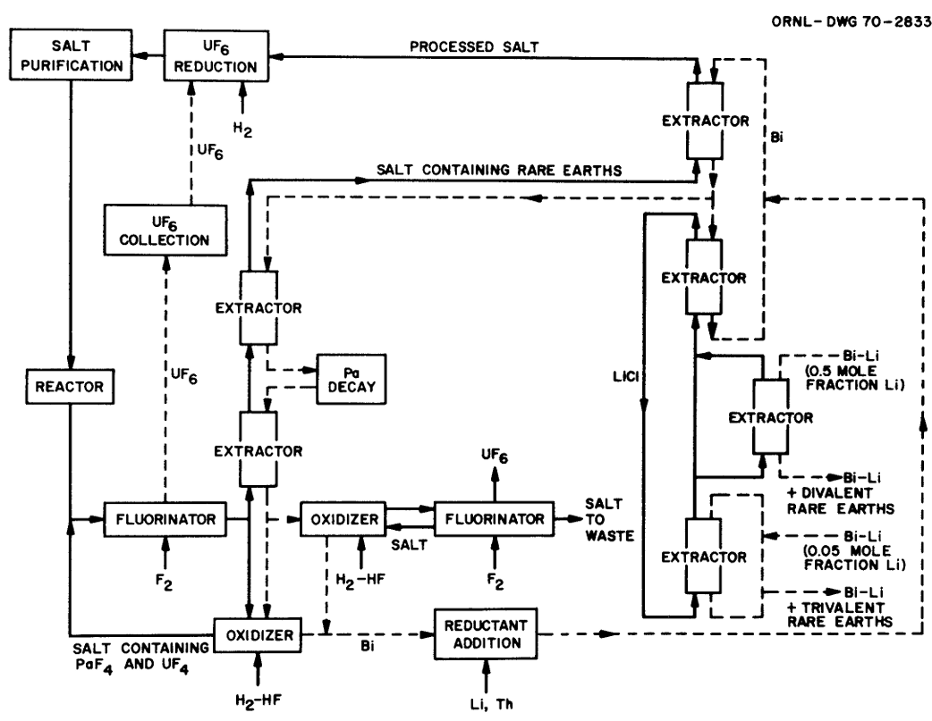
On-line Systems
Pa extraction
Only on-line system in MSBR
Proliferation concerns
Bubble Injector
Tritium removal
Noble metal removal
Potential systems
Medical isotope production
MSBR Chemical Processing Flowsheet [1]
Notes:
David

Slide 7
Fast Spectrum?
MSBR
Thermal spectrum
93% U-235
Expanded fuel types
Spent nuclear fuel
More breeding capabilities
Graphite
Less graphite in core
More reactivity worth per graphite rod
Buoyant in FLiBe
Notes:
Joe, I think the MSBR had 93% enrichment

Slide 8
Issues Under
Analysis
&
Future Work

Slide 9

General Reading
Different designs
European MSFR
MCFR Terrapower
TMSR
Materials
Hastelloy (Haynes International)
Find alternatives?
Book Worm [2]
Notes:
Joe

Slide 10
MSBR & Proposed Changes
Understanding MSBR design choices
Materials
Flow rate
Thermal neutron spectrum
Processing Systems
Our changes
Heating rates with slower flow
Fast spectrum
Transitioning to on-line processing
Notes:
Joe

Slide 11
References
[1] Bettis, E. ORNL-TM-3832.PDF, 27 June 1972, moltensalt.org/references/static/downloads/pdf/ORNL-TM-3832.pdf.
[2] Book Worm Image, https://www.abposters.com/book-worm-f34182974.
[3] Bettis, E. ORNL-TM-3832.PDF, 27 June 1972, moltensalt.org/references/static/downloads/pdf/ORNL-TM-3832.pdf.
[4] “ORNL’s Molten-Salt Reactor Program Quarterly Progress Reports.” Energy From Thorium, 1958-1976, energyfromthorium.com/msrp/.
[5] Furukawa, K., Lecocq, A., Kato, Y., and Mitachi, K. (1990). Thorium molten-salt nuclear energy synergetics. Journal of nuclear science and technology, 27(12):1157–1178.
[6] Vergnes, J. and Lecarpentier, D. (2002). The amster concept (actinides molten salt transmuter). Nuclear engineering and design, 216(1-3):43–67.
[7] Fan-Yi Ouyang, Chi-Hung Chang, Ji-Jung Kai, Long-term corrosion behaviors of Hastelloy-N and Hastelloy-B3 in moisture-containing molten FLiNaK salt environments, Journal of Nuclear Materials, Volume 446, Issues 1–3, 2014, Pages 81-89, ISSN 0022-3115, https://doi.org/10.1016/j.jnucmat.2013.11.045.

Slide 12
Thank you
Questions?

