Slide 1
– Senior Design –
Online Processing for Molten Salt Reactors
– Week 4 –
David Barnett, davidbb2
Nathan Glaser, nglaser3
Joseph Specht, jspecht3

Slide 2
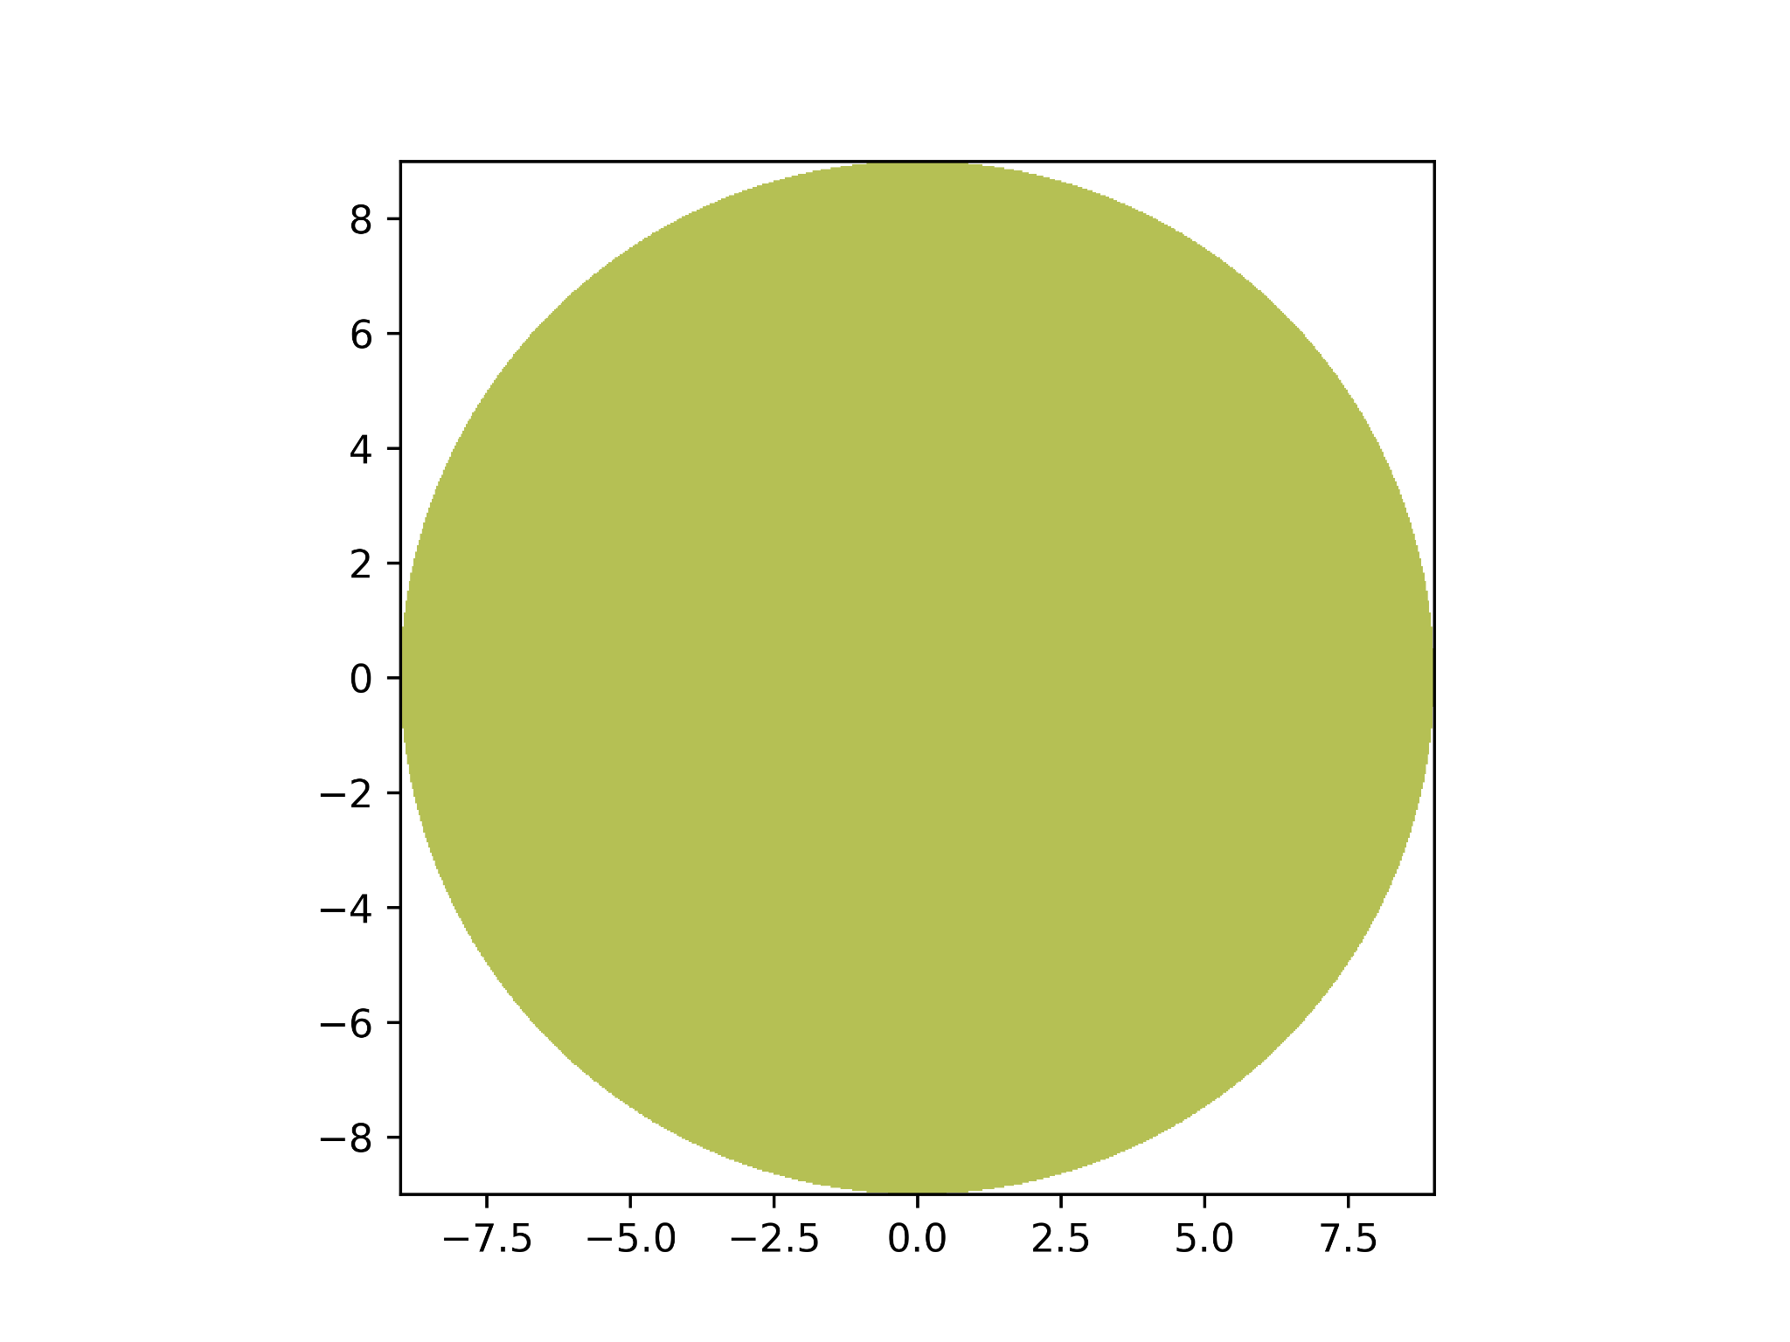
Accomplishments
0.5-D Reactor model
Depletion results*
MGXS results*
Regulatory limits for piping and hastelloy-N
Decided on:
Poisons, Lanthanides, Actinides, Tritium
Mechanical removal systems
Notes:
Nathan

Slide 3

In Progress
0.5-D Reactor model
Depletion results
MGXS results
0.5-D Bateman solve
Chemical separation techniques
Notes:
Joe

Slide 4
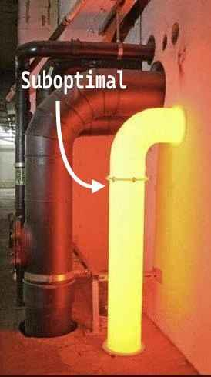
To-Do
Greater understanding of heat transfer in molten salt reactor
Actinide separations
Lanthanide separations
Design
Helium bubble injector / separator
Graphene filter
Notes:
David

Slide 5



Project Github
Notes:
Nathan

Slide 6
Thank You
Questions?

Slide 7
References
[1] Bettis, E. ORNL-TM-3832.PDF, 27 June 1972, moltensalt.org/references/static/downloads/pdf/ORNL-TM-3832.pdf.
[2] Helmenstine, Anne. “Actinides on the Periodic Table (Actinide Series or Actinoids).” Science Notes and Projects, 14 Dec. 2024, sciencenotes.org/actinides-on-the-periodic-table-actinide-series-or-actinoids/.

