Slide 1
– Senior Design –
Online Processing for Molten Salt Reactors
– Week 6 –
David Barnett, davidbb2
Nathan Glaser, nglaser3
Joseph Specht, jspecht3

Slide 2
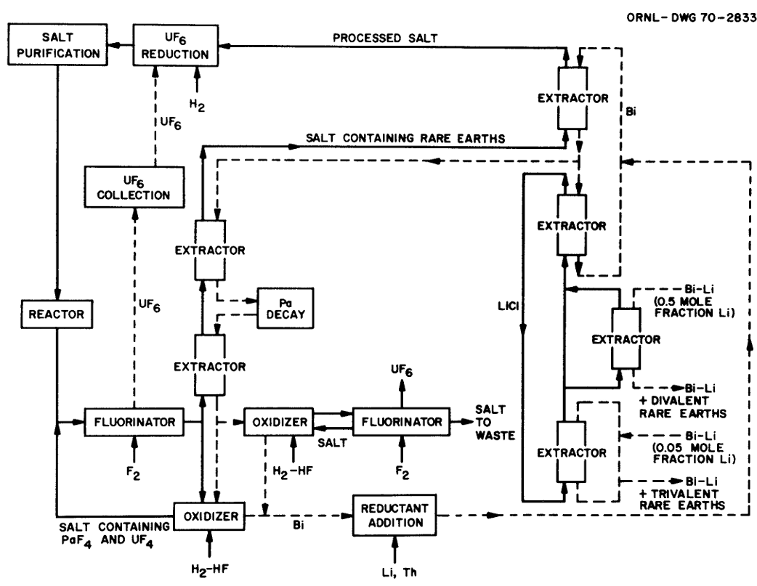
Goals from last week
Further investigation of PyroProcessing for an online system (actinide removal)
Finish source and sink rates for concentrations
Finalize processing system
Work in actinide removal
MSBR Chemical Processing Flowsheet [2]
Notes:
David

Slide 3
Accomplished
Finish source for concentrations
Finalize design of processing system
Work in actinide removal
Deeper understanding of PyroProcessing constraints in an online system
Work on Preliminary Design Report: Structure and Content
Notes:
David

Slide 4
Modular Online Processing (MOP)
Design Overview

Slide 5
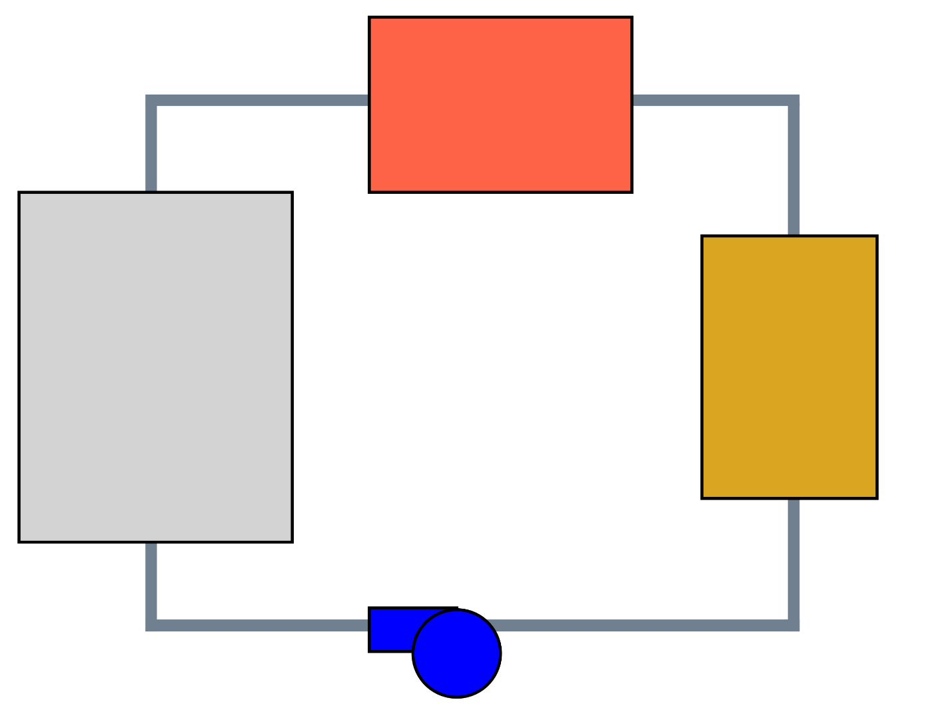
Heat
Exchanger
Reactor
Core
Online
Processing
Reactor Coolant Pump
Notes:
Joseph

Slide 6
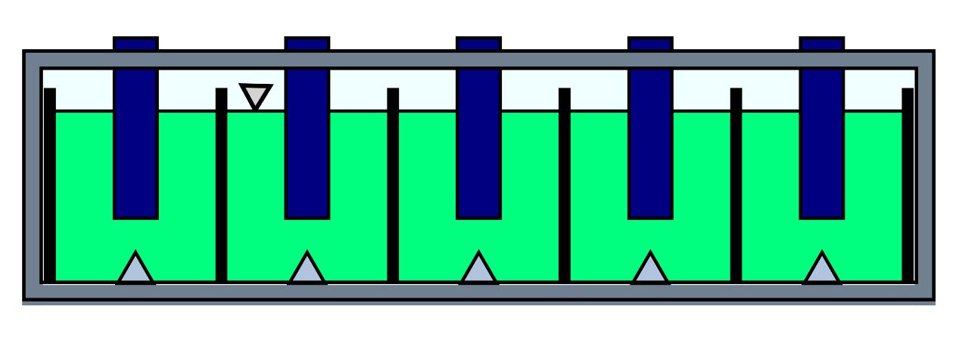
MOP Cross-Section
Adaptive Processing Module
Gas Blanket
Fluid Level
FLiBe
Gas blanket
APM removal through top
Parallel Graphene Plates
He Bubbler
Notes:
Joseph

Slide 7
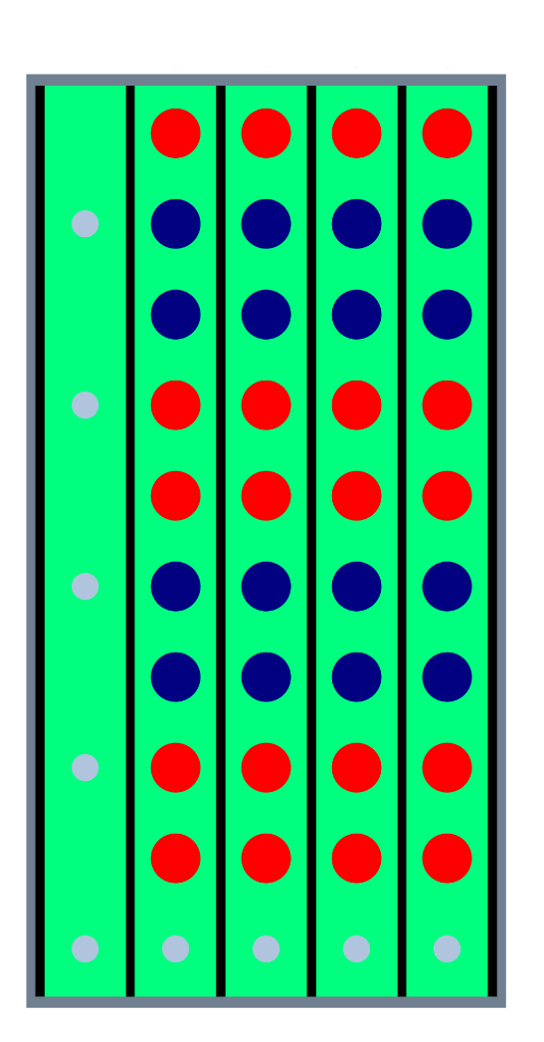
MOP Top Down
Parallel Graphene Plates
Processing Module A
Processing Module B
He Bubbler
Modularity enables menagerie of processing
Need to determine
Length
Channel Count
APM spacing
Energy cost
Notes:
Joseph

Slide 8
Calculations

Slide 9

Source Rates
Modified bateman solve
Upper bounds of per pass production
Isotope | Quantity [mol] | Quantity [atms]
Pa233 | 8.3e-11 | 5e13
Xe135 | 1.7e-4 | 1e20
T (H3) | 1.3e-7 | 8e16
Notes:
Nathan

Slide 10
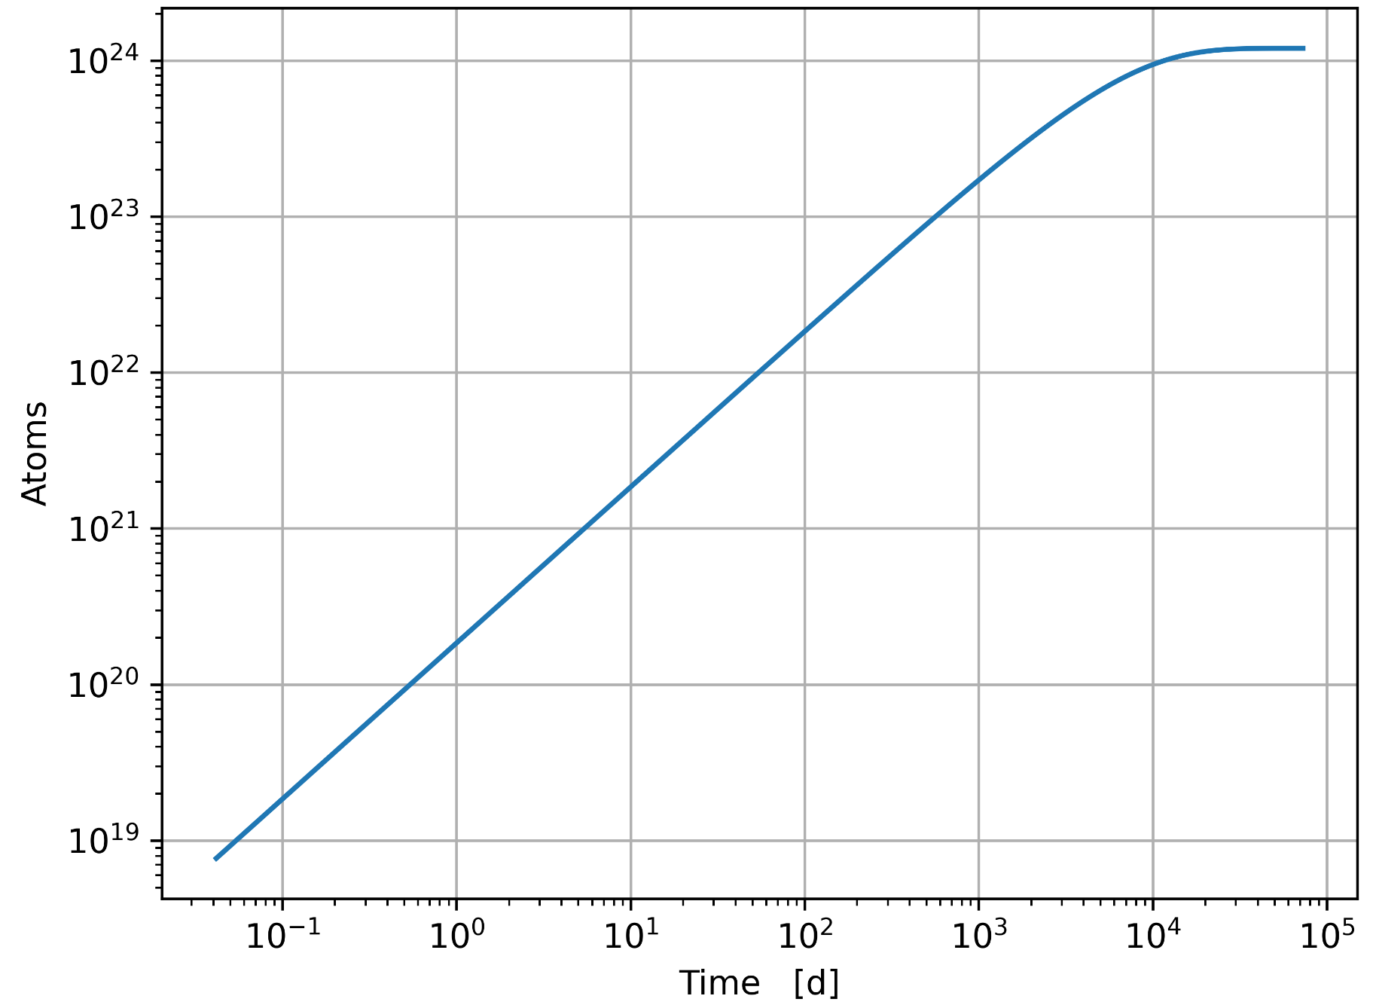
Tritium Equilibrium Source Rate
Notes:
Nathan

Slide 11
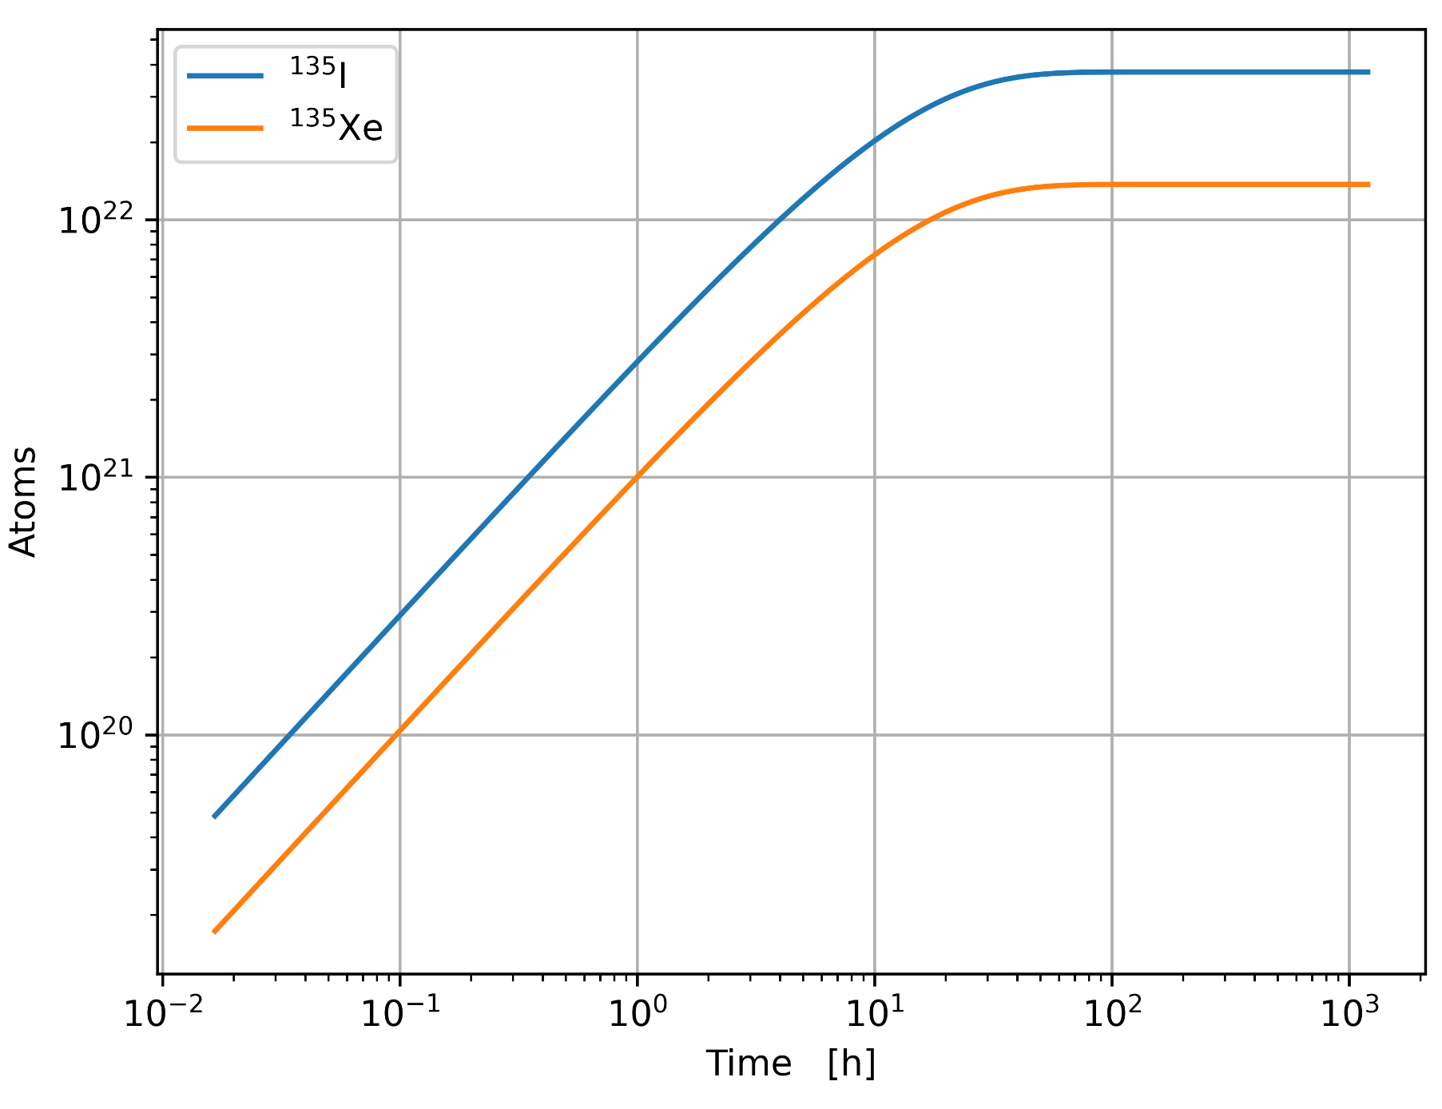
I135 & Xe135 Equilibrium Source Rates
Notes:
Nathan

Slide 12
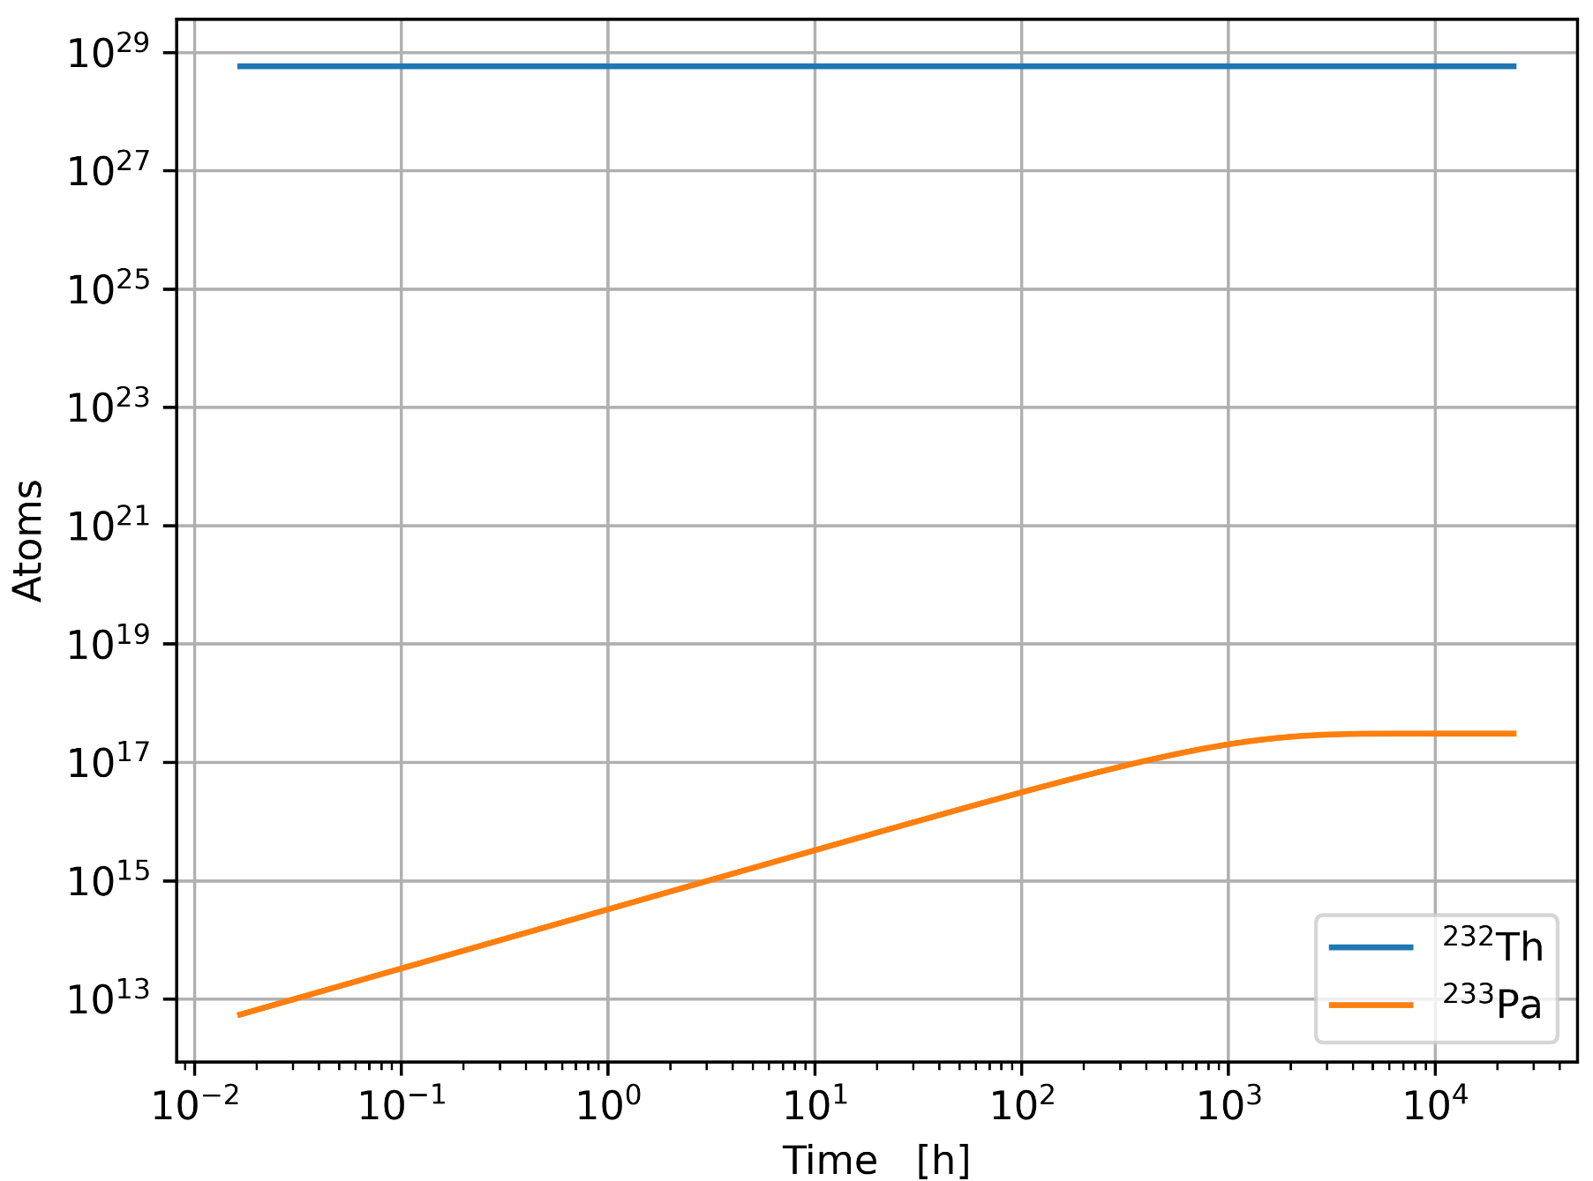
Th232 & Pa233 Equilibrium Source Rates
Different time scales for equilibrium
Th232, Pa233: mos
Xe135, I135: hrs
T: decades
Need to inject constant stream of Th232
Notes:
Nathan

Slide 13
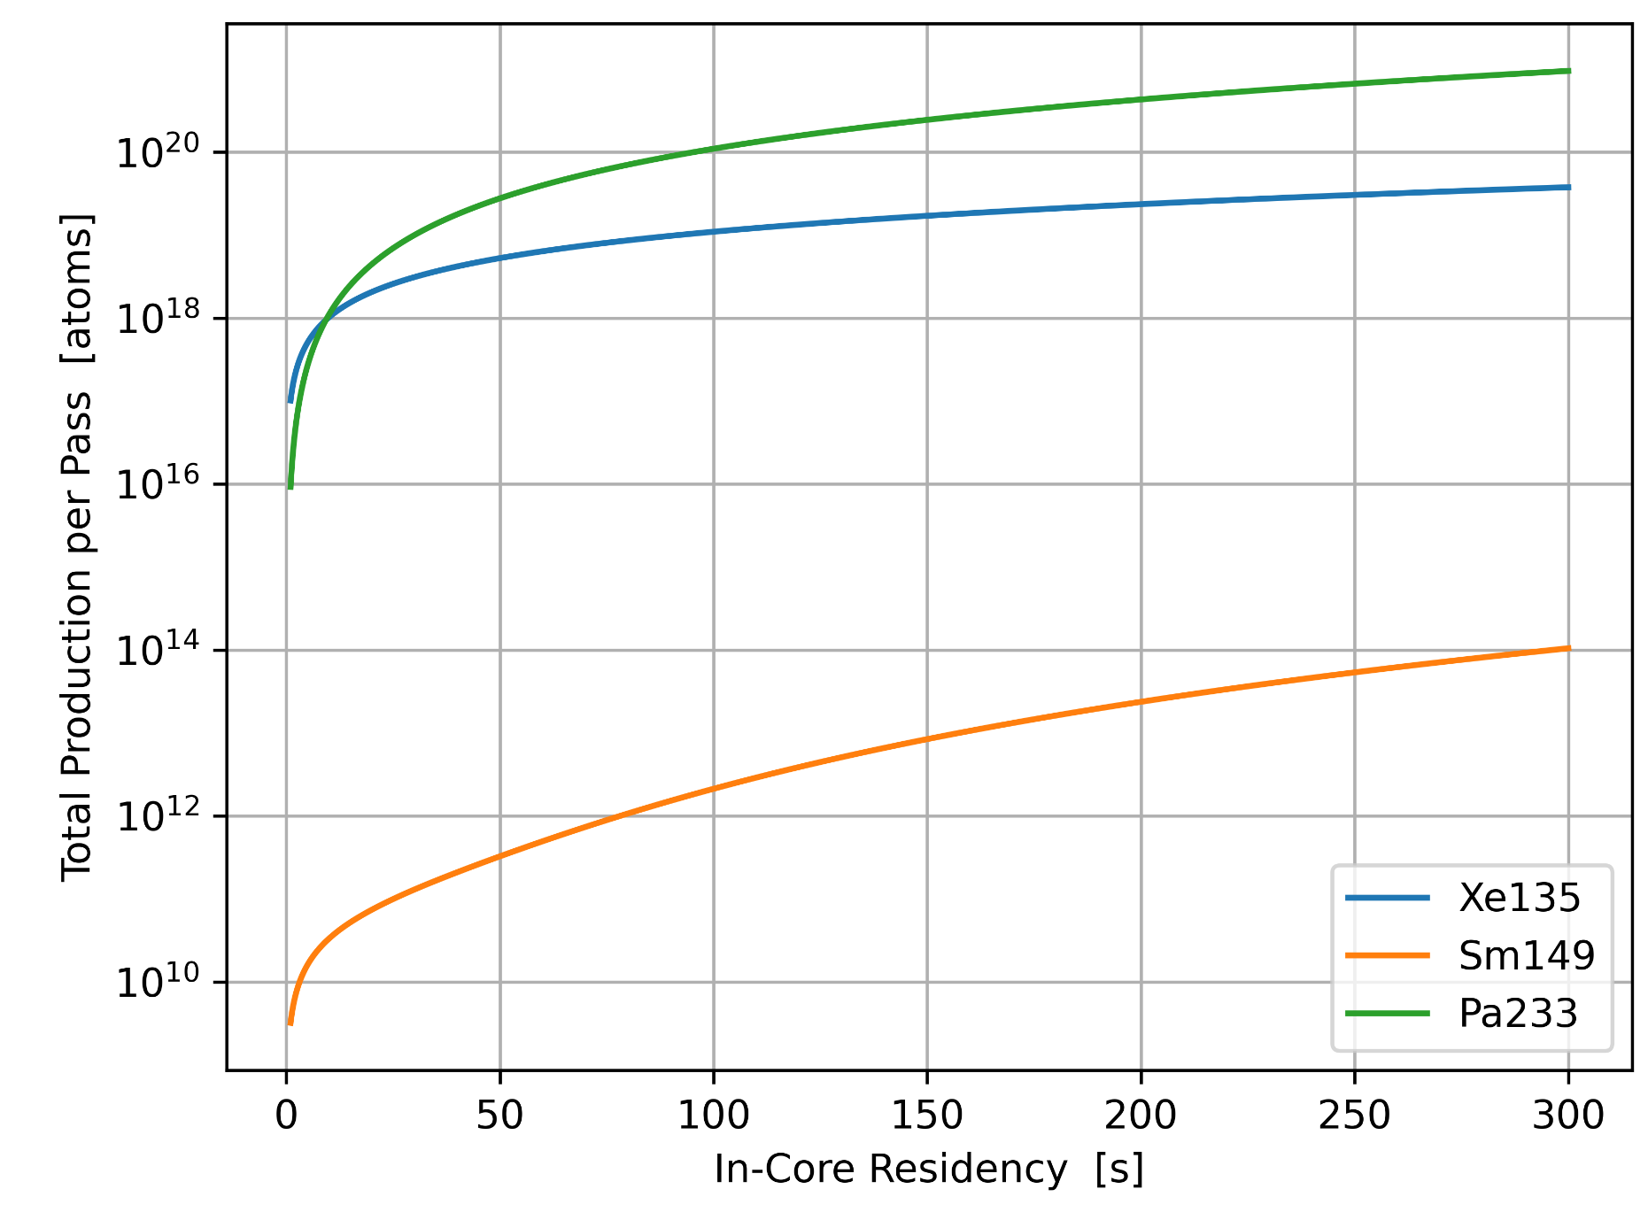
In-Core Residency
Production as a function of in-core residency
Notes:
Nathan

Slide 14


What Next?

Slide 15
Exigent Calculations
APM Spacing
MHD Pressure of FLiBe
Length, Channel #
Removal Efficiency
Desired Concentration
Energy cost
Parallel Graphene Plates
Processing Module A
Processing Module B
He Bubbler
Notes:
Joseph

Slide 16
Further Considerations
Electrode Species
Processing System Removal
Mechanical
Electrode
Per-channel shutdown in APM
Notes:
David

Slide 17
Thank You
Questions?

