Slide 1
– Senior Design –
Online Processing for Molten Salt Reactors
– Week 10 –
David Barnett, davidbb2
Nathan Glaser, nglaser3
Joseph Specht, jspecht3

Slide 2
Project Overview
Notes:
say like we took a step back this past week to review our design in context of what has been done

Slide 3
Background
Molten Salt Reactors (MSRs) are Gen IV reactors
Passive safety features (salt expansion)
Potential for breeding (greater Burnup/fuel utilization)
With fuel processing (purifying fuel-salt)
Maximize burnup (approach ∞ batch core)
Minimize decay heating in core
Load-following
Increased component lifetime
Notes:
david

Slide 4
Ways to Reprocess
Off-line or Batch-wise processing
Siphon a percentage of fuel-salt and process separately
Simpler, not as effective
On-line processing ★
Run all fuel-salt through a series of chemical process
Much more complicated, more effective
Notes:
david

Slide 5
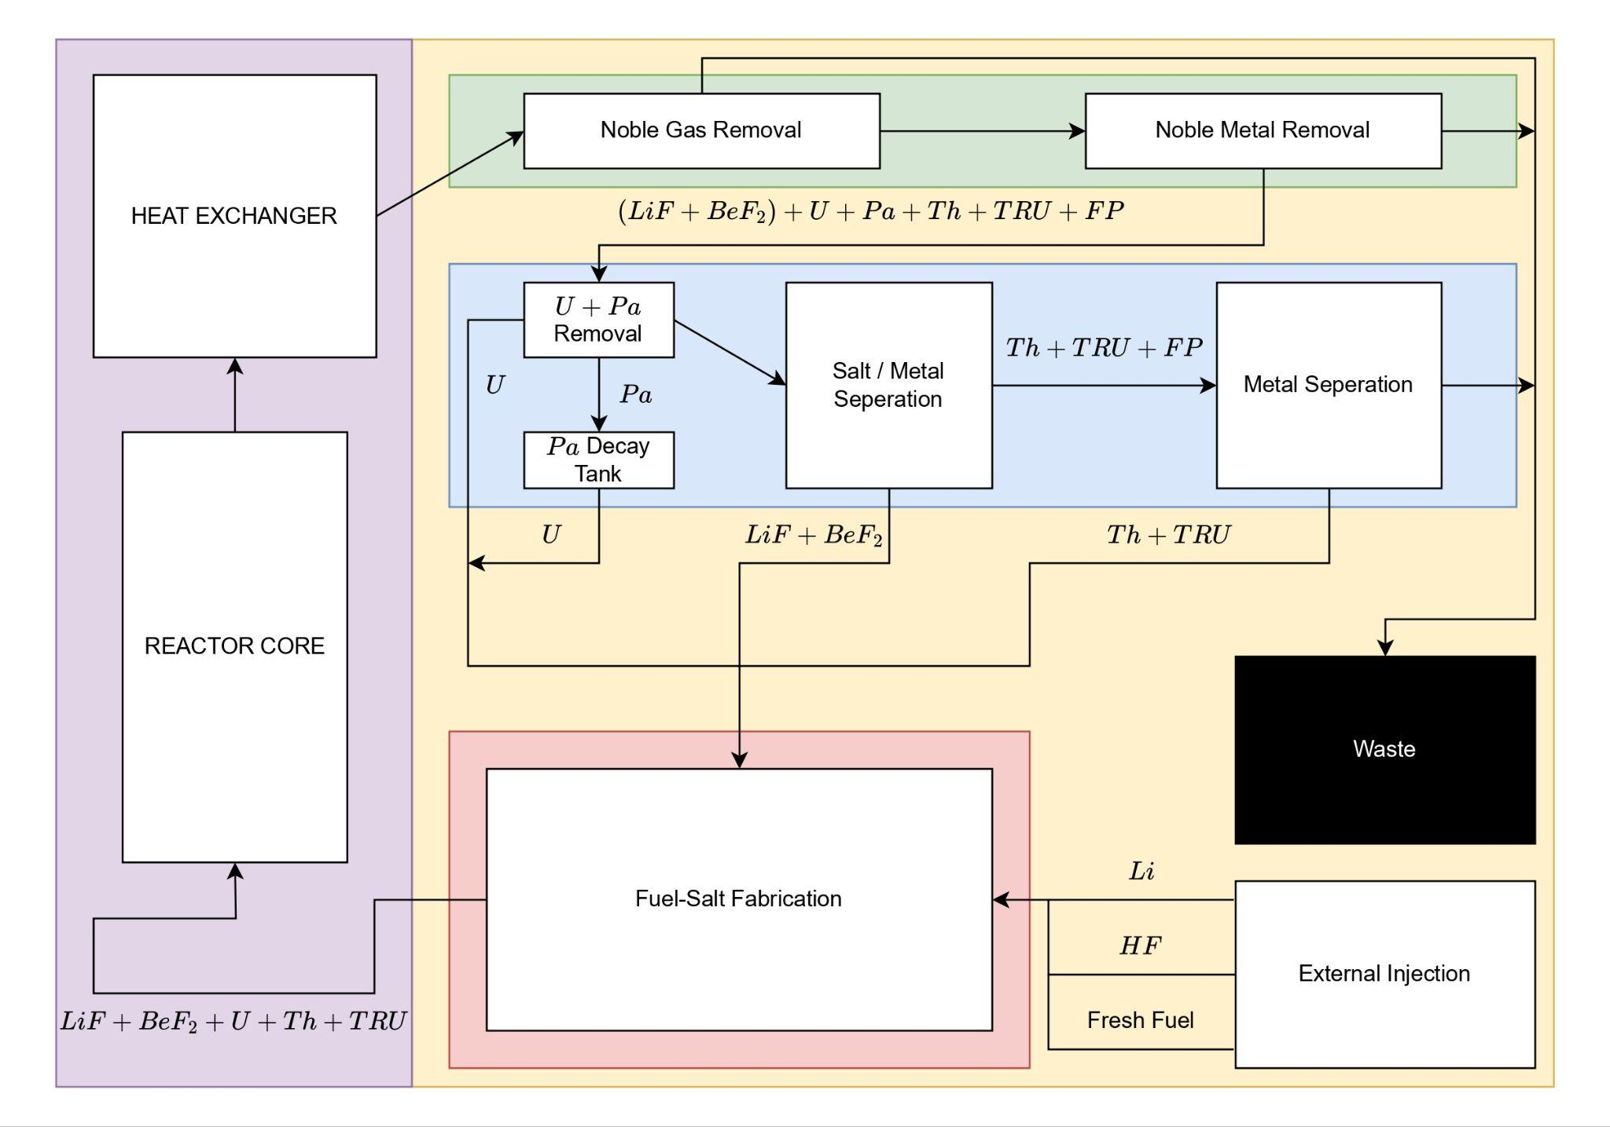
Simplified online processing scheme adapted from [1].
Notes:
david

Slide 6
Typical Methods for Removal

Slide 7
Noble Gas and Metal Removal
Inert gas sparging
Bubble an inert gas (He, Ar) through the fuel-salt
Force gas stream through charcoal filters
Noble gases and some metals
Noble metal plate out
Noble metals do not typically chemically react
They are typically insoluble in FLiBe, form particulates
Deposition of these particulates over structural surfaces
Notes:
sparging removes 10% of metals, 50% plate out in pipes and core, 40% plate out in HX

Slide 8
Uranium and Protactinium Removal
Fused salt volatilization (Uranium)
Bubble fluorine gas through salt, form fluoride gases
forces UF4 to UF6, boiling temperature of ~100 C at 5 atm
Molten Salt / Liquid Metal Extraction (Uranium and Protactinium)
Electrochemical separation (Uranium and Protactinium)
Insert electrodes into the fuel-salt, apply current to the salt
Preferentially separate elements based on red-ox potentials
FLiBe is not electrically stable, BeF2 breaks apart
Notes:
david
Only well suited for uranium because Uranium prefer to be Hexavalent (UF6), which is a gas. Proposed for Np and Pu (NpF6 and PuF6), but neither prefer to be hexavalent.
This one was initially proposed but it either is ~ok at removing protactinium and uranium OR good at removing lanthanides, but depends on process
Best option, U, Pa, and Th all have special red-ox potentials, very easy to remove. Only problem is FLiBe (specifically BeF2) has limited electrochemical stability

Slide 9
TRU and Lanthanide Removal
Molten salt/ liquid metal extraction
Inject salt stream with molten lithium-bismuth
Separates MF into LiF and MBi, “scrubs” salt of metals
Produces a stream of FLiBe and a stream of TRU + waste
Electrochemical separation to separate TRU
Same process as with uranium and protactinium removal
FLiBe has been separated off
Notes:
Liquid metal extraction for uranium requires a huge amount of reductant, intractable
Liquid-metal extraction is like removing the FLiBe from the other stuff, not other stuff from FLiBe because it removes most of waste
Electrochemical is done on the waste stream (TRU + Lanthanides + random other stuff) to remove TRU to put back into the core to burn dump everything else

Slide 10
Our Design

Slide 11
Design Goals
Minimize
Worker Dosage
Salt-Inventory
Amount of waste
Effective cost
Maximize
Thermal efficiency
Fuel-utilization (Burnup)
Component Lifetime
Notes:
Joe
shape that minimizes the flow disruption while maximizing surface area

Slide 12
Constraint Quantification
Core moderator lifetime of 7 years
fluence limited
Tritium concentration below a partial pressure of 0.05 Pa
limit for primary loop w/ metal heat exchanger
Allowable dose below NRC limit of 5,000 mrem/year
Pressure of 75 psi or ~5.1 atm
pressure vessel limit for MSBR
Micron pore size for FLiBe to not wet graphite
Notes:
Joe
what is the level of T the canadian regulator allows

Slide 13
Design Changes
Swapping metal -> graphite HX
Adding noble metal removal
Adding U and Pa removal via electrochemistry
Adding T removal in the primary loop
Notes:
Joe

Slide 14
Thermal Cycle
Fluid | Cycle | η | Pressure [atm] | Temp Range [°C]
Water | Rankine | 43.4%* | 250 | <550
sCO2 | Brayton | >50% | 200 | 550-850
He | Brayton | 54% | 80 | >850
Notes:
Joe

Slide 15
Processing Methodology

Slide 16
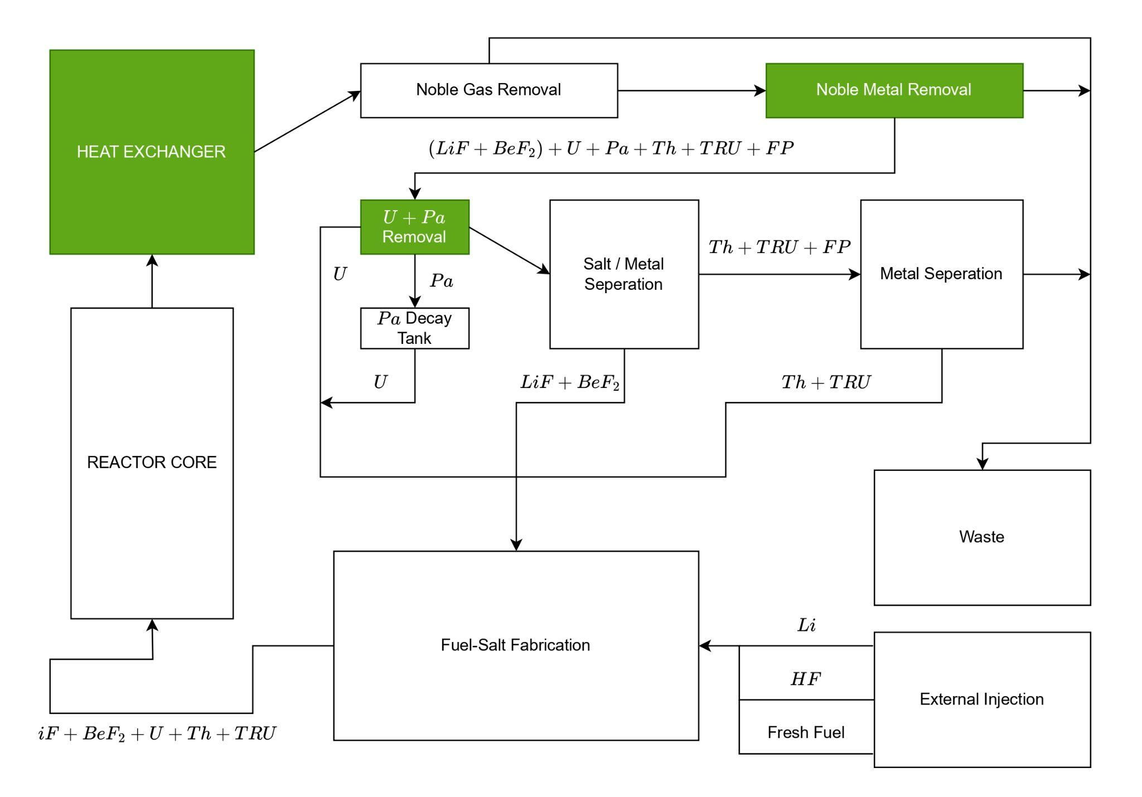
Components from the MSBR we are drastically altering
Notes:
Nathan
separation

Slide 17
Tritium and Noble Gas/Metal Removal
Inert gas sparging
Extremely effective, MSRE proved its efficacy
Graphite HX coupled with SCO2-Brayton Cycle
Greatly reduce noble-metal plate out in HX compared to metal
If tritium leaks into secondary loop, easy to separate from CO2
Metallic filter
High surface area metallic filter for noble metal plate-out
Notes:
Nathan
Helium gas sparging effectively removes all Noble gases, most of insoluble tritium species, and accidentally ~some noble metals
FLiBe doesn’t wet graphite with pore sizes of less than a micrometer (nuclear grade graphite). We can add a tritium removal system (graphene blocks) in primary loop, aswell as minimize worker dose and have removal system in secondary loop (easy to remove from sCO2)
Noble metals are insoluble in FLiBe, forming particulates. They preferentially plate out onto metallic surfaces, so metallic filter with a lot of surface will act as a preferred deposition site. This filter is completely passive, and can simply be replaced when high enough plate out is achieved

Slide 18
Uranium and Protactinium Removal
Electrochemical for Uranium and protactinium
Comparable effectiveness, simplest, and most compact of separation techniques
Detectors for non-proliferation
Not directly studied for protactinium
Notes:
Uranium was studied in FLiBe, but protactinium was not. They have similar thermophysical and chemical properties, much of the literature believe you can remove protactinium without destroying salt. Very high efficiency but no numbers listed

Slide 19
TRU and Lanthanide Removal
Molten salt/ liquid metal extraction
scrubs all of the TRU, Lanthanides, and other molten metals out of the FLiBe
two streams produced by this:
FLiBe + trace FP
TRU + Lanthanides + Molten Metals
Electrochemical separation of TRU from waste stream
The carrier is no longer FLiBe, no longer limited by BeF2

Slide 20
Calculations / Findings

Slide 21
Source Rates!

Slide 22
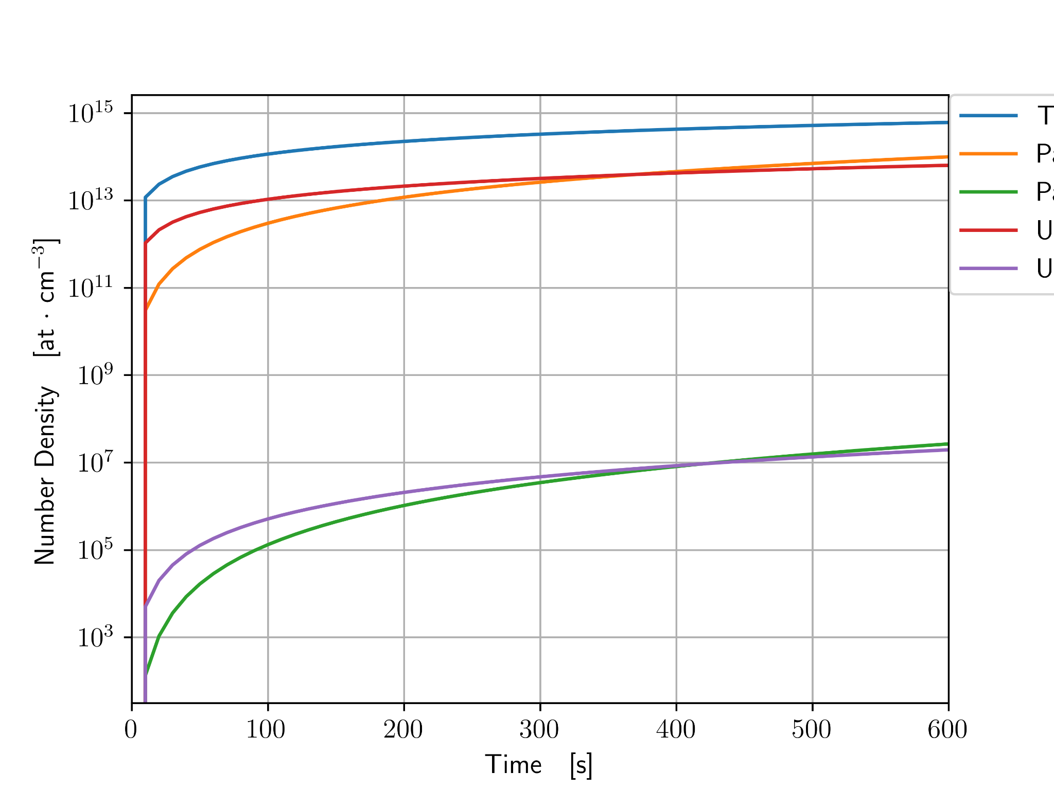
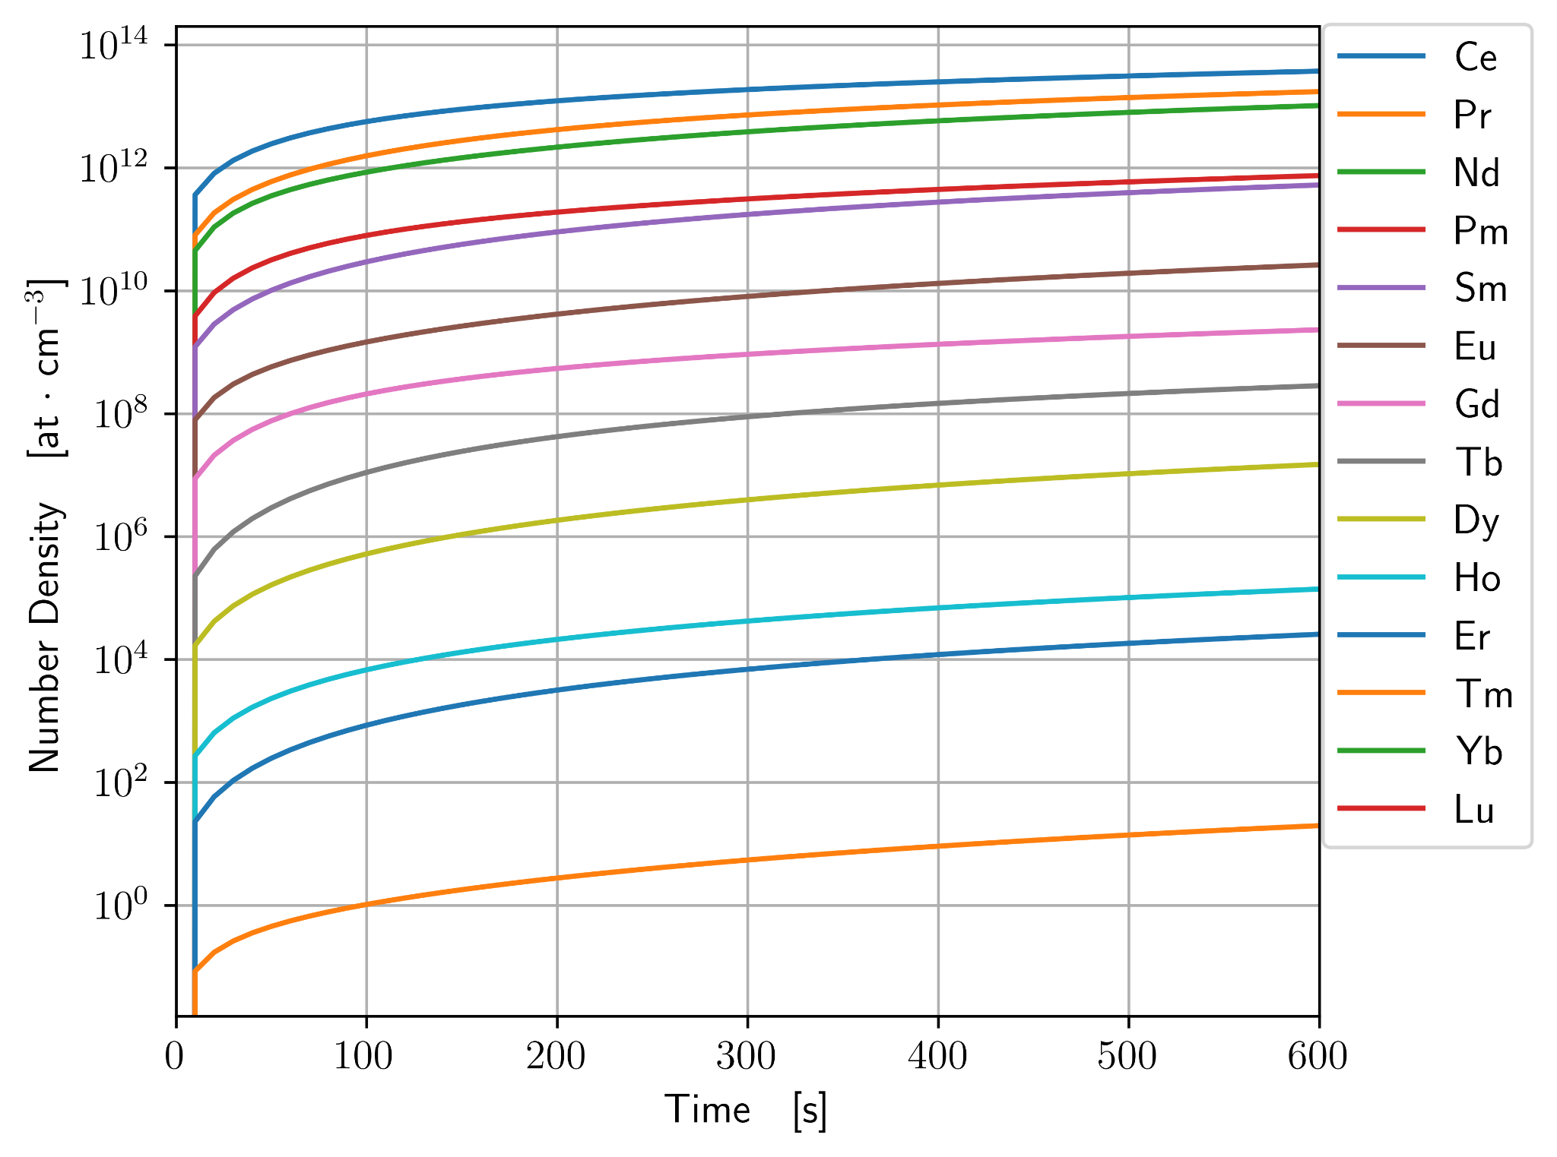
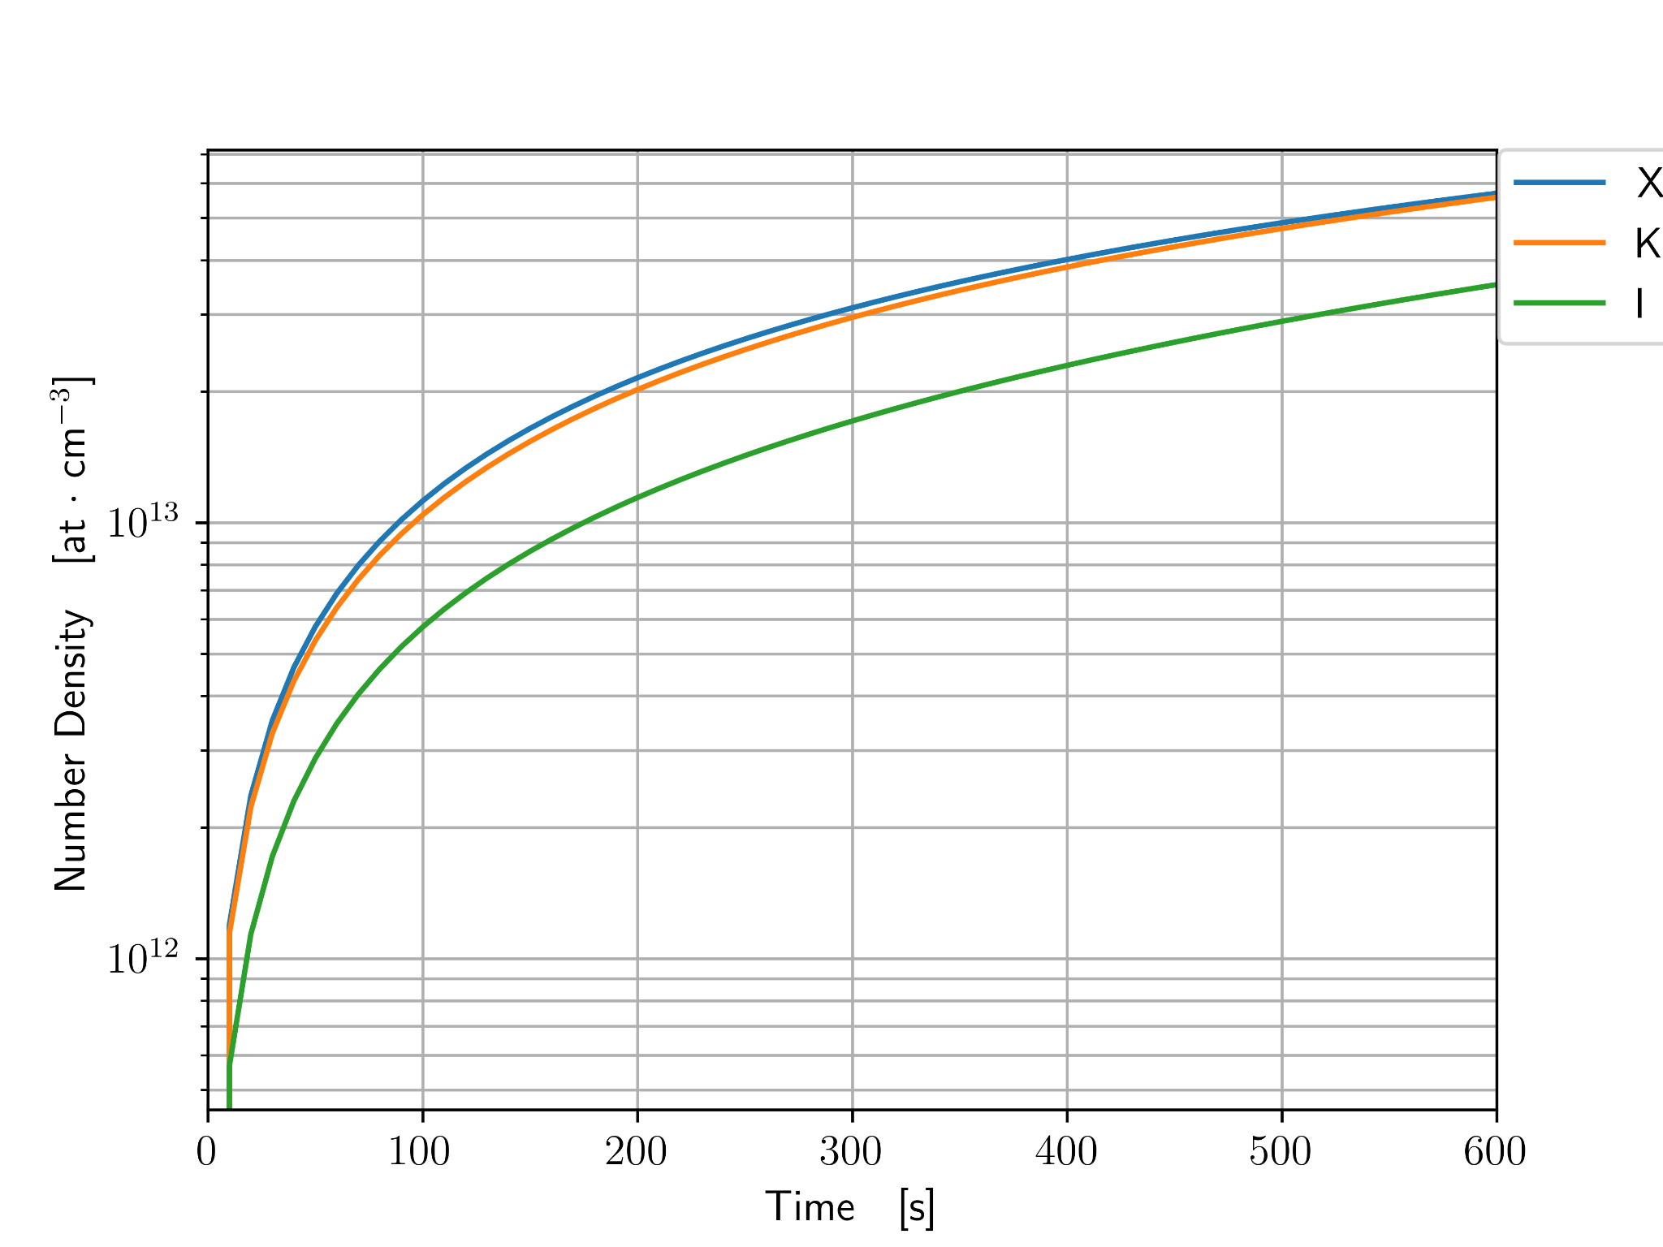
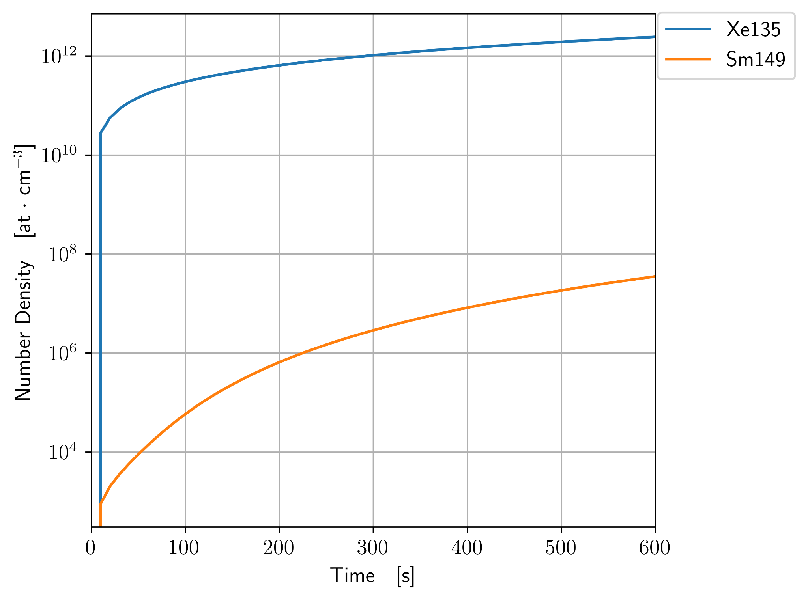
Notes:
Nathan

Slide 23
Decay Heat!

Slide 24
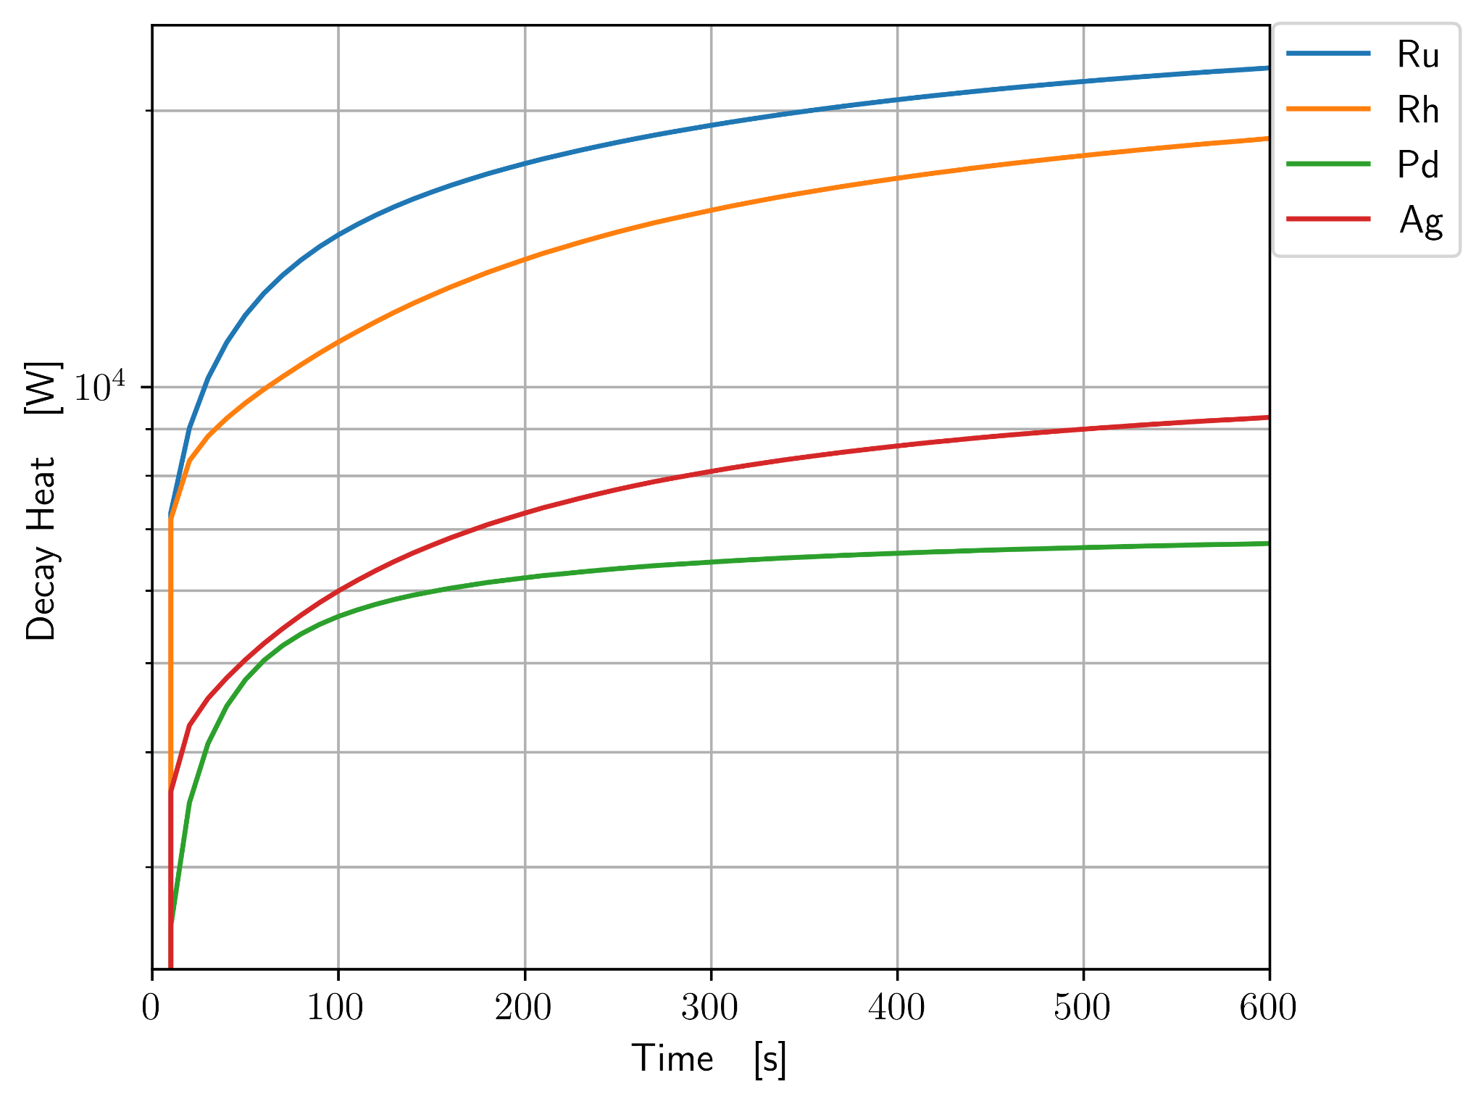
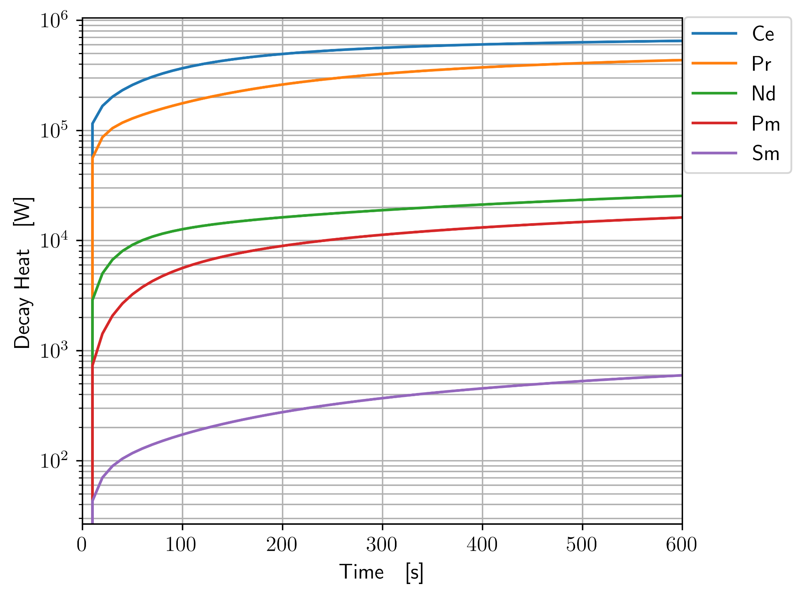
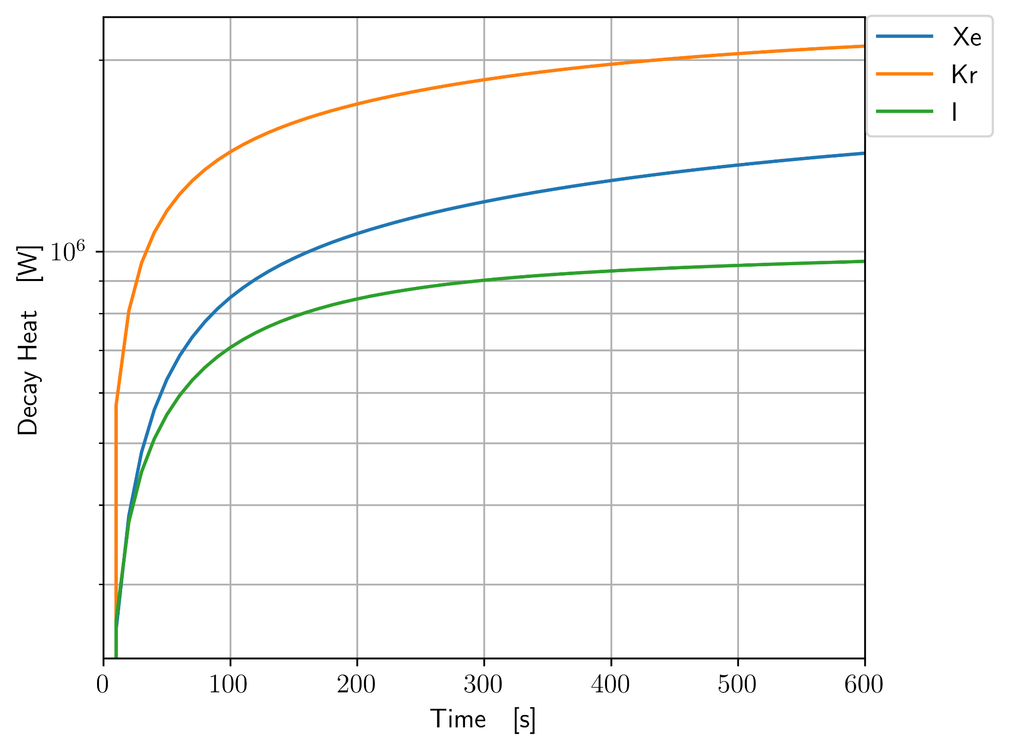
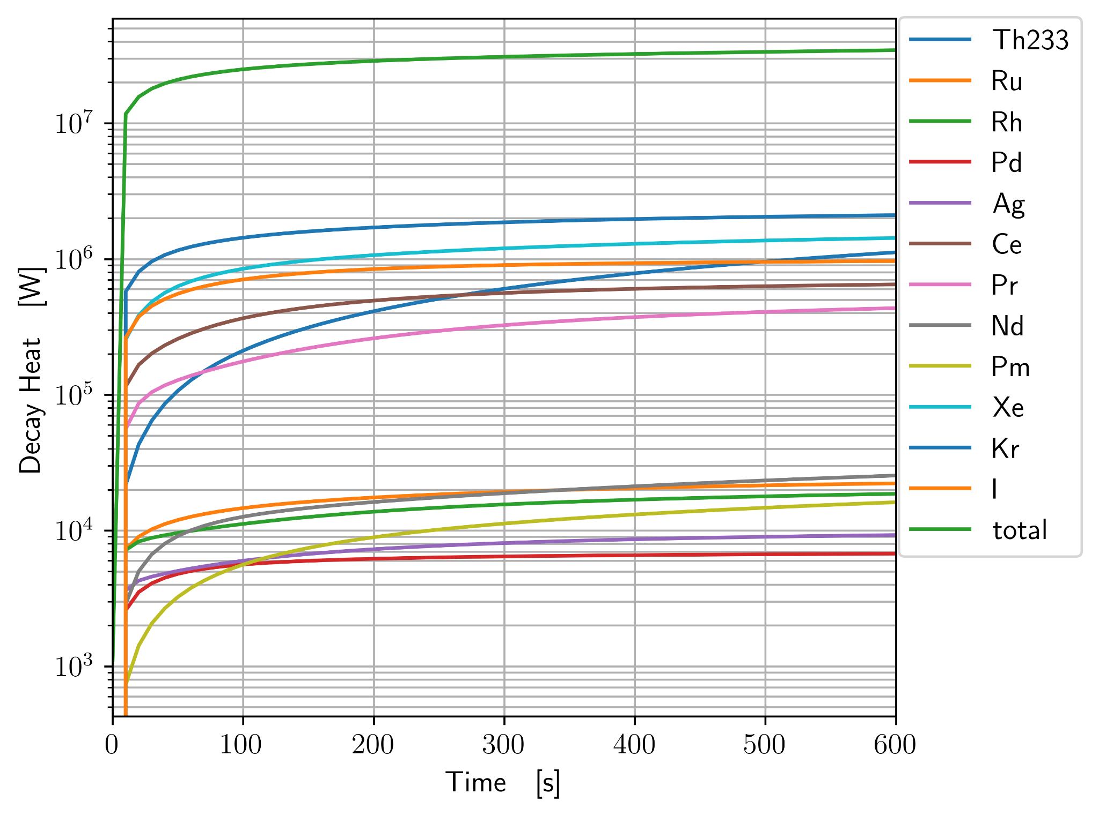
Notes:
Nathan

Slide 25
Updates on Efficiencies

Slide 26
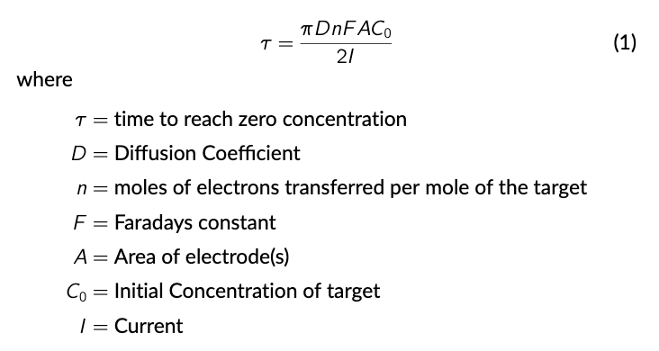
Gas sparging is extremely efficient, removes 99.9% in ~20 seconds
Noble metals plate out very quickly, 99.9% in ~50 seconds
Electrochemical processing has only been studied in stagnant flow
100% efficiency if contact occurs
Diffusion driven process
Diffusion Coefficient of U(4+) in FLiBe is 1.269e-6 cm2/s
Can use to determine distance between electrodes
Sands law for timescale, extremely conservative
1-D, no velocity
Infinite domain
Notes:
Nathan

Slide 27
Next Steps

Slide 28
Next Steps
Volume for each component
Quantify waste production
Worker Dosage
Calculate the new efficiency
Component damage rates
Price comparison to MSBR
Notes:
David
infinite batch burnup 412 equations

