Slide 1
– Senior Design –
Online Processing for Molten Salt Reactors
– Week 11 –
David Barnett, davidbb2
Nathan Glaser, nglaser3
Joseph Specht, jspecht3

Slide 2
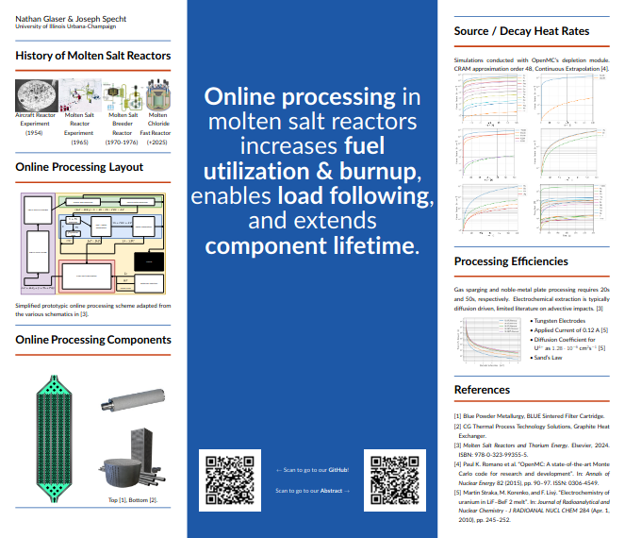
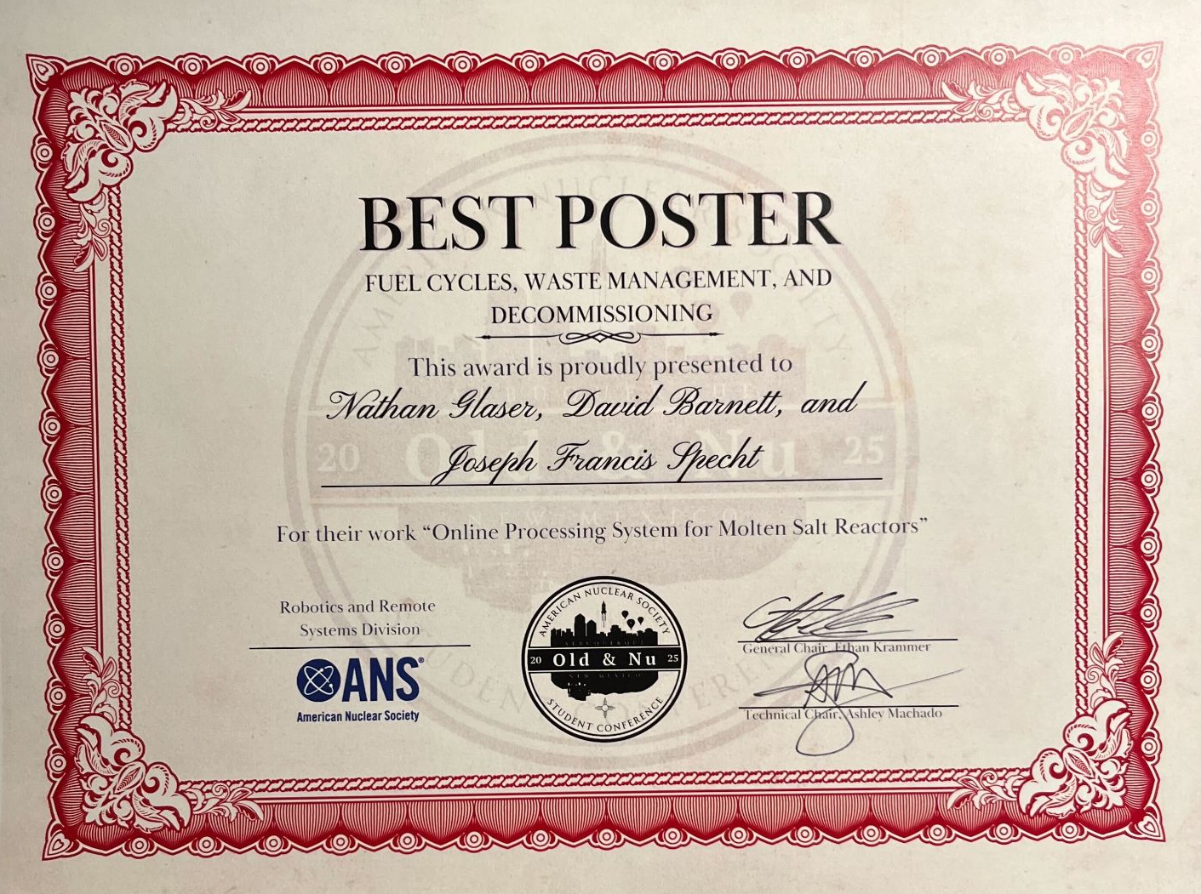
Student Conference

Slide 3
Project Overview

Slide 4
Background
Molten Salt Reactors (MSRs) are Gen IV reactors
Passive safety features (salt expansion)
Potential for breeding (greater Burnup/fuel utilization)
With fuel processing (purifying fuel-salt)
Maximize burnup (approach ∞ batch core)
Minimize decay heating in core
Load-following
Increased component lifetime

Slide 5
Ways to Reprocess
Off-line or Batch-wise processing
Siphon a percentage of fuel-salt and process separately
Simpler, not as effective
On-line processing ★
Run all fuel-salt through a series of chemical process
Much more complicated, more effective

Slide 6
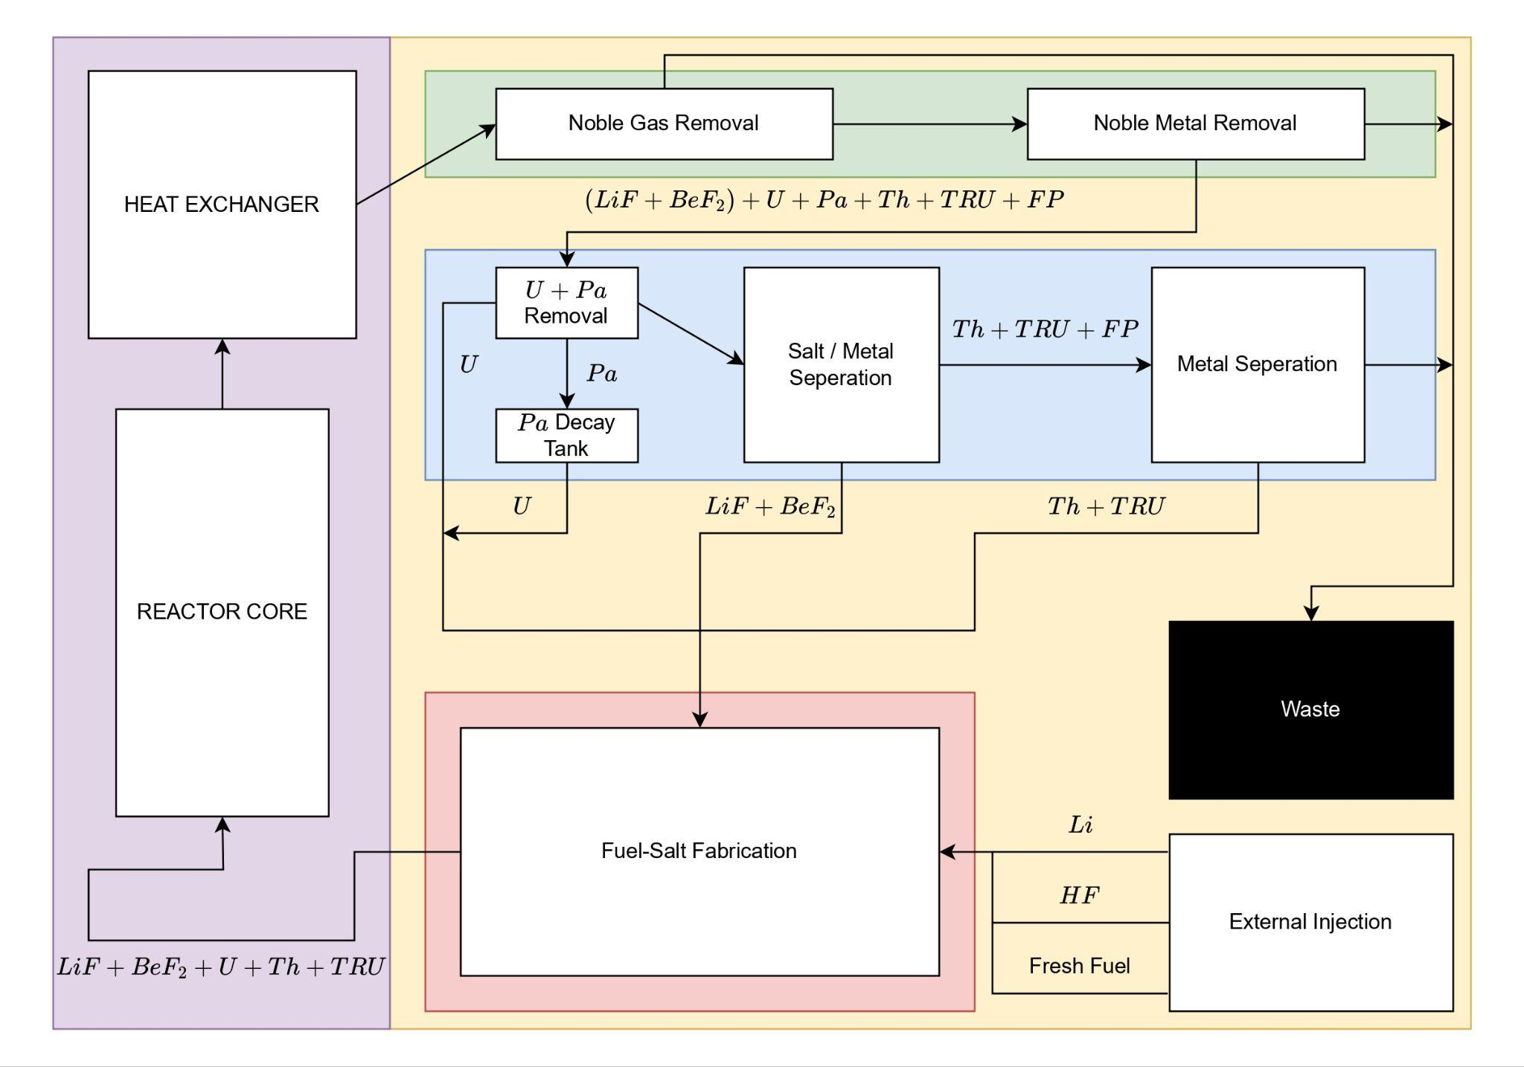
Simplified online processing scheme adapted from [1].

Slide 7
Our Design

Slide 8
Secondary Side
Graphite heat exchanger
⅓ the size of a metallic heat exchanger
less noble metal plate-out
smaller containment
Brayton Cycle
Higher operating temperatures
Rankine η = 43.4%* -> sCO2 Brayton η = >50%

Slide 9
Thermal Cycle
Fluid | Cycle | η | Pressure [atm] | Temp Range [°C]
Water | Rankine | 43.4%* | 250 | <550
sCO2 | Brayton | >50% | 200 | 550-850
He | Brayton | 54% | 80 | >850

Slide 10
Noble Metal Removal
High surface area nickel “sponge”
most of noble metals settle to the bottom of molten salt
They are typically insoluble in FLiBe, form particulates
forms alloys with noble metals
Nickel is corrosion resistant

Slide 11

Electrochemistry Module
Electrochemically remove U and Pa
Partial T adsorption
Biased W anodes
Channels
Graphite/Graphene
B doped
discontinuous

Slide 12
Calculations

Slide 13
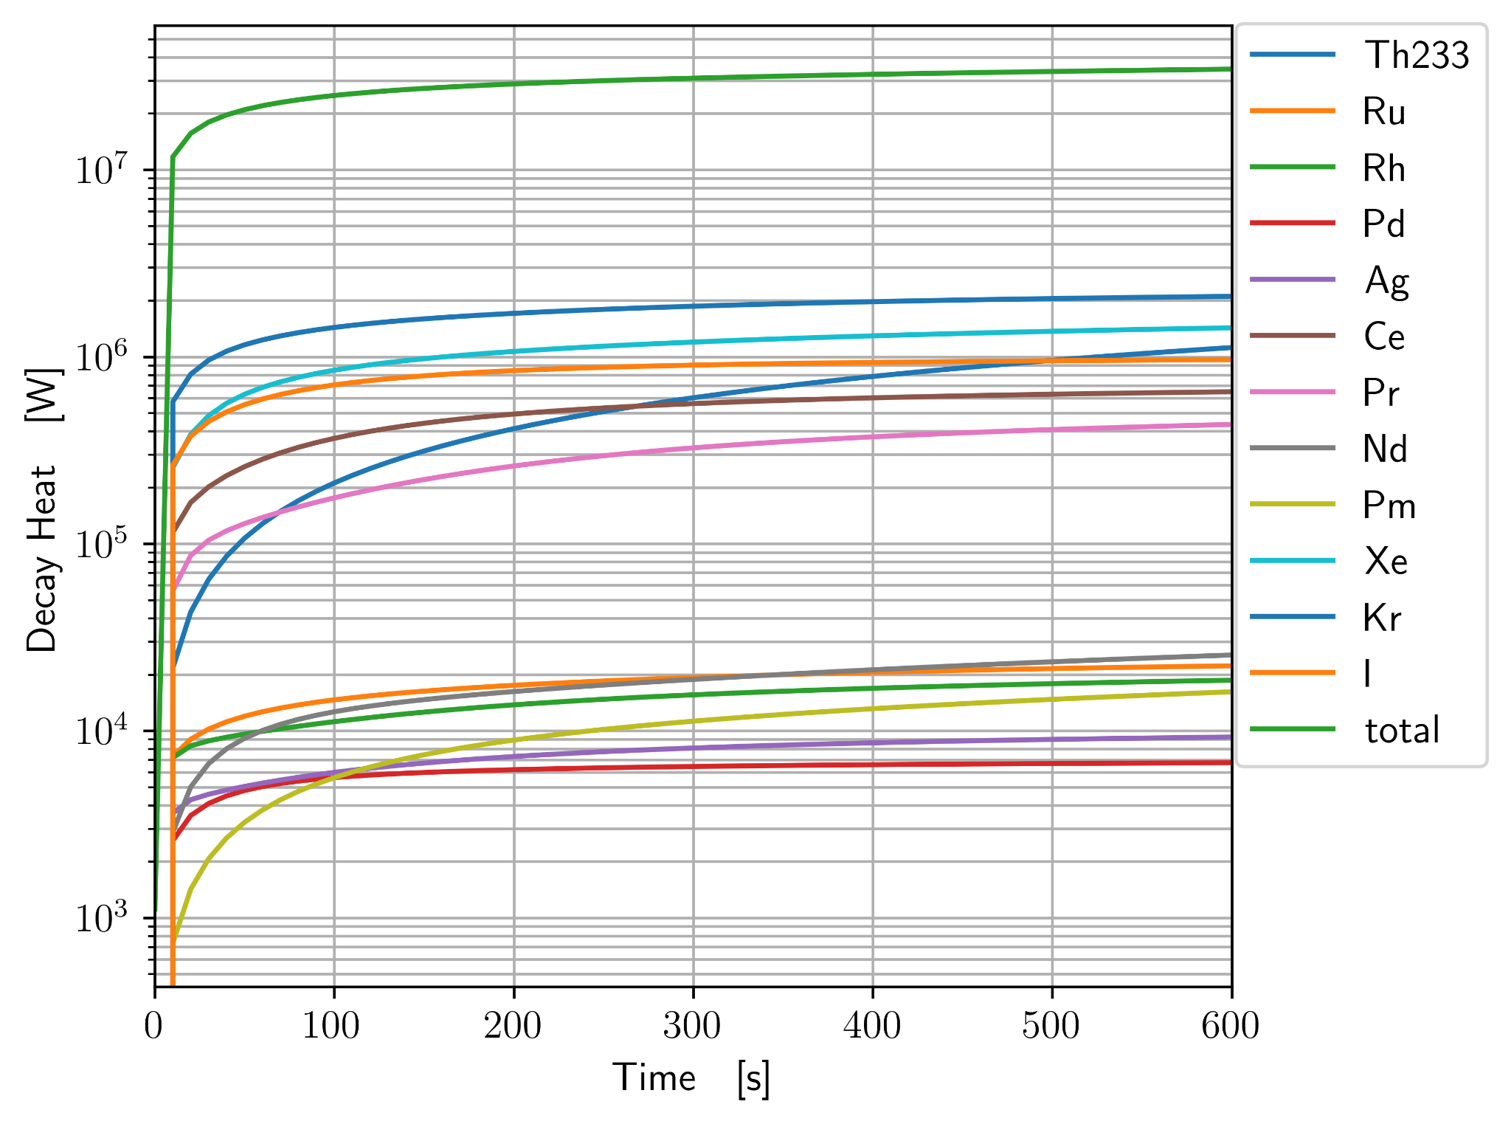

Slide 14
Gas sparging is extremely efficient, removes 99.9% in ~20 seconds
Noble metals plate out very quickly, 99.9% in ~50 seconds
Electrochemical processing has only been studied in stagnant flow
100% efficiency if contact occurs
Diffusion driven process
Sands law for timescale, extremely conservative
1-D, no velocity
Infinite domain

Slide 15
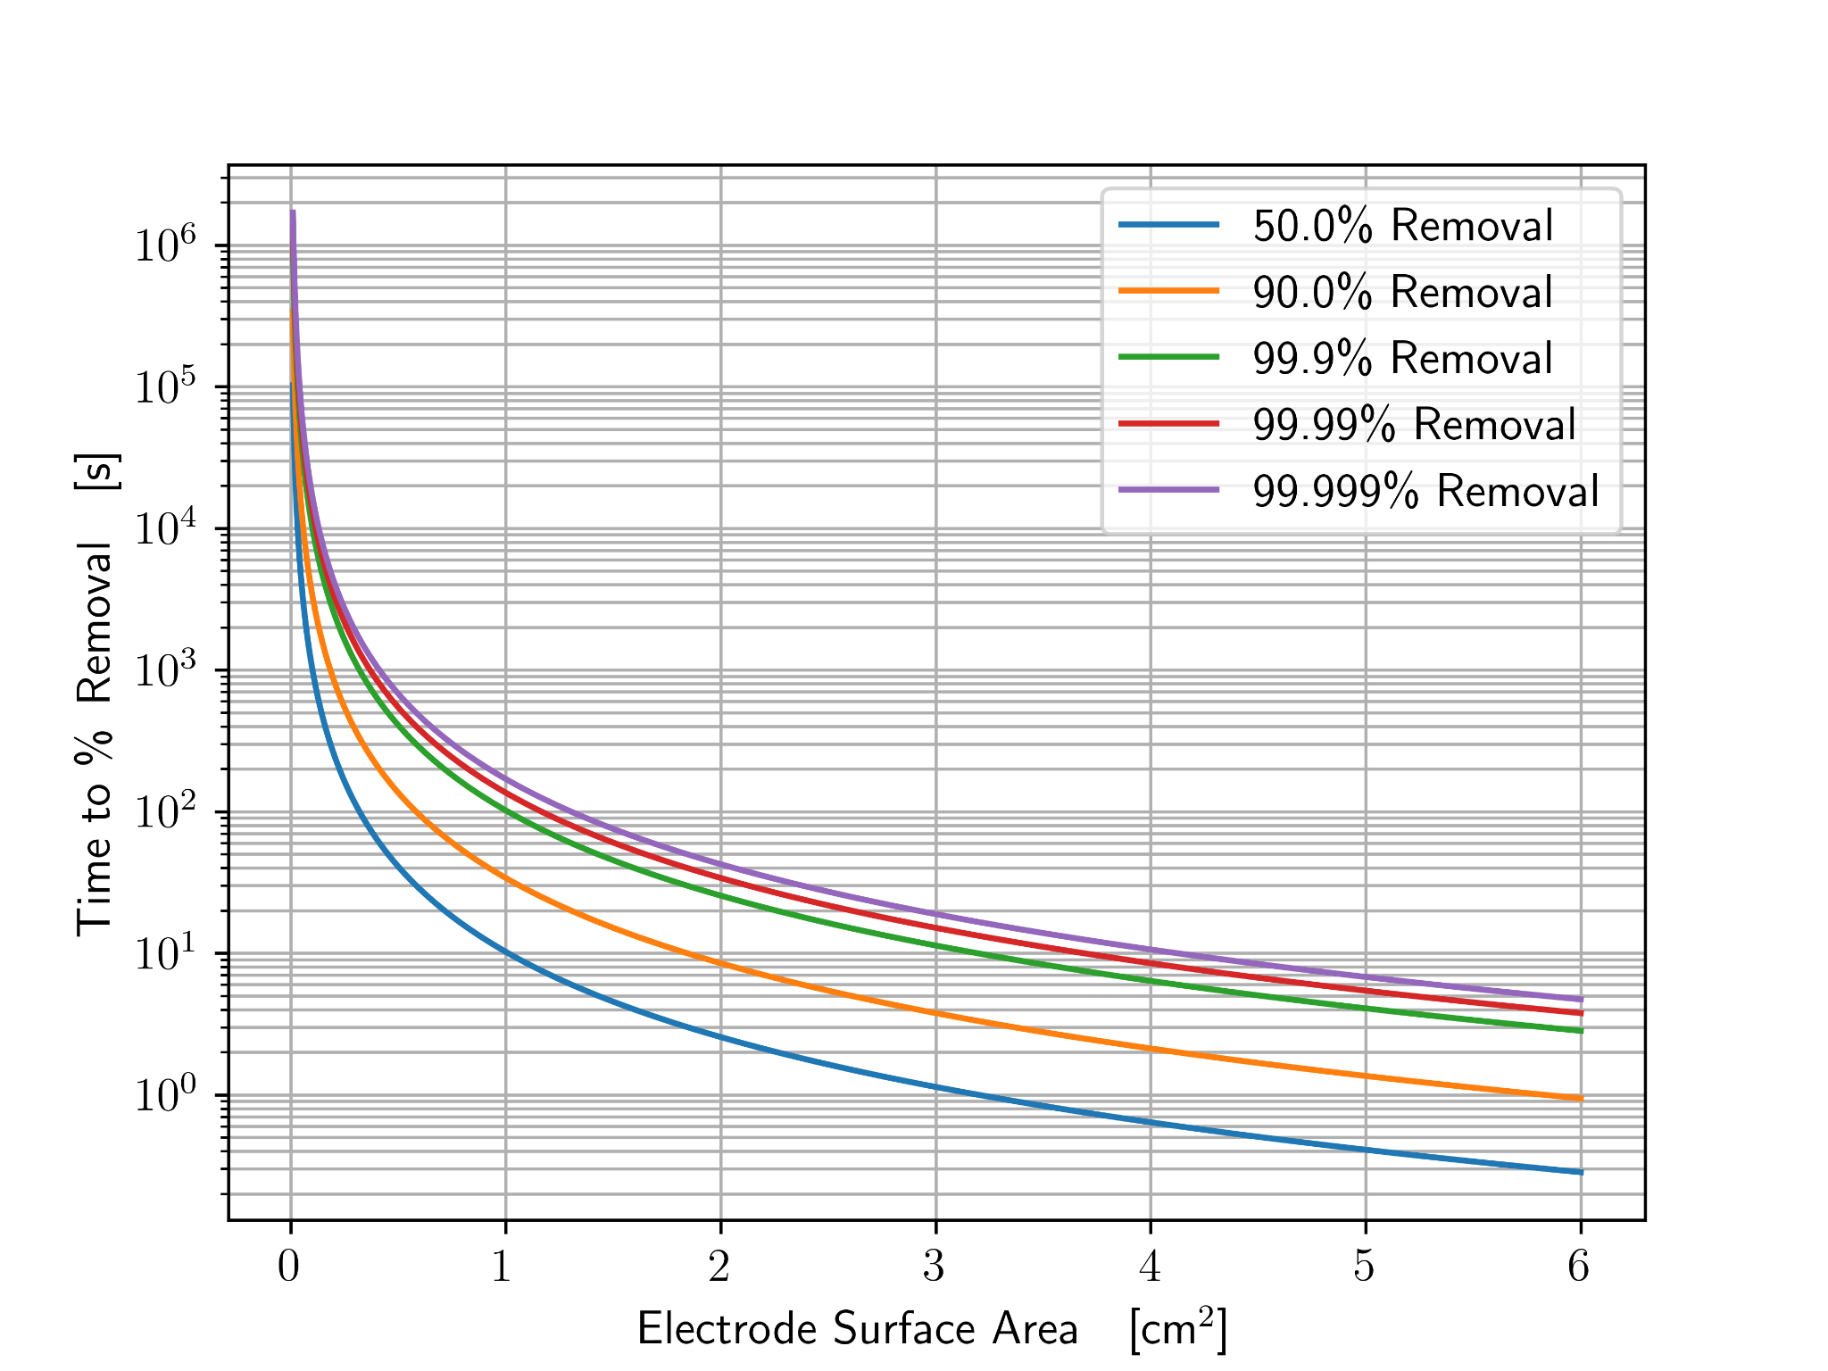
Notes:
Diffusion Coefficient of U(4+) in FLiBe is 1.269e-6 cm2/s

Slide 16
Next Steps

Slide 17
Next Steps
Volume for each component
Quantify waste production
Worker Dosage
Component damage rates
Price comparison to MSBR
Full lifetime economic analysis

Slide 18
References
[1] U. S. D. of Energy. Pathways to Commercial Liftoff: Advanced Nuclear. Tech. rep. Department
of Energy, 2024.
[2] A. P. P. Association. “America’s Electricity Generating Capacity”. In: (2024).
[3] W. N. Association. “Nuclear Power Reactors”. In: (2025).
[4] GIF R&D OUTLOOK FOR GENERATION IV NUCLEAR ENERGY SYSTEMS. Tech. rep.
Generation IV International Forum, 2018. url: https : / / www . gen - 4 . org / resources /
reports/gif- research- and- development- outlook- generation- iv- nuclear- energy-
systems-2018.
[5] H. Li et al. “Study on tritium transport characteristics in fluoride-salt-cooled high-temperature
advanced reactor”. In: International Journal of Hydrogen Energy 56 (2024), pp. 1101–1110.
issn: 0360-3199. doi: https://doi.org/10.1016/j.ijhydene.2023.12.199. url: https:
//www.sciencedirect.com/science/article/pii/S0360319923064996.
[6] P. N. Haubenreich and J. R. Engel. “Experience with the Molten-Salt Reactor Experiment”.
In: Nuclear Applications and Technology 8.2 (1970), pp. 118–136. doi: 10.13182/NT8-2-118.
eprint: https://doi.org/10.13182/NT8-2-118. url: https://doi.org/10.13182/NT8-2-
118.
[7] R. C. Robertson. CONCEPTUAL DESIGN STUDY OF A SINGLE-FLUID MOLTEN-SALT
BREEDER REACTOR. Tech. rep. comp.; Oak Ridge National Lab. (ORNL), Oak Ridge, TN
(United States), Jan. 1971. doi: 10.2172/4030941. url: https://www.osti.gov/biblio/
4030941.
18
[8] Molten Salt Reactors and Thorium Energy. en. Elsevier, 2024. isbn: 9780323993555. doi:
10.1016/C2021- 0- 01689- 8. url: https://linkinghub.elsevier.com/retrieve/pii/
C20210016898 (visited on 03/22/2025).
[9] Advanced Nuclear. en-US. url: https : / / liftoff . energy . gov / advanced - nuclear - 2/
(visited on 03/22/2025).
[10] U. A. E. C. D. of Reactor Development and Technology. AN EVALUATION OF THE MOLTEN
SALT BREEDER REACTOR. Tech. rep. US ATOMIC ENERGY COMISSION, 1972.
[11] V. Dostál. “A supercritical carbon dioxide cycle for next generation nuclear reactors /”. In:
154 (June 2005).
[12] C. W. Forsberg et al. “Tritium Control and Capture in Salt-Cooled Fission and Fusion
Reactors: Status, Challenges, and Path Forward”. In: Nuclear Technology 197.2 (2017), pp. 119–139.
doi: 10.13182/NT16-101. url: https://doi.org/10.13182/NT16-101.
[13] M. C. Cannon et al. “Adsorption of Xenon and Argon on Graphite”. In: Nuclear Science and
Engineering 12.1 (1962), pp. 4–9. doi: 10.13182/NSE62-A25362.
[14] V. Ignatiev et al. “Intergranular tellurium cracking of nickel-based alloys in molten Li, Be,
Th, U/F salt mixture”. In: Journal of Nuclear Materials 440.1 (2013), pp. 243–249. issn:
0022-3115. doi: https : / / doi . org / 10 . 1016 / j . jnucmat . 2013 . 05 . 001. url: https :
//www.sciencedirect.com/science/article/pii/S0022311513007071.
[15] B. Gurovich et al. “Fractographic studies and tensile strength of MPG-6 graphite based on
uncalcined coke, neutron-irradiated at a high temperature”. In: Nuclear Materials and Energy
35 (2023), p. 101453. issn: 2352-1791. doi: https://doi.org/10.1016/j.nme.2023.101453.
url: https://www.sciencedirect.com/science/article/pii/S2352179123000923.
[16] B. J. Riley et al. “Molten salt reactor waste and effluent management strategies: A review”.
In: Nuclear Engineering and Design 345 (2019), pp. 94–109. issn: 0029-5493. doi: https:
//doi.org/10.1016/j.nucengdes.2019.02.002. url: https://www.sciencedirect.com/
science/article/pii/S002954931930024X.
[17] IAEA. Non-baseload Operation in Nuclear Power Plants: Load Following and Frequency Control
Modes of Flexible Operation. Tech. rep. IAEA, 2018.
Notes:
David
infinite batch burnup 412 equations

Slide 19
Questions?

