Slide 1
– Senior Design –
Online Processing for Molten Salt Reactors
– Week 12 –
David Barnett, davidbb2
Nathan Glaser, nglaser3
Joseph Specht, jspecht3

Slide 2
Project Overview

Slide 3
Project Overview
MSRs are advanced reactors that can support online processing
Online processing:
Increases Burnup / Fuel-Utilization
Extends Component Lifetime
Enables Load-Following
Limitations to online processing:
Technology has been limiting factor
Components require lots of energy, space, and external infrastructure

Slide 4
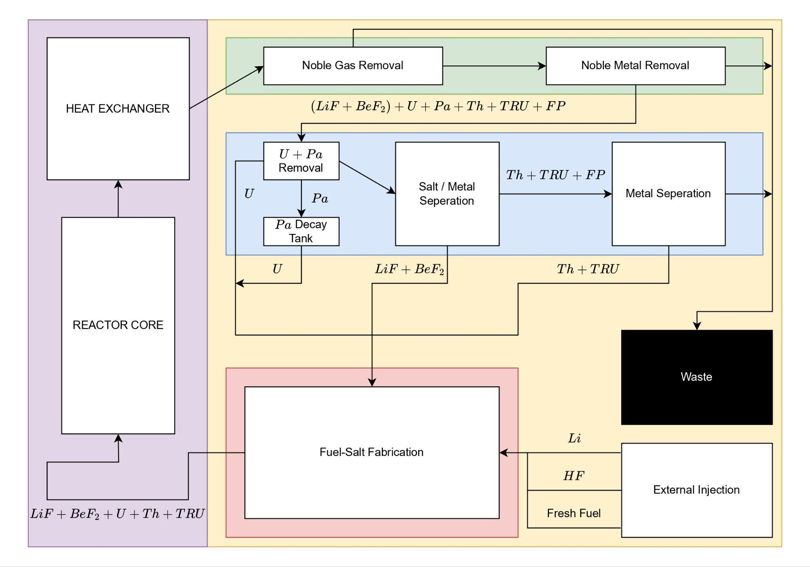
Simplified online processing scheme adapted from [1].

Slide 5
Project Overview (Contd.)
Reprocessing was predominantly considered in the 80s
Technology and understanding has drastically improved
No longer the limiting reactant
Component energy demands, volumes, and infrastructure requirements are not feasible
choose methods that require less infrastructure / energy
FSV -> ECP, E/CRNM -> NMF
reduce volumes via combination of methods
Notes:
Fused salt volatization -> Electrochemical processing
Electro/chemical removal of noble metals -> Nickel metal filter

Slide 6
Other Constraints + Solutions
High temperature, limited applicability of Rankine cycle
NACC / SCO₂ Cycle
Noble metal plate-out in HX
Graphite heat exchanger
Tritium breeding
Graphene columns + removal from secondary side coolant
Fuel salt flowing outside of core, proliferation
reduced component volume (gHX, combination)
Notes:
Fused salt volatization -> Electrochemical processing
Electro/chemical removal of noble metals -> Nickel metal filter

Slide 7
Fuel-Salt Inventory

Slide 8
Component Volume per Reactor
Component / Region | Volume [ft³] | Volume [m³]
Core | 1074 | 30.4
Heat Exchangers (4 units) | 287.6 | 8.1
Primary System | 1720 | 48.7
Off-Gas System | 31,020.0 | 878.4
Notes:
real - https://www.osti.gov/servlets/purl/4030941/
old - https://moltensalt.org/references/static/downloads/pdf/ORNL-CF-59-12-64.pdf
new - https://moltensalt.org/references/static/downloads/pdf/ORNL-4812.pdf

Slide 9
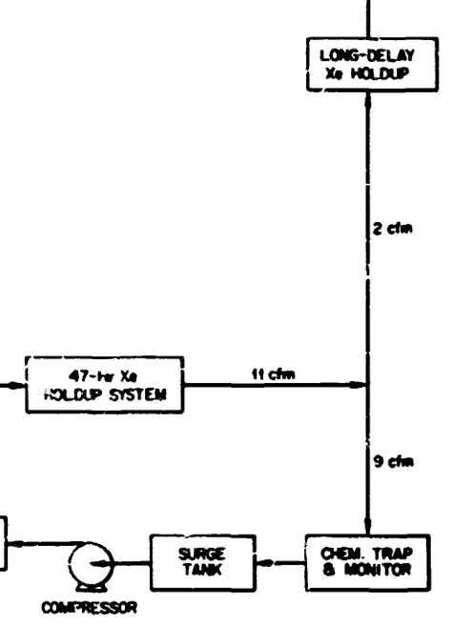
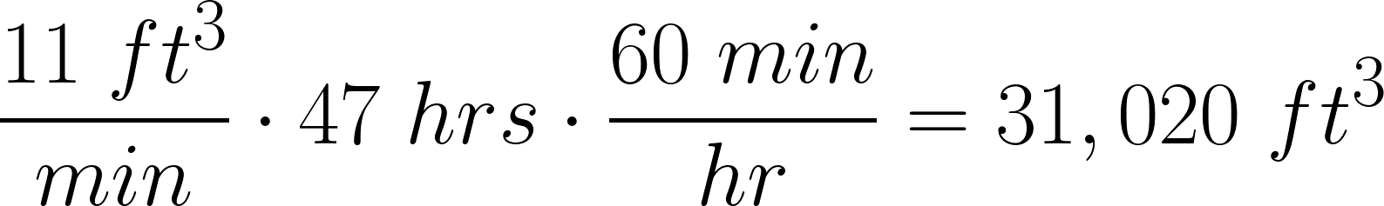

Off-Gas Volume Calculations
47-hr Xe holdup system
47 hour residence time
11 ft³/min
878.39 m³
Volume of 17.5 school buses!!!
Off-Gas System [ORNL-4541]
https://tenor.com/search/mind-blown-emoji-gifs
Notes:
real - https://www.osti.gov/servlets/purl/4030941/
old - https://moltensalt.org/references/static/downloads/pdf/ORNL-CF-59-12-64.pdf
new - https://moltensalt.org/references/static/downloads/pdf/ORNL-4812.pdf

Slide 10

Volume Changes
Graphite Heat Exchanger
⅓ the volume of a metallic HX
-215.7 ft³ of fuel-salt
Online Noble Gas Bubbler
Volume TBD
small portion of MSBR system
10,000’s of ft³ saved
Electrochemical Module
Volume TBD
https://www.vecteezy.com/png/29239972-money-tongue-pop-out-mouth-face-3d-emoji-icon
Notes:
https://moltensalt.org/references/static/downloads/pdf/ORNL-CF-59-12-64.pdf

Slide 11
Next Steps

Slide 12
Next Steps
Quantify waste production and forms
Worker Dosage
Finalize design of electrochemical module
Economics

Slide 13
References
[1] U. S. D. of Energy. Pathways to Commercial Liftoff: Advanced Nuclear. Tech. rep. Department
of Energy, 2024.
[2] A. P. P. Association. “America’s Electricity Generating Capacity”. In: (2024).
[3] W. N. Association. “Nuclear Power Reactors”. In: (2025).
[4] GIF R&D OUTLOOK FOR GENERATION IV NUCLEAR ENERGY SYSTEMS. Tech. rep.
Generation IV International Forum, 2018. url: https : / / www . gen - 4 . org / resources /
reports/gif- research- and- development- outlook- generation- iv- nuclear- energy-
systems-2018.
[5] H. Li et al. “Study on tritium transport characteristics in fluoride-salt-cooled high-temperature
advanced reactor”. In: International Journal of Hydrogen Energy 56 (2024), pp. 1101–1110.
issn: 0360-3199. doi: https://doi.org/10.1016/j.ijhydene.2023.12.199. url: https:
//www.sciencedirect.com/science/article/pii/S0360319923064996.
[6] P. N. Haubenreich and J. R. Engel. “Experience with the Molten-Salt Reactor Experiment”.
In: Nuclear Applications and Technology 8.2 (1970), pp. 118–136. doi: 10.13182/NT8-2-118.
eprint: https://doi.org/10.13182/NT8-2-118. url: https://doi.org/10.13182/NT8-2-
118.
[7] R. C. Robertson. CONCEPTUAL DESIGN STUDY OF A SINGLE-FLUID MOLTEN-SALT
BREEDER REACTOR. Tech. rep. comp.; Oak Ridge National Lab. (ORNL), Oak Ridge, TN
(United States), Jan. 1971. doi: 10.2172/4030941. url: https://www.osti.gov/biblio/
4030941.
18
[8] Molten Salt Reactors and Thorium Energy. en. Elsevier, 2024. isbn: 9780323993555. doi:
10.1016/C2021- 0- 01689- 8. url: https://linkinghub.elsevier.com/retrieve/pii/
C20210016898 (visited on 03/22/2025).
[9] Advanced Nuclear. en-US. url: https : / / liftoff . energy . gov / advanced - nuclear - 2/
(visited on 03/22/2025).
[10] U. A. E. C. D. of Reactor Development and Technology. AN EVALUATION OF THE MOLTEN
SALT BREEDER REACTOR. Tech. rep. US ATOMIC ENERGY COMISSION, 1972.
[11] V. Dostál. “A supercritical carbon dioxide cycle for next generation nuclear reactors /”. In:
154 (June 2005).
[12] C. W. Forsberg et al. “Tritium Control and Capture in Salt-Cooled Fission and Fusion
Reactors: Status, Challenges, and Path Forward”. In: Nuclear Technology 197.2 (2017), pp. 119–139.
doi: 10.13182/NT16-101. url: https://doi.org/10.13182/NT16-101.
[13] M. C. Cannon et al. “Adsorption of Xenon and Argon on Graphite”. In: Nuclear Science and
Engineering 12.1 (1962), pp. 4–9. doi: 10.13182/NSE62-A25362.
[14] V. Ignatiev et al. “Intergranular tellurium cracking of nickel-based alloys in molten Li, Be,
Th, U/F salt mixture”. In: Journal of Nuclear Materials 440.1 (2013), pp. 243–249. issn:
0022-3115. doi: https : / / doi . org / 10 . 1016 / j . jnucmat . 2013 . 05 . 001. url: https :
//www.sciencedirect.com/science/article/pii/S0022311513007071.
[15] B. Gurovich et al. “Fractographic studies and tensile strength of MPG-6 graphite based on
uncalcined coke, neutron-irradiated at a high temperature”. In: Nuclear Materials and Energy
35 (2023), p. 101453. issn: 2352-1791. doi: https://doi.org/10.1016/j.nme.2023.101453.
url: https://www.sciencedirect.com/science/article/pii/S2352179123000923.
[16] B. J. Riley et al. “Molten salt reactor waste and effluent management strategies: A review”.
In: Nuclear Engineering and Design 345 (2019), pp. 94–109. issn: 0029-5493. doi: https:
//doi.org/10.1016/j.nucengdes.2019.02.002. url: https://www.sciencedirect.com/
science/article/pii/S002954931930024X.
[17] IAEA. Non-baseload Operation in Nuclear Power Plants: Load Following and Frequency Control
Modes of Flexible Operation. Tech. rep. IAEA, 2018.
Notes:
David
infinite batch burnup 412 equations

Slide 14
Questions?

