Slide 1
– Senior Design –
Online Processing for Molten Salt Reactors
– Week 8 –
David Barnett, davidbb2
Nathan Glaser, nglaser3
Joseph Specht, jspecht3

Slide 2
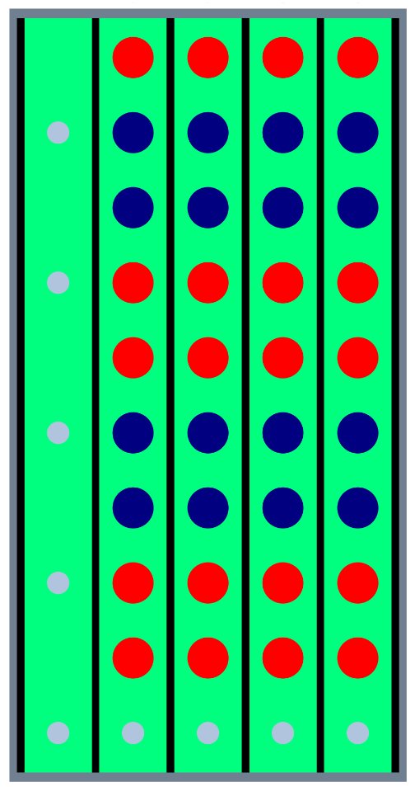
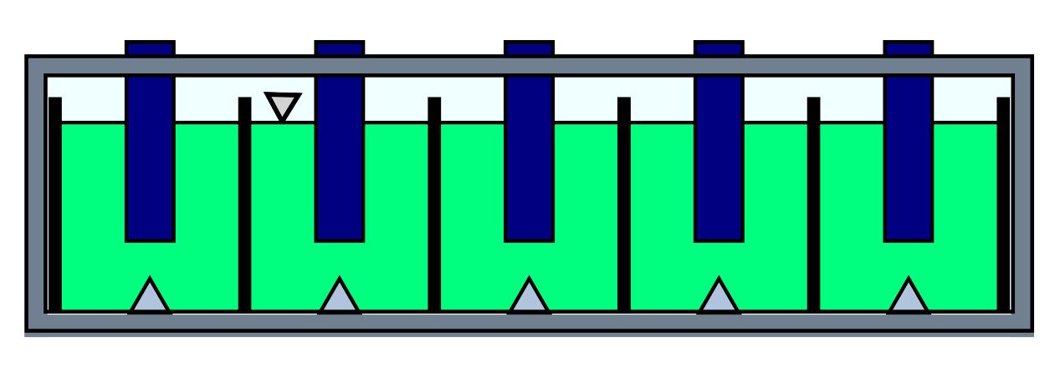
¿¿¿Project Overview???
Modular Online Processing in MSRs (MOP)
replace batch-wise/offline
Adaptive Processing Modules (APM)
each module removes specific nuclide
He bubbler for fission gasses
Lower equilibrium concentrations

Slide 3

Online Processing for MSRs
Replace batch processing
Lower:
corrosion rate
disposal cost
fuel-salt inventory
Higher:
Burnup / fuel-utilization
component lifetime

Slide 4

Accomplishments
Meeting with Professor Stubbins
taking a step back
Put cart before the horse (right)
came up with solution
tried to justify our solution
Need to invert the design process

Slide 5
Future Work

Slide 6

Reading
David
Electrochemistry
Nathan
Fission Gasses, Neutronics
Joe
Current Status, Tritium, Waste Removal

Slide 7
Redox potential control
active sensor
communication with electrodes
allows more effective use of electrodes
possible ability to cycle them off and on to maintain equilibrium
need more research into potentials, timescales, materials, energy usage, efficiencies

