Slide 1
Quality in Agile

Slide 2
Quality in Agile
Red green refactor approach
The testing pyramid
Red, green, refactor demo
Specification by example
What to automate
Reusable and repeatable
Business friendly

Slide 3
Red, Green, Refactor approach
Red
Write your test first and run it to see that it does actually go red
Achieved two things: you have an automated test which will ensure the integrity of your software over time, and it also describes the client requirement
By writing the test, it proves (assuming you’ve got it right of course) that you understand the business requirement. And if not, it proves that you didn’t understand it!
Green
Now you have a test in place, you can write the code to make the test pass but only write enough code just to make it pass and nothing more.
No client has ever been happy when software is delivered late or poor in quality. So If the test passes, then that requirement has been satisfied and you can move onto the next task
Refactor
As code grows sprint by sprint, developers would eventually modify the existing code that were written in the past to accommodate the new tasks so called refactoring of code.
Helps the code base cleaner and maintainable.
During this process, tests written on existing code should protect from breaking!

Slide 4
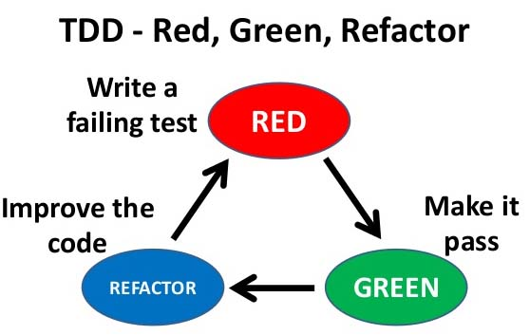

Slide 5
The testing pyramid
Unit Tests
Exploratory Tests
Integration tests
UI Acceptance Tests
Business Rule Tests

Slide 6
About Selenium
2004 by Jason Huggins - JavaScript based
Google who has been a long time user of Selenium and Simon Stewart one who developed the newer framework called WebDriver and standardized it as so called wire protocol. http://www.w3.org/TR/webdriver/
Selenium and Web driver merges into one framework
An open source
Selenium is a suite of testing automation tools used for Web Based applications: Selenium IDE, Selenium RC, Selenium WebDriver and Selenium Grid
These tools provide a rich set of testing functions specifically geared to varied testing scenarios of all types of Web applications
It supports multiple browsers
Some OS limitations
Support for multiple programming languages

Slide 7
Architecture of Selenium
browser
Client
--------------
Programming languages
API Bindings
Java
C#
Node
Ruby
Python
..
..
Server
----------------
Selenium Driver
Implementations
IE
Chrome
Firefox
Safari
Opera
browser
Wire protocol
browser
browser
*server can be local or remote
*browser drivers are another piece which receives commands from Server

Slide 8
Protractor – Selenium for AngularJS
Protractor is an end-to-end test framework for AngularJS applications. Protractor runs tests against your application running in a real browser, interacting with it as a user would.
Automatic Waiting is a plus
You no longer need to add waits and sleeps to your test. Protractor can automatically execute the next step in your test the moment the webpage finishes pending tasks, so you don’t have to worry about waiting for your test and webpage to sync.
For AngularJS Apps
Protractor supports Angular-specific locator strategies, which allows you to test Angular-specific elements without any setup effort on your part.

Slide 9
Protractor – How it works! https://angular.github.io/protractor/#/
NODE JS
WebDriverJS
Test Frameworks:
-----------------------
Jasmine
Mocha
Cucumber
Selenium Drivers
Chrome, Firfox drivers…
Protractor
Browser running AngularJS application

Slide 10
Write a test

Slide 11
Locators
Are for finding DOM-elements, interacting with them, and getting information about the current state of your application web page
By Id
By Name
By CSS
By XPath
Angular specifics:
By model
By binding

Slide 12
Locators – an example
Using css selector: by.css('.myclass')
Using id selector: by.id(‘myid’)
An working example:
// select an element
var el = element(by.id(‘username’));
// Click on the element
el.click();
// Send keys to the element (usually an input)
el.sendKeys('my text');
// Clear the text in an element (usually an input)
el.clear();
// Get the value of an attribute, for example, get the value of an input el.getAttribute('value');

Slide 13
Install Selenium (Dev.) end to end tests using Protractor - Jasmine
Install NodeJS on your machine
visit: https://nodejs.org/
Install Protractor with Jasmine framework
npm install –g protractor
Update web drivers
webdriver-manager update
Now start the web driver
webdriver-manager start

Slide 14
Protractor configuration
A configuration file
// create a file: conf.js
exports.config = { framework: 'jasmine2',
seleniumAddress: 'http://localhost:4444/wd/hub',
specs: [’<name of your spec file>']
}
Test scripts / Spec file

Slide 15
Run the test
Protractor <configuration file>
For example:
protractor conf.js

Slide 16
Page Object Pattern
When writing end-to-end tests, a common pattern is to use Page Objects.
Page Objects help you write cleaner tests by encapsulating information about the elements on your application page.
A Page Object can be reused across multiple tests, and if the template of your application changes, you only need to update the Page Object.

Slide 17
Page Object – an example
With page object pattern
With out page object pattern

Slide 18
Visit my github for the demo source
https://github.com/senips/protractor-demo

